Slide 1
Convex Hulls
Michael T. Goodrich

Slide 2
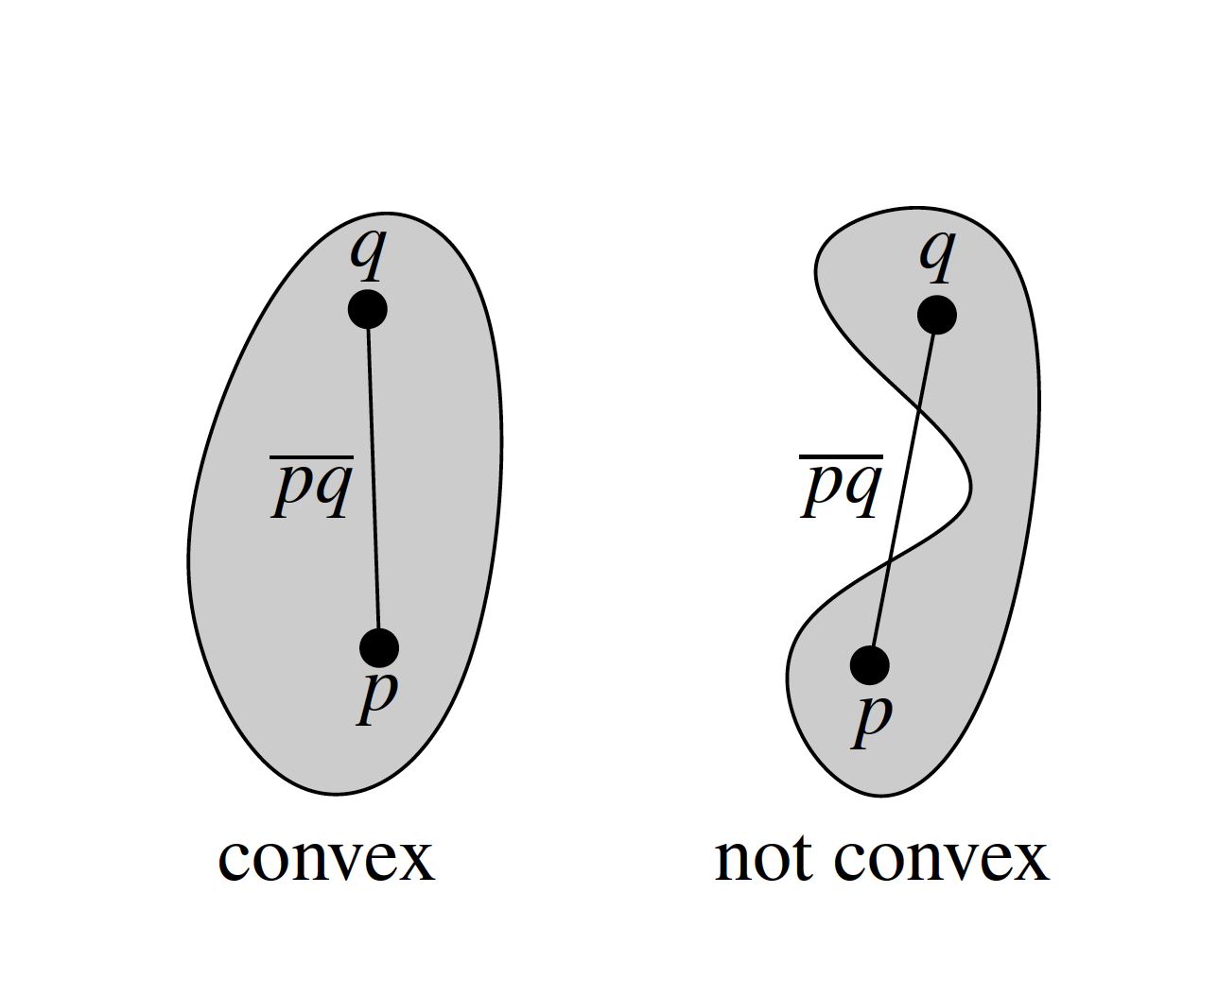
Review: Convexity

Slide 3
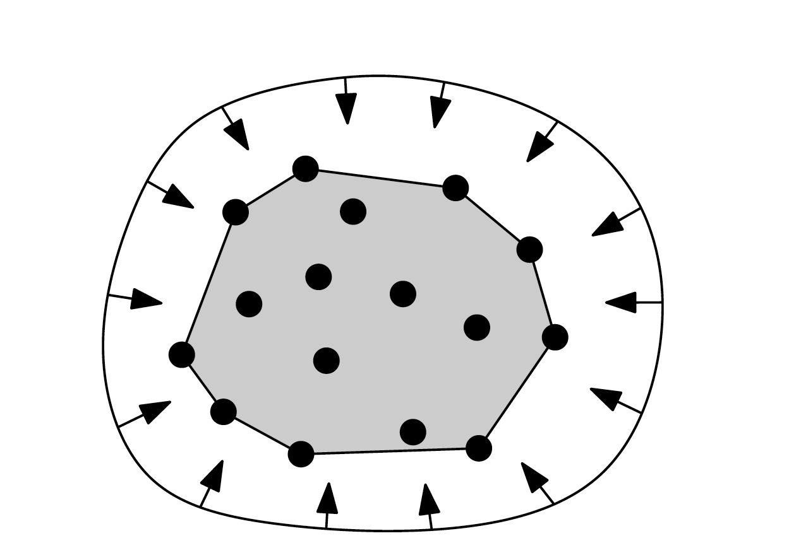
Convex hull
Smallest convex set containing all n points

Slide 4
Convex hull
Smallest convex set containing all n points

Slide 5
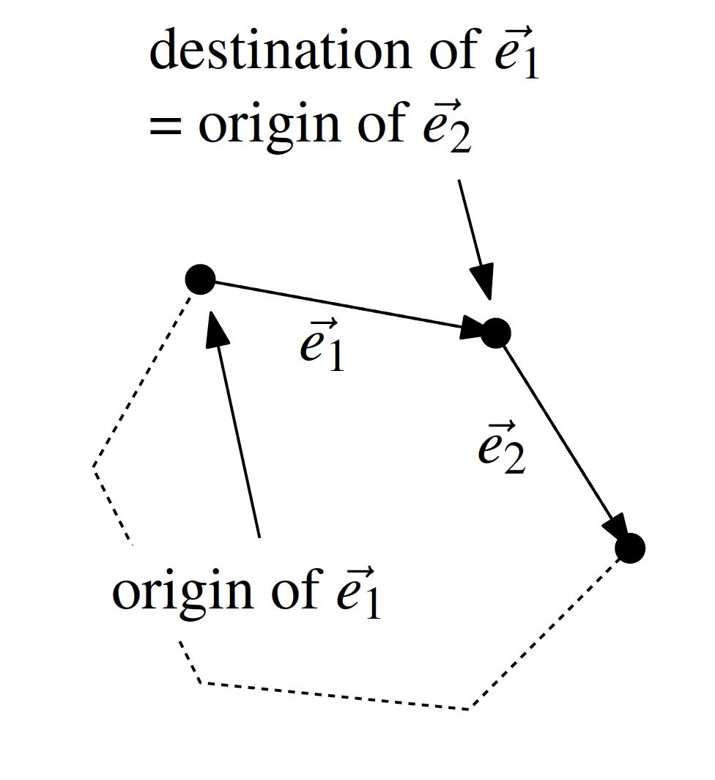
Orientation Test
right turn or left turn (or straight line)

Slide 6
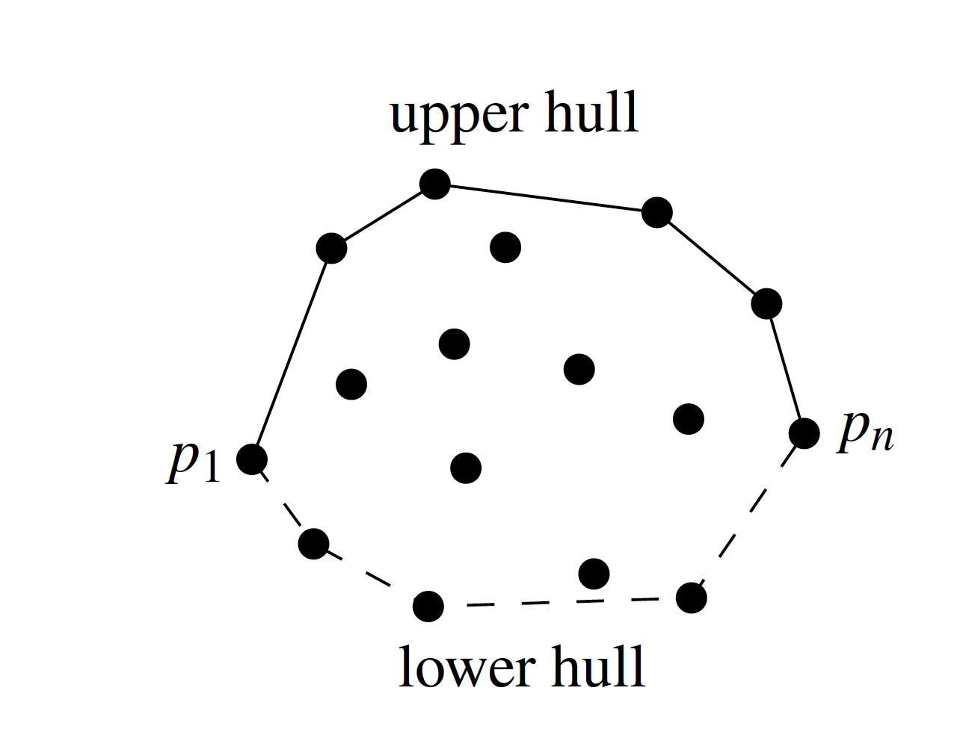
A Better Convex Hull Algorithm

Slide 7
Plane-Sweep Technique
We “sweep” the plane with a vertical line
Stop at event points
Maintain a partial solution for the swept-over area

Slide 8
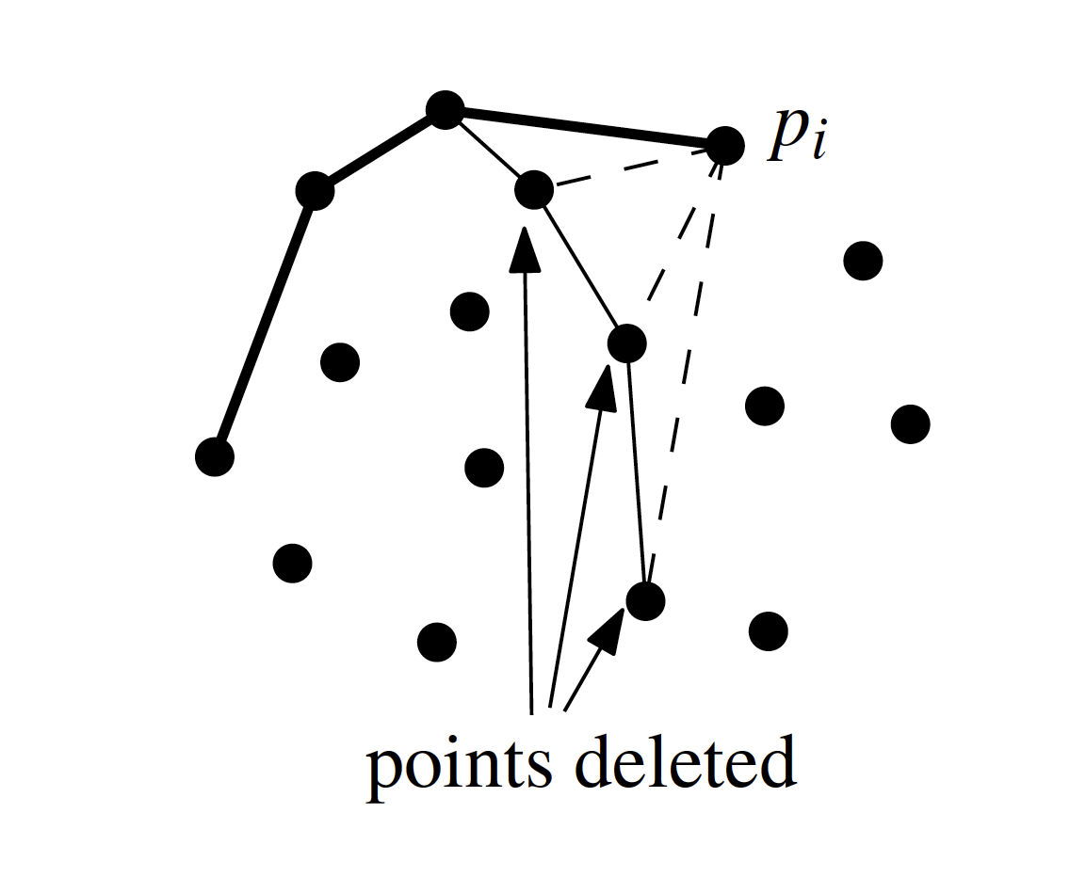
Events
Each point determines an event

Slide 9
Upper Hull Algorithm

Slide 10
Upper Hull Algorithm

Slide 11
Divide-and-Conquer
If the problem is smaller than a constant, solve it
Else:
Divide the problem into two or more subproblems
Solve each subproblem recursively
Merge the two solutions together

Slide 12
Divide-and-Conquer Convex Hull

Slide 13
Divide-and-Conquer Convex Hull

Slide 14
Divide-and-Conquer Convex Hull

Slide 15
Divide-and-Conquer Convex Hull

Slide 16
Divide-and-Conquer Convex Hull

Slide 17
Divide-and-Conquer Convex Hull

Slide 18
Divide-and-Conquer Convex Hull

Slide 19
Divide-and-Conquer Convex Hull

Slide 20
Lower Bound for Convex Hull
A reduction from sorting to convex hull is:
Given n real values x_{i}, generate n 2D points on the graph of a convex function, e.g. (x_{i},x_{i}²).
Compute the (ordered) convex hull of the points.
The order of the convex hull points is the numerical order of the x_{i}.
So CH time is Ω(n log n)

Slide 21
Convex Hull – Gift Wrapping
Algorithm:
Find a point p₁ on the convex hull (e.g. the lowest point).
Rotate counterclockwise a line through p₁ until it touches one of the other points (start from a horizontal orientation).
Repeat the last step for the new point.
Stop when p₁ is reached again.
Time Complexity: O(nh), where n is the input size and h is the output (hull) size.

Slide 22
Convex Hull – Gift Wrapping
Algorithm:
Find a point p₁ on the convex hull (e.g. the lowest point).
Rotate counterclockwise a line through p₁ until it touches one of the other points (start from a horizontal orientation).
Repeat the last step for the new point.
Stop when p₁ is reached again.

Slide 23
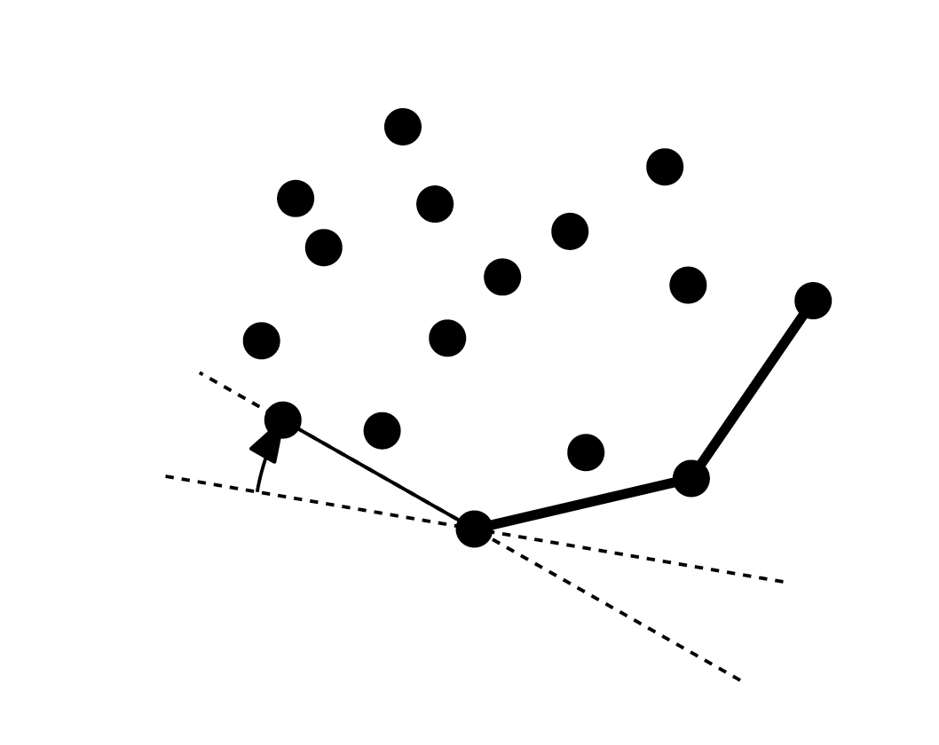
Gift Wrapping
Running time is output sensitive
The time depends on both the size of the input and the size of the output
Time Complexity: O(nh), where n is the input size and h is the output (hull) size.

