Slide 1
Computing the Overlay of Two Subdivisions
Michael Goodrich
Computational Geometry

Slide 3
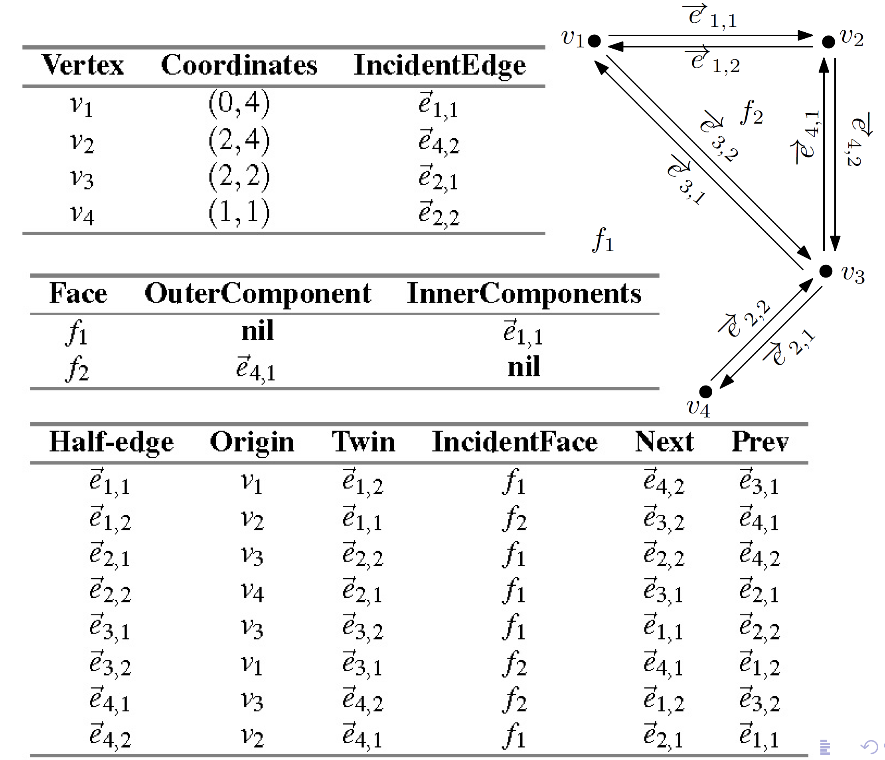
Example DCEL

Slide 4
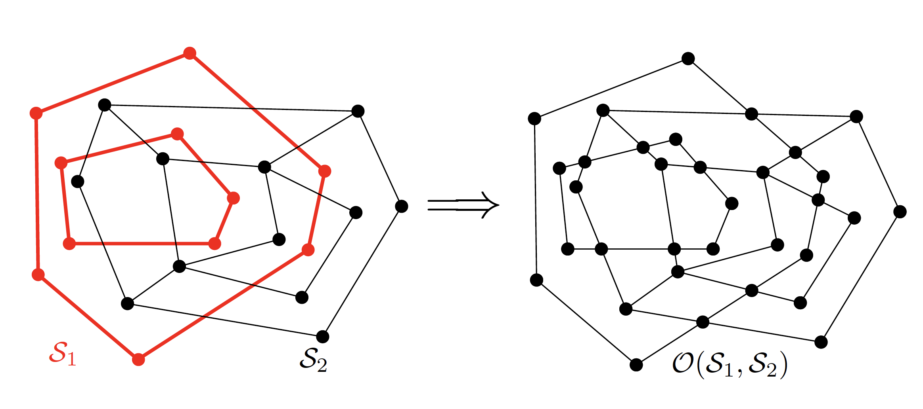
Computing the Overlay
Input: DCEL for S₁ and DCEL for S₂
Output: DCEL for the overlay of S₁ and S₂

Slide 5
Computing the Overlay
Initialization: copy the DCEL for S₁ and S₂
These are then “merged” into one

Slide 6
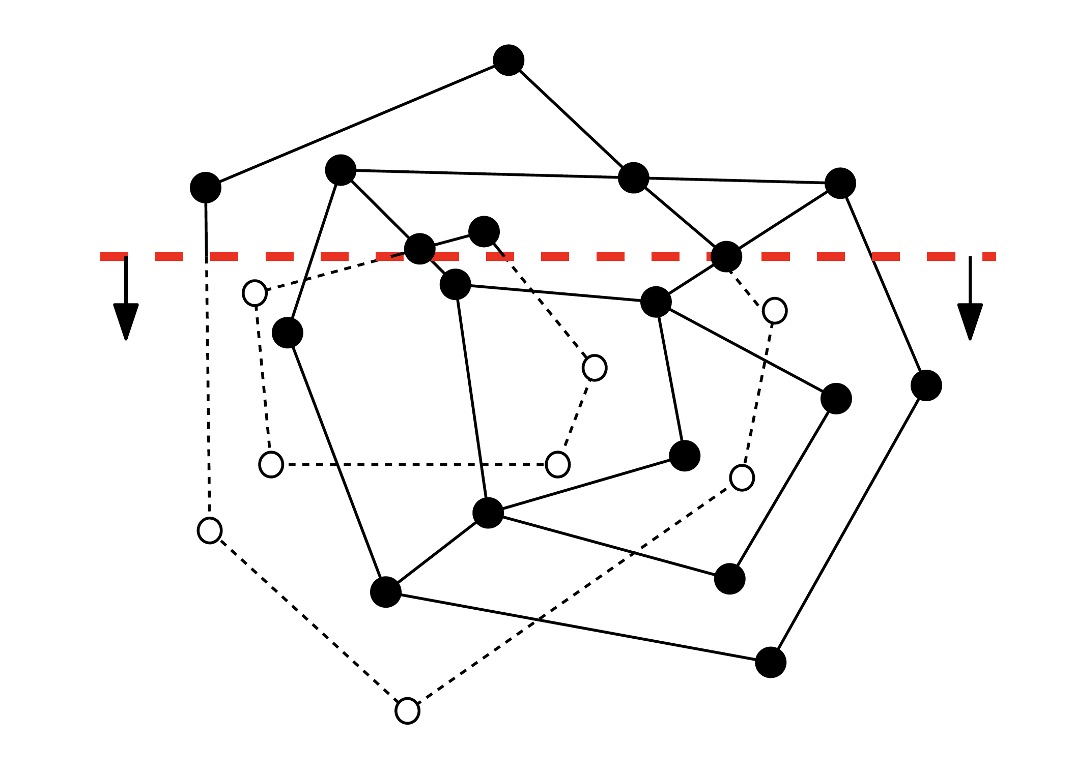
Use Our Plane-Sweep Algorithm
Plane-sweep as in our line segment intersection algorithm

Slide 7
A New Step
For each intersection event, add a new vertex to the merged DCEL

Slide 8
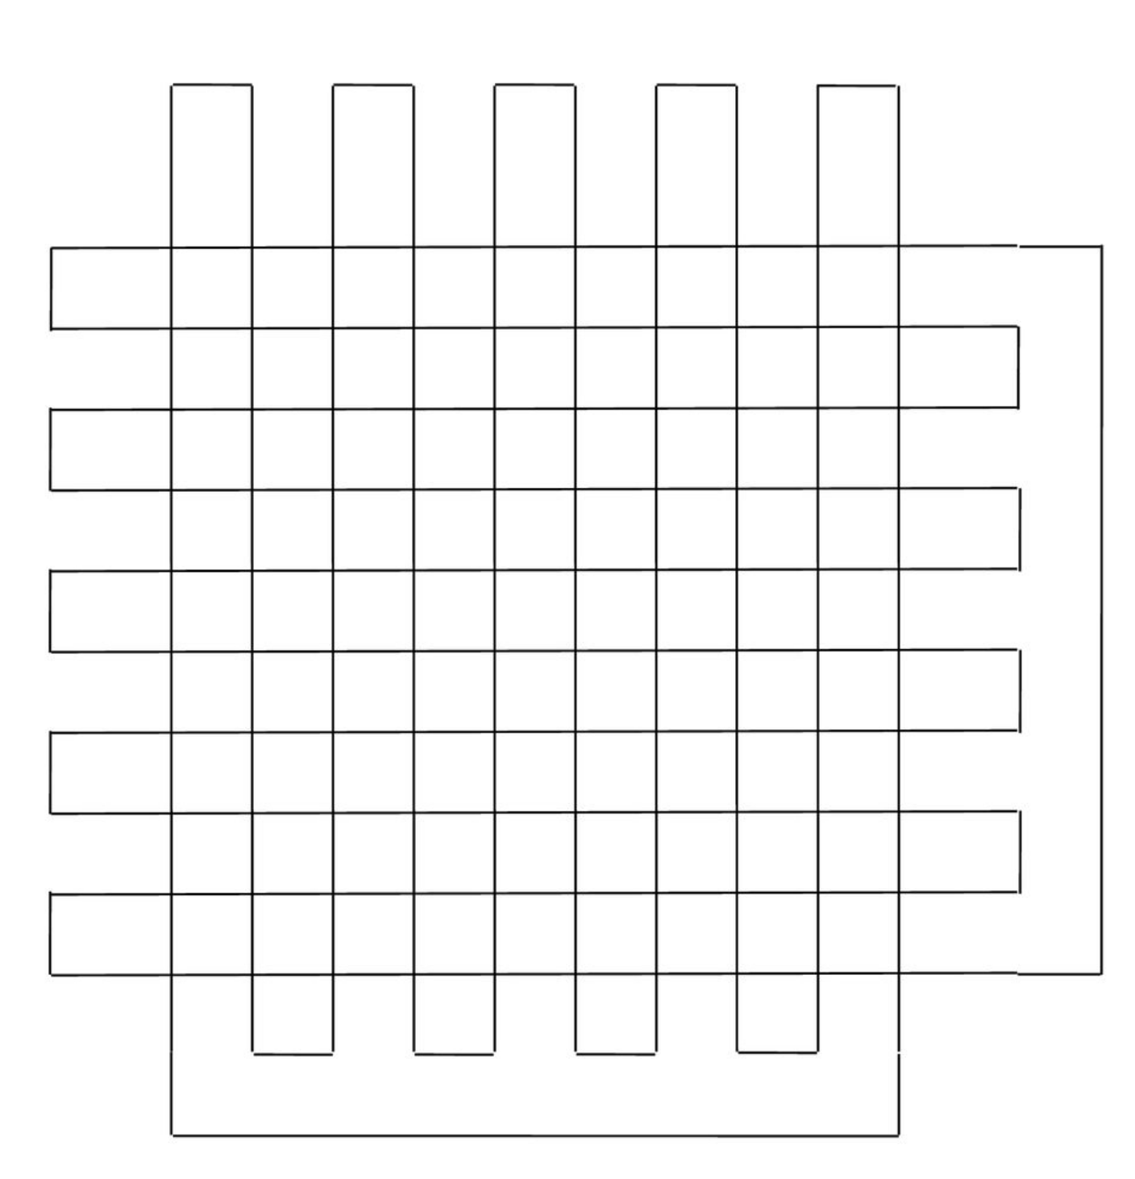
Time Complexity
The running time is O((n+k)log n), where n is the total size of the two input subdivisions and k is the number of intersections
And k can be O(n²):

Slide 9
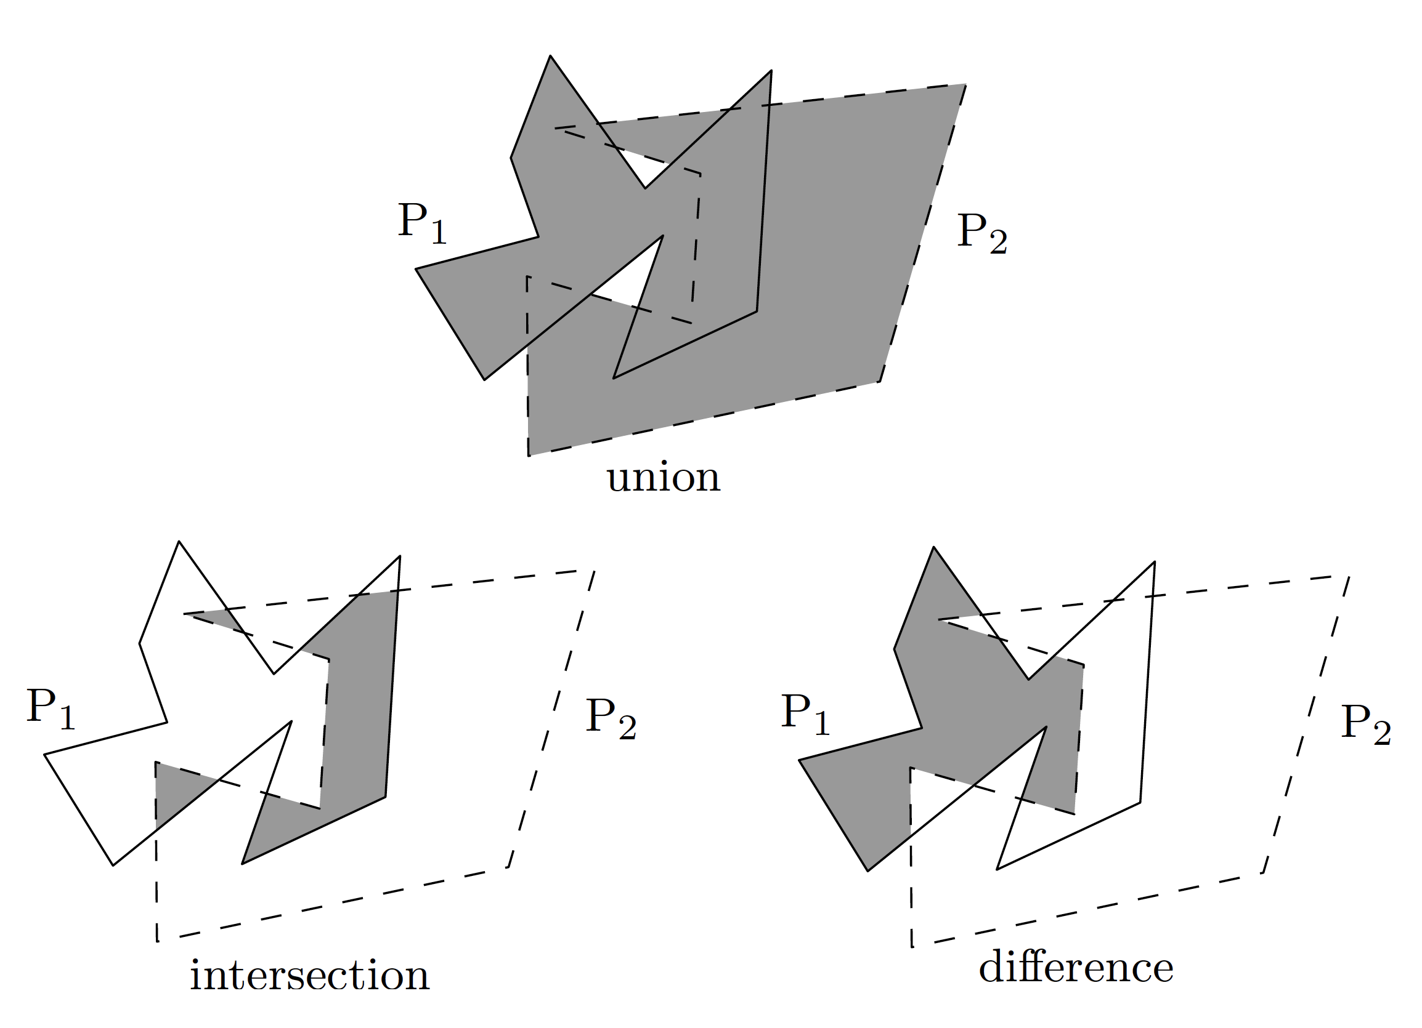
Boolean Operations
Essentially the same algorithm can be used for geometric Boolean operations

