Slide 1
2-3 Cuckoo Filters for Faster Triangle Listing and Set Intersection
David Eppstein¹, Michael T. Goodrich¹, Michael Mitzenmacher², and Manuel Torres¹
¹University of California, Irvine
²Harvard University

Slide 2
Triangle Listing Problem
List all triangles in a network.

Slide 3
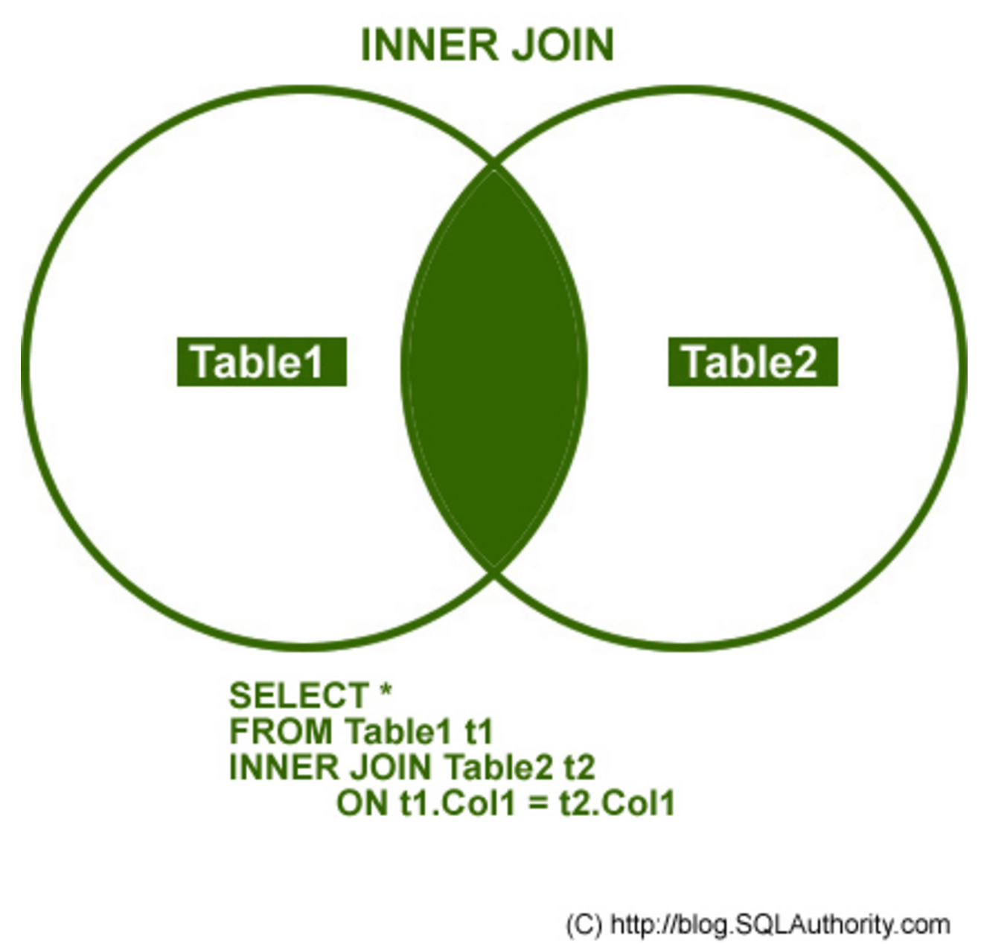
Set Intersection Problem
Preprocess a collection of sets so as to quickly answer set-intersection queries.

Slide 4
Listing Triangles Using Set Intersection Queries
For each edge, e=(v,w):
Intersect the adjacency lists for v and w.
v
e
w

Slide 5
Improved Algorithm
Order G’s vertices by a k-degeneracy order:
Each vertex has out degree at most k.
Can be done by a greedy algorithm.
k is proportional to the arboricity, Α(G), of the graph.
Improved Algorithm: for each edge e=(v,w):
Intersect the out-going adjacencies for v and w.
Runs in O(m Α(G)) time
[e.g., see Chiba-Nishizeki ’85, Ortmann-Brandes ‘14]

Slide 6
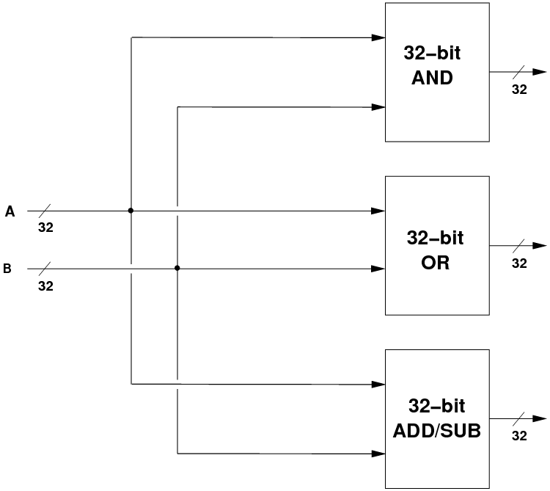
Further Improvements for Real-World Computational Models
Take advantage of bit-level operations
This model of computation is known as the word-RAM or practical-RAM model.
E.g., use built-in operations of C, C++, Java, Python, T-SQL.
Related to external-memory model

Slide 7
Previous Results / Our Results
Kopelowitz et al. ‘15 introduce a set intersection data structure and use it to list the triangles in a graph G in expected time O(m(Α(G) log² w)/w + log w + k).
w is the word size (in bits), k is output size.
We introduce a new set intersection data structure for listing the triangles in a graph in O(m(Α(G) log w)/w + k) expected time.
We also give an external-memory version.

Slide 8
Review: Cuckoo Hash Tables
Each element is mapped to 1-out-of-2 possible locations by a pair of random hash functions.
Insertions “bounce” elements to their alternative location as needed. [Pagh, Radler ’04]
We can add a small stash cache of size s to reduce the probability of failure to be 1/n^{s}.
Analysis involves characterizing the “cuckoo graph” defined by pairs of locations defined by each element’s 2 locations [Kirsch et. al ‘10]
T:
cat
pig
dog
cat
dog
pig

Slide 9
Review: Cuckoo Filters
A cuckoo table and parallel cuckoo filter.
See Fan et al. ‘14, Eppstein ‘16.
Provides improved functionality over Bloom filters.
T:
cat
pig
dog
cat
dog
pig
M:
111
000
000
000
000
000
111
111
000
F:
2
5
4
1 word
1 word
1 word

Slide 10
New: 2-3 Cuckoo Filters
A cuckoo table and parallel cuckoo filter, where each element is stored in 2-out-of-3 possible locations.
T:
cat
dog
pig
cat
pig
dog
cat
dog
pig
M:
111
000
111
111
000
111
111
111
000
F:
2
4
5
2
5
4
1 word
1 word
1 word

Slide 11
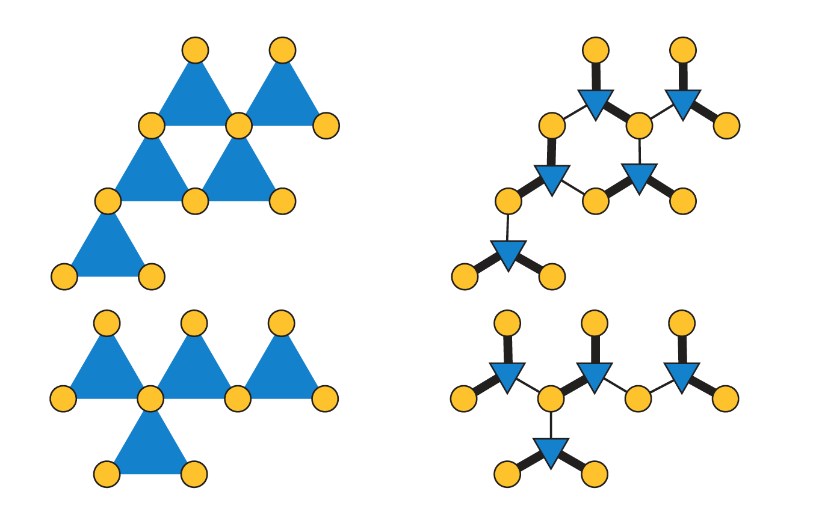
Cuckoo Hypergraph
Instead of analysis w/ a cuckoo graph, we use a cuckoo hypergraph (which is 3-uniform).
Our 2-out-of-3 paradigm corresponds to a two-assignment.

Slide 12
Correctness
Correctness Lemma: Any 3-uniform hypergraph has a 2-assignment if and only if each of its connected components is acyclic or unicyclic.

Slide 13
Small Components
Let C_{v} be the component containing v in the randomly chosen hypergraph, and let E_{v} represent the set of edges in C_{v}.
Implies that components are small with high probability.

Slide 14
Cyclomatic Numbers
Let the cyclomatic number α(H) be the smallest number of triangles which should be removed from a 3-uniform hypergraph H in order to make H become acyclic.

Slide 15
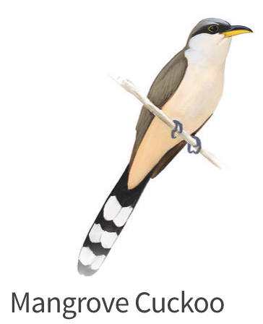
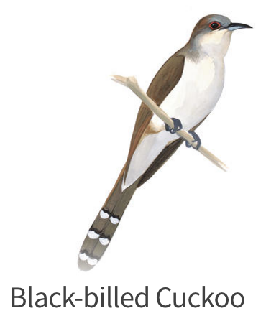
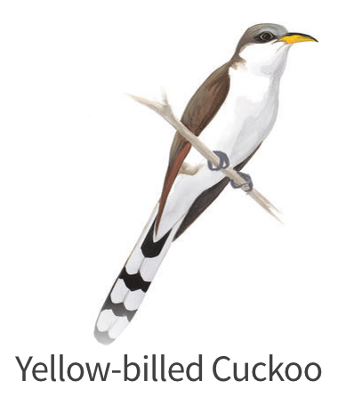
2-3 Cuckoo Hashing with a Stash
Skipping two pages of equations…

Slide 16
Intersecting Two 2-3 Cuckoo Filters
At least one location must overlap:
We may have false-positives, though.
T₁:
cat
dog
pig
cat
pig
dog
M₁:
111
000
111
111
000
111
111
111
000
F₁:
2
4
5
2
5
4
T₂:
cat
cat
fox
pig
pig
fox
M₂:
111
111
000
000
111
111
111
111
000
F₂:
2
2
4
5
5
4

Slide 17
Set Intersection Analysis
By above analysis, we can construct 2-3 cuckoo filters of size at least 2 with constant-size stashes with probability at least 1-1/w^{c}.
Choosing a fingerprint size of at least log w bits implies false positives occur with probability less than 1/w.
Expected number of false positives is O(n/w).
Thus, expected time for a set intersection query is O(n(log w)/w + k), where k is the output size.
Intersect cuckoo filters w/ bit-parallel operations
Examine each colliding position
Output intersection elements & discard false positives

Slide 18
Triangle Listing Algorithm
Order vertices by a k-degenerate ordering.
Build a 2-3 cuckoo filter for each out-going adjacency list. (Each is size (Α(G)log w)/w.)
For each edge e=(v,w):
Intersect the out-going adjacency lists for v and w by the above set-intersection algorithm.
For any adjacency lists where 2-3 cuckoo construction failed, do intersection by merging.
Probability of failure is at most 1/w^{c}.
Expected running time: O(m(Α(G)log w)/w + k).

Slide 19
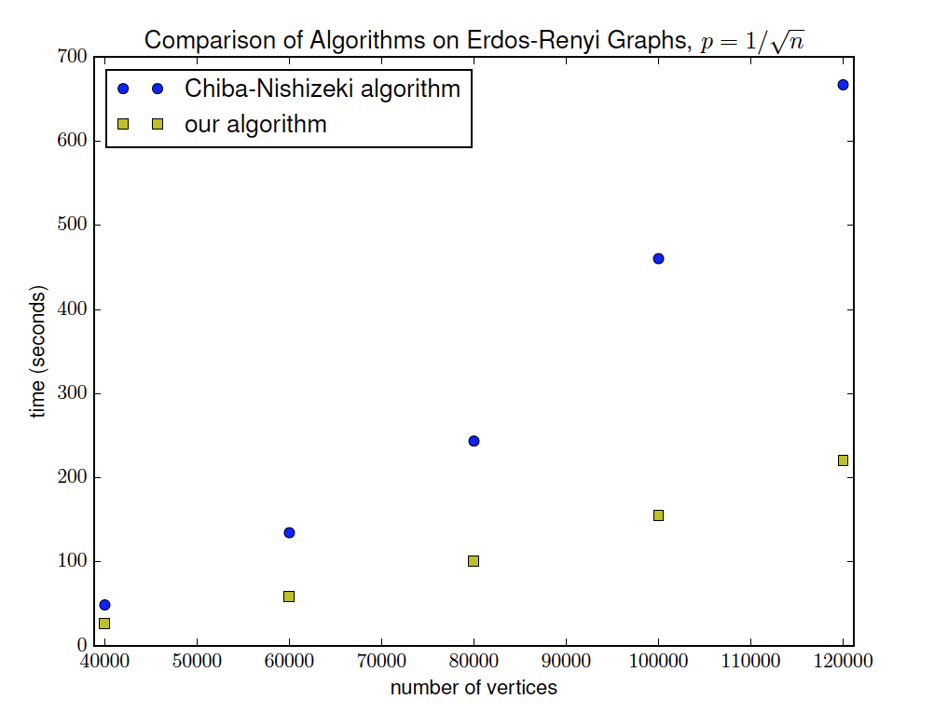
Preliminary Experiments
This is admittedly a theory paper, but we nevertheless did some preliminary experiments.
Word size = 64
Fingerprint size = 8

Slide 20
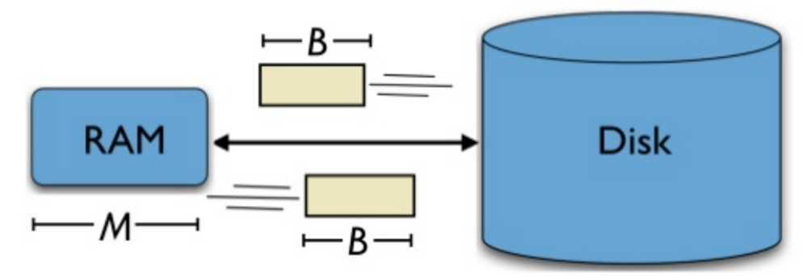
External-Memory Algorithm
We also have an external-memory algorithm.
We can list all the triangles in G using an expected number of I/Os that is:
O(sort(n Α(G)) + sort(m(Α(G)log w)/w) + sort(k)).

Slide 21
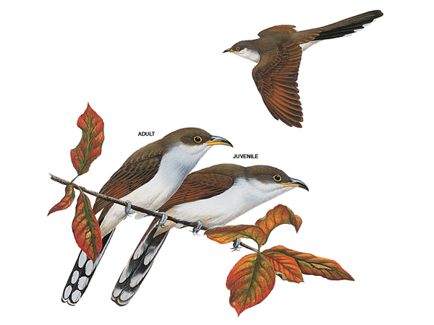
Conclusion
2-3 cuckoo hash-filters are simple and lead to improved set-intersection queries.
Open problem:
Are there other applications for 2-3 cuckoo hash-filters?

