Slide 1
What is Discrete Math?

Slide 2
What is Discrete Math?
“Discrete mathematics is the study of mathematical structures that are fundamentally discrete rather than continuous.”
[ wikipedia.com ]

Slide 3
What is Discrete Math?
“Discrete mathematics is the study of mathematical structures that are fundamentally discrete rather than continuous…. A distinct object takes on distinct, separate values.”
[ wikipedia.com ]

Slide 4
Continuous/Discrete Set Example
0
The set of real numbers is continuous.
0
The set of integers is discrete.

Slide 5
A Continuous Function
f(x)
f(x) = x²-3x-4
x

Slide 6
A Discrete Function
f(x)
f(x) = x²-3x-4
x

Slide 7
Discrete math is typically concerned
with sets of objects that are either:
Finite
One-to-one correspondence with the integers (countably infinite):
For example the set of all binary strings:
0, 1, 00, 01, 10, 11, 000, 001, 010, 011, 110,…
1 2 3 4 5 6 7 8 9 10 11…….

Slide 8
1010111010101010101
1010101111110101000101001
101010101111101010101110110
111101010000000101001011001
101010000101000101010111010
100001010010101010101010
1010101101010101…

Slide 9
Discrete Structures in CS Circuits
0/1
0/1
0/1
0/1

Slide 10
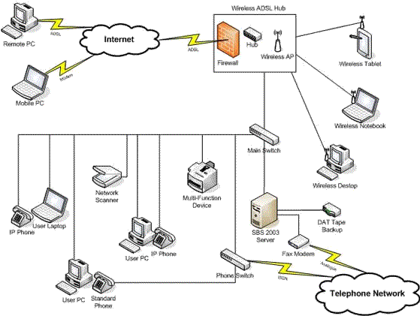
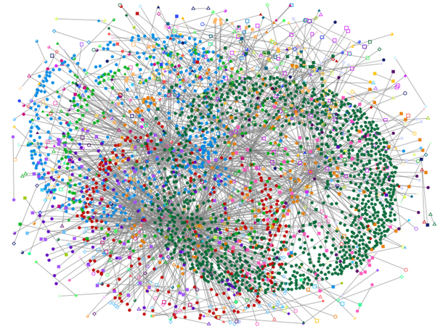
Discrete Structures in CS: Networks

Slide 11
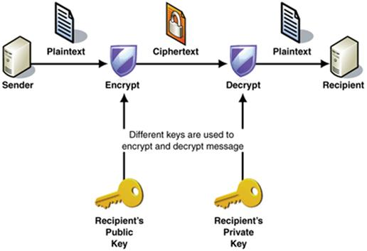
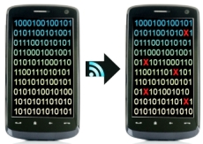
Discrete Structures in CS: Codes

Slide 12
Discrete Mathematics
Mathematical language to specify discrete structures
Tools to mathematically analyze discrete structures
Proofs to formally establish facts about discrete structures

Slide 13
Discrete Math in CS
Design a network connecting a set of devices that will minimize congestion.
How likely is it that the network will become disconnected of communication links fail with a certain probability?
What is the best assignment of tasks to computers in a distributed network that will even out the computational load on each computer?

Slide 14
Discrete Math in CS
What is the most efficient way to encode a file so that if characters are lost in transmission the file can still be recovered?
Given a desired input/output relationship for a circuit, what is the most efficient circuit (minimum number of grates) that will compute that function?
How long does it take this program to run on an input file of a particular length?

