Slide 1
Causality Project
Jennifer Stoneking
David Conley
Byung Lee
Vijay Hattiangadi

Slide 2
Today:
Methodologies
Results
End of round 1
Round 2
Improvements & Suggestions
Final timeline
What's left?
Who is working on it?
Notes:
Vijay

Slide 3
Our Methods
1. Initial heuristic evaluation
2. Usability experiment
Two rounds of testing
Talk aloud method
Note taking & screen recording
3. Pre and post questionnaires
Notes:
Vijay

Slide 4
Results from Testing phase 1
Home page necessary for users
Testing helped determine what needed to be put on the home page
Wording caused confusion
Links don't look like links
Users had a hard time finding their way to individual pages
Visualization is complicated to understand
Problem with density of image
Notes:
Byung

Slide 5
What was added:
Home page
Key for visualization
Our next slide shows the home page...
Notes:
Byung

Slide 6
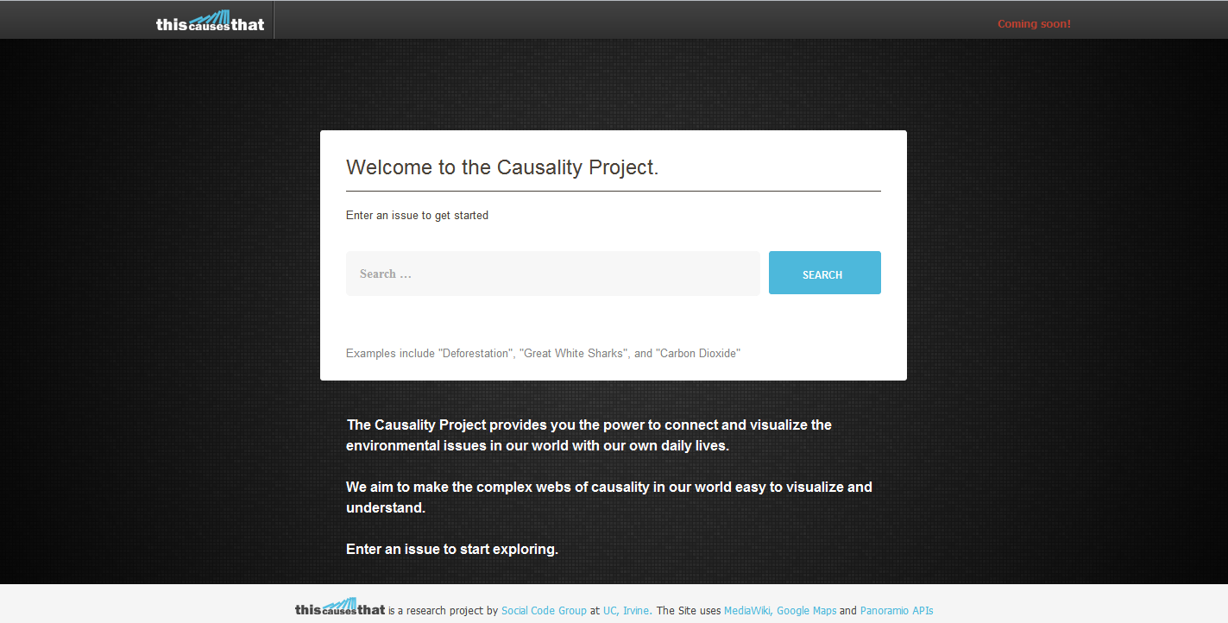
Notes:
Byung

Slide 7
After Testing Phase 2
Home page had mixed results
Not everyone looked at it
Search button doesn't search when clicking on text
Text does not show on all resolutions without scrolling
Searching
Users wanted to search full relationships like:
"Unemployment causes Bankruptcy"
Drop down menus that auto-populate had troubles:
Items show up and then disappear
Notes:
David

Slide 8
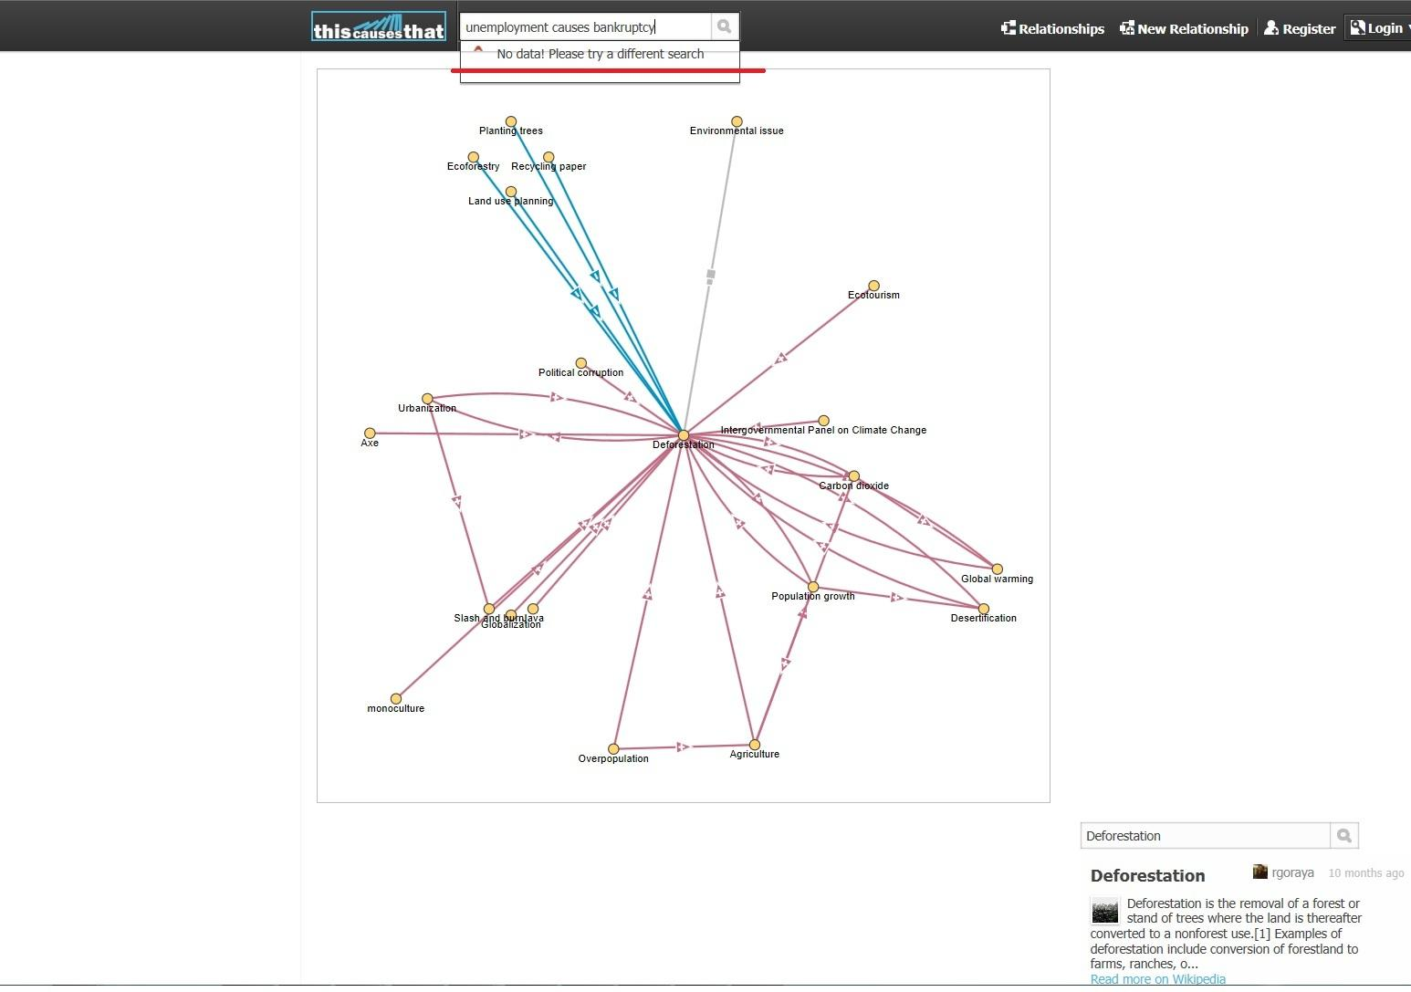
Notes:
David - talk about the drop down search menu

Slide 9
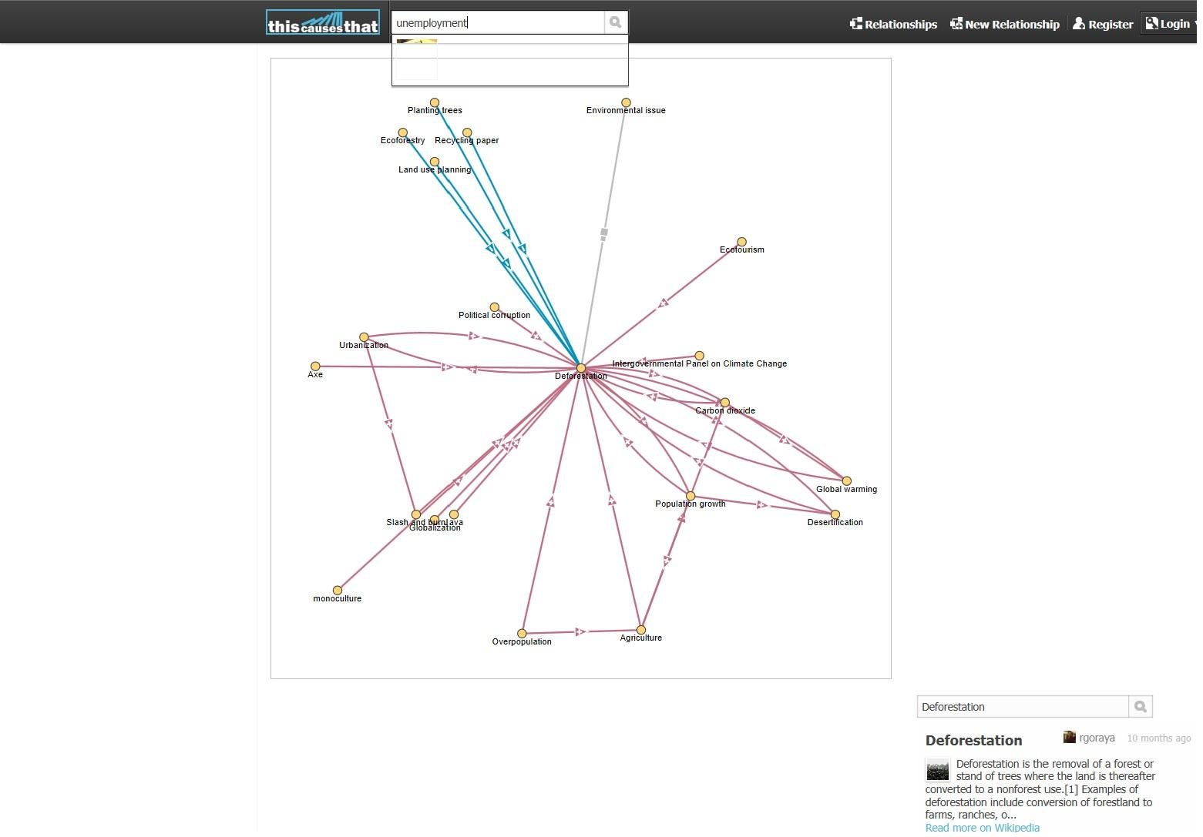
Notes:
David - also about the drop down search menu.... disappearing items (although this is not the best screen shot)

Slide 10
More Results From Phase 2
Still issues with visualization
Key is poorly placed
Size is too small
Hitting backspace to return to previous page sometimes causes a page of code to show up
Notes:
David

Slide 11
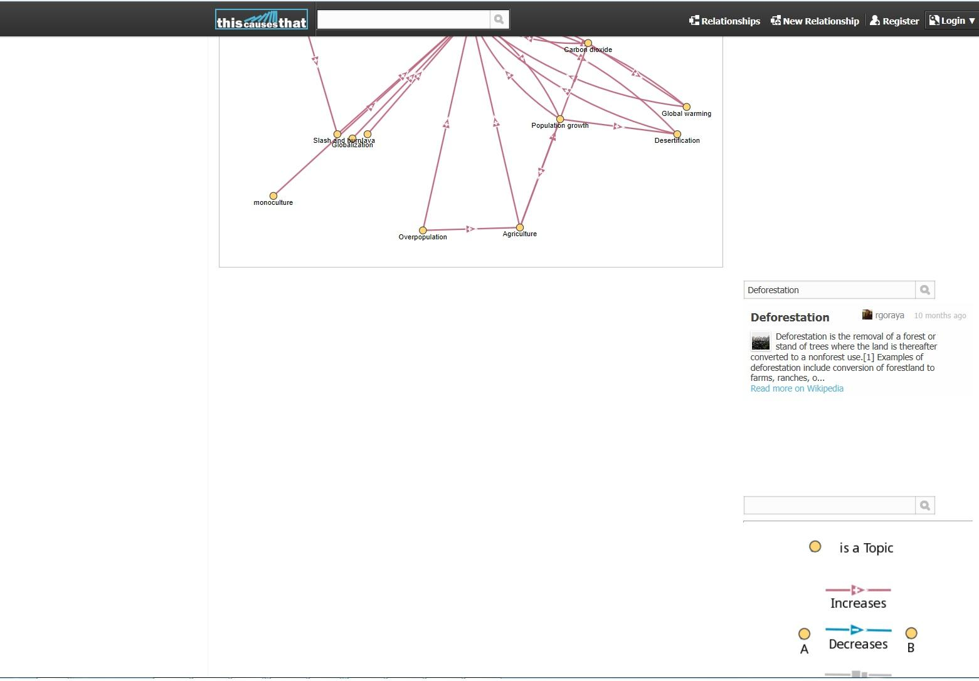
Notes:
David - talk about the placement of the key

Slide 12
Positives
Key for the visualization is good when people see it
Home page does give users an idea of what the project is about
Unfortunately, still not perfect
Need to get users to read it!
Mouse-over text is used often
Notes:
David

Slide 13
Future improvements:
Fixing search issues
Auto-populating menus
Searching for plural items (e.g. "Trees" --> "Tree")
Potentially adding ability to search relationships through text (e.g. "Sun causes ultraviolet light")
Improvements for visualization
Zoom
Ensuring key can always be seen
Notes:
Jennifer

Slide 14
More improvements...
Ensuring links to other pages look like links
Adding a tutorial or help section for users
Color issues can be resolved
Not having any colors too similar to white background
We're looking at you, light grey...
Notes:
Jennifer

Slide 15
Other great additions:
Forward and back button on pages
Categorizing relationships
Adding alphabetical listing for items
Using labels/tags for relationships
Could possibly tag different relationships according to categories like "Environmentalism" or "Physics"
Would allow users to search for all relationships in the "Environmentalism" category
Notes:
Jennifer

Slide 16
What's left?
Finishing the paper
Completing analysis from our research
Determining more suggestions to fix issues discovered during testing
Notes:
Vijay

Slide 17
Revised Timeline
All during week 10:
Finish analysis from all user tests
Determine suggestions for the interface
Finish writing and editing our paper
Collect all materials for appendix
June 10th
Submit paper & assorted materials
Notes:
Vijay

Slide 18
A big thanks to:
Professor Kobsa
Bill Tomlinson
The Causality Project Team
(Especially Sahand)
Notes:
Vijay

