Slide 1
132 Final Presentation
Group 4 - Library Usability Study
Brandon Stoltz
Freddie Zenteno
Steven Crane
Yu Cheng

Slide 2
Testing Results from phase 1
- Preliminary analysis from phase 2, but all the significant data from phase 1 has been analyzed.
- There were 11 different combinations of tasks and scenarios:
In 6 of them, our implementation produces faster results, in 1 there was little or no difference and in 4 the current library maps produced faster results.
This suggests that our interface tended to allow users to find things faster, but not for every task.

Slide 3
Questionnaire results from Phase 1
- 7 out of 10 users answered that they would prefer our map to the current library maps.
- All 7 of these users answered that they would recommend our version of the map to someone else

Slide 4
Second Phase of User Testing
- The second phase of user testing was the same as the first, with the following changes:
1) Users were no longer asked to use the current library map. (PDF Maps)
2) The users were provided with an improved version of the previous interface.
3) Half of the users in the second phase used a mobile device to view the interface and the other half used the computer.

Slide 5
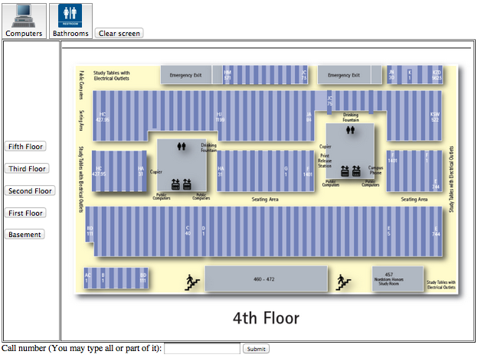
The Second interface
Hosted on Freddie's website at.
www.fzenteno.net/new3.html
- Contained all of the major changes we discussed in the interim presentation. Notably:
1) Movement of buttons to the
top and side
2) More specific
call # searching
3) Buttons with graphics

Slide 6
Second Phase of User Testing Results
Desktop Version
Users performed the same tasks with some similar results.
3 out of 5 users ignored the buttons at the top.
1 out of 5 actually used one of the buttons.
1 out of 5 noticed the button and did not use it.

Slide 7
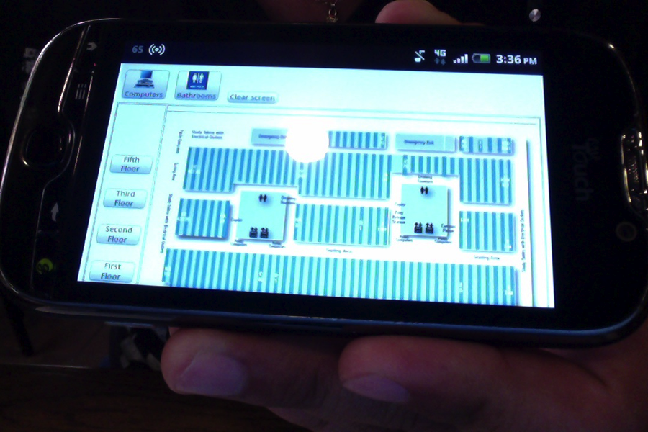
Second Phase of User Testing Results
Mobile Version
Android Device (v2.3.4)

Slide 8
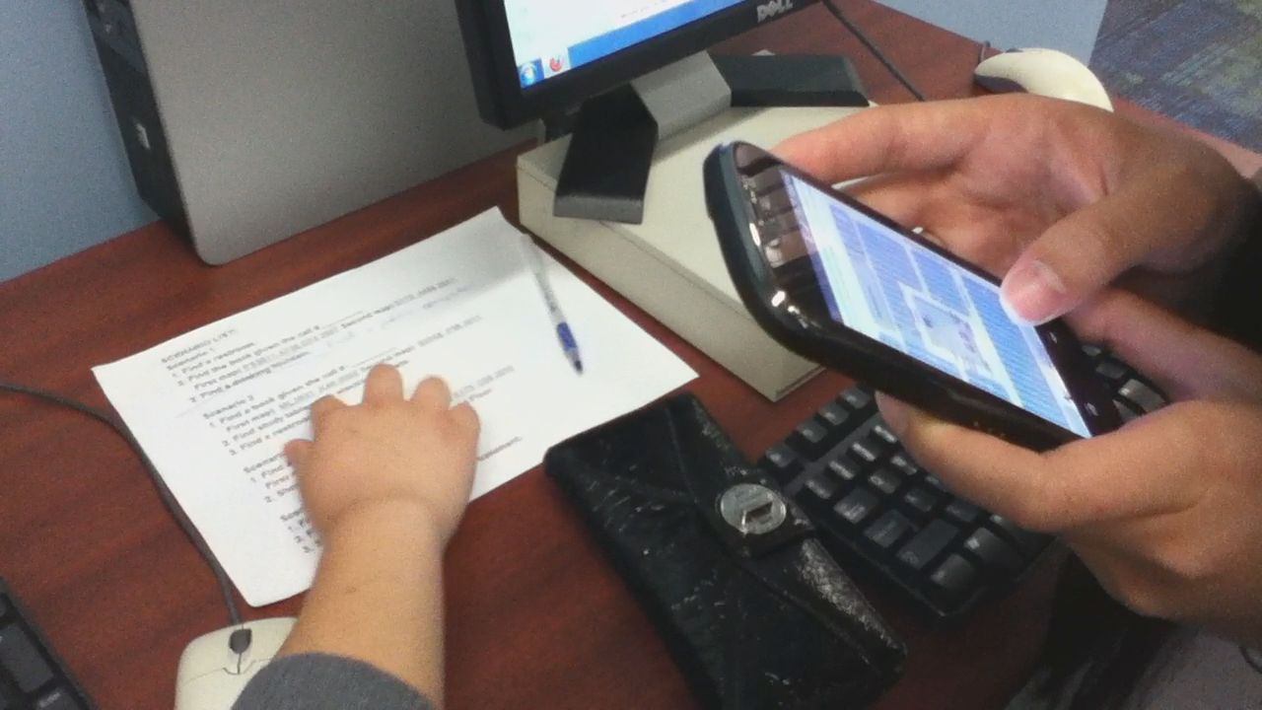
Mobile Method Madness
Introduced Mobile testing into the project

Slide 9
Mobile - Usability testing - Importance
. Ensures data and usability consistency
. Covers a wider range of common interfaces
. Focuses on speed and convenience

Slide 10
Mobile Usability Methods Used
. Brought up Interface on a group member's Smartphone or iPod
. Brought up questionnaire on public desktop or personal laptop
. Handed mobile device zoomed out, vertical orientation
. Closely monitored subject as they were given tasks
. Logged times and commentary, noted any convenience or hindrance

Slide 11
Second Phase of User Testing Results
Five users tested for mobile interface.
  All five users instantly "pinch to zoom in" and view the map.
  All users were not able to see the buttons after zooming in.
  1 out 3 of the users that were asked to find a book actually used the search feature at the bottom.
  "If there were more buttons at the top, I would have probably used them" - Test User 5
    Feedback from a mobile use tester.

Slide 12
Second Phase of User Testing Results
Mobile Version
Users were able to find items quickly.
Smaller screen resulted in less eye movement.
Users liked the ability to interact with the map. (Zoom In/Out)
Users liked the idea of being able to take their mobile device and use it as a map.

Slide 13
Mobile Considerations
. More hands-on immediate focus on manipulating the map
. Button sizes need to be taken into consideration
. Buttons still spread out, not drawing enough attention.
. Legible font on actual map.

Slide 14
Schedule Weeks 1-9 Completed
Week 1 - Week 9
- Held meetings with customer
- Gathered materials (materials document)
- Completed and analysed user testing phase 1
- Refined user interface version 2, completed user testing phase 2
- Started analyze round 2 user test videos and gather stat

Slide 15
Proposed Schedule
Week 10
- Final presentation
- Final evaluation /analysis
- group meeting on Wednesday
- meeting with the customer on Friday
- Final report (June 10)

Slide 16
Group 4 Sign-off
*All users who switched floors did it significantly faster with our approach.
*A mobile friendly application is feasible.
* Both desktop and mobile implementations are important for fundamental tools, like maps

Slide 17
Group 4 Sign-off
Thank you
Professor Kobsa
&
Christopher Davis

Slide 18
Group 4 Sign-off
Questions?

