Slide 1
Usability of a Course Management System for Students
Group 2A: Madeleine Surjani, Alexia Bareno, Emily Puth, & Christopher Ries
Notes:
Christopher R
Presentation structure:
Summarize very briefly the problems that you address and the methods that you use for this purpose (i.e., condense your first presentation into 2-3 slides :-)
Describe what you have done so far
Describe what insights you have gained to date, as related to the problems described in (1)
Describe difficulties that you encountered
Discuss any decisions that will still need to be made
Present your updated / more detailed timeline for the remaining project duration (assign dates and people to each task)

Slide 2
FOCUS
Should UCI adopt the Canvas system?
How well does Canvas suit UCI students?
Determine:
Learnability
Efficiency
Adaptability
Simplicity
Notes:
Madeleine S

Slide 3
METHODS
Heuristic Evaluations
Cognitive Walkthroughs
Think-Alouds
Measure usability through participant task performance and error rate
Interviews
Notes:
Alexia B

Slide 4
Heuristic Evaluations
The Good:
Flexibility and Efficiency of Use
Consistency and Standards
Visibility of System Status
The Bad:
Help and Documentation
Help Users Recognize, Diagnose, and Recover from Errors
Error Prevention
1
Notes:
Christopher R - Regression Testing
The Bad (Item 2): When I access the “Submission Details” in the Assignments tab and attempt to submit an assignment that does not have any content (i.e. a submission with no file attached) I get no such error message notifying me that no such file was submitted. Users are able to recover from errors with no problems whatsoever, but recognizing/diagnosing errors when they are not denoted could be a problem for the end user. These minor nuances need to be revisited before mass implementation at UC Irvine.

Slide 5
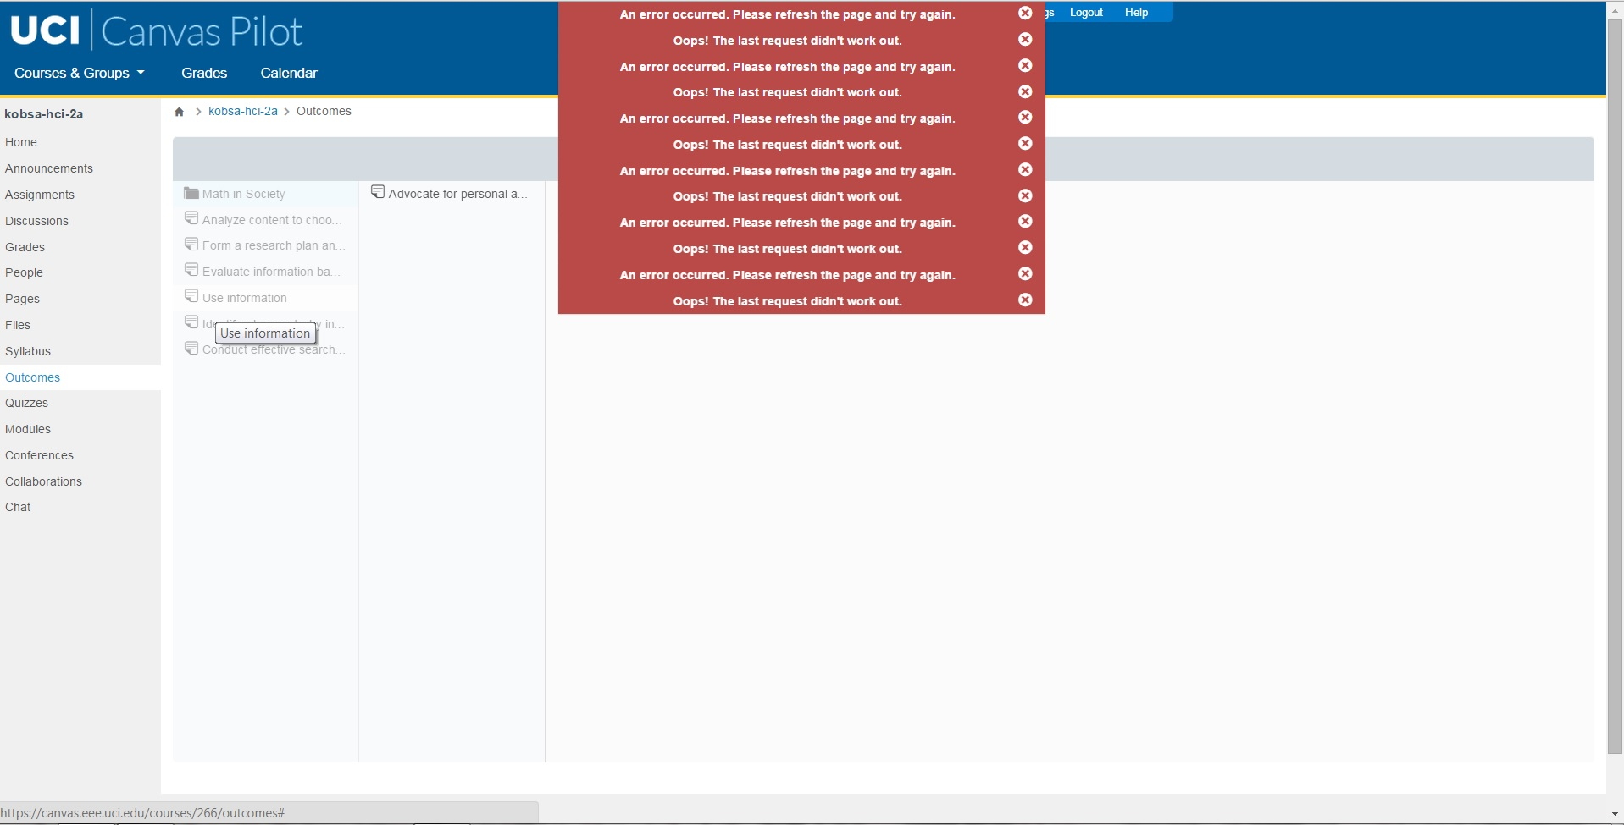
Error Handling Example
1
Notes:
Christopher R - Regression Testing
The Bad (Item 2): When I access the “Submission Details” in the Assignments tab and attempt to submit an assignment that does not have any content (i.e. a submission with no file attached) I get no such error message notifying me that no such file was submitted. Users are able to recover from errors with no problems whatsoever, but recognizing/diagnosing errors when they are not denoted could be a problem for the end user. These minor nuances need to be revisited before mass implementation at UC Irvine.

Slide 6
Cognitive Walkthroughs
Task analysis
8 different tasks
Outlined sequence of steps involving user performed tasks and system responses
Identify issues if any
2
Notes:
Alexia B

Slide 7
Think-Aloud Sessions
4 participants familiar with Canvas
4 participants unfamiliar with Canvas
Assign participants tasks
Focus on the functionalities: Announcements, Discussion, People, Files, Outcomes, Modules, Collaborations
Certain tasks are more complicated than others
3
Notes:
Emily P
Conducted think-aloud and interview sessions with 4 Canvas users and 4 non-Canvas users
Assigned tasks focused on the 7 functionalities: Announcements, Discussion, People, Files, Outcomes, Modules, and Collaborations
Each participant was able to complete every task
Observe their performance rate based on how quickly they completed each task
Noticed some were more complicated to complete than others
Suggested solutions - mockups

Slide 8
Interviews
”I believe that with any successful integration is great help documentation as well as an awesome support infrastructure...”
Interviewee Recommendations
“Everything is compartmentalized into one website”
Piazza vs. Discussion Thread
“For the most part, it is pretty simple…”
except for some confusion of:
embedding image
zip icon
4
Notes:
Madeleine S

Slide 9
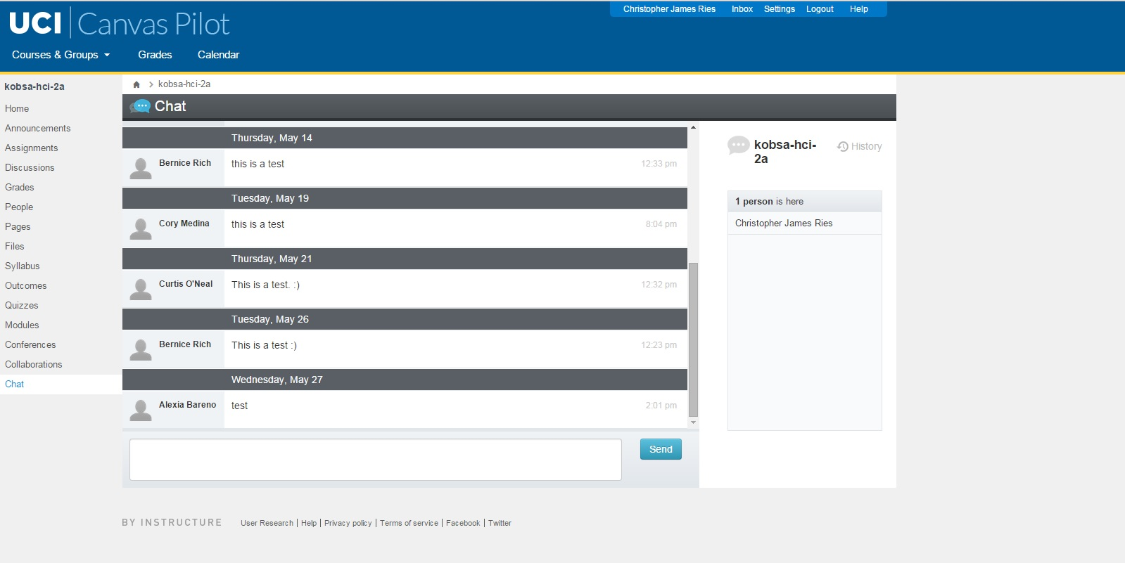
MOCKUPS (Chat-Old)
Notes:
Emily P / Christopher R

Slide 10
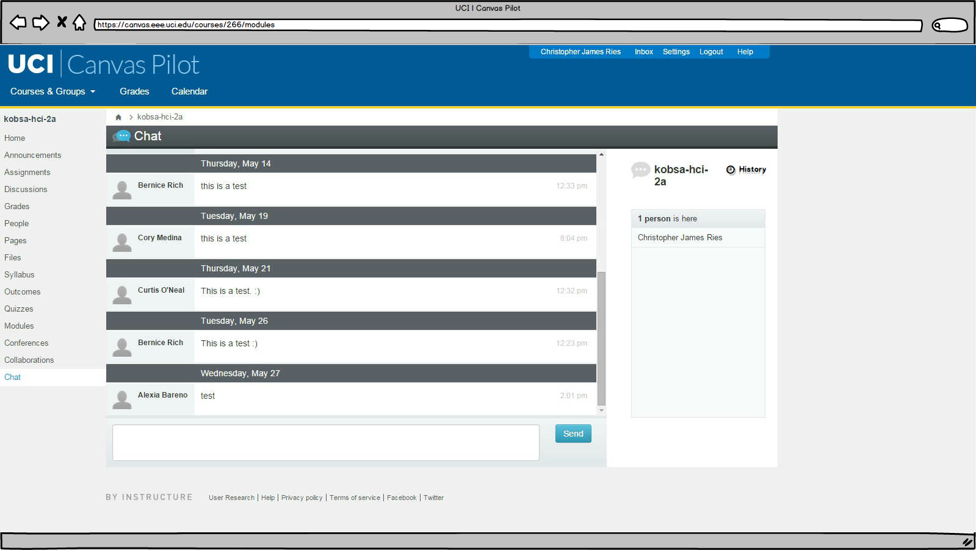
MOCKUPS (Chat-New)
Notes:
Emily P / Christopher R

Slide 11
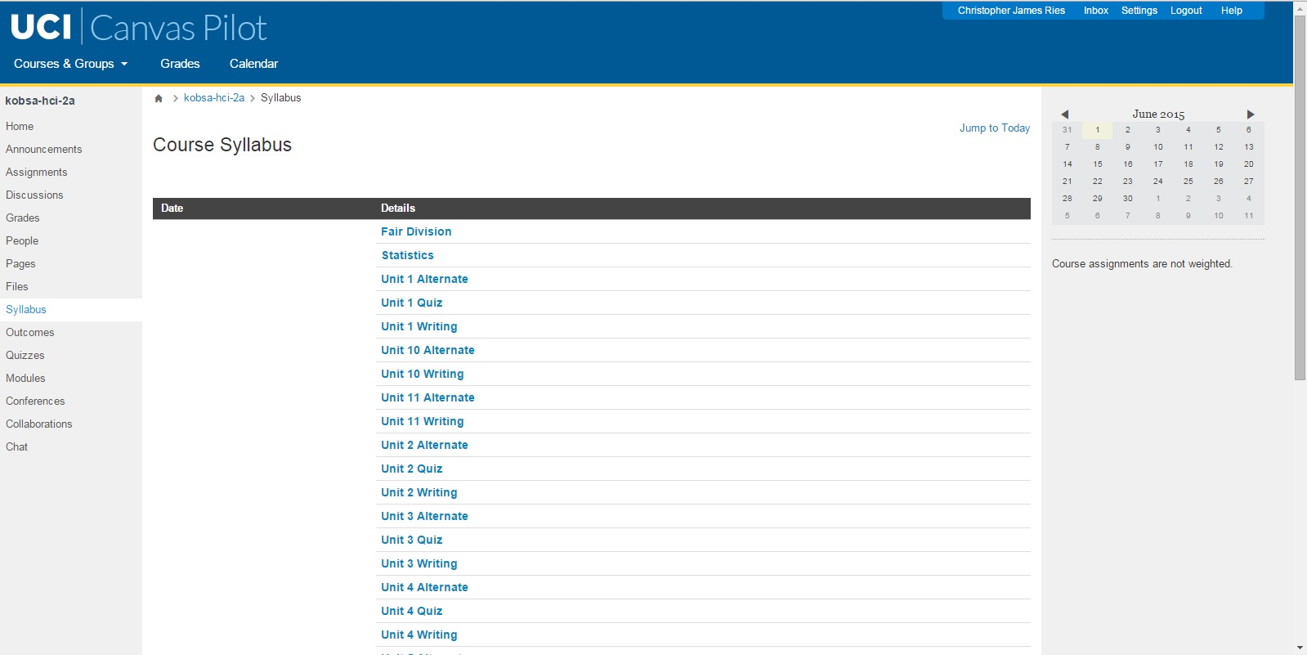
MOCKUPS (Notifications-Old)
Notes:
Emily P / Christopher R

Slide 12
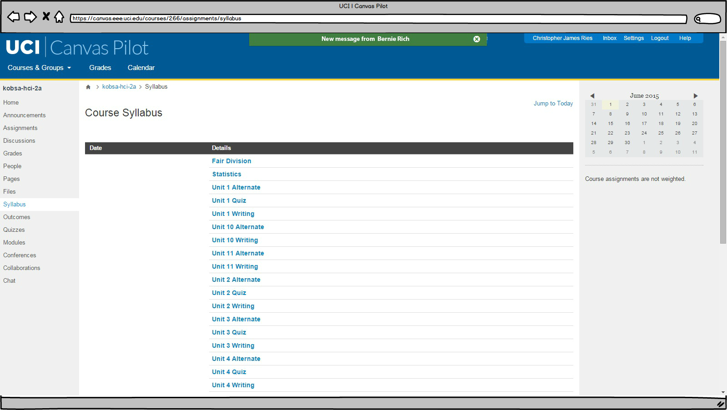
MOCKUPS (Notifications-New)
Notes:
Emily P / Christopher R

Slide 13
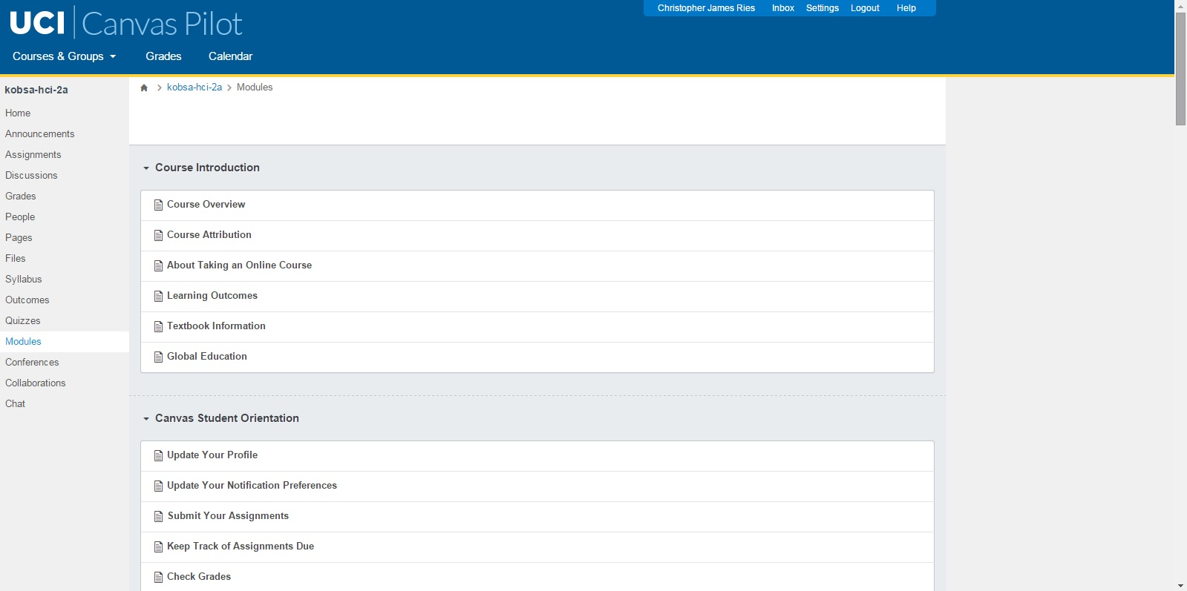
MOCKUPS (Modules-Old_1)
Notes:
Emily P / Christopher R

Slide 14
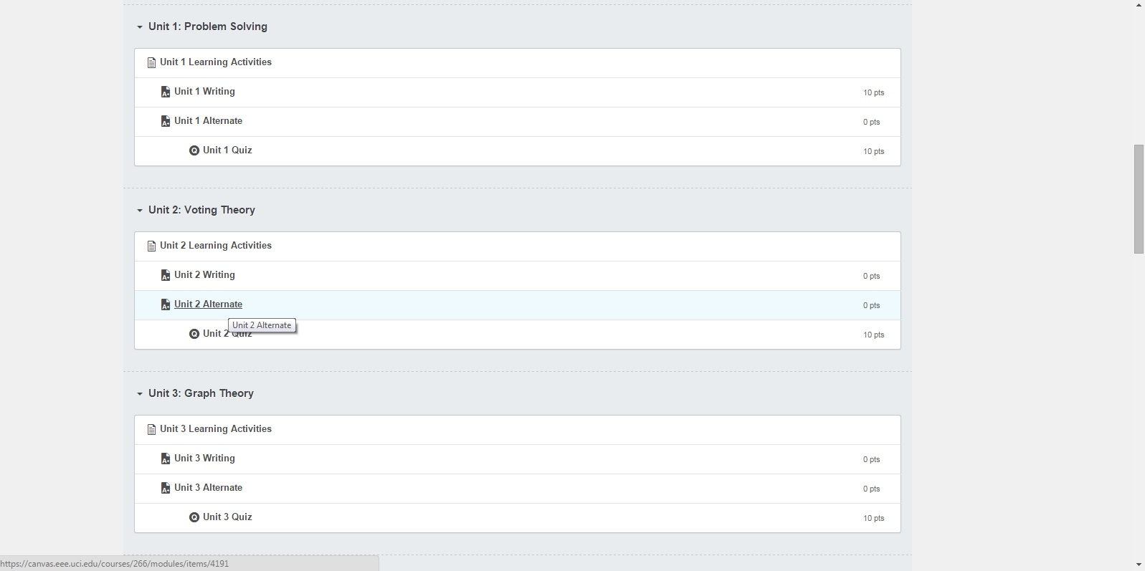
MOCKUPS (Modules-Old_2)
Notes:
Emily P / Christopher R

Slide 15
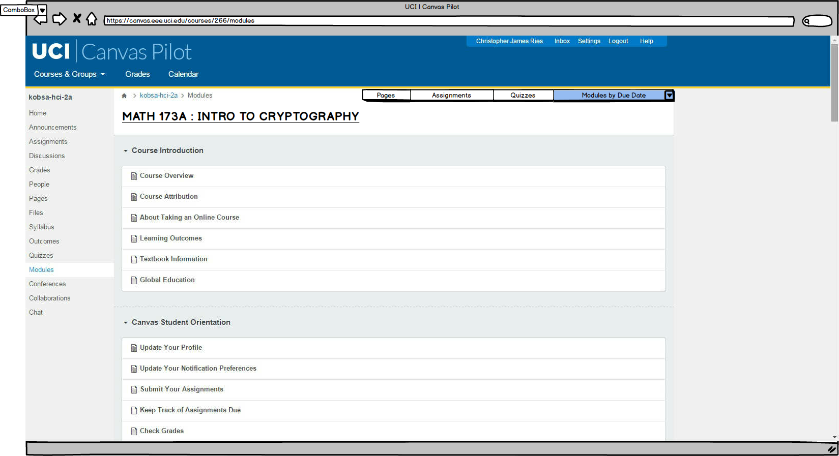
MOCKUPS (Modules-New_1)
Notes:
Emily P / Christopher R

Slide 16
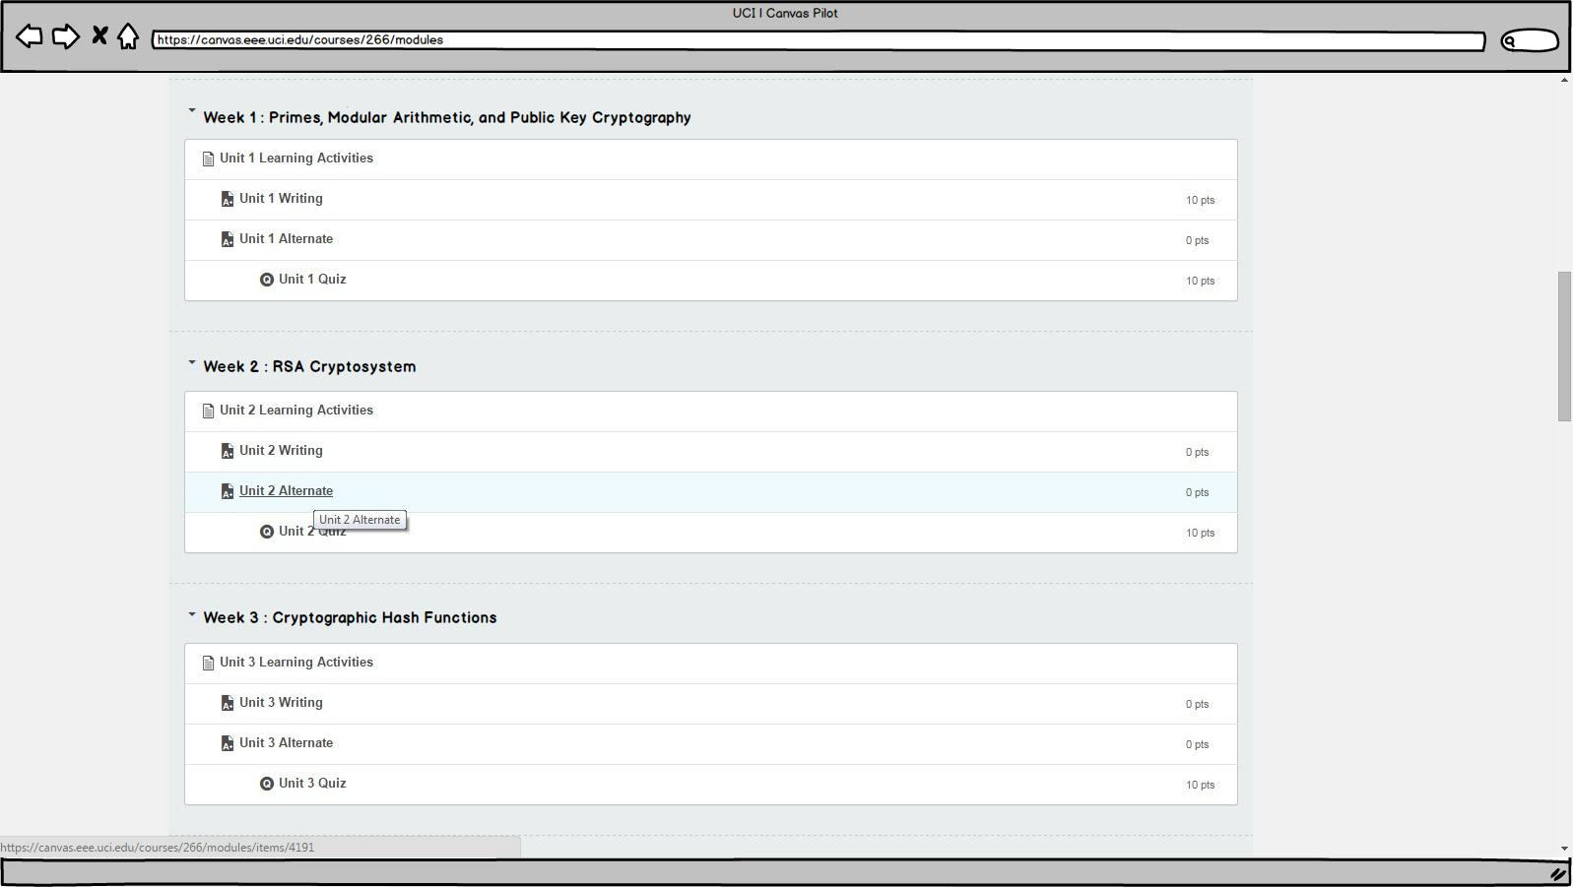
MOCKUPS (Modules-New_2)
Notes:
Emily P / Christopher R

Slide 17
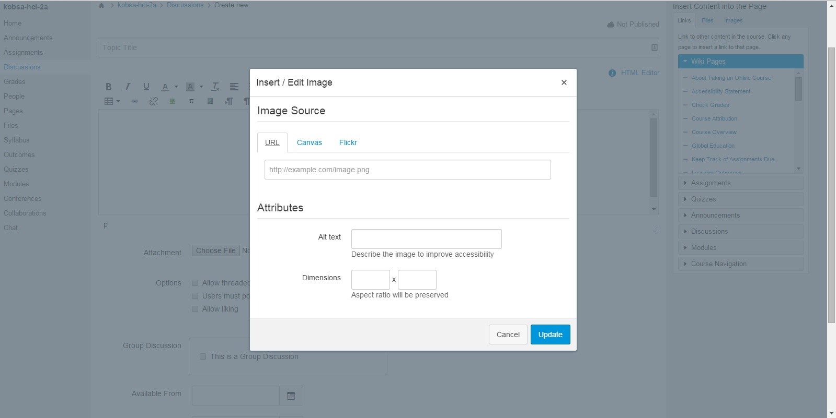
MOCKUPS (Embedded_Image-Old_1)
Notes:
Emily P / Christopher R

Slide 18
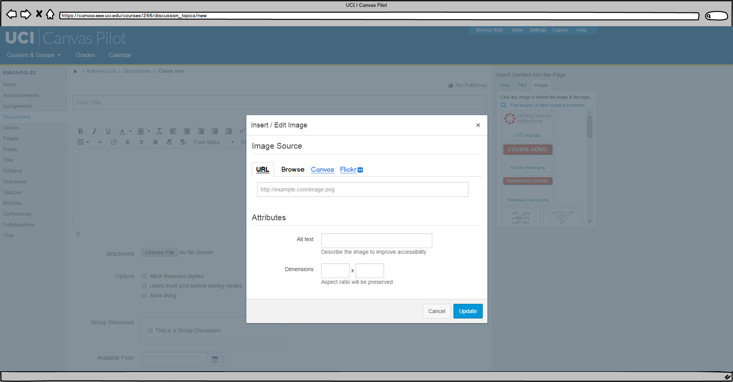
MOCKUPS (Embedded_Image-New_1)
Notes:
Emily P / Christopher R

Slide 19
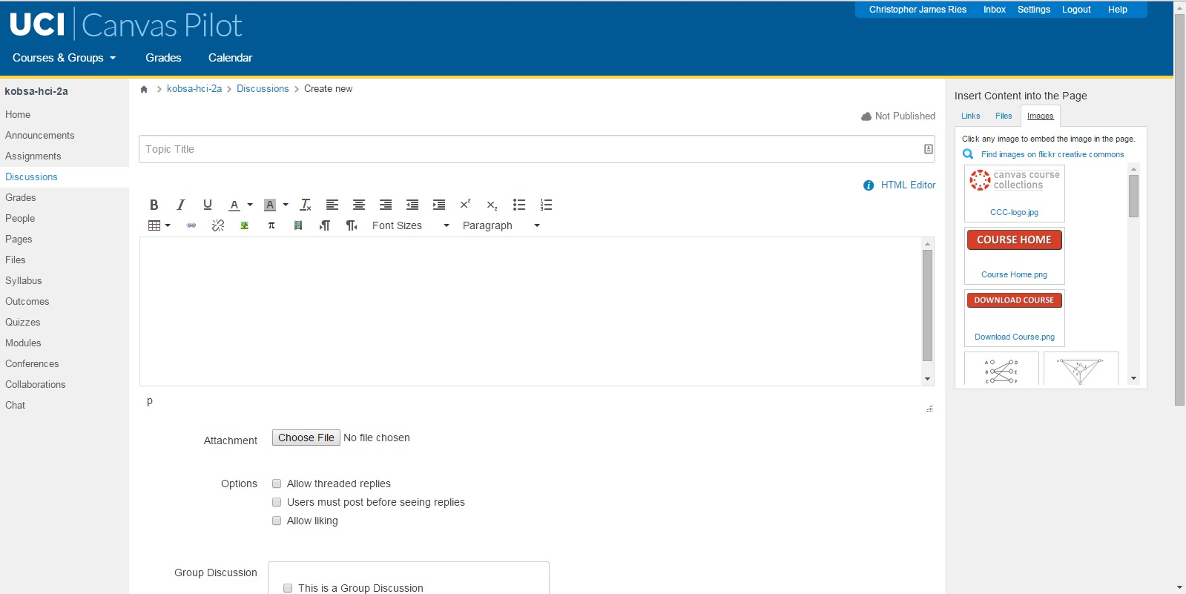
MOCKUPS (Embedded_Image-Old_2)
Notes:
Emily P / Christopher R

Slide 20
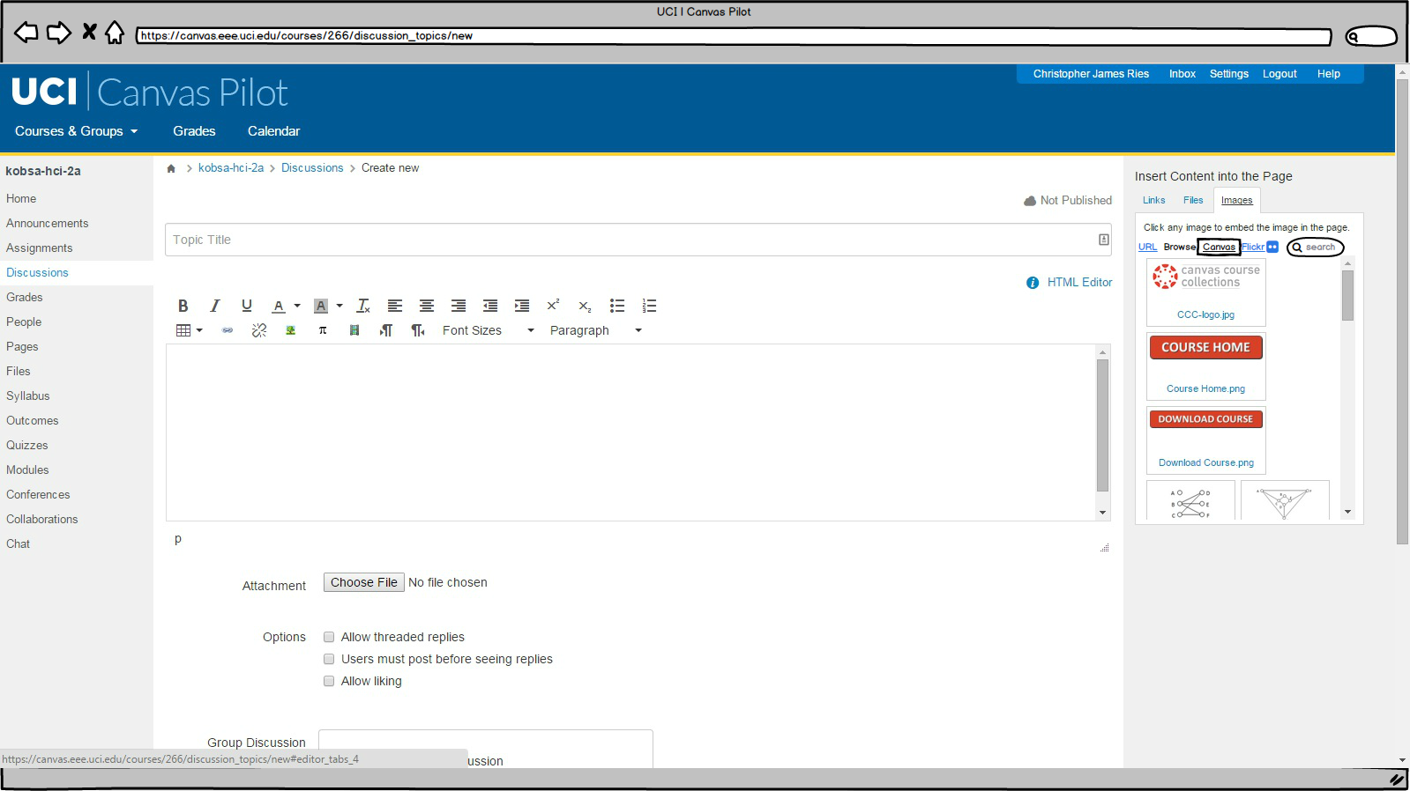
MOCKUPS (Embedded_Image-New_2)
Notes:
Emily P / Christopher R

Slide 21
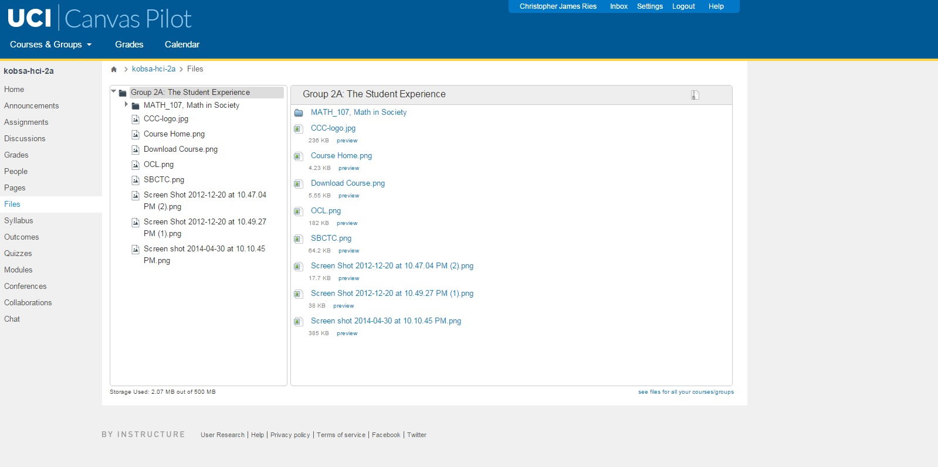
MOCKUPS (Files_Zipped-Old)
Notes:
Emily P / Christopher R

Slide 22
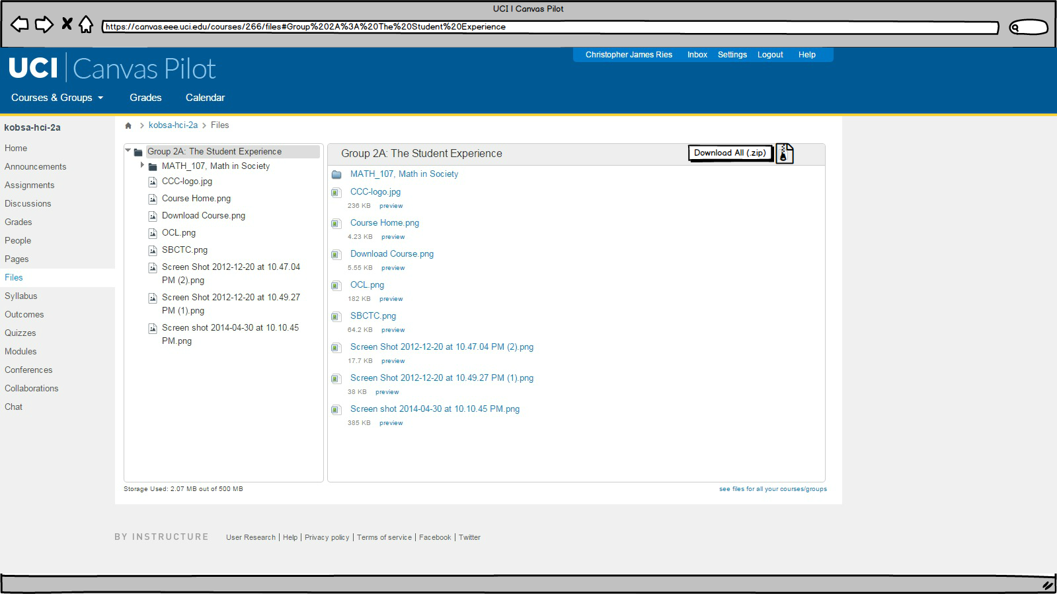
MOCKUPS (Files_Zipped-New)
Notes:
Emily P / Christopher R

Slide 23
TIMELINE
Think-alouds and interviews with different testers
Friday, June 5, 2015
Everyone
Mockups (if more usability issues are found)
Friday, June 5, 2015
Chris, Emily
Final Report
Sunday, June 7, 2015
Everyone
Notes:
Emily P

Slide 24
FINAL RECOMMENDATIONS
Full switch
Convenient having quizzes
Calendar feature
Chat feature
Google Drive-like interface
Have a “Help” documentation

Slide 25
Thanks!
ANY QUESTIONS?

