Slide 1
Justin Ma Rodrigo Ramos Alex Terreri
Alex Panganiban John Delshadi
Team A:

Slide 3
Usability Problems
Logical and Unconstrained Navigation
Consistent and Common Theme
Flexible and Efficient Use
Clear and Minimal Aesthetic
-By Theresa Neil

Slide 4
Client’s Focus
Site as a Resource
Professional Looking
An All-Purpose Reference Guide

Slide 5
Primary Users
Attorneys
Academics
Students
Professors
Media
Public

Slide 6
Methods
Usability Testing
Heuristic Evaluation
Cognitive Walkthrough
Interview
30 minutes (think-aloud tasks, semi-structured)

Slide 7
Our Progress
Website
Content is 80% Completed
Continuing Feedback and Update Cycle
Testing
HE and CW Completed
Public & Media Usability Testing Completed
Next are… Attorneys and Academics
Notes:
Build the website, design aspects (color selection, logo, and theme)
80% content.
although...
Missing Pretrial Motions, Cases, and the Home Page
Second Round of Prototyping. After feedback Revamped the website to make it look more scholarly and changed a few menu items to emphasize certain pages
we have interviewed and completed testing in 2 user groups Public and Media… in these evaluations, we surveryed the design of the website and asked users to locate specfic locations
and we have begun testing in Attorneys and Academics with the help of our client

Slide 8
Insights Gained
Order of links affects navigation
Color and theme affects general feel
Balance amount of content on website
Clearly portray who the website was for
Notes:
Order affects how people receive information; links at top make website flexible
Color affects the overall tone (Professional or childish)
Not so populated; not too much going on at one time

Slide 9
Feedback Received
Logo Changes
Not professional enough
No pastel colors
Not serious enough
Tape too big, smaller tape
Eliminate gray on photos

Slide 10
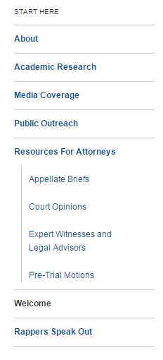
Feedback Received
Other Changes
Order of the links:
About, resources for attorneys
Font changes
Media buttons too big
Move about content to home page

Slide 11
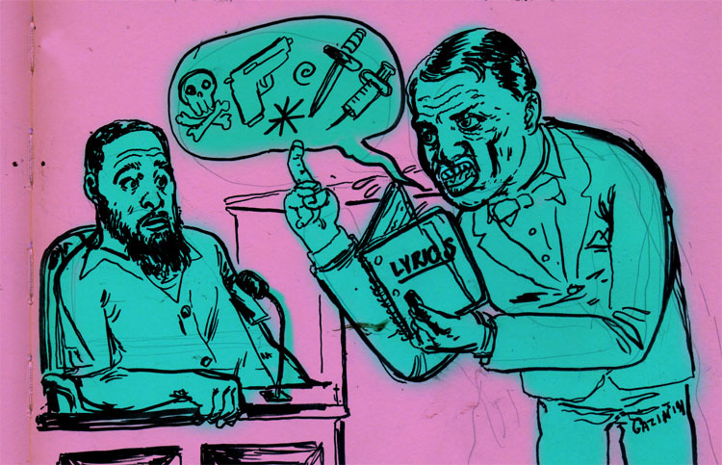
Difficulties Encountered
Wordpress limitations
Couldn’t make fonts changes
Resizing of embedded videos
Recoloring of menu bars
Keeping a balance
Creating an engaging website
Maintains its professional mission

Slide 12
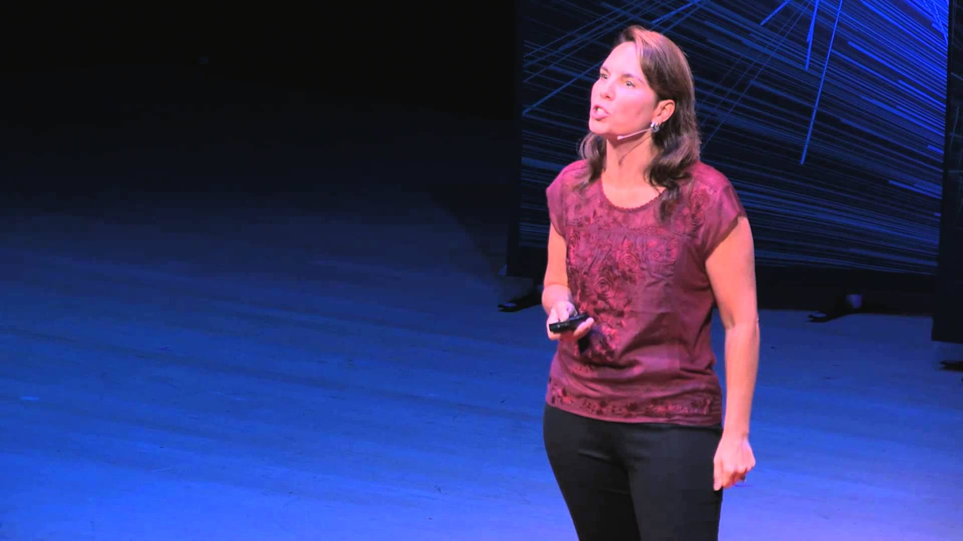
What’s Next?
Finishing User Testing
Data Analysis
Updating Website & Finalizing Pages
Writing Final Report
Studying for Final
Notes:
Finishing user testing - like said before, we still need to do user testing on attorneys and academics
data analysis - gathering all information from our usability tests & interviews and analyzing to find patterns, any outliers → using this analysis to update our website and for the final
Updating website - anymore feedback from Charis, but like said previously we have about 80% of the website completed
Writing final report - creating a well written report with screenshots of our website including before and after screenshots that shows what we implemented from Charis’s feedback and our testing

Slide 13
Final Timeline
Task | Estimated Timespan | Team Member(s)
Conduct Final Interviews | Now-5/30 | Alex T., Justin
Analyze and Condense Qualitative Data | Now-5/31 | Rodrigo, Alex P.
Continued Contact and Updates with Client | Now-6/9 | Alex T.
Website Updates and Tweaks | Now-6/1 | John, Justin
Development and Usability Teams Synthesize Final Thesis and Draft Report | 5/29-6/7 | Team A

Slide 14
Thank You!

