Slide 1
RACIAL VIOLENCE ARCHIVE
A Presentation By Team 1B:
Jared Axelrod, Vinson Gotingco, Alex Hirota, Amy Vo, Qiushi Cai

Slide 2
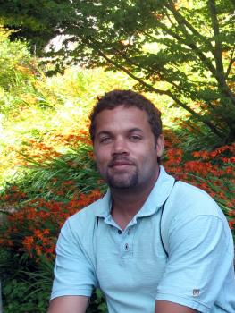
Our Client: Professor Geoff Ward
Associate Professor Criminology, Law, and Society and Sociology
Ph.D. University of Michigan
Specializations
Racial Politics of Social Control
Race Violence
Juvenile Justice
Court Communities
Justice Workforce
Historical Research

Slide 3
Racial Violence Archive
Gathers and shares information related to racial violence in U.S. history
The collection currently focuses on terroristic acts targeting African-Americans in the 20th century U.S. South
Incorporates and extends relevant collections
Searchability
Generating a database

Slide 4
What we Need to Do
Google fusion table
Searchability
New event submission
Give client ability to approve event input
More information
News/Stories
Project description
Better UI

Slide 5
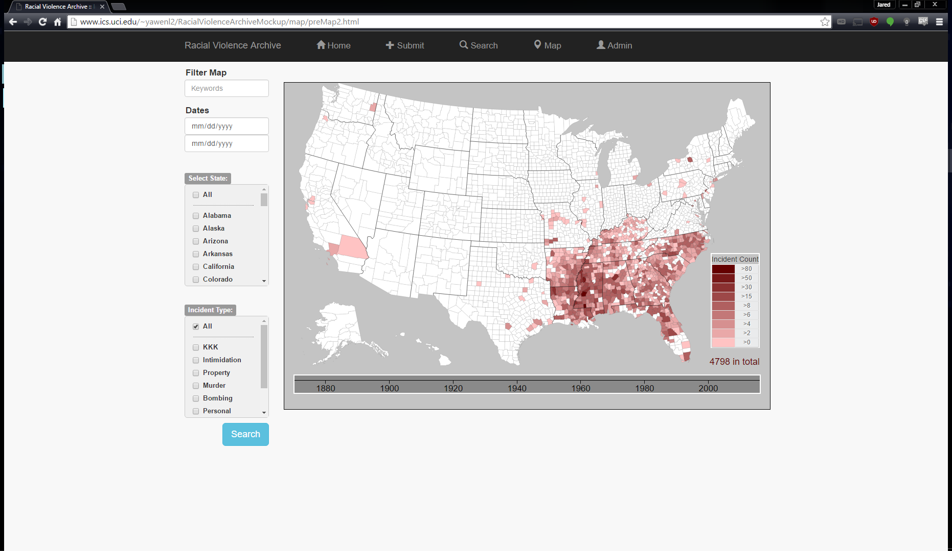
The Site Now:
Hard to maintain
Uninviting
Visualizations?

Slide 6
The Answer : Google Fusion Tables
The Good
Introduced in 2009, made official part of Drive in 2011.
Allows for easier manipulation and low maintenance
Familiarity with Google Maps among user base
The Bad
Works best with data that includes very specific locations
Only allowed single relation between tables

Slide 7
METHODS TO SOLVE SAID PROBLEM
User Types
People who have interest in subject
Subgroups
Scholarly people: professors, researchers, college students
Test Users
3-4 people, representing the variety of subgroups
Methods
Interviews
Questionnaires

Slide 8
METHODS TO SOLVE SAID PROBLEM continued...
Research Phases
User Testing (weeks 4-5)
Set up face-to-face interviews with users
Map developers will work on the interactive map simultaneously based on customer needs
Redesign (week 6)
Redesign the interactive map based on results from user testing
Re-evaluation (week 7)
Same users who participated in user testing
Same tasks to re-evaluate the improvements
Fill out short questionnaires on Google Form

Slide 9
METHODS TO SOLVE SAID PROBLEM continued...
Preparing a User Test:
Contacting Users
Obtain user contact information from the customer, Mr. Ward
Make initial contact via email
Selecting Tasks
Interact with the map
And
Identify one county with no events
Search for a keyword (eg. name)
Search by state
Look for particular events
Creating Scenarios

Slide 10
METHODS TO SOLVE SAID PROBLEM continued...
Conducting User Testing:
Interviews
Location: To Be Determined
Duration: average 20-25 minutes
Screen recording of user interactions with the map
Note taking of major activities

Slide 11
METHODS TO SOLVE SAID PROBLEM continued...
Redesigning:
Who is responsible
Programmer: Jared & Alex
HCI experts: Vinson, Amy & Qiushi
What are the measurements
Performance Measurements
Time needed to carry out a task
Error rate
Task completion rate
Time spent on/ frequency of unproductive activities
Measure of Satisfaction
User ratings - System Usability Scale
Observed frustration/ confusion/ surprise/ satisfaction

Slide 12
METHODS TO SOLVE SAID PROBLEM continued...
Re-evaluating:
Google Form Questionnaire
Send links to Google Form via email
Average 5 questions (the same tasks as user testing)
Users answer short questions to re-evaluate the map performance

Slide 13
TIME PLAN
3 Major Phases (As with all software)
Design Phase
Testing Phase
Evaluation Phase

Slide 14
TIME PLAN continued...
Design Phase
Developing a working version of the RVA Heat Map
Developing a method in which user-data-entry can be analyzed and approved by Professor Ward

Slide 15
TIME PLAN continued...
Testing Phase
Alpha Testing
In house testing amongst our team, ensuring that functionality is there
Testing with Professor Ward to make sure he likes what we have done
Beta Testing*
Referring to the methods for solving the problem.
Obtaining Feedback from our User Groups
Collect the results from these tests
Doesn’t only refer to our deliverables
*Note that we will provide test builds for users, and all users will use the same test build for each user test.

Slide 16
TIME PLAN continued...
Evaluation Phase
As a team, analyze and evaluate all feedback
Answer the questions to why users could not complete tasks
Analyze what the good usability aspects of our project are
...And then do everything again.

Slide 17
TIME PLAN continued...
*This is tentative and subject to change.

