Slide 1
ICS Undergraduate Student Affairs Office
Fall 2018

Slide 2
Student Affairs Office
  352 ICS Building (Bldg 302)
  Telephone: (949) 824-5156
  E-mail: ucounsel@uci.edu
  Web: www.ics.uci.edu
  FB: @icsugradstudentaffairs
  Monday – Friday:
  9 a.m. – 12 p.m. & 1-4 p.m.

Slide 3
Visiting the Student Affairs Office
  Undergrad counselors are available to assist with:
    Academic planning
    grad checks
    long and short term goal setting
    referrals to campus resources
Before Your Meeting with a Counselor
Arrive on time. Call ahead if you will be late, or need to reschedule
Come prepared with questions and concerns
Bring a notebook or your laptop to write notes down
Keep an open mind to consider the options presented to you

Slide 4
Peer Academic Advisors
ICS Peer Academic Advisors are available daily for walk-in advising
They can assist you with:
-Academic planning/course planning
-Scheduling issues
-Campus resources
-Changing/Adding Majors
-Minors
-Academic progress check
-Graduation Check
-Non-academic issues
Stress management
Time management
Success strategies
  Jason Bai
  Steven Chalmers
  Amy Elsayed
  Brett Galkowski
  Jonathan Lin

Slide 5

Student Responsibility
It is the student's responsibility to make decisions about his/her educational and career goals.
Undergraduate Counselors are here to help students work towards those goals, and academic advising is a partnership between the student and his/her counselor in which the shared goal is the student’s academic success.

Slide 6
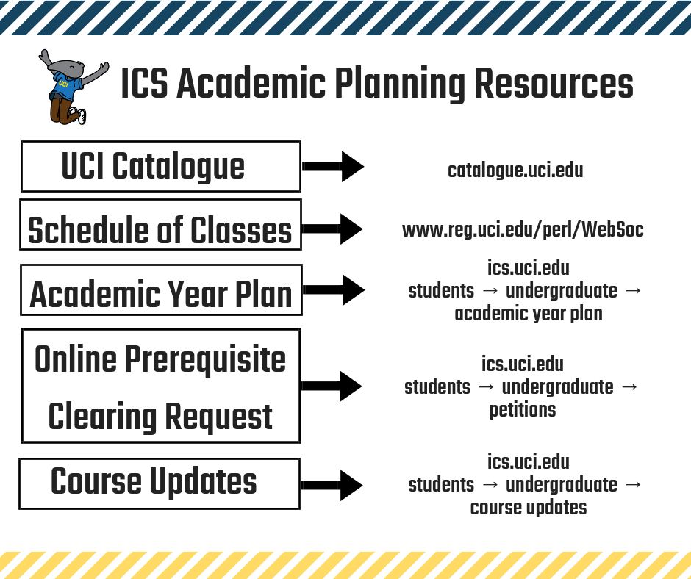
Academic PLanning

Slide 7

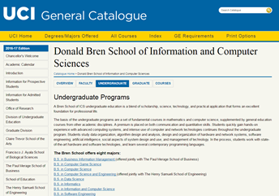

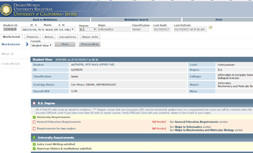
Academic Planning Tools
Review the UCI CATALOGUE (catalogue.uci.edu)
Find your major and GE requirements
Find sample academic plans
Review your DEGREEWORKS audit
Then you can review your remaining degree
requirements (major and GE).

Slide 8

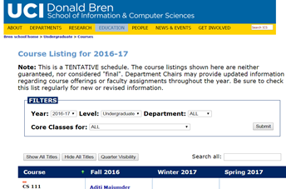

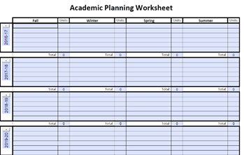


Academic Planning Tools
Refer to the ICS ACADEMIC YEAR PLAN
(ics.uci.edu)
Tabs: Education – Undergraduate - Academic year plan
PLAN!
* You can always have your academic plan come in for review by a Peer Academic Advisor*

Slide 9

Academic Planning Tips
•SELECT one math course per quarter until you exhaust all of your required math courses
•LEARN to **Mark** courses that are offered every QTR
•DECLARE your Specialization/Track sooner than later
•CHECK your prerequisites
•UPDATE your plan as quarters finish
•FOLLOW US ON FB @icsugradstudentaffairs

Slide 10
Navigating the ICS Website: ics.uci.edu
Find walk in hours & Contact information
Graduation information
Academic Planning resources
Faculty information
Skip the walk in line and send an email instead!
  Submit petitions online.
    Example- Degreeworks update, Declare Specialization/Track, Online Pre-req Clearing, Request Excess Units, Syllabi Review
Find out about upcoming events!

Slide 11
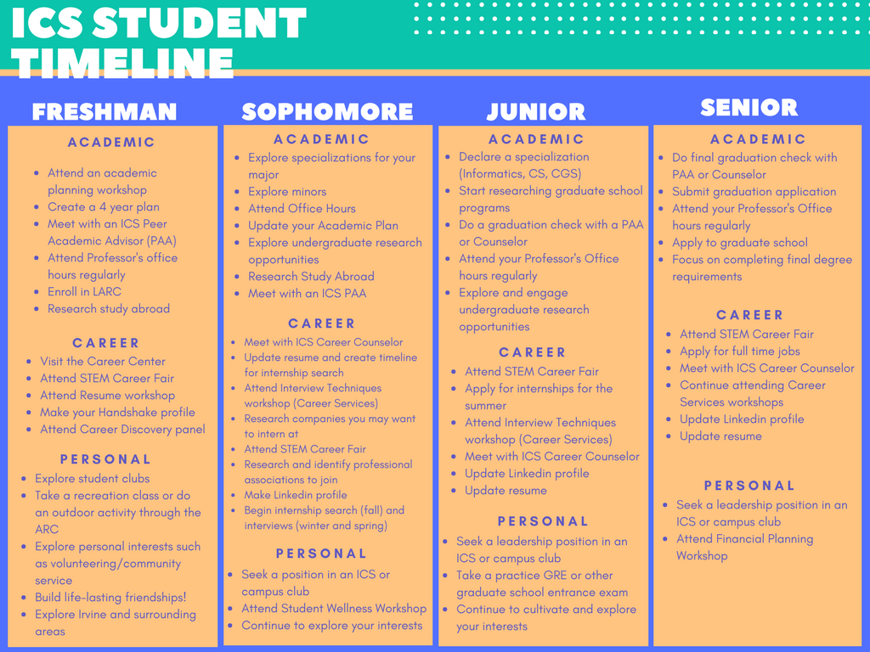

Slide 12

Career Resources
Oct 18, 2018:
STEM Career Fair
Explore career.uci.edu
for more resources for
jobs and internships

Slide 13


Slide 14
Student Affairs Office
  352 ICS Building (Bldg 302)
  Telephone: (949) 824-5156
  E-mail: ucounsel@uci.edu
  Web: www.ics.uci.edu
  FB: @icsugradstudentaffairs
  Monday – Friday:
  9 a.m. – 12 p.m. & 1-4 p.m.

Slide 15
QUESTIONS??

