Slide 1
Personal Health Navigator
Ramesh Jain
Department of Computer Science
University of California, Irvine
jain@ics.uci.edu

Slide 2
As a Student: Normal student life in India
V. National Institute of Technology, Nagpur. B.E.
Indian Institute of Technology, Kharagpur. Ph.D.
Wanted to be a scientist/engineer.
Participated in sports.
Edited Magazines.

Slide 3
Teacher, Researcher, Entrepreneur
Professor at: IIT Kharagpur, UT Austin, Wayne State, University of Michigan, University of California, San Diego, Georgia Tech, UC Irvine.
Researcher: Computer Vision, Artificial Intelligence, Control Systems, Multimedia, Future Health.
Entrepreneur: Imageware, Virage, Praja, …, Krumbs, Institute for Future Health

Slide 4
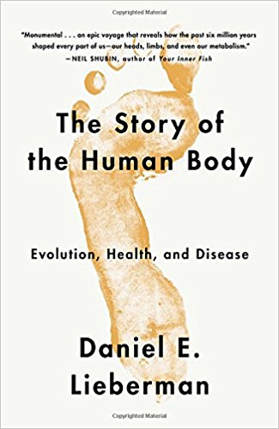
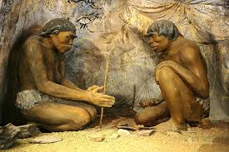
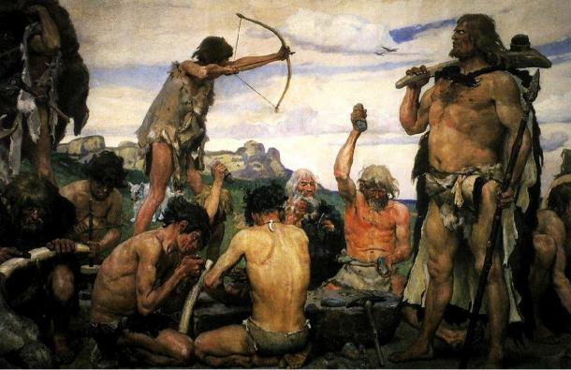
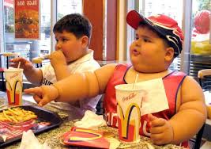
Technology has fundamentally altered the environment and lifestyle for which human body evolved.
Food
Habitats
Commuting – activity
Environment
Technology replaced lower mortality by higher morbidity.
Technology ought to solve it.

Slide 5
Health is not an Afterthought; it is Essence of Life.
Can technology enable this?

Slide 6
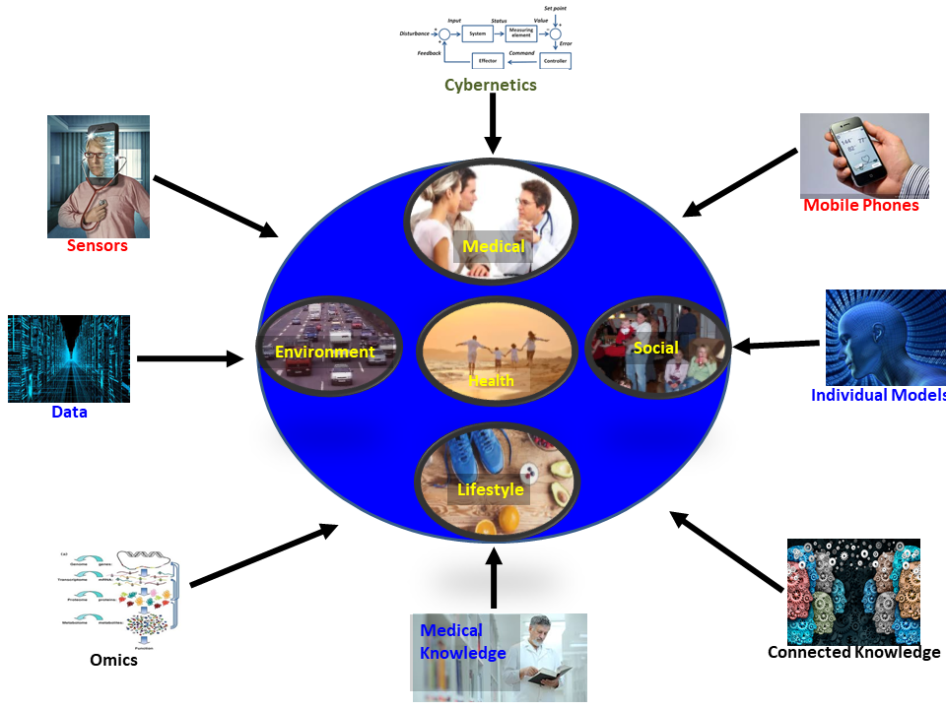
Meta-nexus of Genetics, Biology, Sensing, Computing, and Mobile.
Empower individuals to regulate their health and quality of life using technology.

Slide 7

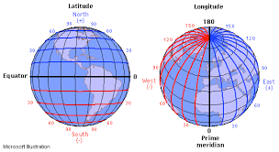

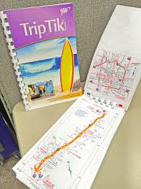
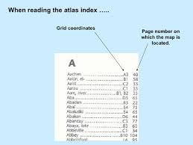

How did you get to your destination?
Perspective and Representations make a big difference.

Slide 8
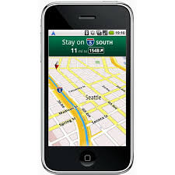

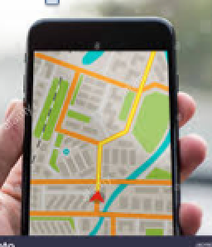
Can you drive without a Navigation System?
Knowledge
Navigation
System
Current State
Destination
Cybernetic Loop

Slide 9
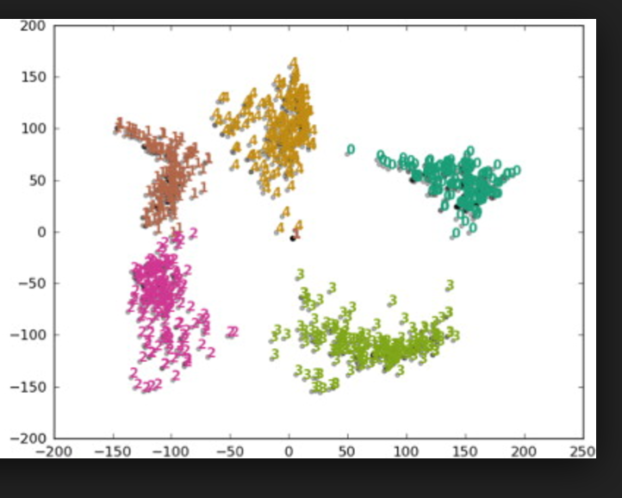


Thinking about Health in Healthcare.
Think Health State – not Disease!

Slide 10
A real life algorithm:
You go to a doctor because you feel sick.
The doctor asks you questions about your health status and history while observing your reactions.
The doctor examines your body and may order some tests (such as x-rays or blood work).
Based on your exam and test results, the doctor estimates your health state (disease and its severity).
A prescription and regimen are stipulated and explained.
You try to follow those instructions.
The doctor sees you periodically, as needed. (In a week; admit in hospital; put you through surgery followed by ICU.)

Slide 11
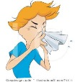
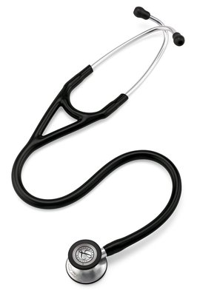






Cycle: Measure, Estimate, Guide, Influence
Measure
Collect all
Relevant data
Estimate
(Health State)
Guidance
Influence and Compliance

Slide 12
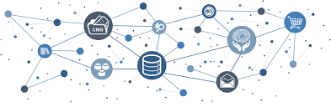
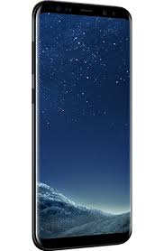




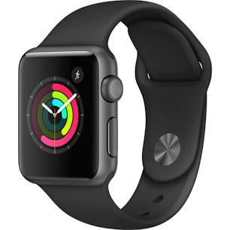
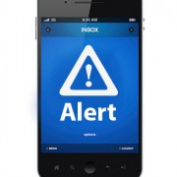

Cybernetics: Perpetual Health Guidance.
Knowledge Cloud
Environment
Knowledge
‘Omics’
Personal Model
Medical
Local
Demographics
Environment
Regulations
Personicle
Measure
Collect all data
Estimate
(Health State)
Guidance
Influence and Compliance

Slide 13
Basic Systems Theory
Where x, u, and y are state, input, and output vectors; A, B, C, D are appropriate matrices for transformation.
Time variant discrete systems - matrices are time variant.
Controllability: Get to desirable state.
Observability: Determine state using measurements.

Slide 14
Challenging problems
Personal Model
Estimation of Health States
Knowledge Processing to make it situationally actionable
Influence Person to execute and comply

Slide 15
Building Two Platforms and More
Personal Health Navigator
Personal Model Builder

Slide 16
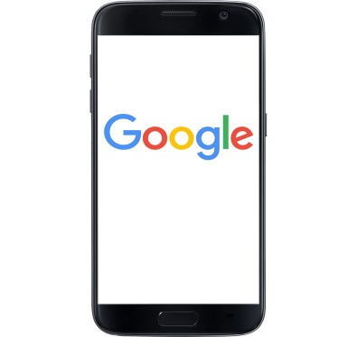
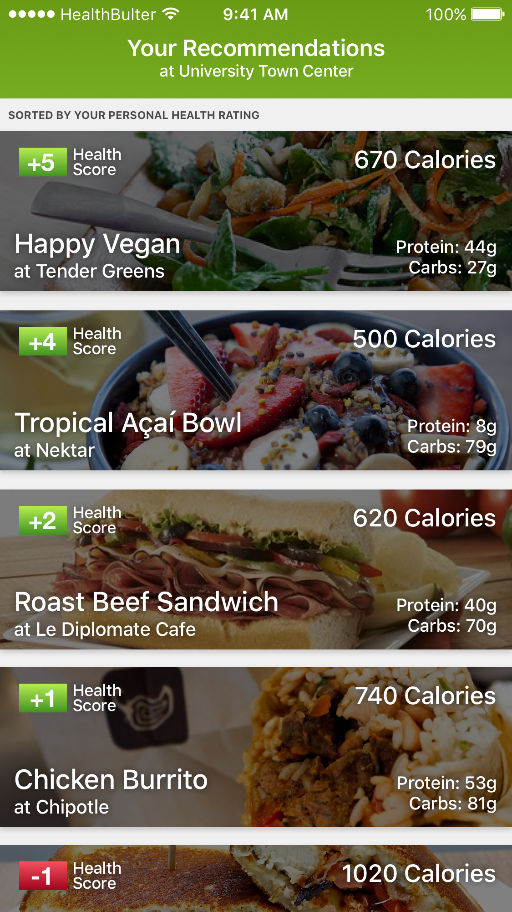
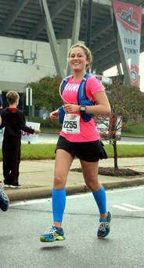
Personal Health Navigator
Dynamic Personal Model
Population Model
Health Navigator
Medical Knowledge
Guidance
Food
Activity
Emotion
Medical
Environment
Daily Activity
Scores: Food, Activity, Emotion,
Medical,Environment, Daily Activity
Goal:
Participate in
the Marathon
Current Situation

Slide 17
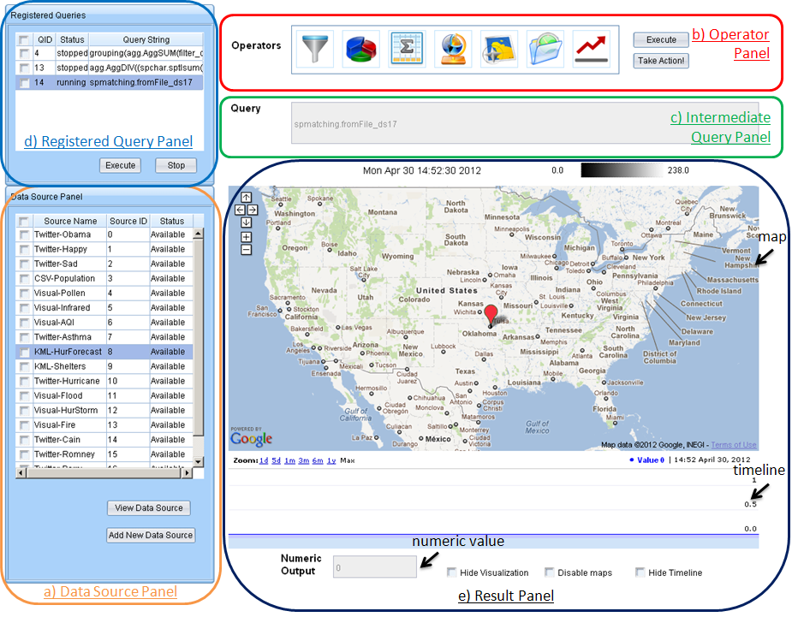
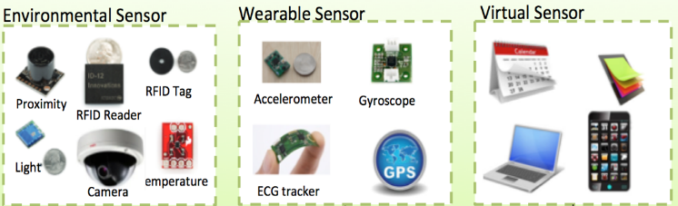
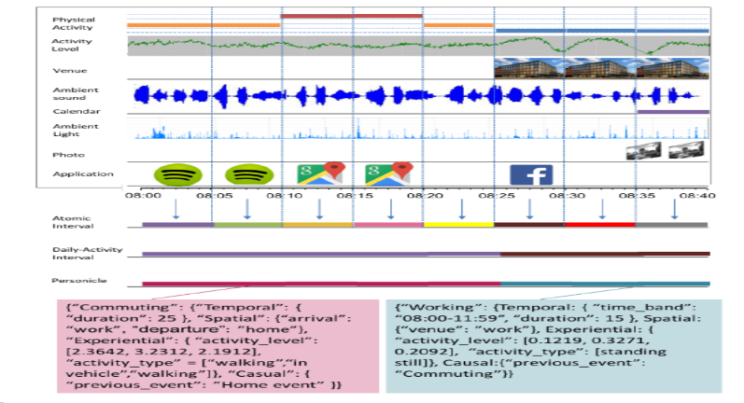
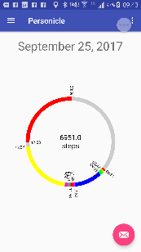
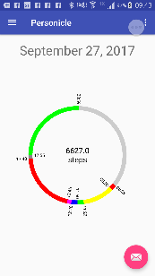
Personal Model Builder
EventShop for Situation Recognition and geo-spatial event analysis.
‘Omics’
Environment
Knowledge
Propensity to diseases
Rule Based Health Behavior
Personal Model
Kahneman et al: Day Reconstruction Method for Wellbeing research.
Personicle
AI + Learning

Slide 18
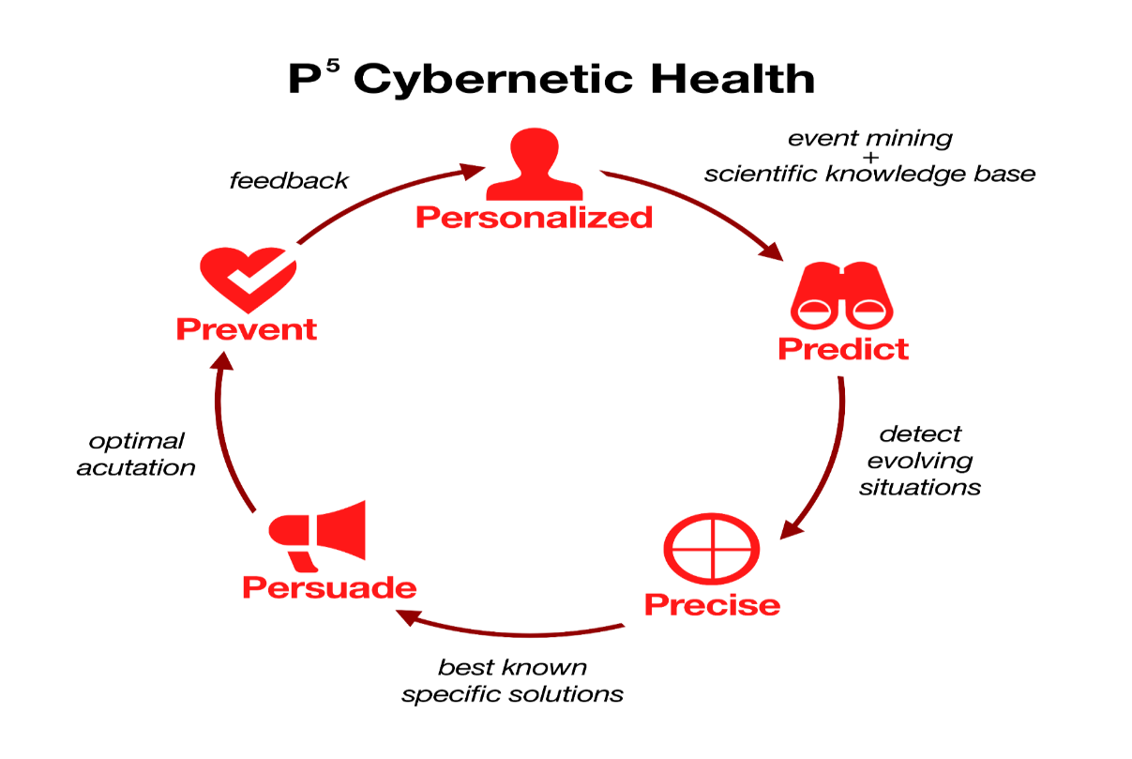
Cybernetics Leads to P5 using Health Navigator
Your food and activity scores for the last 3 days are on low side.
Health Navigator

Slide 19

Institute for
Future Health
Focus on health.

Slide 20

Thanks.
jain@ics.uci.edu

