Slide 1
Enriching Esports: Opportunities & Challenges
Constance Steinkuehler
UNIVERSITY OF CALIFORNIA, IRVINE

Slide 2

I study cognition & learning
in videogames.
Notes:
CONSTANCE

Slide 3
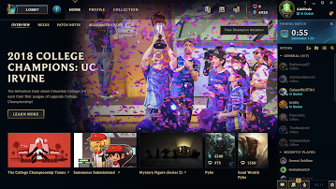


ESPORTS RESEARCH AGENDA
Cognition
Attitudes
Readiness
Tilt
Team Composition
Team Attention
Team Cognition
Team Readiness

Slide 4
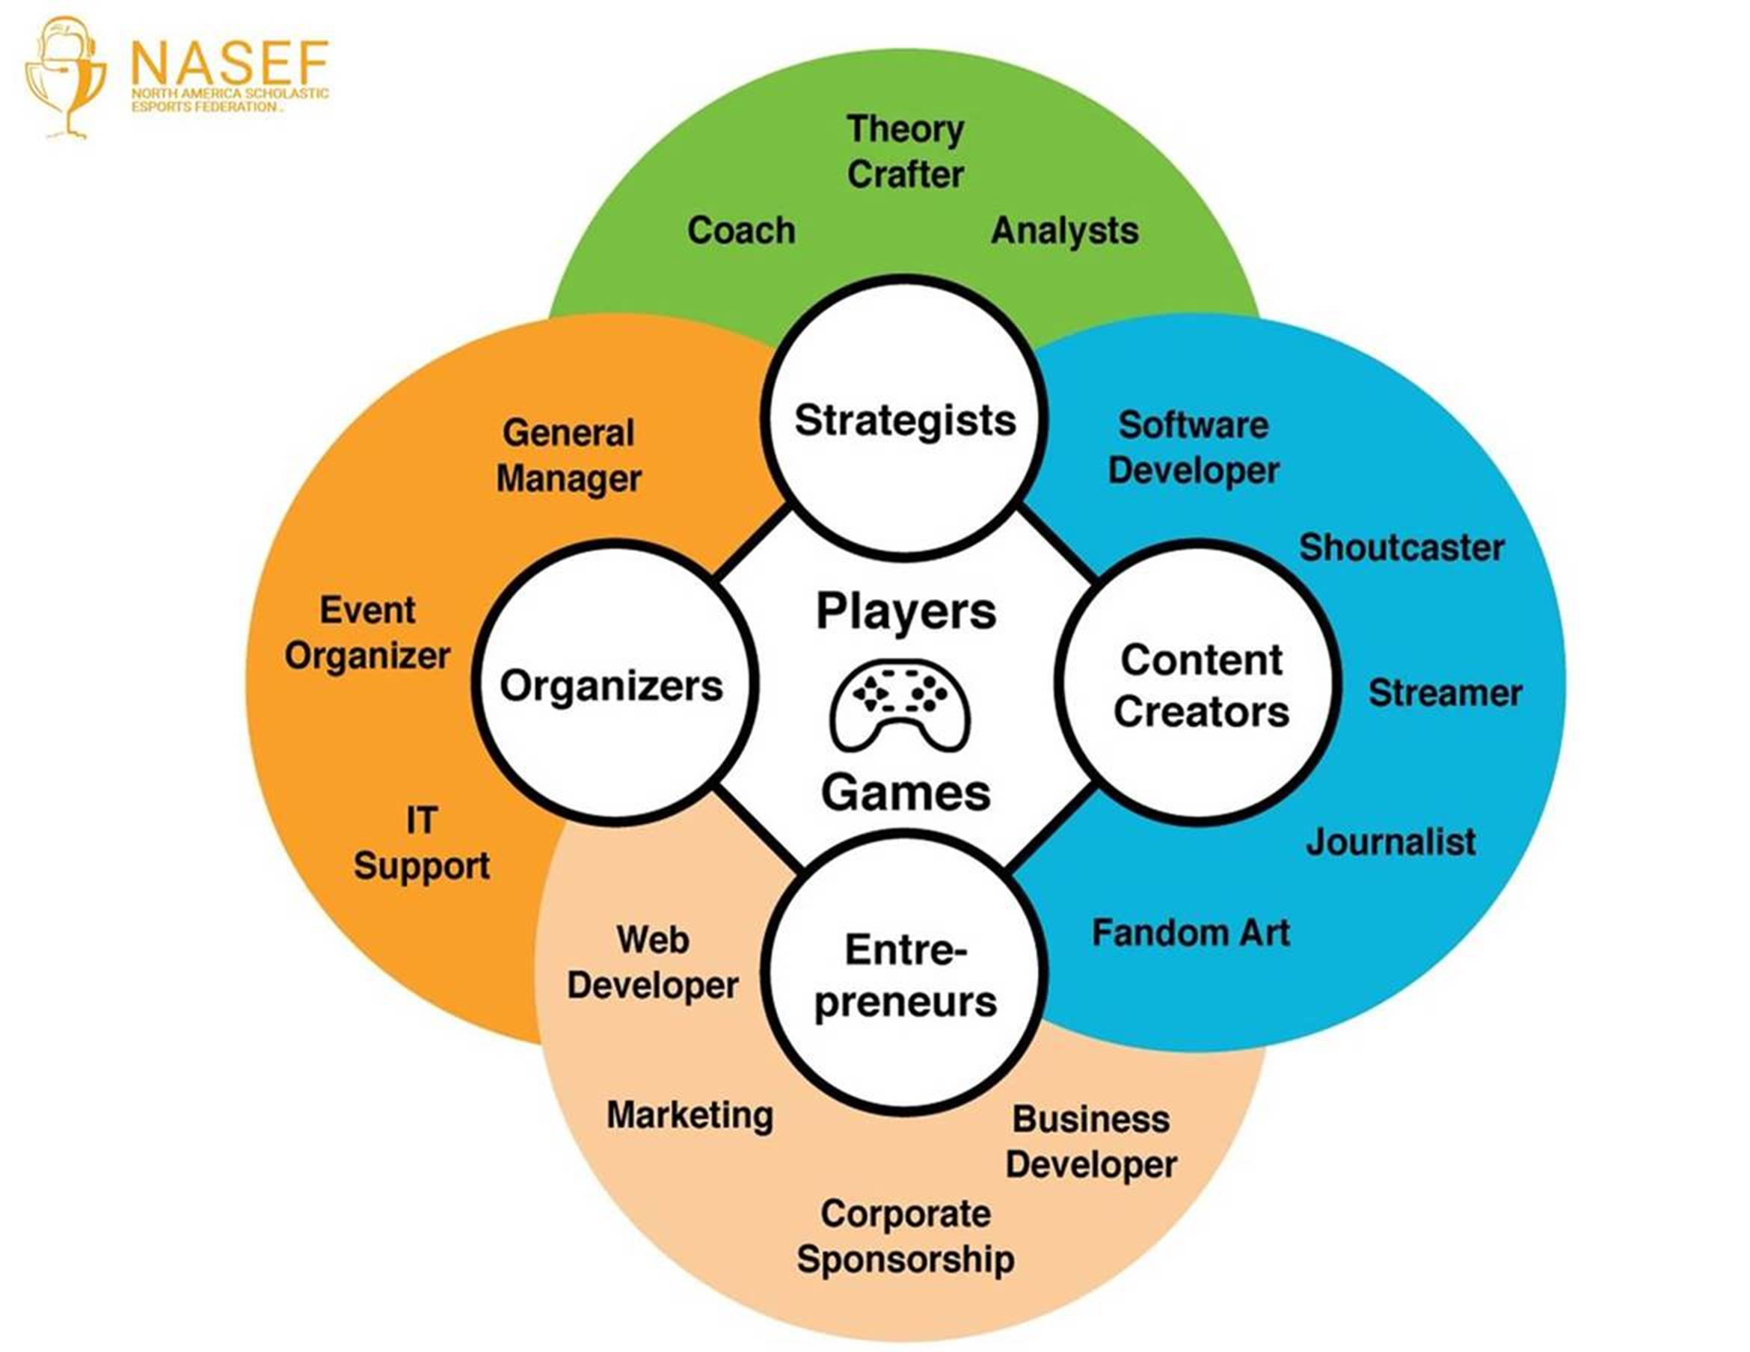
ESPORTS ECOSYSTEM

Slide 5
ESPORTS ECOSYSTEM
important
knowledge & skills

Slide 6


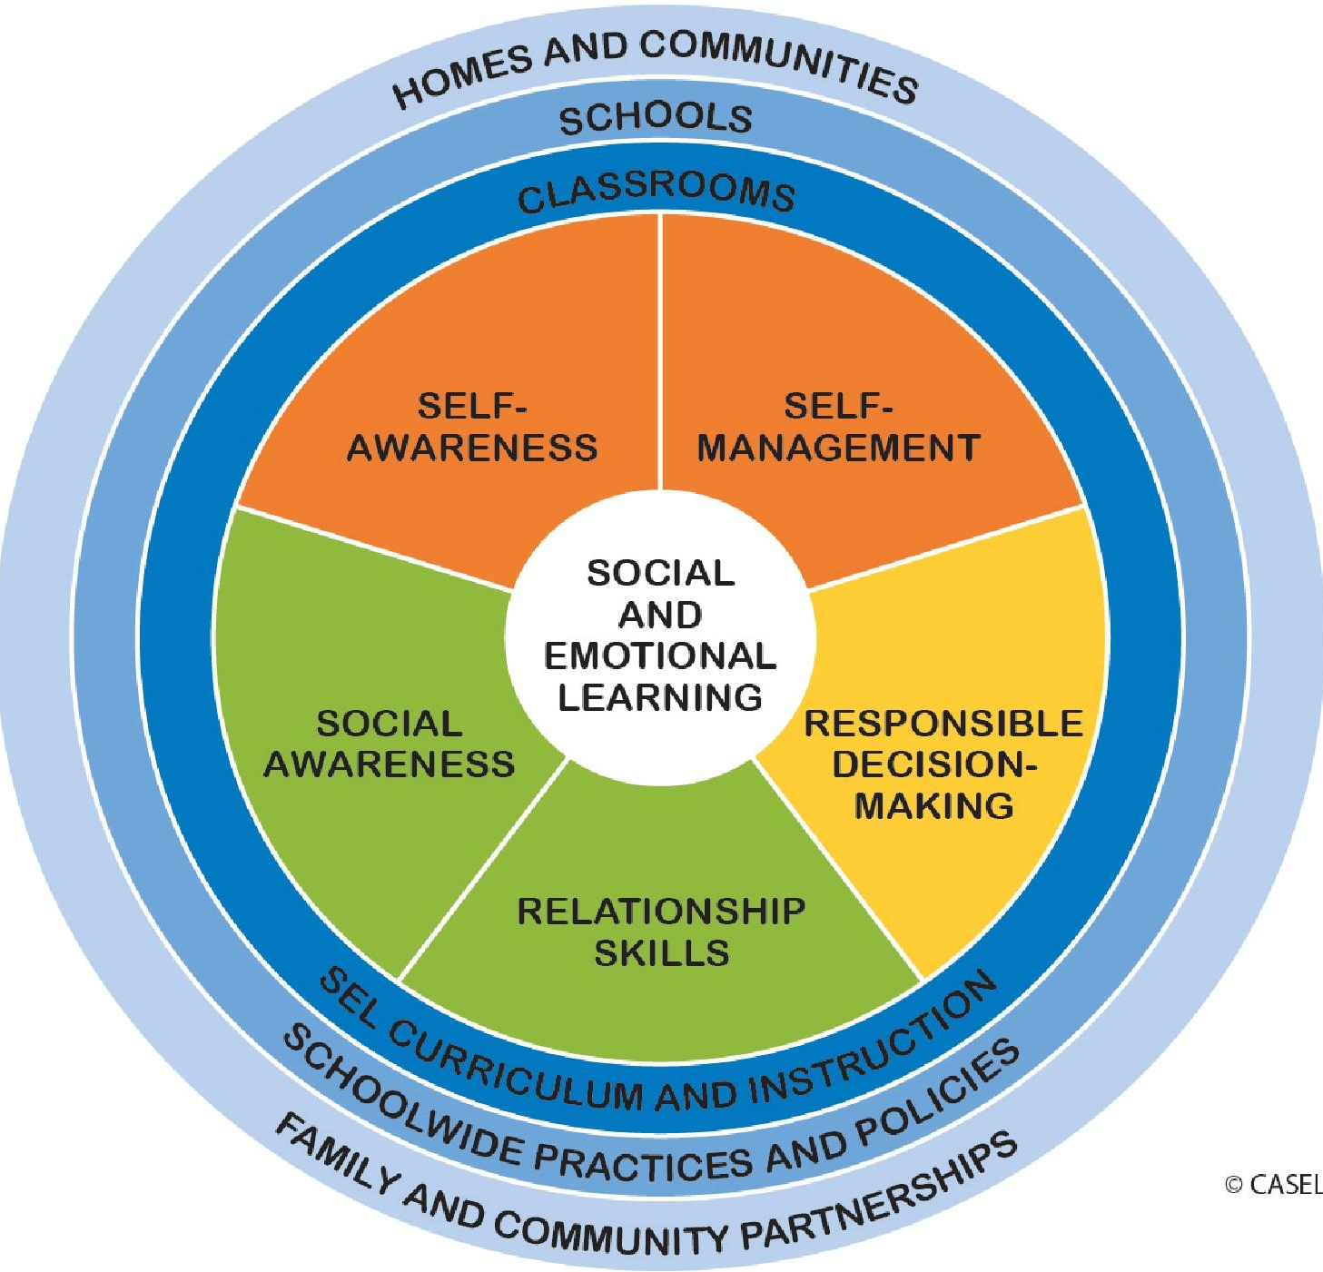


Educational Standards
Anderson, Tsaasan, Reitman, Lee, Wu, Steele, Turner, & Steinkuehler, (2018). Understanding Esports as a STEM Career Ready Curriculum in the Wild. IEEE Proceedings of VS-Games (pp. 224-230).
Notes:
TOM

Slide 7
CAN WE FORMALIZE THIS
& Amplify FOR KIDS?

Slide 8
VIDEOGAMES & LEARNING
Improve visual acuity & attention (Green & Bevelier).
Foster scientific reasoning (Clark; Steinkuehler & Duncan; NRC).
Accelerate language learning (Young et. al.).
Improve digital and print literacy (Gee; Leander; Steinkuehler).
Increase problem solving skills (Adachi & Willoughby).
Associated with higher math achievement (Bowers & Berland).
Strongly associated with technology fluency (Hayes).
Notes:
CONSTANCE

Slide 9
SPORTS & LEARNING
Associated with higher GPA for HS students (Fox et. al.).
Fosters personal growth (Richard & Ares).
Associated with higher degree completion (Ryan).
Cultivates “internal locus of attribution” (Pascarella et. al.).
Increases satisfaction with school (Astin).
Promotes cooperation rather than individual activity (Holloway).
Connects students more meaningfully to school, teachers and other students, and its values (Finn)
Notes:
CONSTANCE

Slide 10







Community Partnership
Notes:
GERALD

Slide 11

Lee, J.S., Wu, M., Lee, D., Fleming, L., Ruben, L., Turner, T., Brown, K., & Steinkuehler, C. (2020). Designing an interest-based ELA curriculum for esports. International Journal of Designs for Learning, 11(3), 78–95. https://doi.org/10.14434/ijdl.v11i3.27663

Slide 12
ESPORTS WITH A MISSION
To provide opportunities for all students to use esports as a platform to acquire critical communication, collaboration, and problem-solving skills needed to thrive in work and in life.
Notes:
GERALD

Slide 13
Key Components
Mentors
Teacher GMs on the high school campuses, providing guidance and resources for students to develop their own community
Online coaches, trained to work with young people, for each team
Network of industry and higher education professionals
Inclusion & Diversity
Expanding game selection to cater
to a larger audience of students
Camps for underrepresented populations in esports
Joint Activity & Apprenticeship
Online clinics, hosted by coaches, aligned with topics on improving their game play
In-person workshops, hosted by UCI, aligned with roles in the esports ecosystem
Live events, where students can fill necessary roles (casters, analysts, volunteers)
Community
Code of conduct for participation that prioritizes teamwork and inclusivity
Notes:
ADRIAN

Slide 14
Research Based
Research Drive
Notes:
CONSTANCE

Slide 15
Research Based
Research Driven
Notes:
CONSTANCE

Slide 16

YEAR ONE RESEARCH
Exploratory Analysis: What are existing & potential alignments to national educational standards?
Sampling:
  6 schools
selected for maximum variation
Data Collection:
Field observations (20 hours of fieldnotes)
Focus groups with student & club members (n=39)
Focus groups with GMs (n=11) & coaches (n=5)
In-person interviews with parents at Championship (n=10)
Notes:
Katie

Slide 17
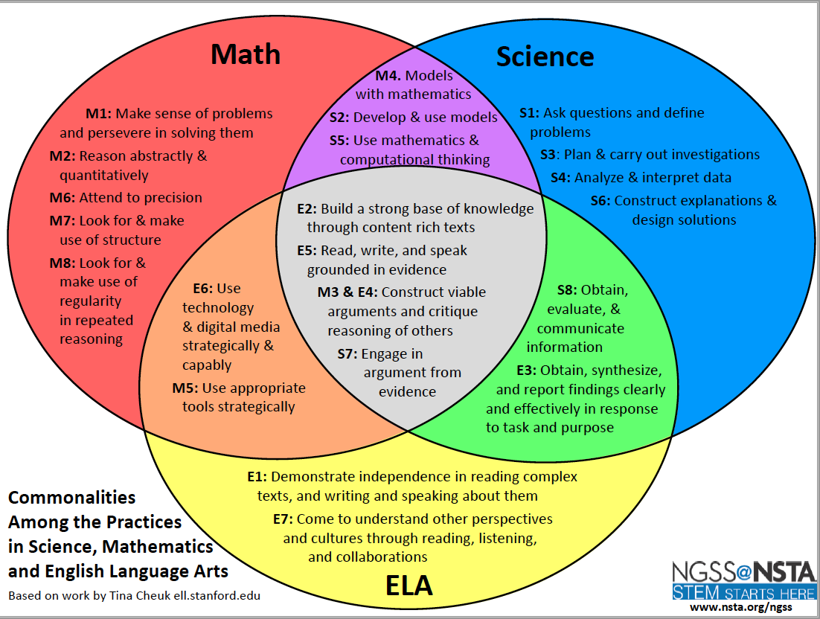
Quantitative Analysis
YEAR ONE RESEARCH
Unit of analysis: turn of talk,
fieldnote
Corpus:
Students: 3414
GMs: 1717
Coaches: 739
Interrater agreement:
92.31%
SCIENCE:
Ask questions & define problems
Plan and carry out investigations
Analyze & interpret data
Scientific explanations & design solutions
MATH:
Problem-solving
Reason quantitatively
Attend to structure
Attend to regularity
Appropriate (math/digital) tool use
ELA:
Communicate info/findings
Construct/critique argument
Use evidence
SOCIAL EMOTIONAL LEARNING: (5)
RELATIONSHIPS:
Mentorship/Apprenticeship/Modeling
Affiliation
Equity
CODE FRAMEWORK
Notes:
Katie

Slide 18
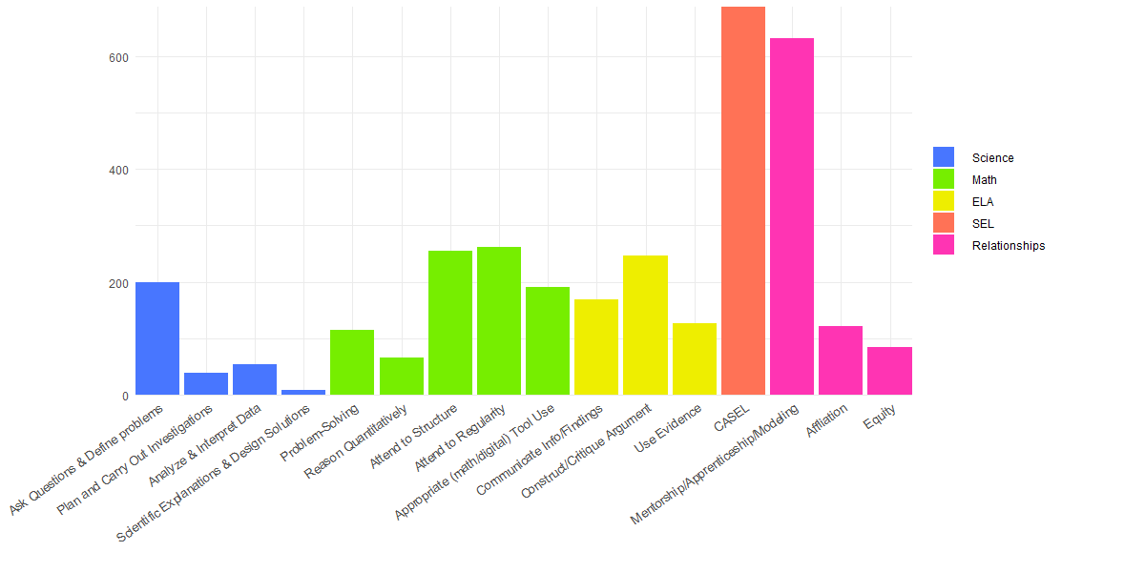
Quantitative Analysis
YEAR ONE RESEARCH
Reitman, J., Gardner, R., Campbell, K., Cho, A., & Steinkuehler, C. (2020) Academic and Social-Emotional Learning in High School Esports. Proceedings of the Connected Learning Summit, Cambridge MA.
Notes:
Katie

Slide 19
Quantified Findings
YEAR ONE RESEARCH
Notes:
Katie

Slide 20
YEAR ONE RESEARCH
Notes:
Katie

Slide 21
YEAR ONE RESEARCH
Notes:
Katie

Slide 22

How DOES NASEF COMPARE
TO OTHER CLUBS?
Notes:
Katie

Slide 23
YEAR TWO RESEARCH
Notes:
Katie

Slide 24
YEAR TWO RESEARCH
Notes:
Katie

Slide 25
YEAR TWO RESEARCH
Notes:
Katie

Slide 26
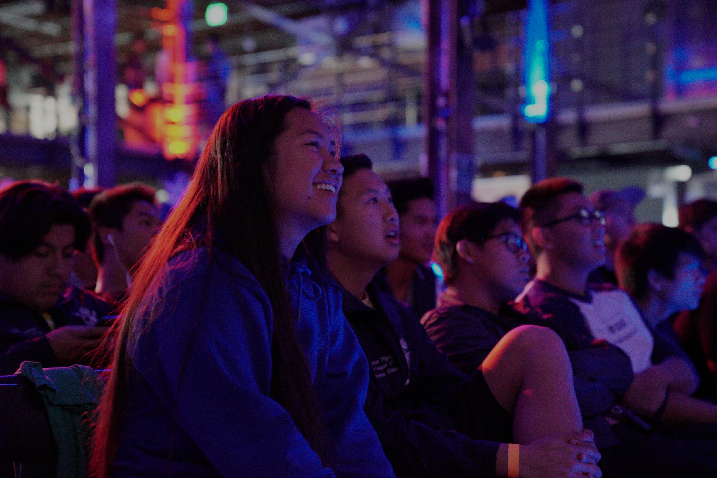
CAN WE DETECT THESE SAME
POSITIVE PATTERNS Directly?
Notes:
Katie

Slide 27

YEAR THREE RESEARCH
T1 T2
Quasi-Experimental: Pretest/posttest design (natural groups)
Analysis: Within-subject comparisons (not between-subjects)
Notes:
Katie

Slide 28

Research Halted
Research Drive
Notes:
CONSTANCE

Slide 29
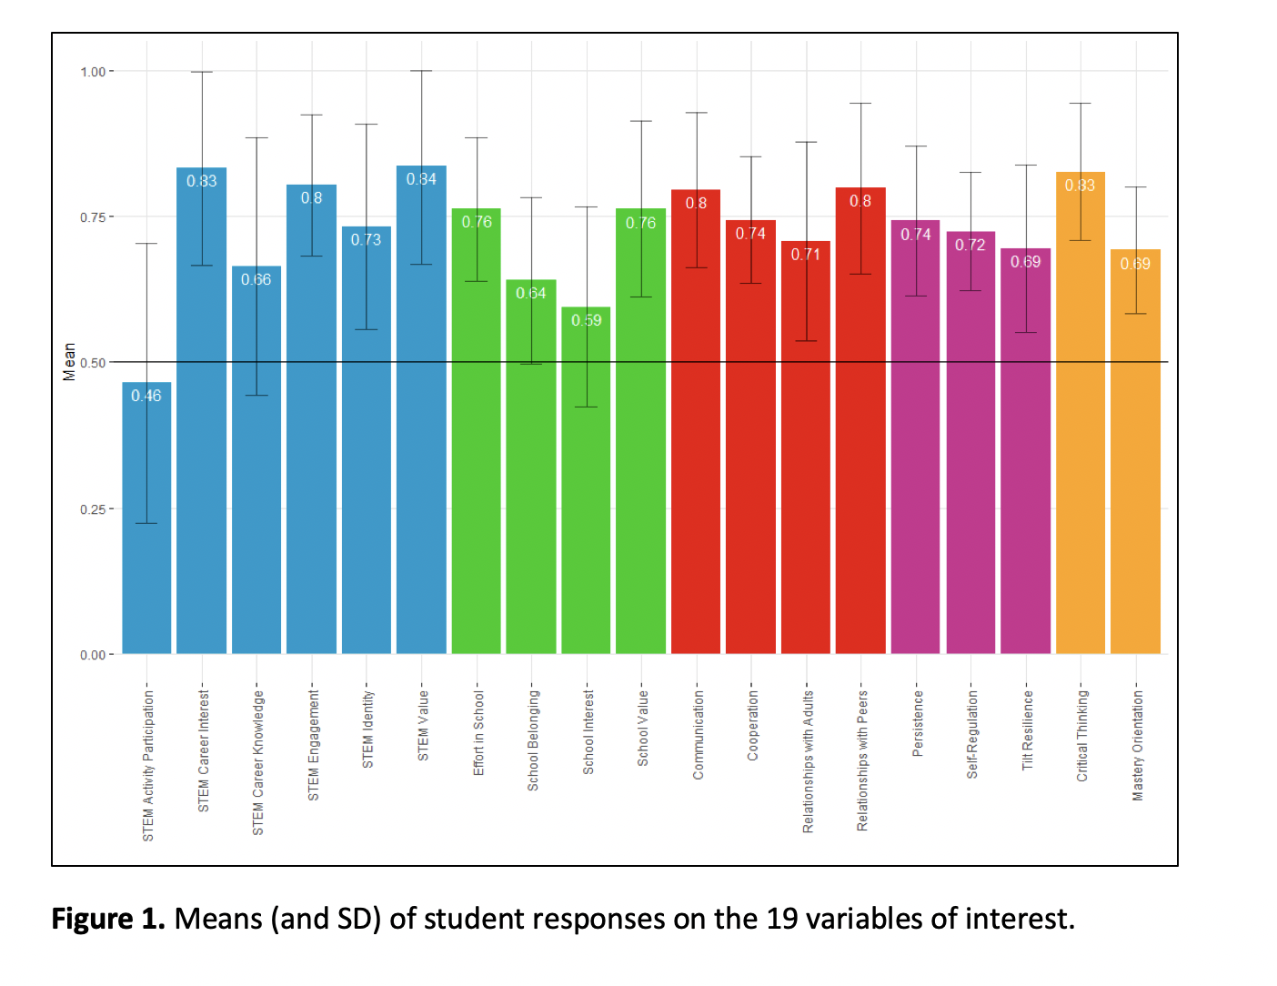
YEAR THREE RESEARCH
Data collection halted at n=82 / 350
******************
Notes:
Katie

Slide 30
What features of NASEF contribute
to these positive gains?
Notes:
CONSTANCE

Slide 31
LOoKING BACK TO YEAR ONE…
Notes:
Katie

Slide 32
LOoKING BACK TO YEAR ONE…
Notes:
Katie

Slide 33
LOoKING BACK TO YEAR ONE…
Notes:
Katie

Slide 34
Looking BACK TO YEAR ONE…
Notes:
Katie

Slide 35
LOoKING BACK TO YEAR ONE…
Notes:
Katie

Slide 36
Equity?
Notes:
Where are…
Women
Students of color
varying disability
sexual orientation?

Slide 37
YEAR FOUR RESEARCH (ONGOING)
Research questions
What are students’ attitudes toward the NASEF program & its features?
What are the impacts of the NASEF program on students’
  Self-Regulation
  Communication
  Relationships
  Wellness
Are outcomes equitable across SES, gender, ethnicity, ability, sexual orientation?
What program features impact student outcomes?
Student Length in Program
Student Time Investment
Extent of Program (student roles
filled, # activities, # resources used)
  STEM Interest
  School Engagement
  GPA & school attendance
  Constructive Mindset
  Curriculum Implemented at club site
  GM assessment of impact
  GM satisfaction
  Coaches
Notes:
Students generate examples of each.
What aesthetics apply to Civ?

Slide 38
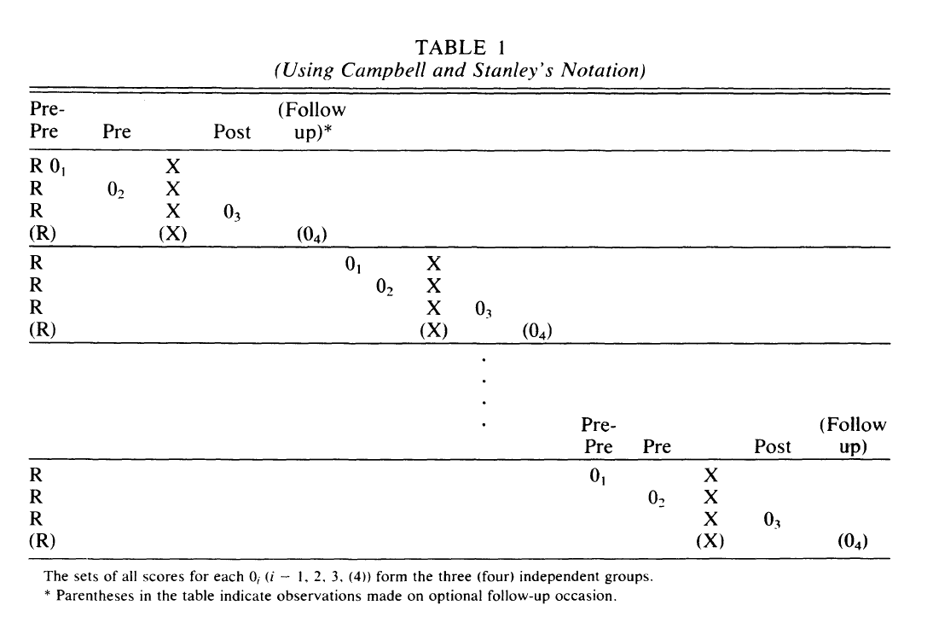
YEAR FOUR RESEARCH (ONGOING)
Research questions
Alternative One Sample Pretest-Posttest Design (Johnson, 1986)
  4 groups (n=50) x 2 league seasons, each randomly assigned to time of survey observation, to allow for stronger causal claim
Notes:
Students generate examples of each.
What aesthetics apply to Civ?

Slide 39
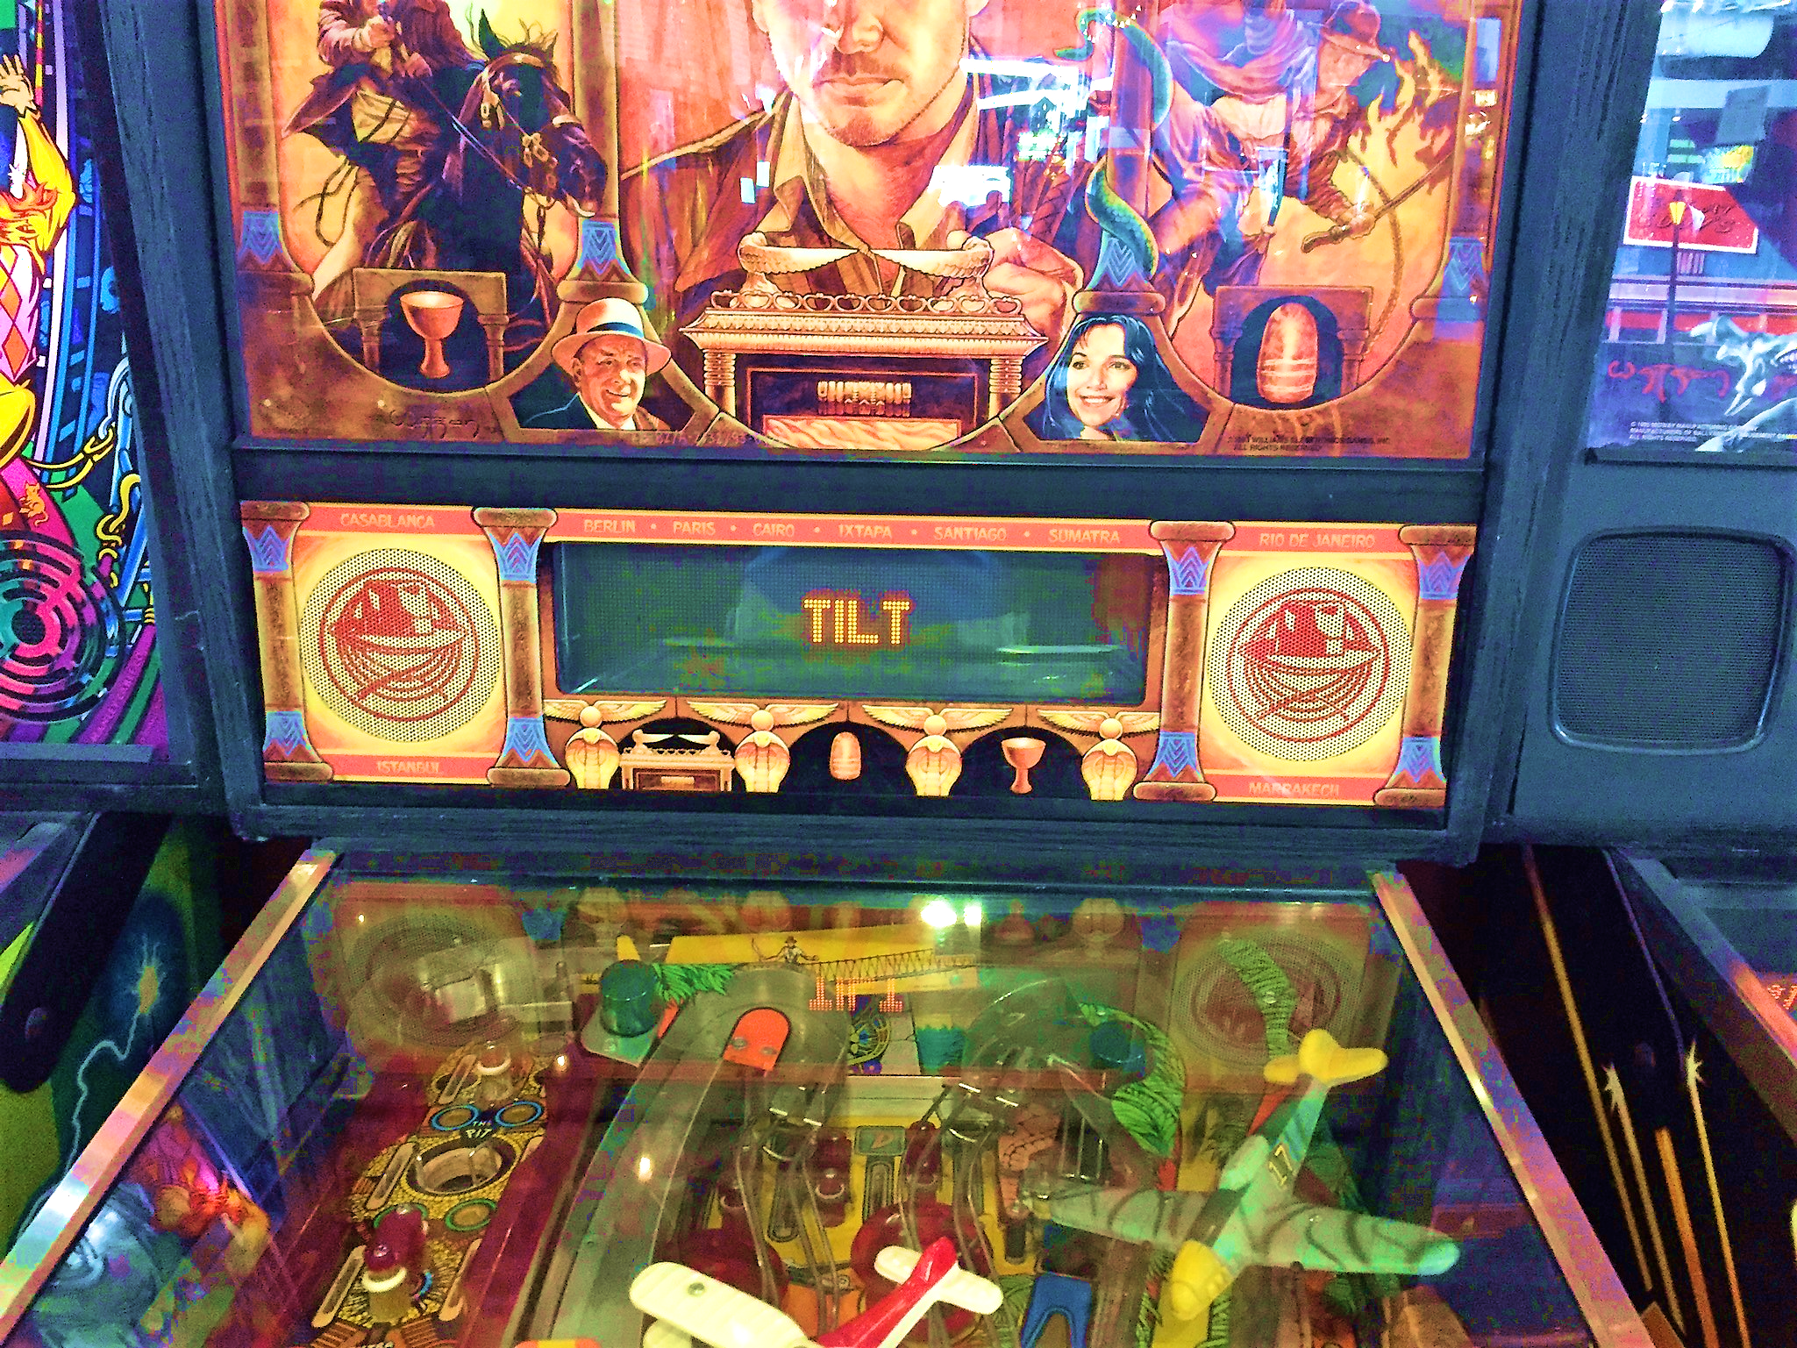
pinball
Image Source: OffTheLeash
“Tilt Tilt” by Dice.com via Flickr [CC BY-NC-ND 2.0]

Slide 40
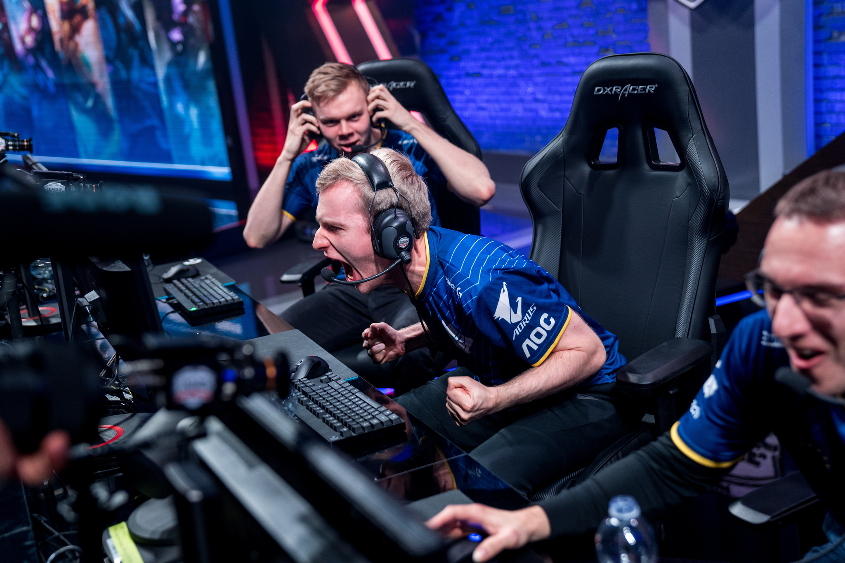
Image Source: Riot Games

Slide 41
LOoKING BACK TO LAST YEAR…
Research questions
How do players define tilt?
What triggers tilt?
What responses do players have?
Do they view tilt as malleable?
H1. Different triggers → different tilt responses
H2. Beliefs about tilt’s malleability → tilt response

Slide 42
LOoKING BACK TO LAST YEAR…
TILT STUDY
Design: Mixed methods research
Instruments: Player surveys & staff interviews
Sample: 95 players and 8 staff (n=103)
Analysis: Inductive coding, 3 researchers independently,
all discrepancies negotiated
What words do you associate with tilt? (open response)
What gets you tilted? (open response)
When you feel tilted, what do you do? (open response)
Do you think you can change how easily you get tilted? (Y/N/IDK)

Slide 43
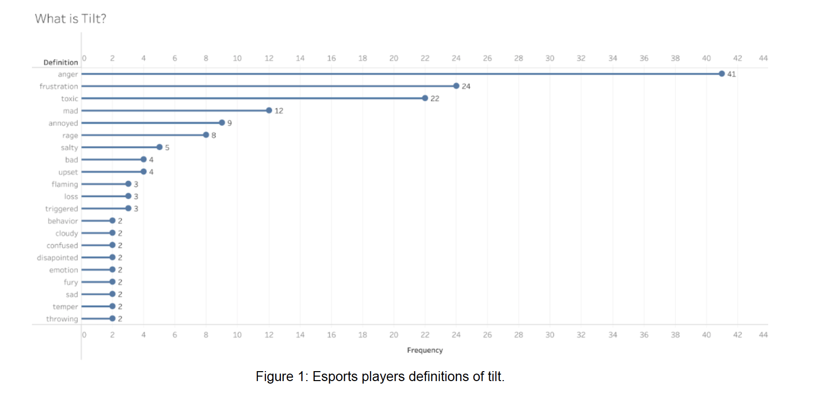
LOoKING BACK TO LAST YEAR…
TILT DEFINITION
emotional component
behavioral component
Wu, M., Lee, J.S. & Steinkuehler, C. (2021). Understanding Tilt in Esports. CHI Proceedings.

Slide 44
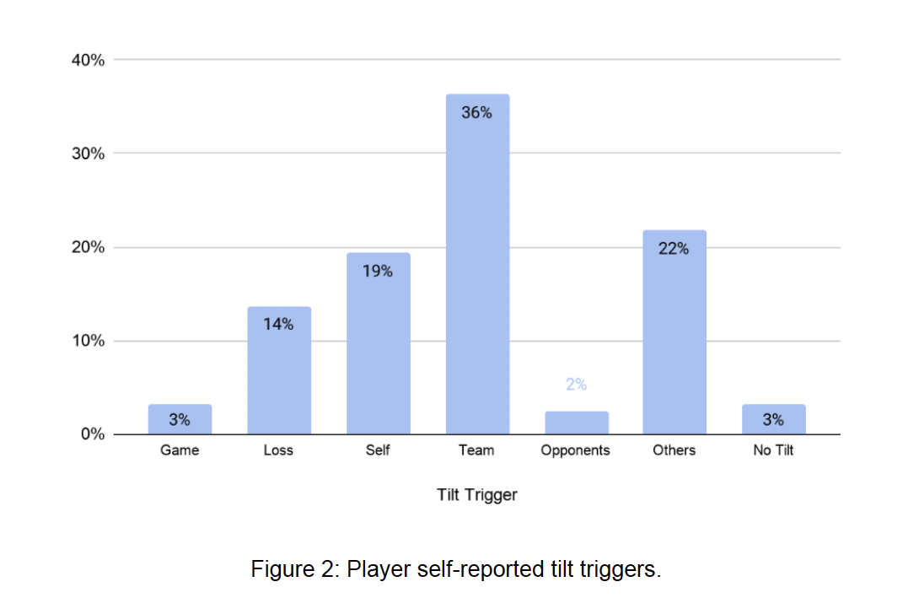
LOoKING BACK TO LAST YEAR…
TILT TRIGGERS
*
*
*
Wu, M., Lee, J.S. & Steinkuehler, C. (2021). Understanding Tilt in Esports. CHI Proceedings.
Notes:
One’s own team
Other players in general
Self

Slide 45
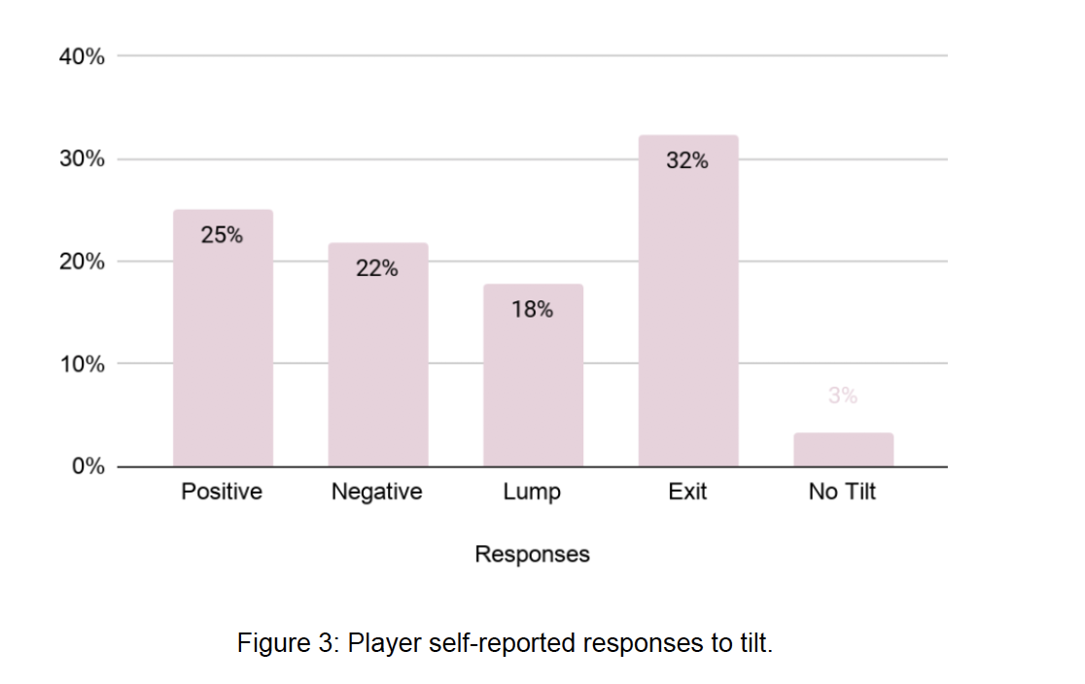
LOoKING BACK TO LAST YEAR…
TILT RESPONSES
*
*
!
*
Wu, M., Lee, J.S. & Steinkuehler, C. (2021). Understanding Tilt in Esports. CHI Proceedings.
Notes:
Exit (+)

Slide 46
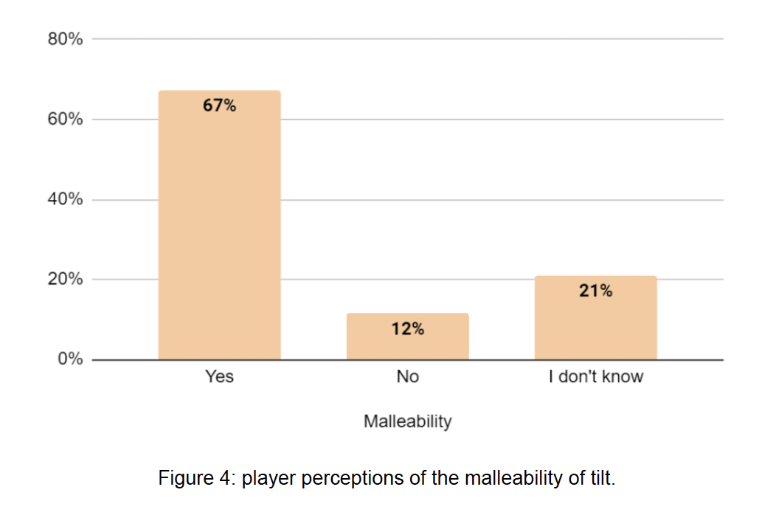
LOoKING BACK TO LAST YEAR…
TILT Malleability
Wu, M., Lee, J.S. & Steinkuehler, C. (2021). Understanding Tilt in Esports. CHI Proceedings.

Slide 47
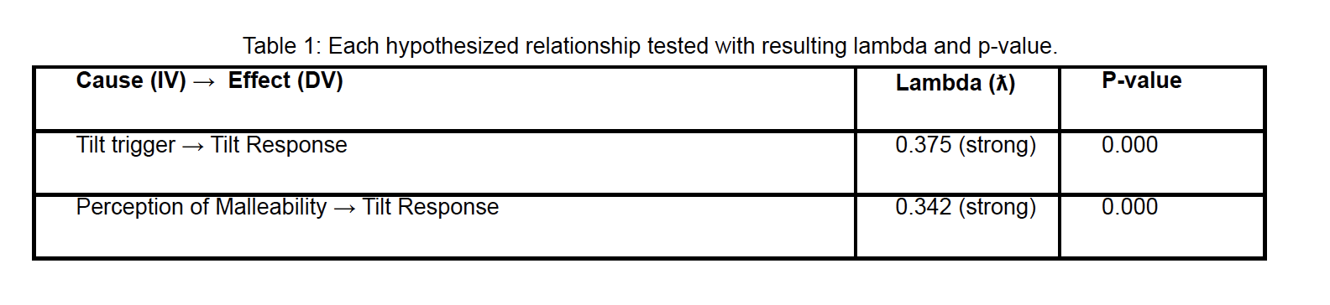
BOtH Hypotheses confirmed
LOoKING BACK TO LAST YEAR…
Wu, M., Lee, J.S. & Steinkuehler, C. (2021). Understanding Tilt in Esports. CHI Proceedings.
Notes:
Measure of association for nominal variables, PRE, ranges 0-1
weak: 0.01 – 0.09
Moderate: 0.10 – 0.29
Strong: 0.30 – 0 .99

Slide 48
BOtH Hypotheses confirmed
LOoKING BACK TO LAST YEAR…
*
Different types of triggers elicit different types of responses.
Wu, M., Lee, J.S. & Steinkuehler, C. (2021). Understanding Tilt in Esports. CHI Proceedings.
Notes:
Measure of association for nominal variables, PRE, ranges 0-1
weak: 0.01 – 0.09
Moderate: 0.10 – 0.29
Strong: 0.30 – 0 .99

Slide 49
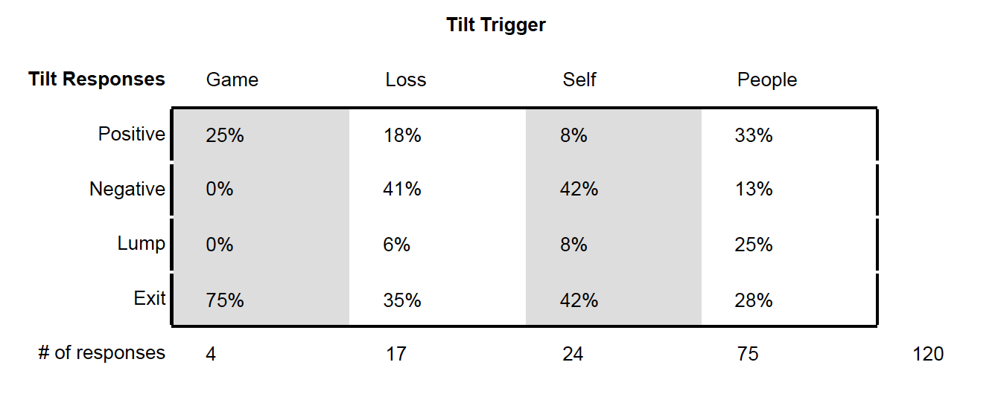
LOoKING BACK TO LAST YEAR…
H1. Different triggers →
different responses
Wu, M., Lee, J.S. & Steinkuehler, C. (2021). Understanding Tilt in Esports. CHI Proceedings.
Notes:
Exit (+)

Slide 50
LOoKING BACK TO LAST YEAR…
H1. Different triggers →
different responses
Players’ harshest responses are reserved for themselves while their best efforts at containing frustration are reserved for other people.
Wu, M., Lee, J.S. & Steinkuehler, C. (2021). Understanding Tilt in Esports. CHI Proceedings.
Notes:
Exit (+)

Slide 51
Hypotheses confirmed
LOoKING BACK TO LAST YEAR…
*
Beliefs about tilt’s malleability determine how one responds to tilt.
Wu, M., Lee, J.S. & Steinkuehler, C. (2021). Understanding Tilt in Esports. CHI Proceedings.
Notes:
Measure of association for nominal variables, PRE, ranges 0-1
weak: 0.01 – 0.09
Moderate: 0.10 – 0.29
Strong: 0.30 – 0 .99

Slide 52
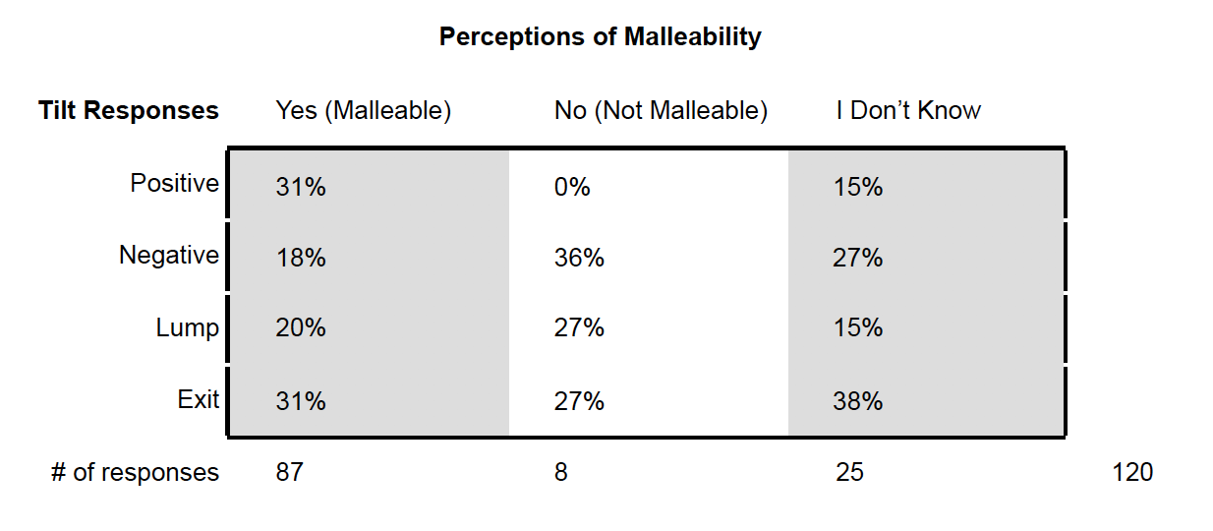
LOoKING BACK TO LAST YEAR…
H1. Beliefs of tilt malleability→
different tilt responses
Wu, M., Lee, J.S. & Steinkuehler, C. (2021). Understanding Tilt in Esports. CHI Proceedings.
Notes:
Exit (+)

Slide 53
LOoKING BACK TO LAST YEAR…
H1. Beliefs of tilt malleability→
different tilt responses
Perceiving tilt as malleable has a positive effect on how players respond when tilted, leading them to choose more positive responses to tilt overall.
Wu, M., Lee, J.S. & Steinkuehler, C. (2021). Understanding Tilt in Esports. CHI Proceedings.
Notes:
Exit (+)

Slide 54
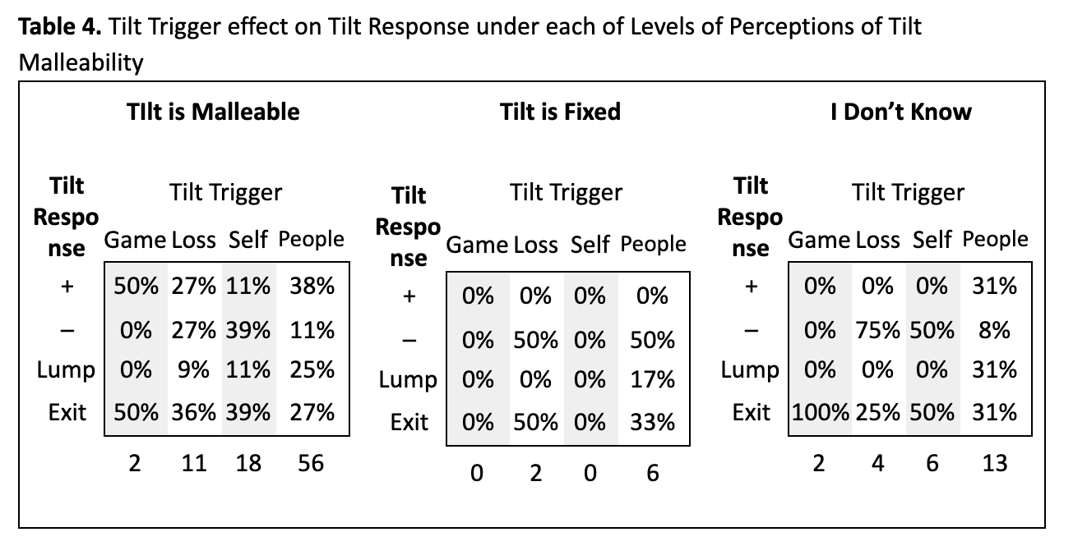
Relationships among variables
LOoKING BACK TO LAST YEAR…
Yet such beliefs do not mollify tilt response when you yourself are trigger.
Wu, M., Lee, J.S. & Steinkuehler, C. (2021). Understanding Tilt in Esports. CHI Proceedings.
Notes:
TILT FIXED: responses shift to negative or exit

Slide 55
So, what now?
Notes:
Where are…
Women
Students of color
varying disability
sexual orientation?

Slide 56
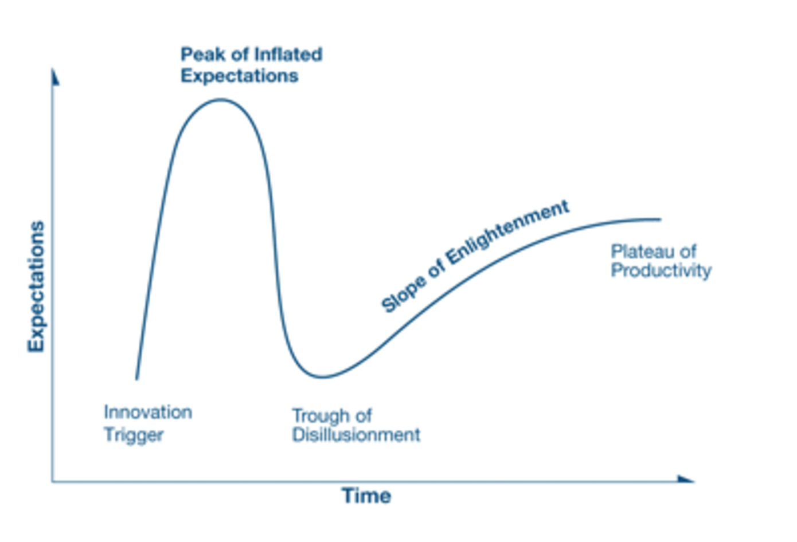
Gartner Hype Cycle
Source: www.gartner.com
Notes:
Mainstream

Slide 57

Gartner Hype Cycle
Source: www.gartner.com
Notes:
Mainstream

Slide 58

Gartner Hype Cycle
Source: www.gartner.com
Notes:
Mainstream

Slide 59


Gartner Hype Cycle
Source: www.gartner.com
Notes:
Senator Jeff Flake
January 2017

Slide 60
Gartner Hype Cycle
Source: www.gartner.com
Notes:
Mainstream

Slide 61


Current stuff
Toxicity: Are online games normalizing hate?
Extremism: what doo we know empirically about exposure and recruitment to alt-crazy groups?
Disinformation: Is critical reasoning the solution or the problem?

