Slide 1
Connect K
Richard Fang
rfangAI

Slide 2
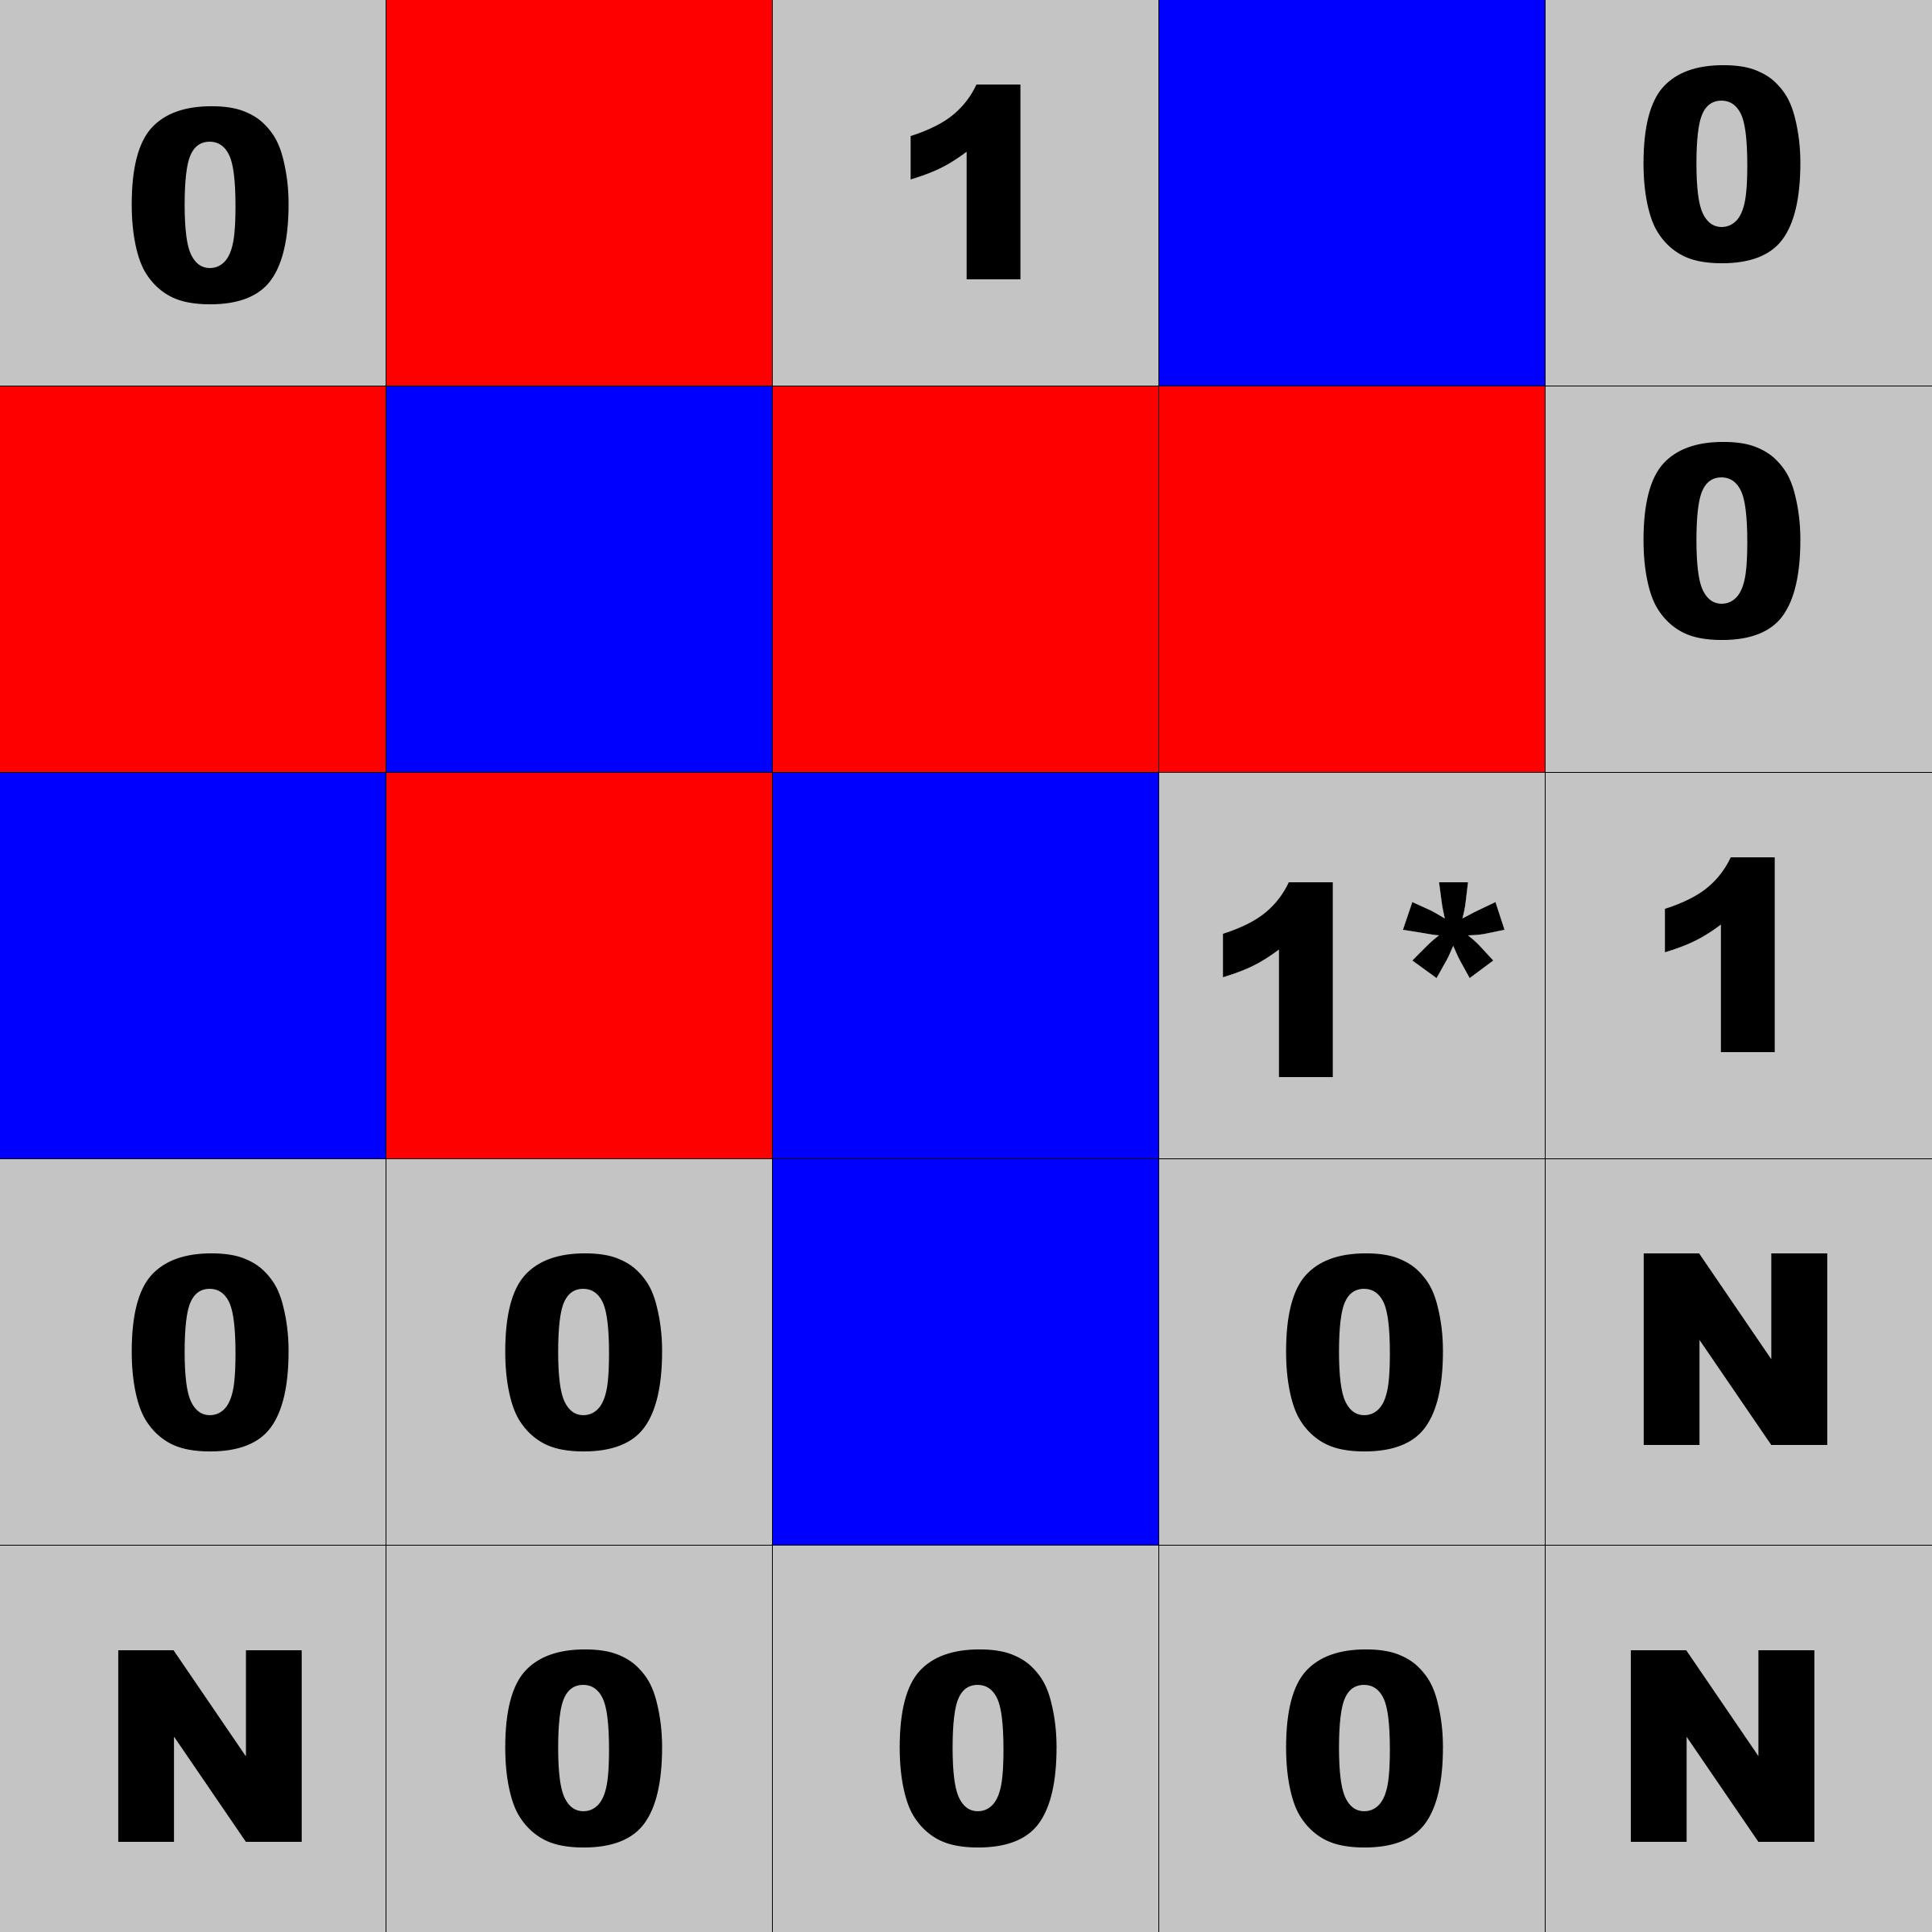
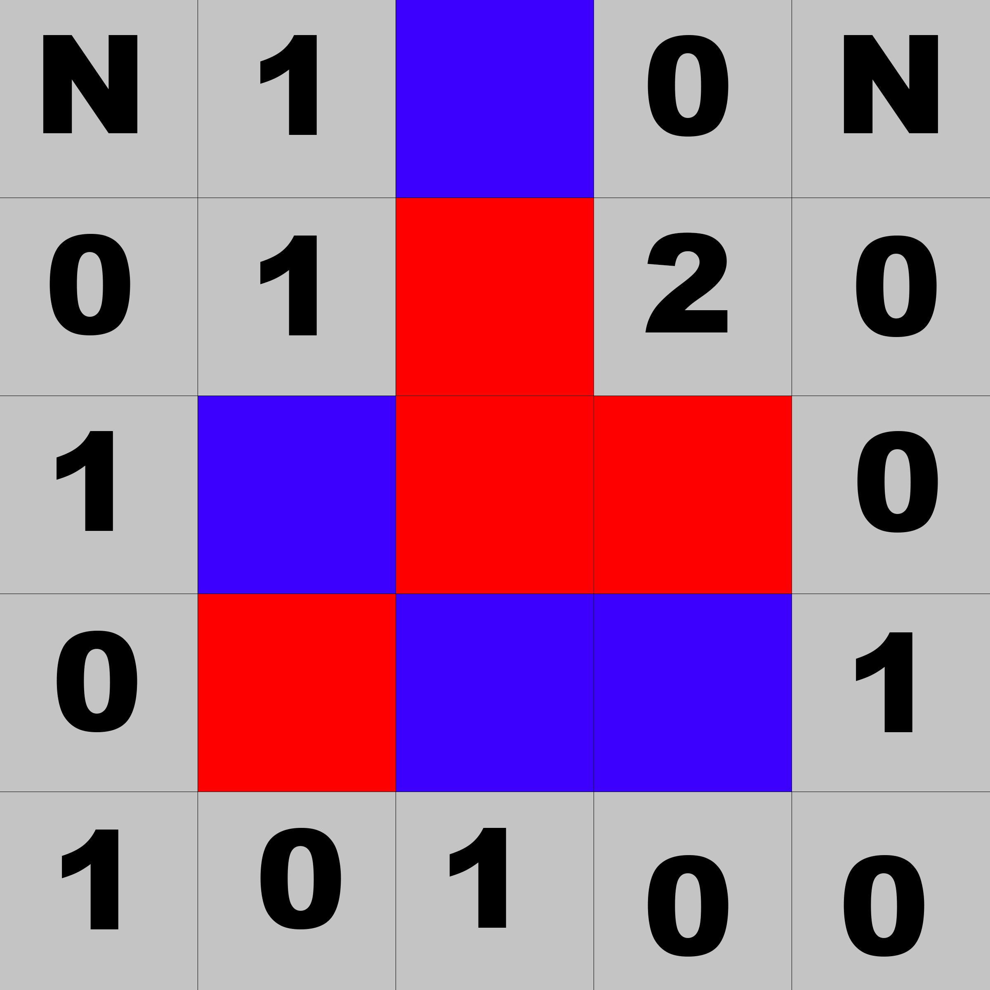
Heuristic
Choose the move that results in the most unblocked (the opponent does not share the same row/col/diagonal) contiguous lines for the player. Weighted by line length
Ex: 5 x 5 , K = 4
next move : red
numbers are the number of lines
* even though it is the same length as the other moves, the resulting line is longer.

Slide 3
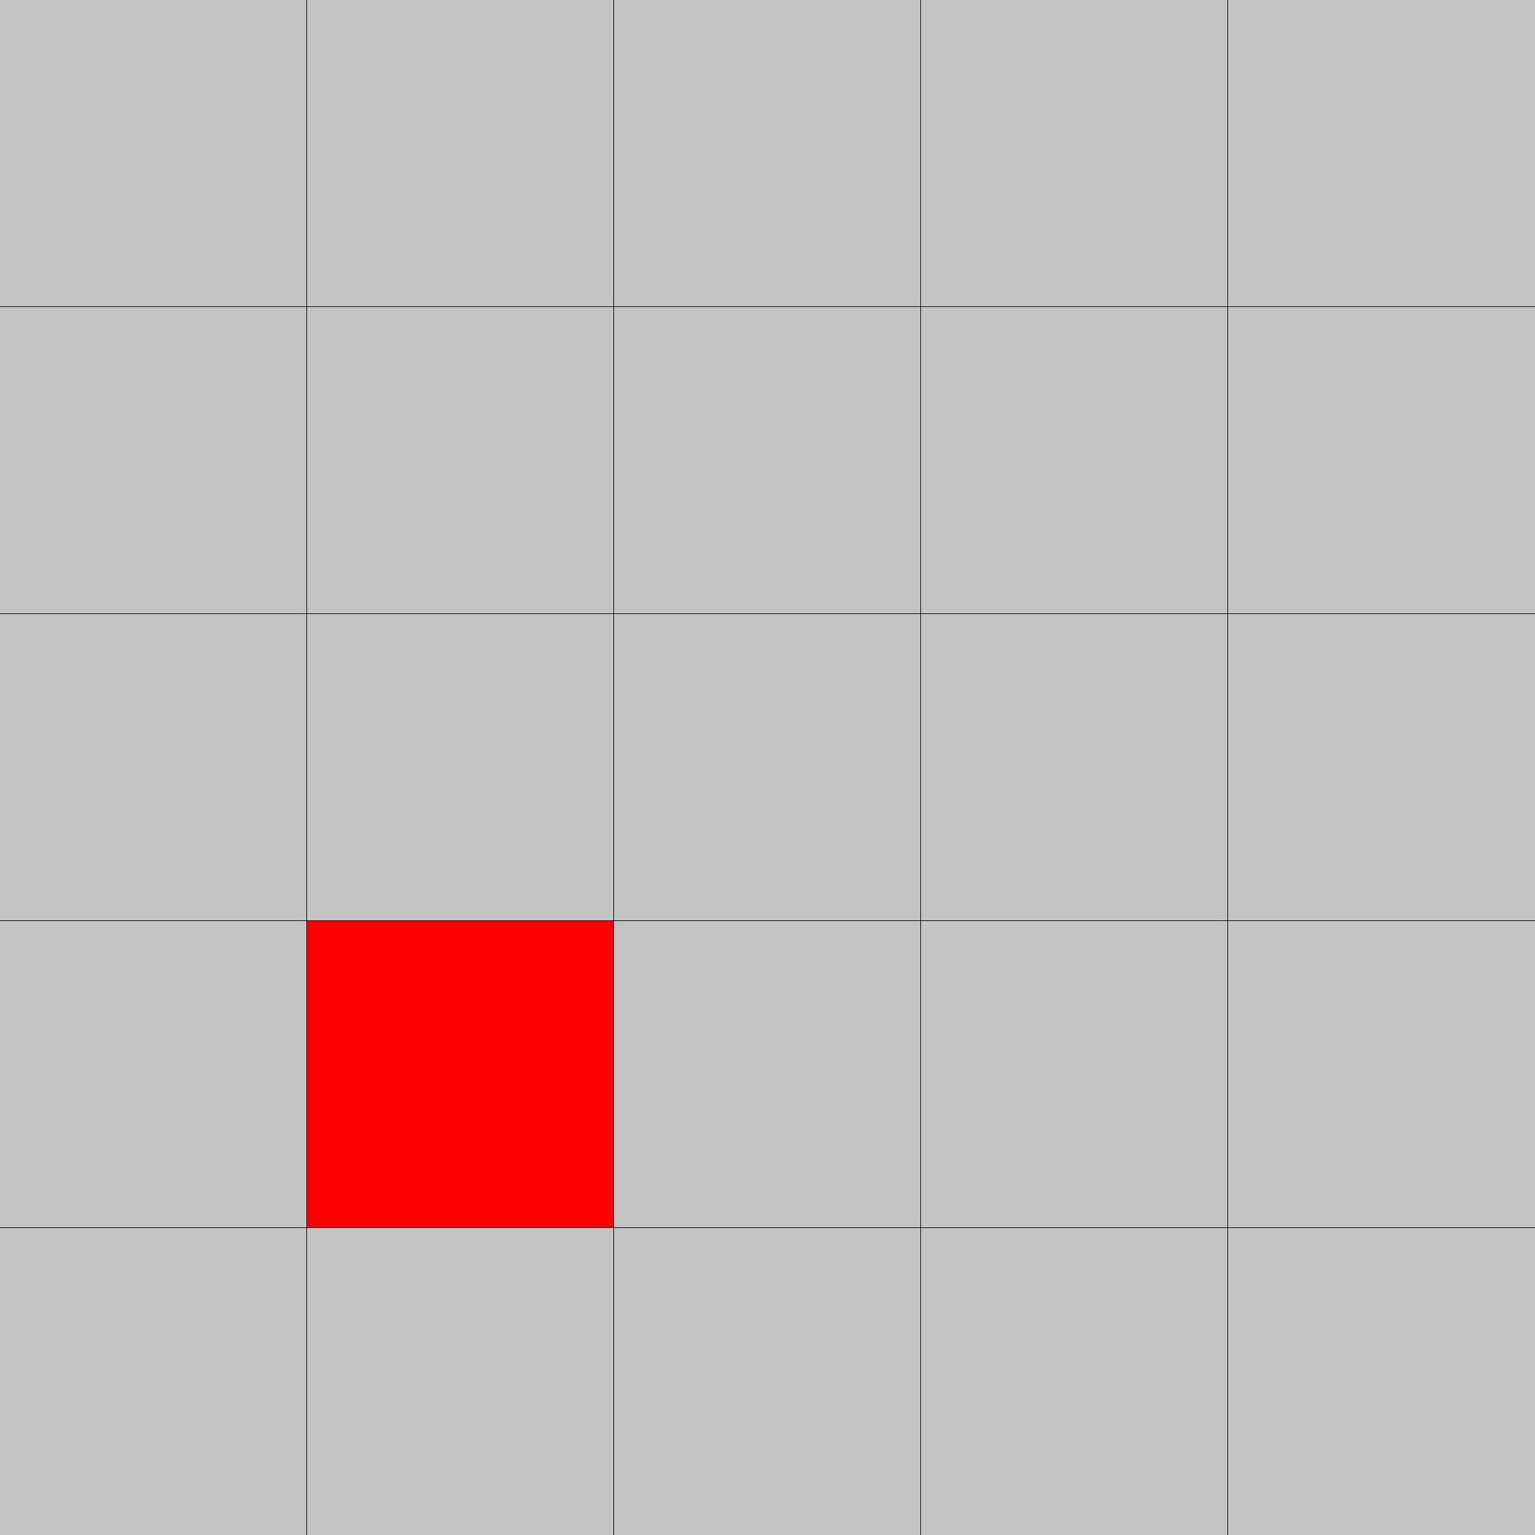
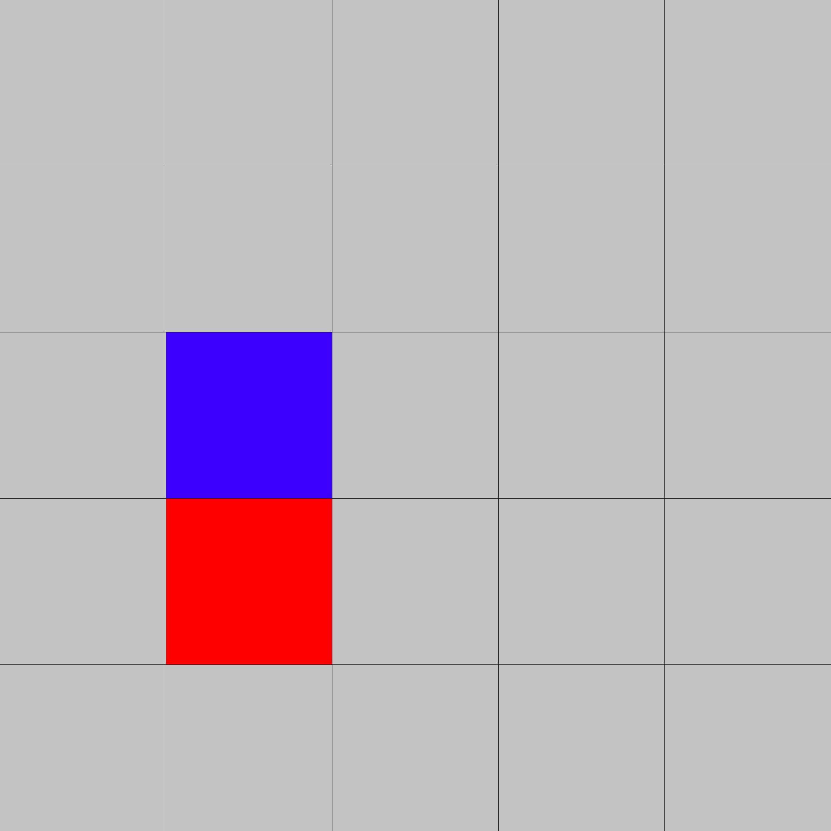
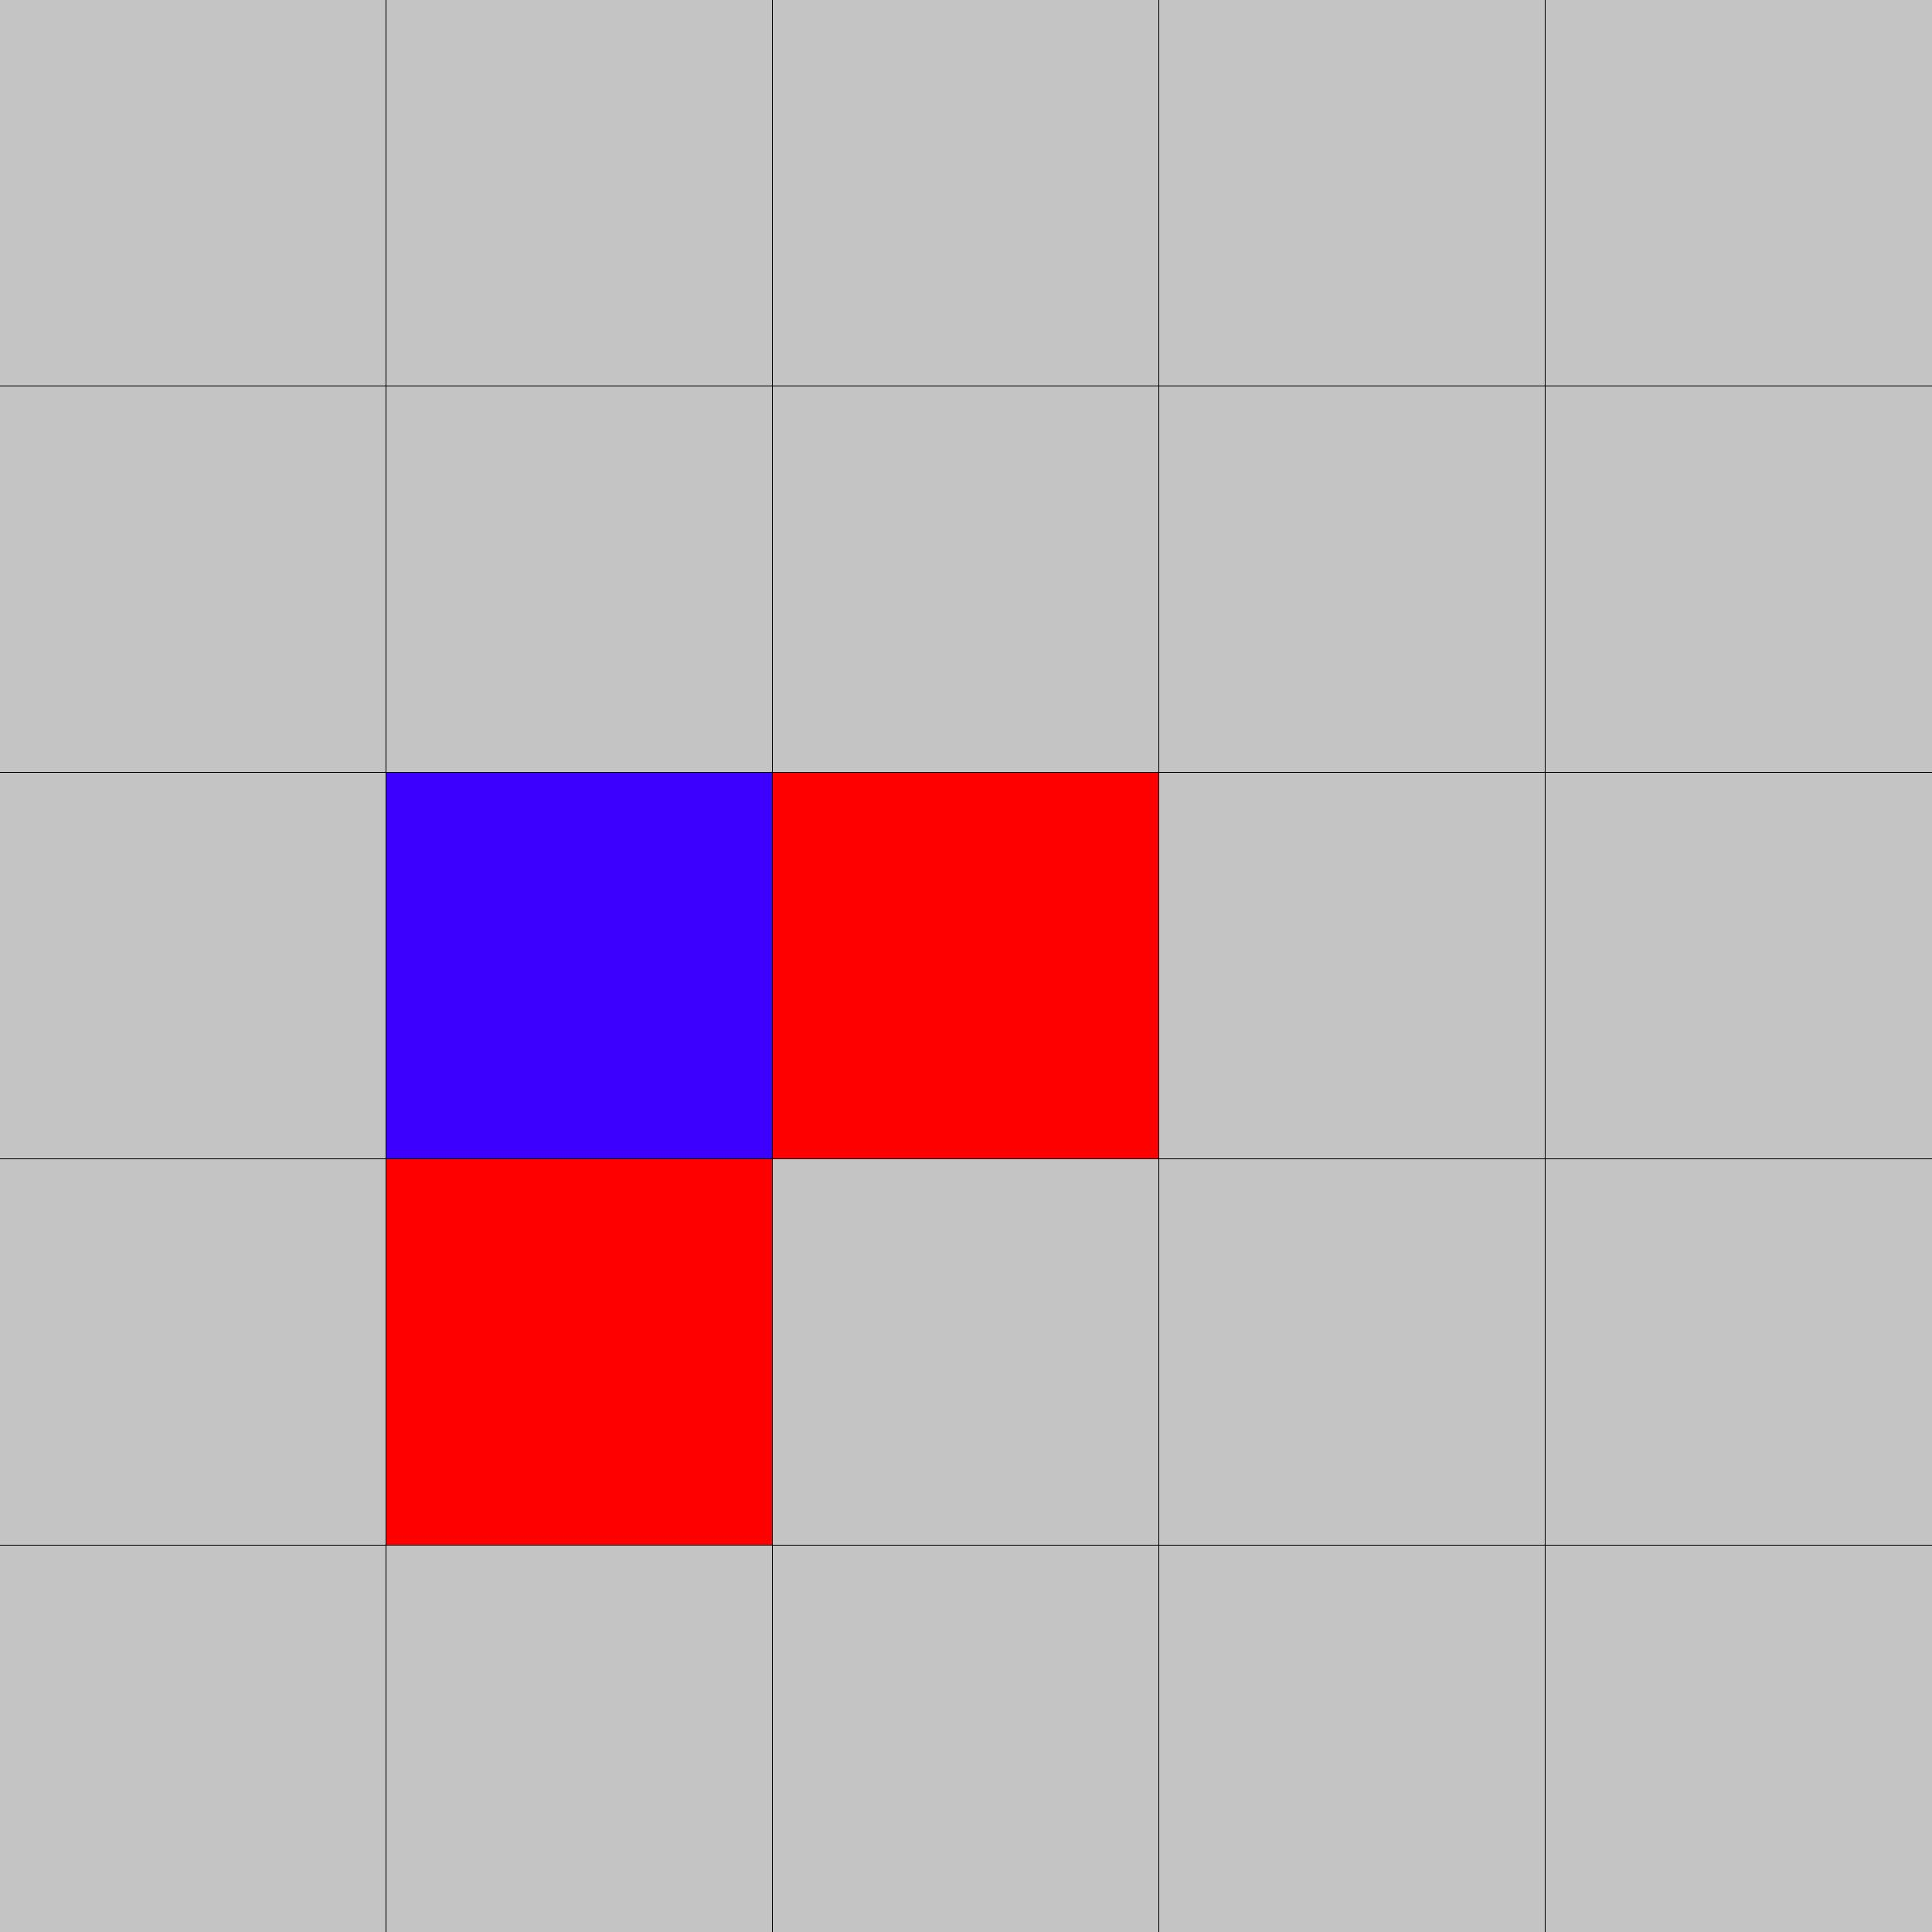
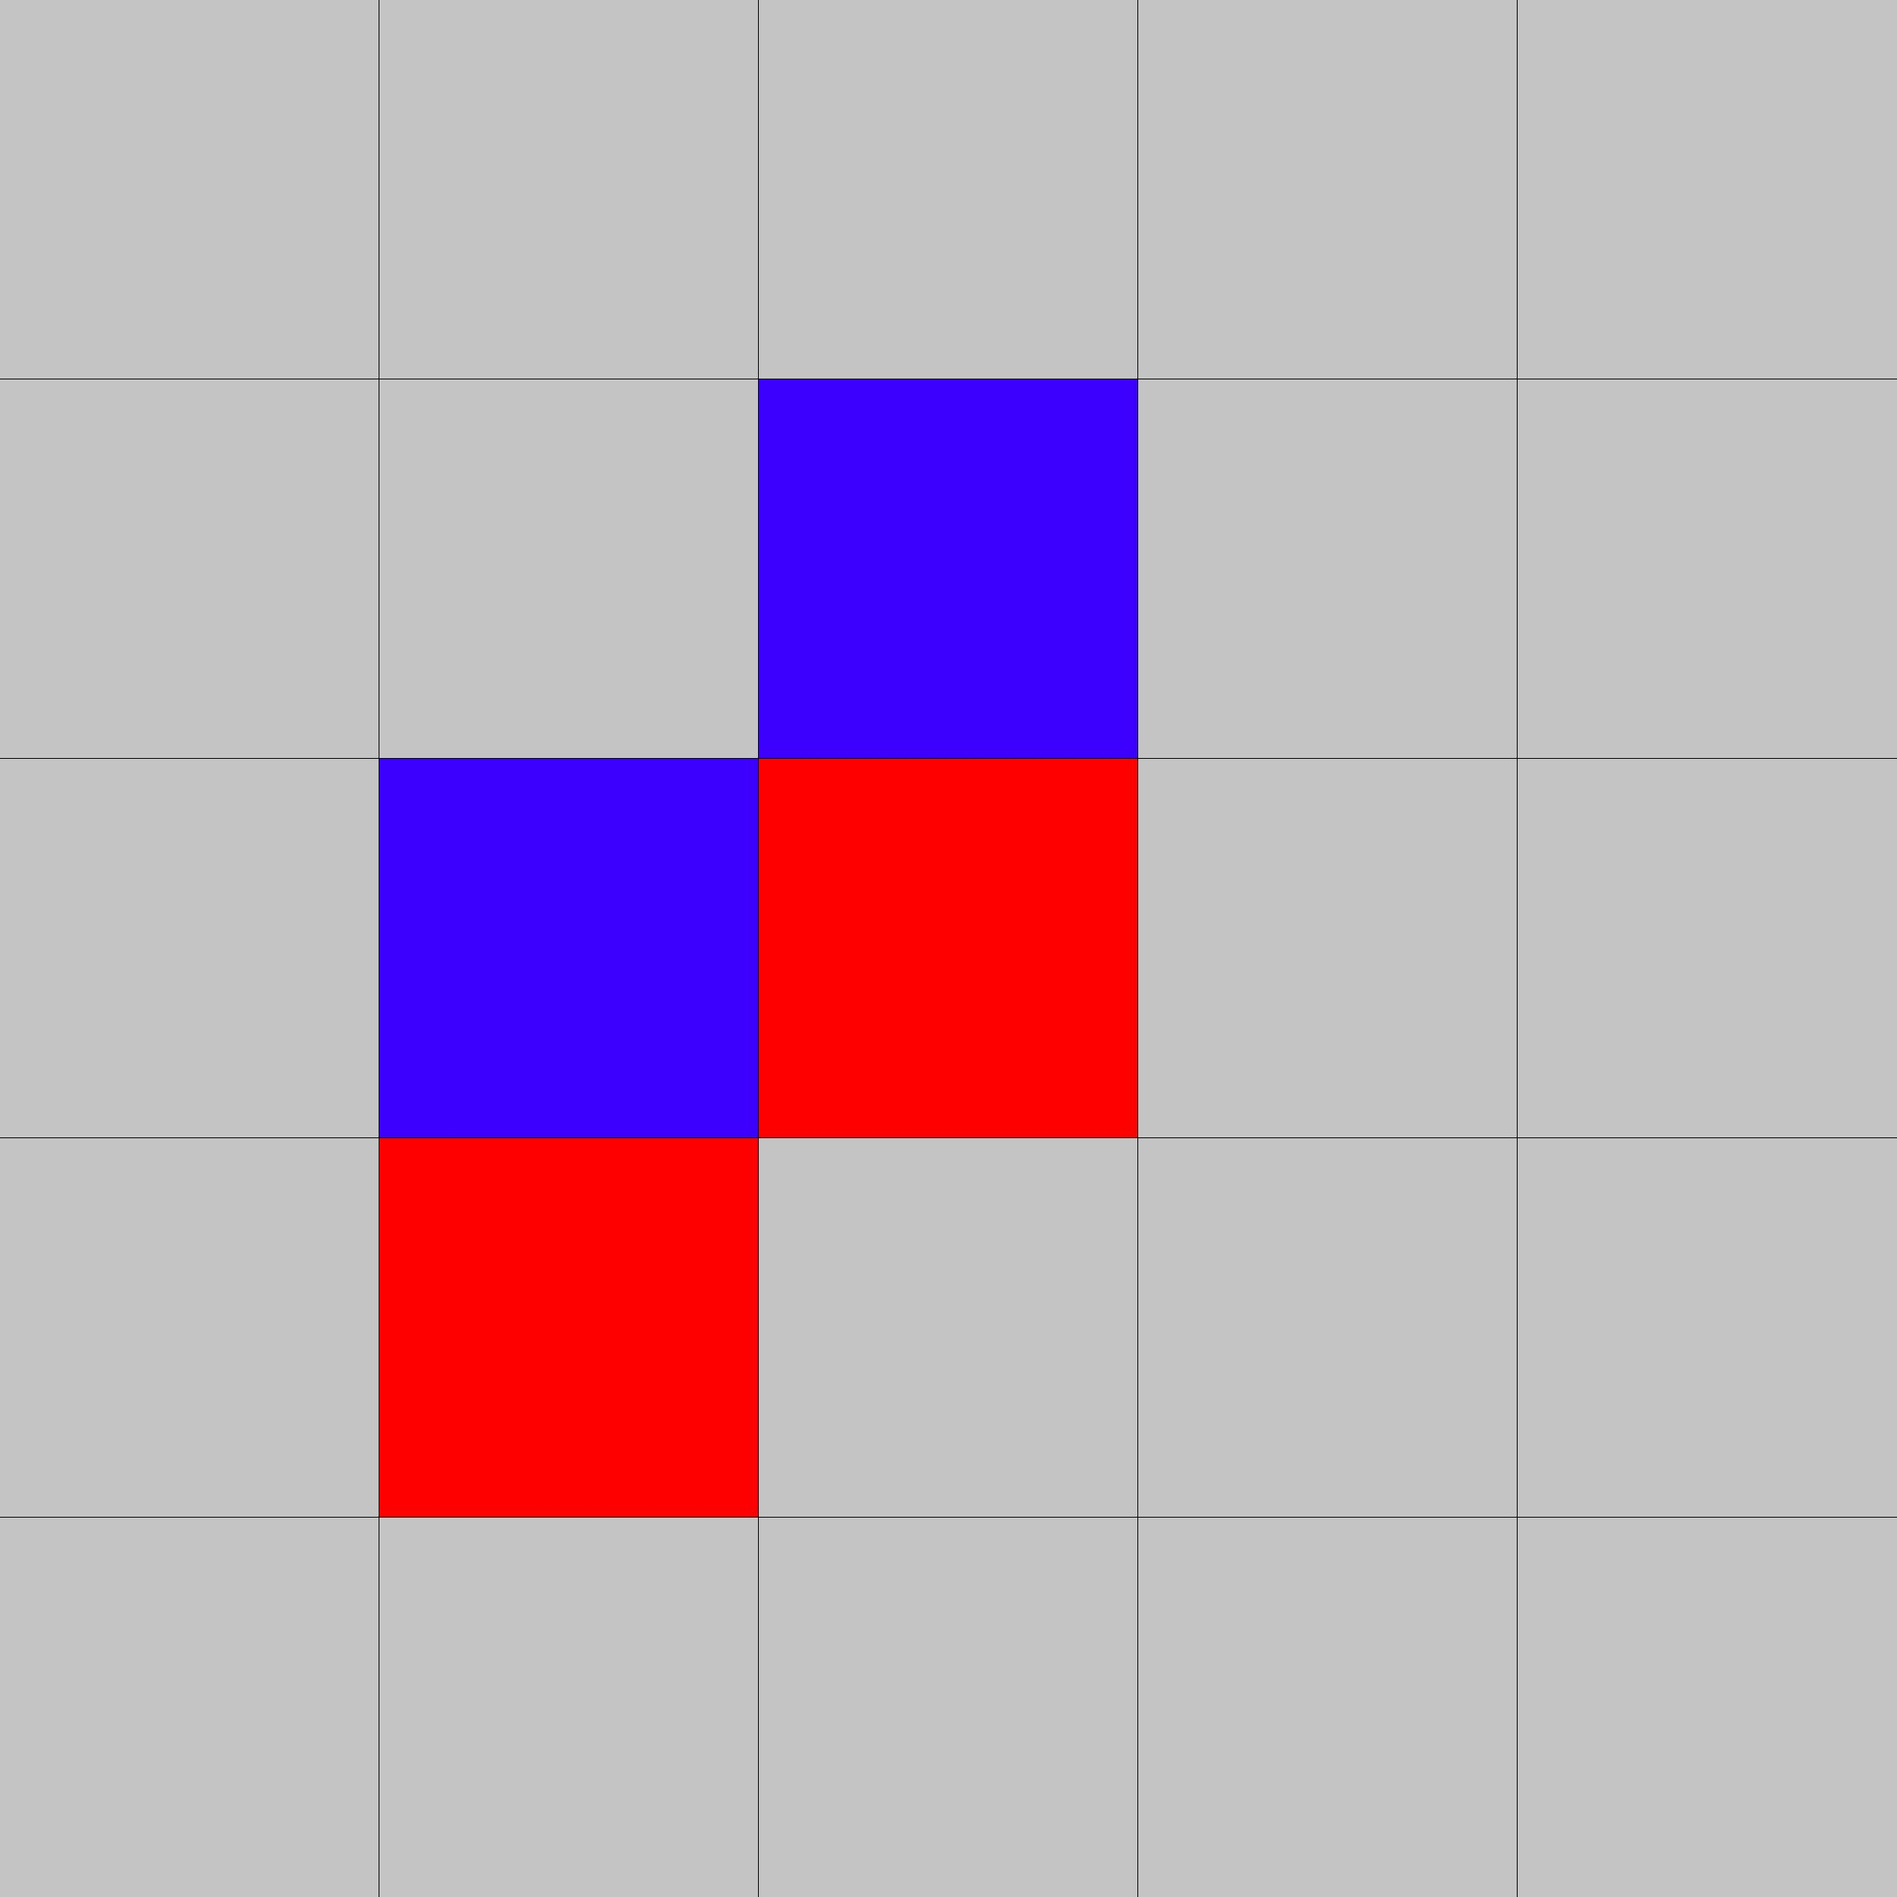
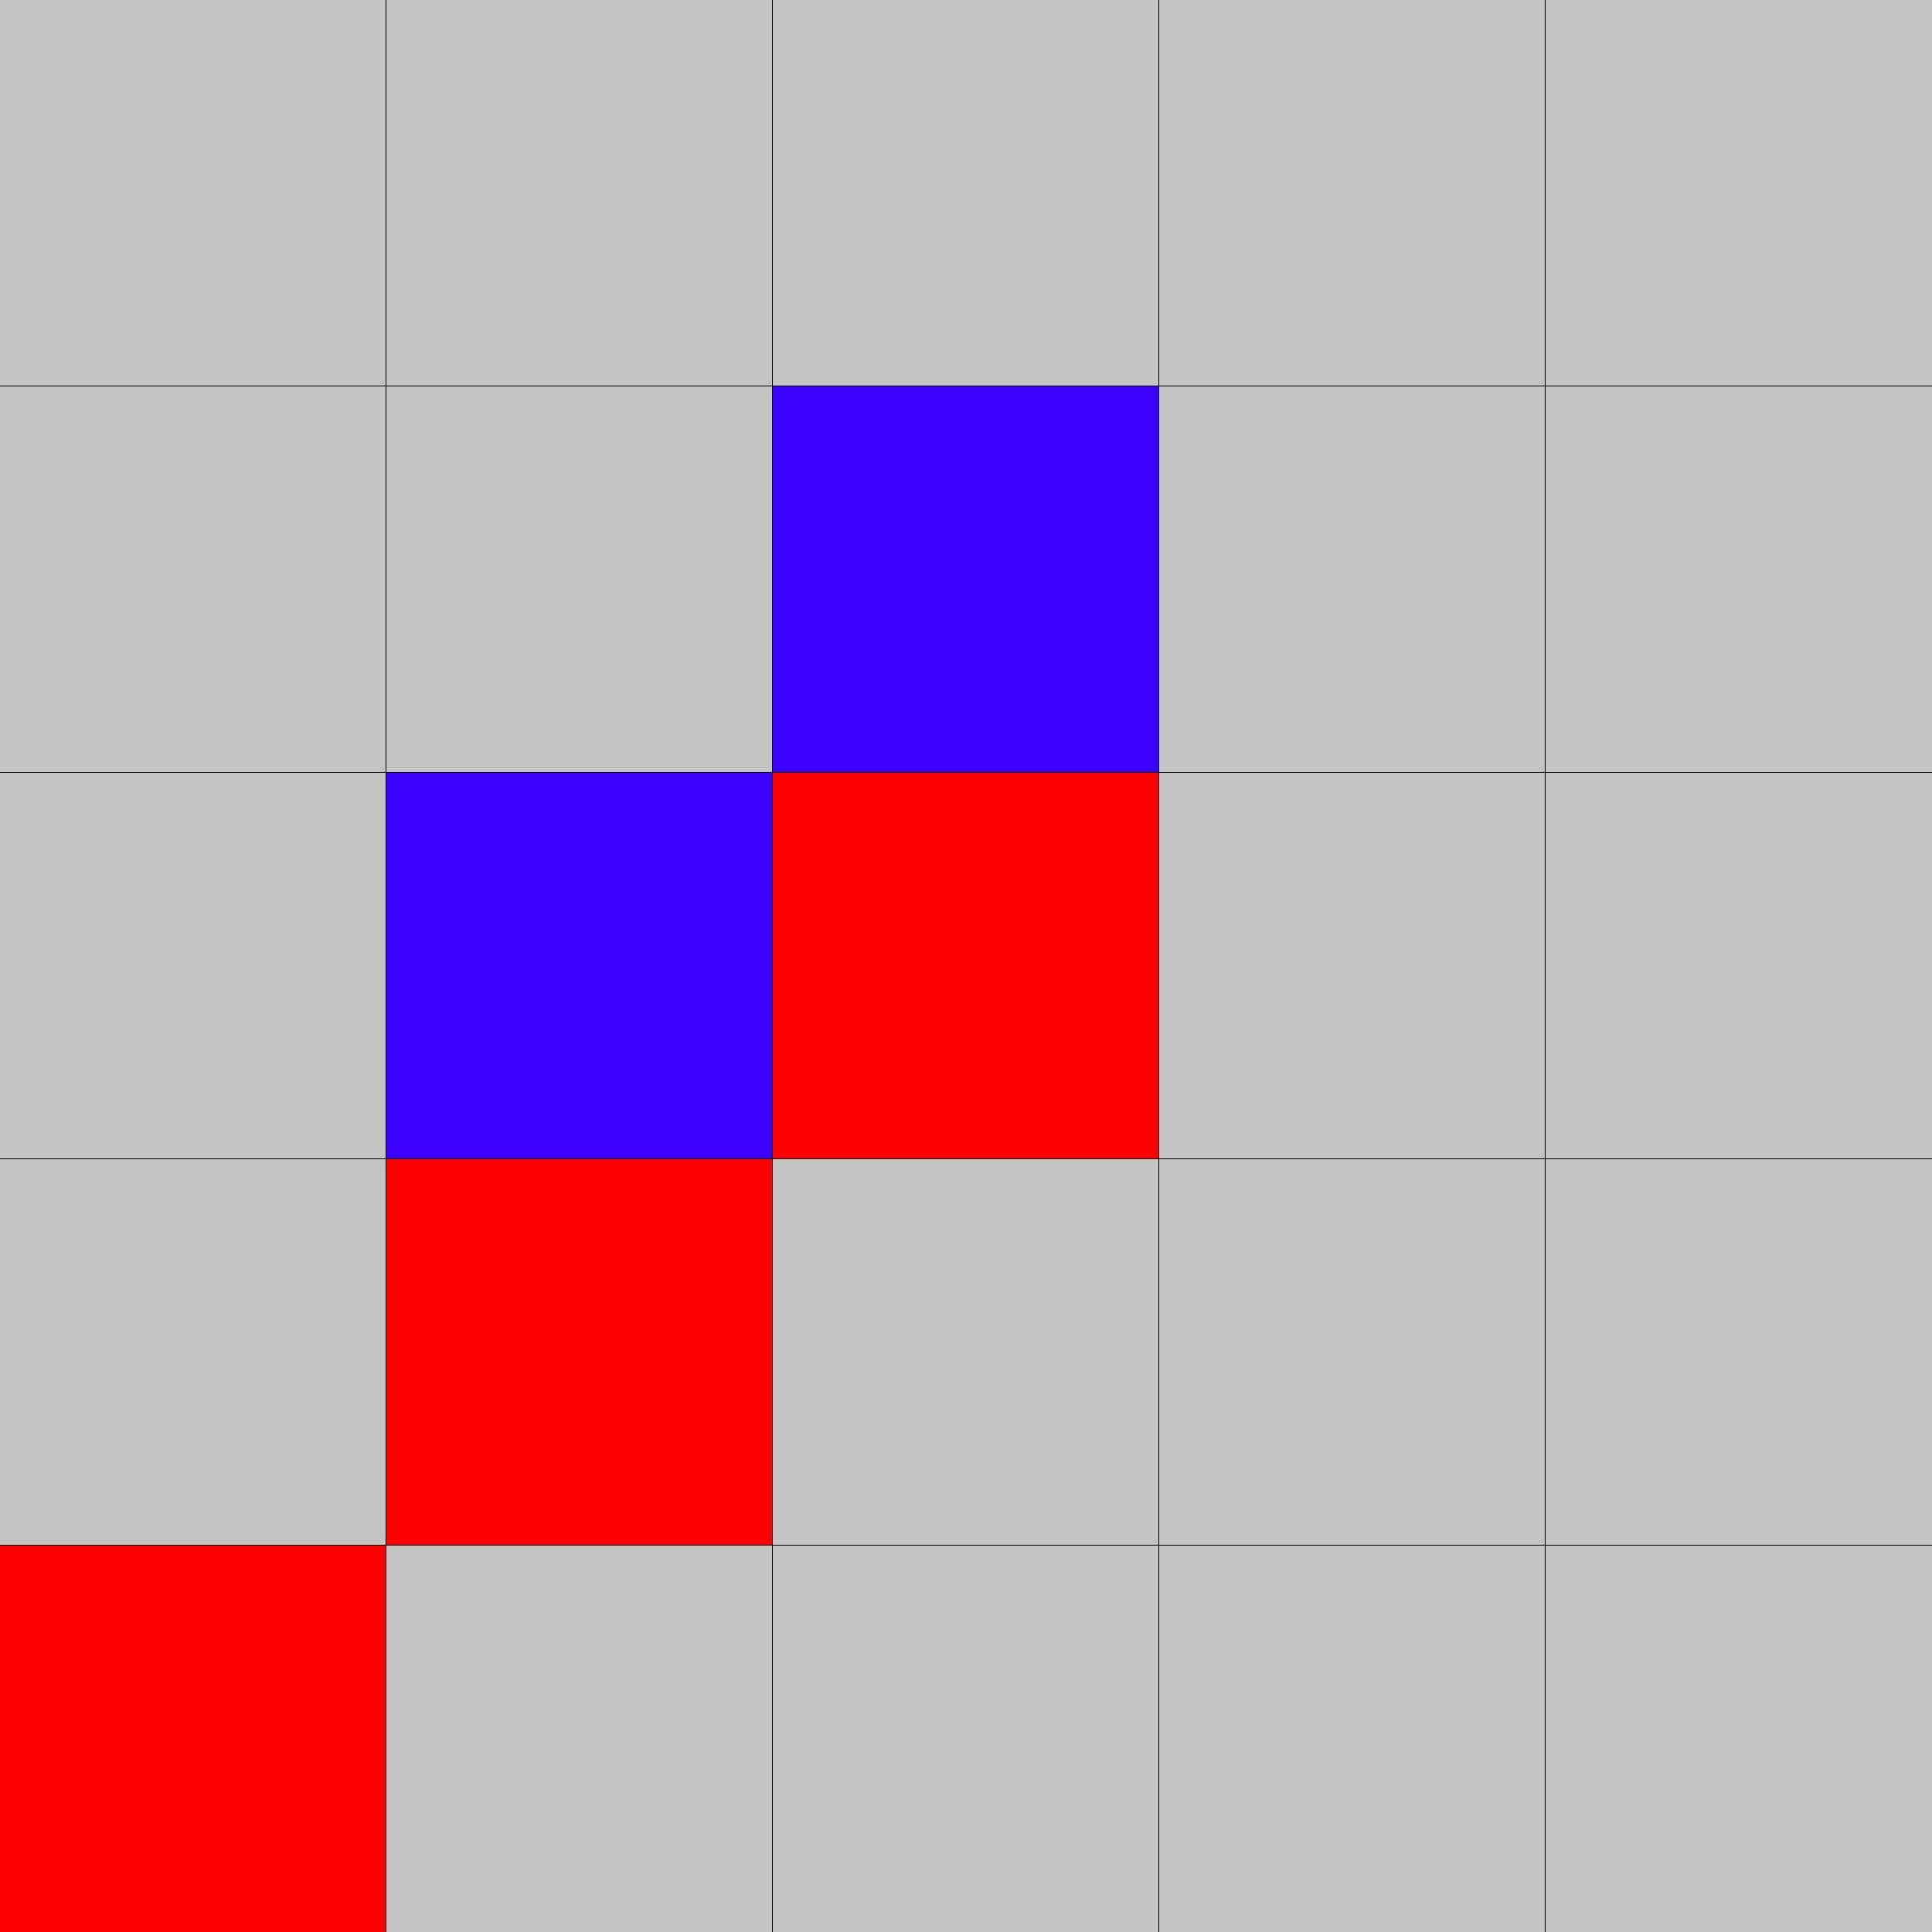
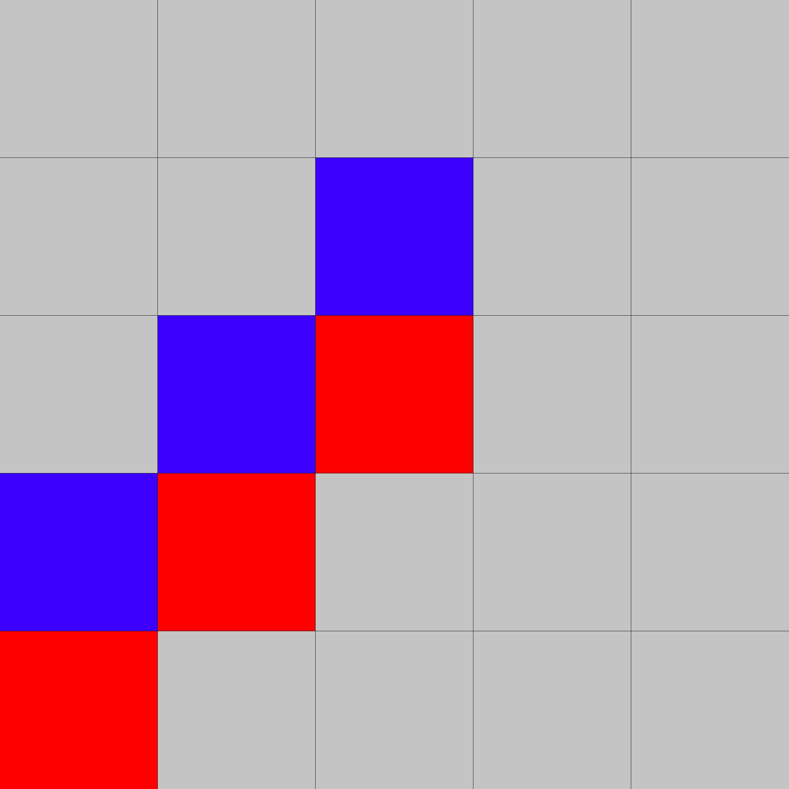
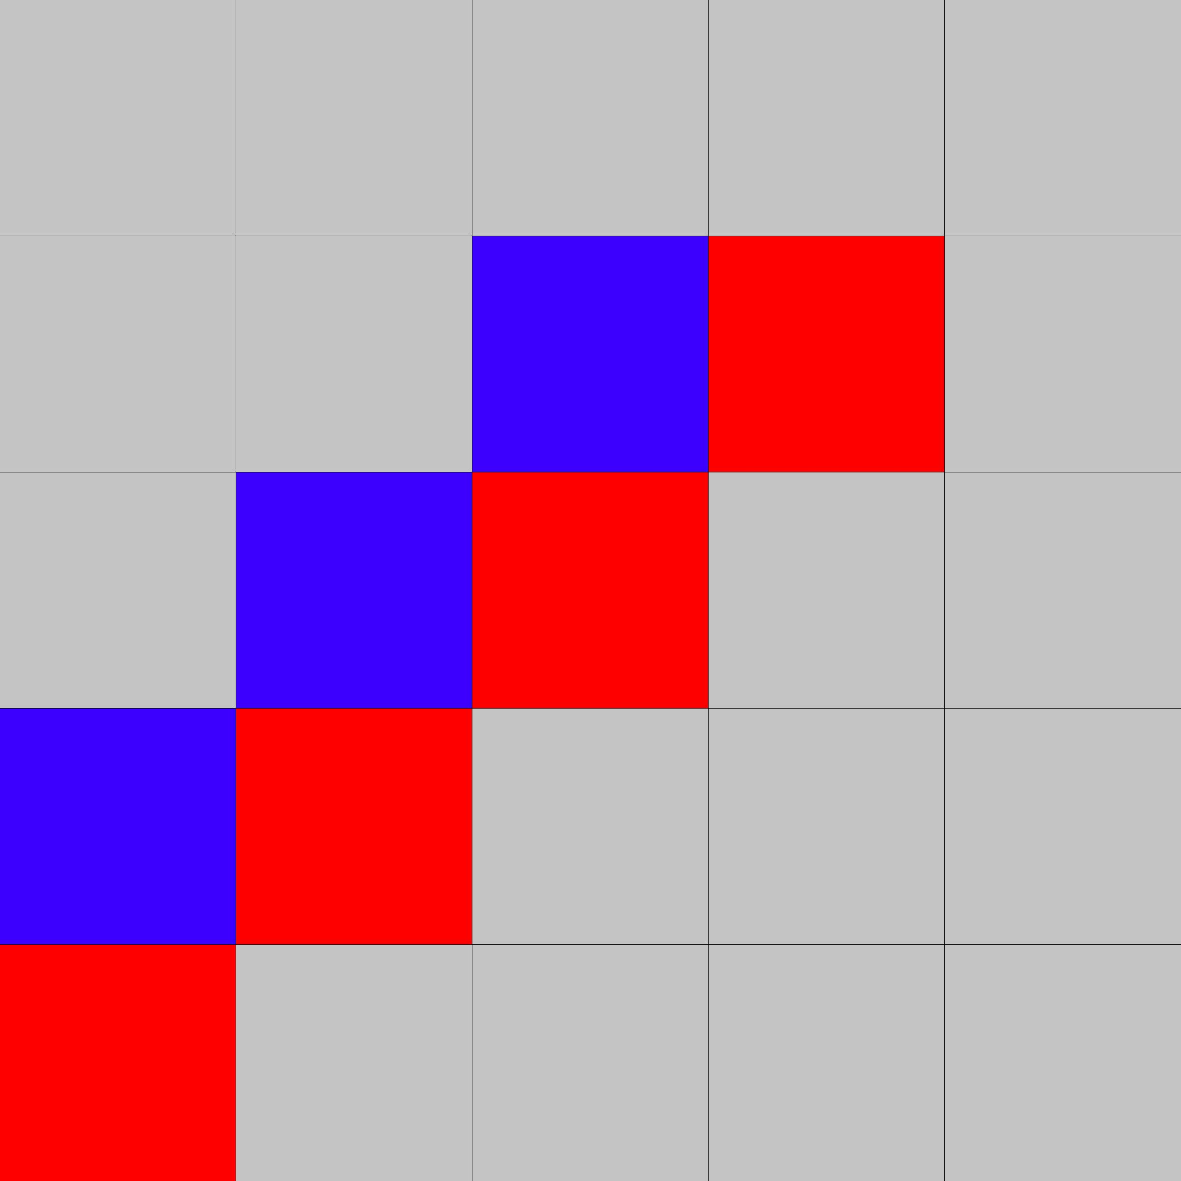
Actual Result: 5 x 5 K = 4
3.jpg

Slide 4
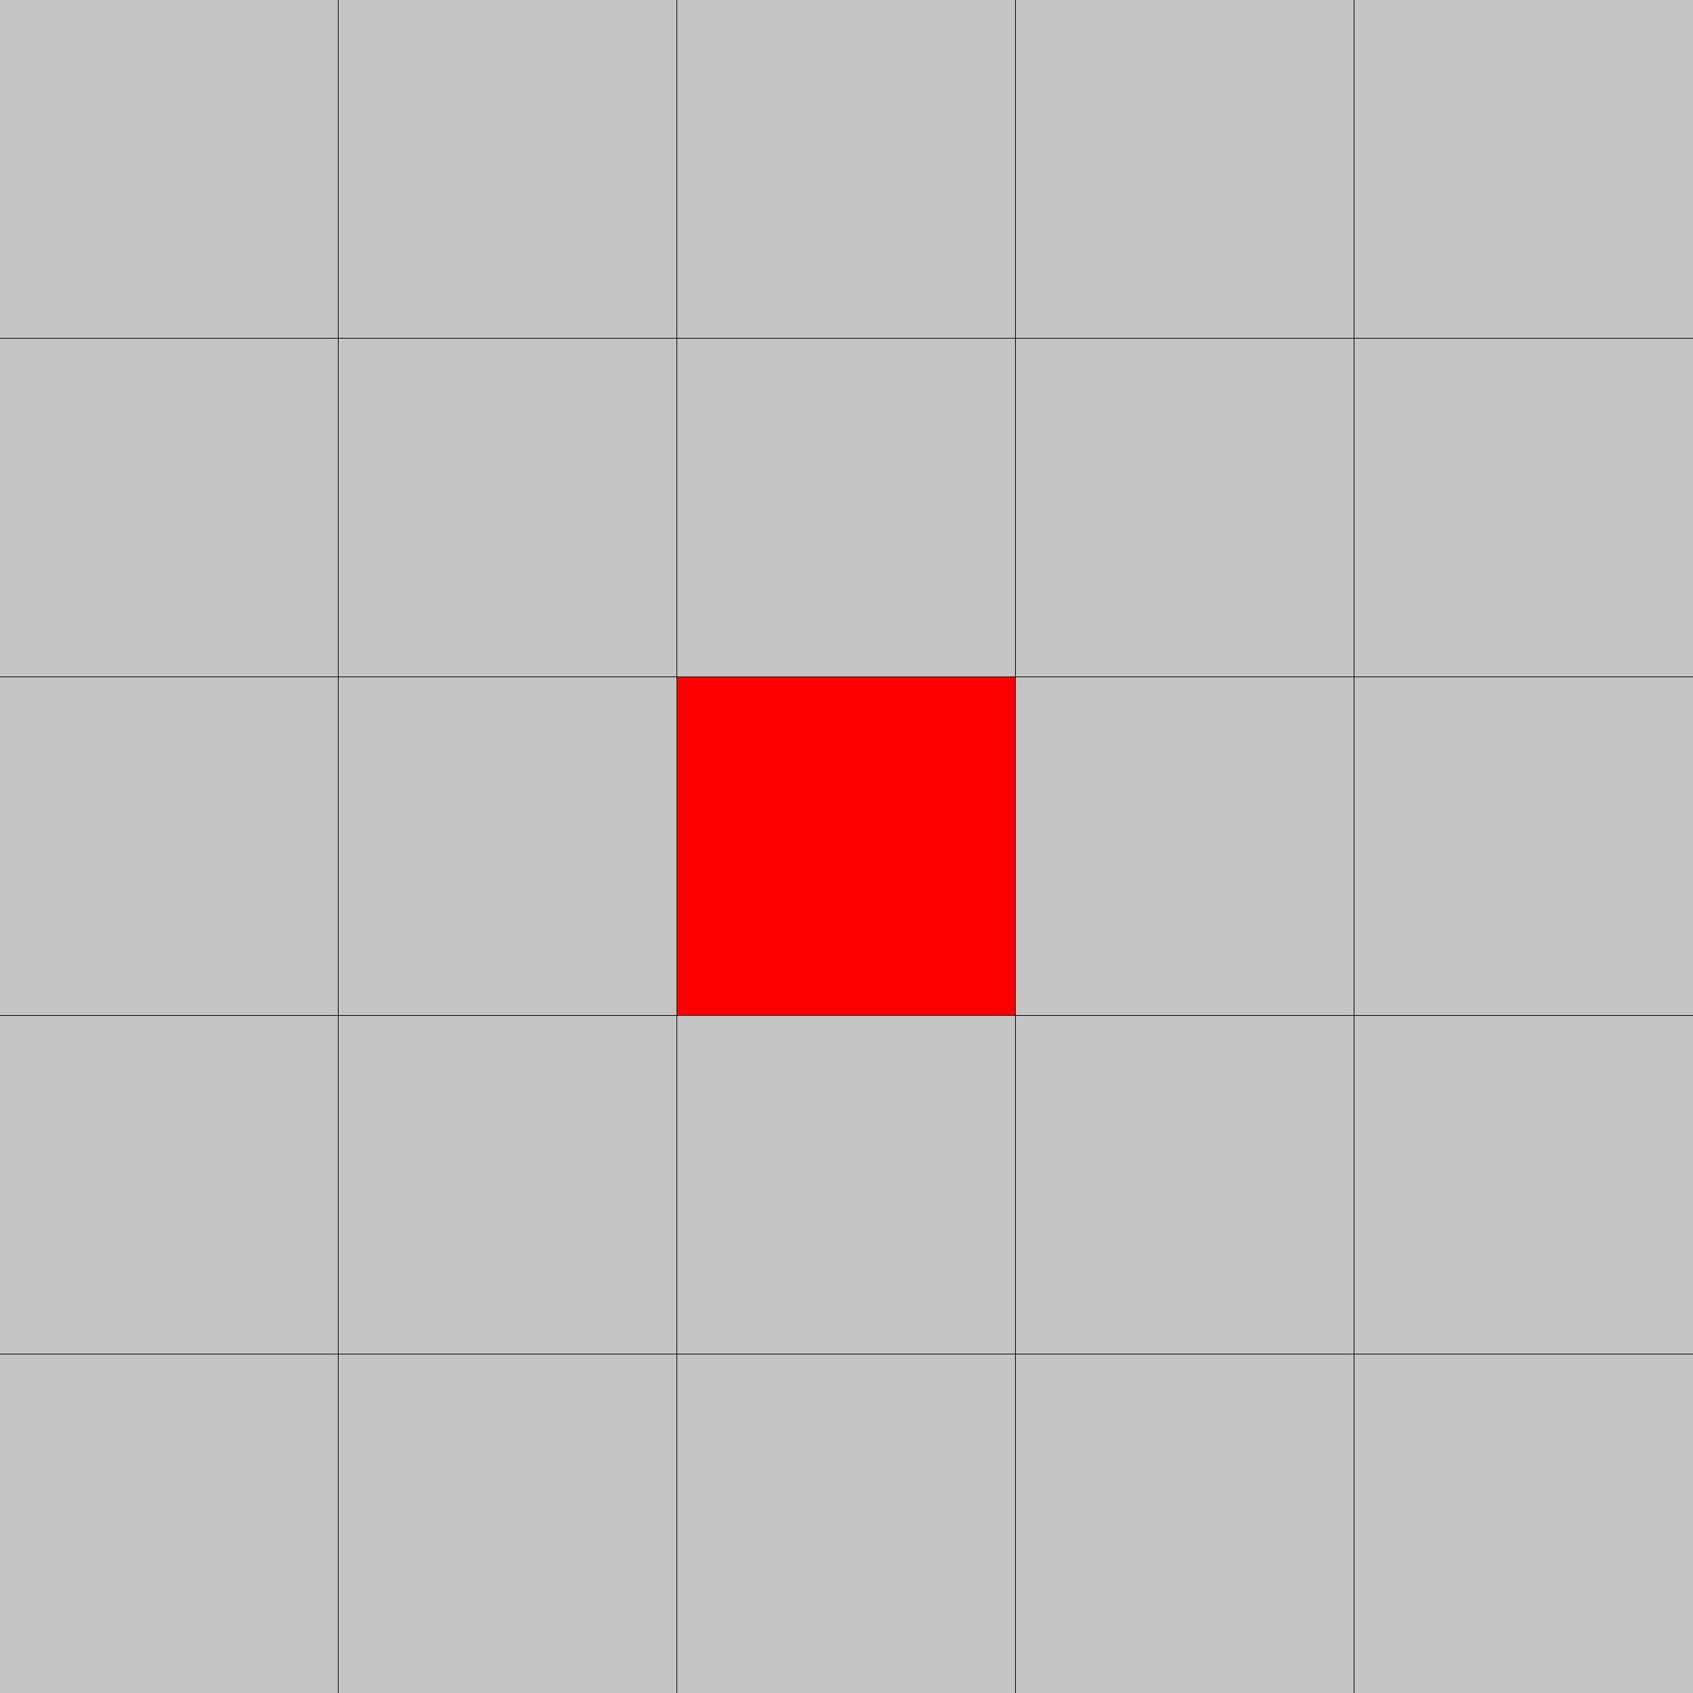
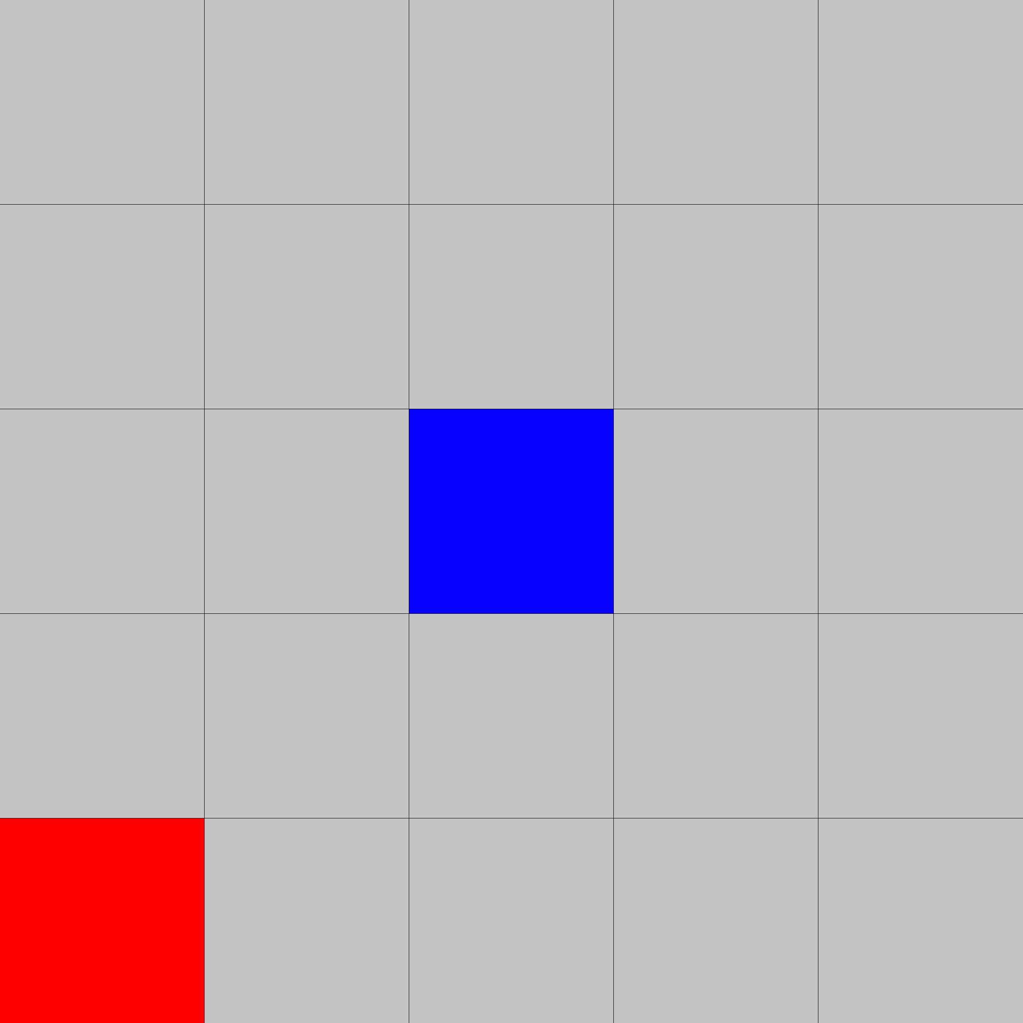
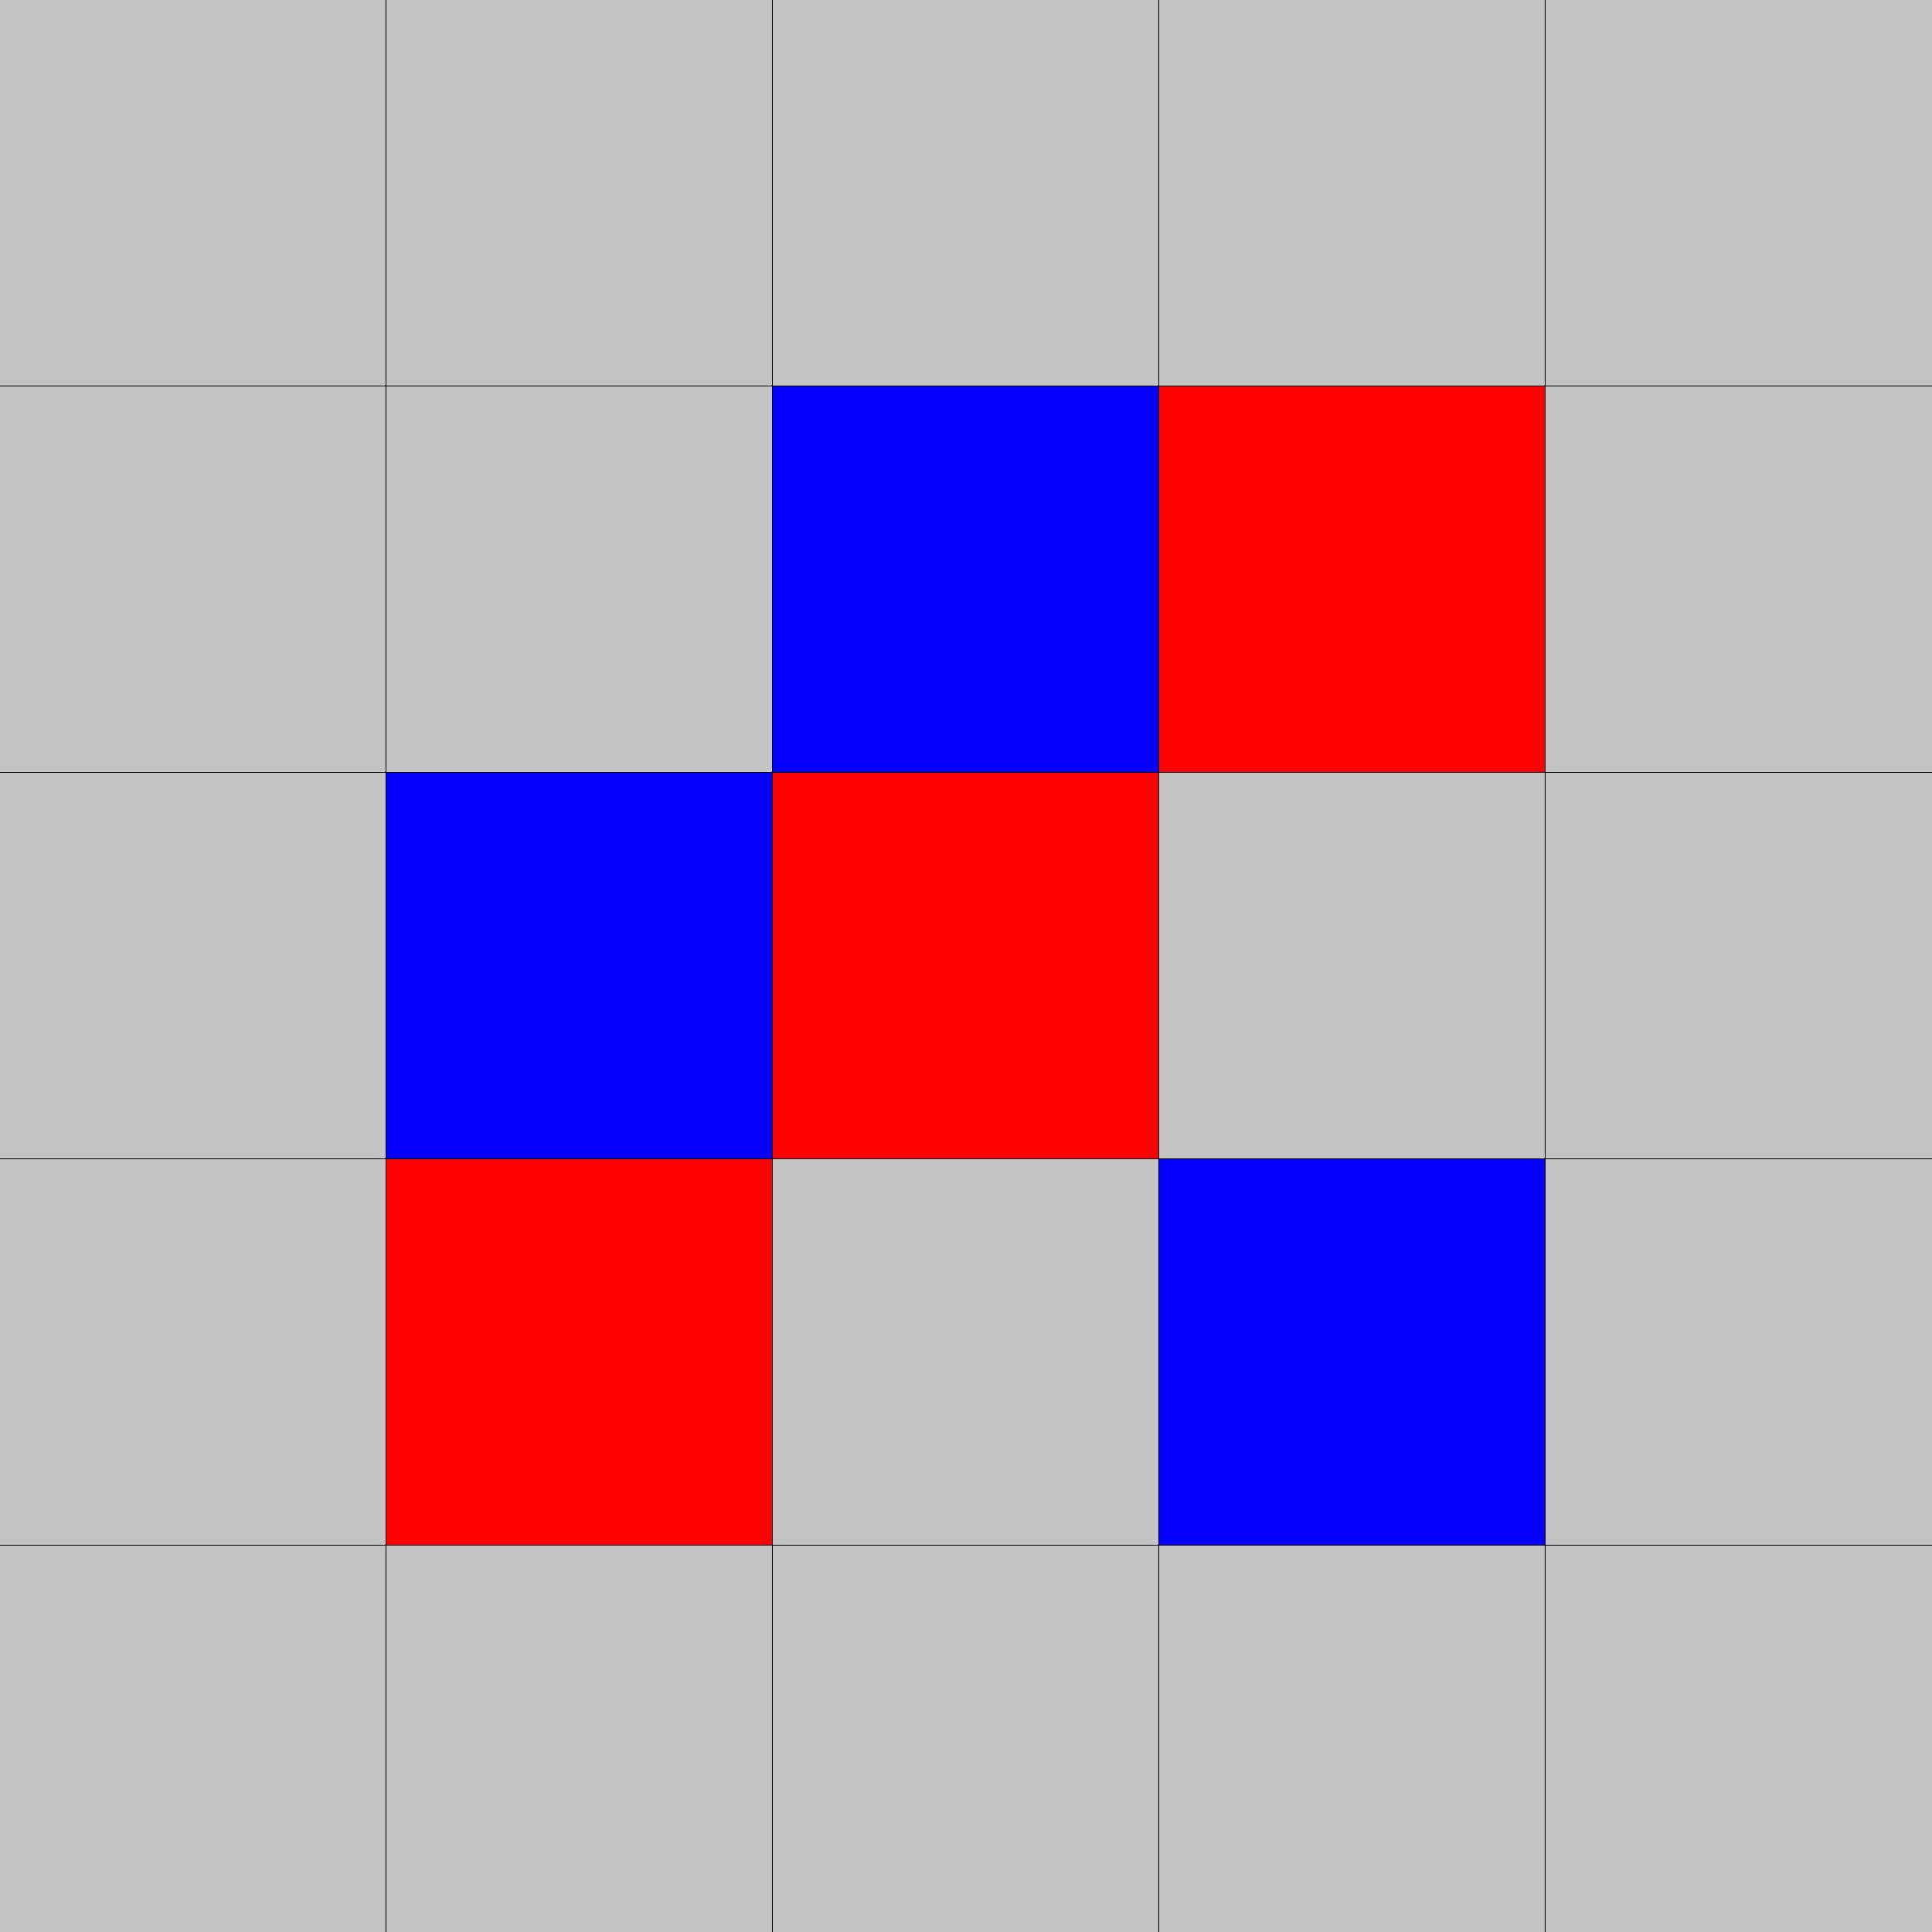
Prioritized Checks
1. Take the middle spot if available (W/2, H/2)
2. Take the spot if player will win (at depth 0)
3. Take the spot if player will lose (at depth 0)
4. Take spot if opponent will have k - 1 in a row
to avoid this scenario →
5. Take spot if player will have k - 1 in a row
to be in this scenario →

Slide 5
Other tips
- Don’t check all available spots
- Only check spots that are adjacent to existing pieces
- Focus on getting the min/max algorithm working before adding other constraints (time limit, alpha pruning, etc)
- Step through your algorithm by hand if needed

