Slide 1
Instructions for ConnectK Game AI project
Introduction to Artificial Intelligence, CS-171
Professor Rick Lathrop (rickl@uci.edu)
Tournament Teaching Staff:
Reza Asadi (rasadi@uci.edu)
Minhaeng Lee (minhaenl@uci.edu)
Ahmad Majomard (srazavim@uci.edu)
Please, send any questions to the Tournament Teaching Staff, and CC: rickl@uci.edu.
Please, follow these instructions *scrupulously*. You may lose points if your failure to follow these instructions breaks our scripts and so your Game AI cannot be run.

Slide 2
Well formatted project files
The correct format for the names of Game AI folders and files:
Submit your project in a single zip file, only one Game AI submission per team.
The name of the zip file MUST be in following format:
yourLastName_yourUCINetID_yourTeamName
Don’t use “_” in the name of your team.
If you had “_” in the name of your team, just remove “_” and combine other words.
yourTeamName MUST be the name you registered with the Readers earlier in the quarter.
There MUST be exactly three folders:
src
bin
doc
In the bin folder, you MUST have exactly one file with a name like “*AI.class”
This file MUST be your Game AI, which is what our scripts will run in the tournament.
You can have more files there, but none with “AI” at the very last part of their names.
You can have subclasses which have names like “*AI_subclass_name.class”
If your team partner submitted your Game AI as your one submission per team:
Please deposit a text file stating your name/ID, your partner’s name/ID, and your team name.
The name of the text file MUST be in the format stated above:
yourLastName_yourUCINetID_yourTeamName

Slide 3
How to compile cpp files?
As it is described in http://www.ics.uci.edu/~rickl/courses/AI-projects/connect-k/CS171ConnectKStudentResources/readme.txt
You can compile your c++ projects using the following command on openlab.ics.uci.edu:
g++ ConnectK.cpp Move.cpp AIShell.cpp -o myAI
Make sure that your projects run on openlab.ics.uci.edu.
Current g++ version is 4.4.7
To check g++ version, use following command:
g++ -v
(We compile again your projects using a similar script)

Slide 4
How to run your project on openlab.ics.uci.edu

Slide 5
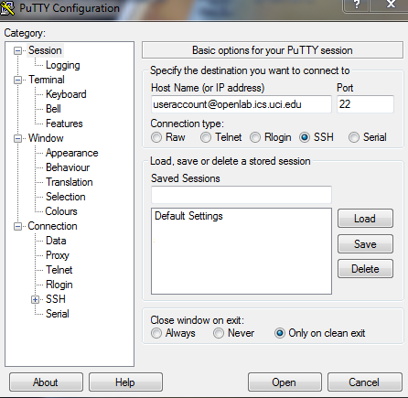
Download Putty
Enter your account in
host name:
user@openlab.ics.uci.edu

Slide 6
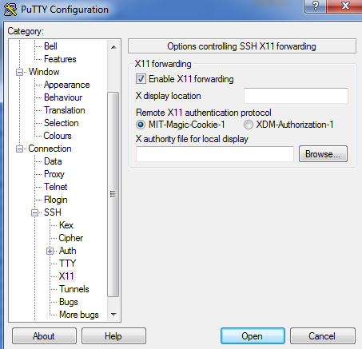
Enable X11 forwarding
Then click open.

Slide 7
Download Xming X server Check that it’s running

Slide 8
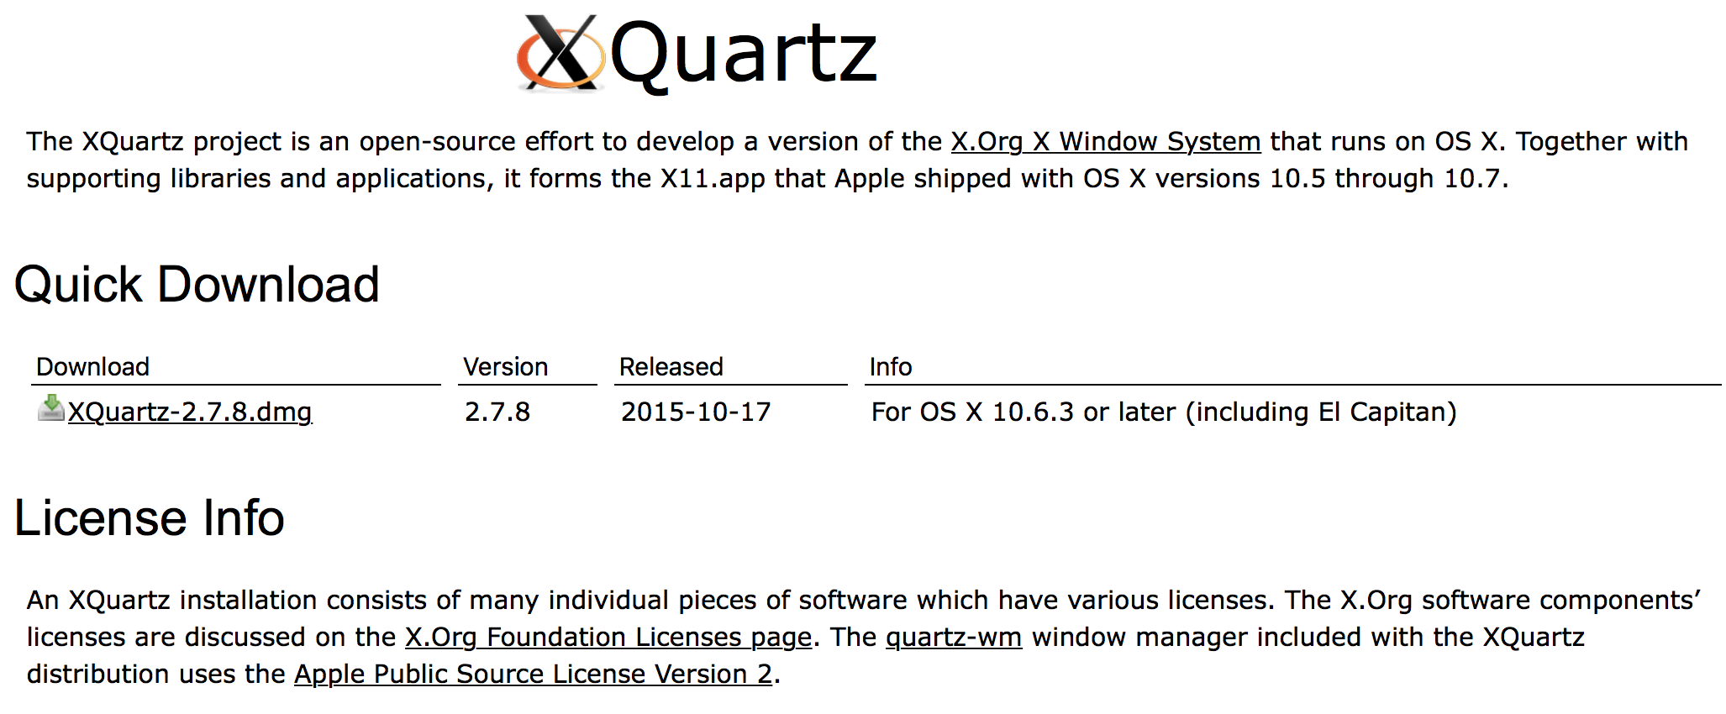
X11 for Mac User
Download and install XQuartz (http://www.xquartz.org)
Reboot your mac
Use –X (capital X) option when you use ssh to connect openlab.
Example:
ssh –X <username>@ics.uci.edu
Run connectK.jar shell

Slide 9
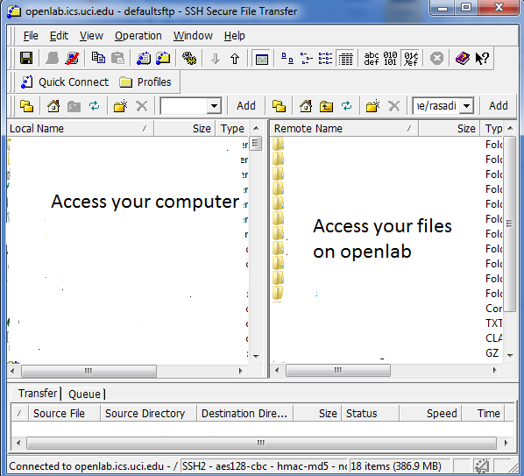
SSH Secure File Transfer
Download SSH
secure file transfer
Open ssh
Click on Connect
Host name=
Openlab.ics.uci.edu
Enter your ics account
and password

Slide 10
Important commands to run project on openlab.ics.uci.edu
Copy your project into your account using SSH secure file,
Using Putty, go to the folder which consists of your project:
cd AIproject (suppose Aiproject is your folder name.)
Using following command, check if you are in correct folder:
pwd
Check java version on your computer (cmd) and openlab using following command. On openlab java version is 1.7.
java –version
Again check Xmingserver is running on your computer.
Run following command:
Java –jar tournament.jar PoorAI.class PoorAI.class

Slide 11
Summary of running project on openlab
Download and run Putty.
Enable X11 forwarding in putty.
Download and run xming server.
Download and run SSH secure file.
Connect from SSH to your account on openlab.
Copy your project in a folder.
Write a command to run tournament.jar on your project against opponent.
Check java version using java –version.
There are more instructions on eee forum.

