Slide 1
Week 4
Jan 29th 2016

Slide 2
Agenda
Review Project Specifications
Released on Jan 28th
Testing program
Questions
Heuristic Search Examples
Local Search Examples

Slide 3
Heuristic Search

Slide 4
Heuristic Evaluation Function
Recursive Heuristic Evaluation Function
h(n) = F [ h(m_1), h(m_2), … , h(m_N) ]
you can compute your heuristic evaluation function by reusing the values of heuristic evaluations function from its children
Non-recursive?
Computationally inefficient…

Slide 5
Heuristic Evaluation Function
Admissible
If your h(n) is optimistic
If you are looking for shortest path, (minimize)
it is less than actual distance to goal
If you are looking for longest path, (maximize)
It is greater than actual distance to goal
Inadmissible?

Slide 6
Heuristic Evaluation Function
Consistent
If h(n) satisfies triangular inequality
Consistent → Admissible [review proof]
Admissible → Consistent
H(b)
W(a,b)
goal
H(a)

Slide 7
Heuristic Search Algorithms
Recall Uniform Cost Search,
Sort frontier (open list) w.r.t. g(n); the cost from the initial node to current node
Greedy Best First Search,
Sort frontier (open list) w.r.t. h(n); the estimated cost from current node to goal node
A* Search
Sort frontier (open list) w.r.t. f(n) = g(n) + h(n);

Slide 8
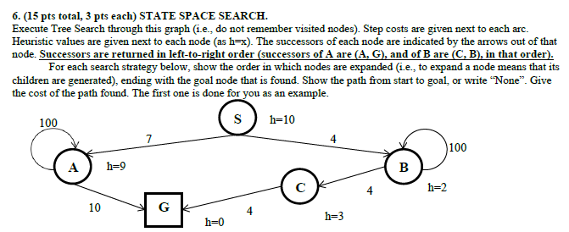

Slide 9
Greedy Best First Tree Search
Frontier
S
Select
Expand (generate all children)

Slide 10
Greedy Best First Tree Search
Frontier
S
Select
S
Expand (generate all children)

Slide 11
Greedy Best First Tree Search
Frontier
Select
S
Expand (generate all children)
A, B

Slide 12
Greedy Best First Tree Search
Frontier
B(2) A(9)
Select
S
Expand (generate all children)
A, B

Slide 13
Greedy Best First Tree Search
Frontier
B→S (2) A→S(9)
Select
B
Expand (generate all children)

Slide 14
Greedy Best First Tree Search
Frontier
A→S(9)
Select
B
Expand (generate all children)
C, B

Slide 15
Greedy Best First Tree Search
Frontier
B→B (2), C→B (3), A→S(9)
Select
B
Expand (generate all children)
C, B

Slide 16
Greedy Best First Tree Search
Frontier
B→B (2), C→B (3), A→S(9)
Select
B
Expand (generate all children)

Slide 17
Greedy Best First Tree Search
Frontier
C→B (3), A→S(9)
Select
B
Expand (generate all children)
C, B

Slide 18
Greedy Best First Tree Search
Frontier
B→B(2), C→B (3), C→B (3), A→S(9)
Select
B
Expand (generate all children)
C, B
B → B → S (Loop)

Slide 19
Greedy Best First Graph Search
Frontier
S
Select
Explored Set
Expand (generate all children)

Slide 20
Greedy Best First Graph Search
Frontier
Select
S
Explored Set
Expand (generate all children)

Slide 21
Greedy Best First Graph Search
Frontier
Select
S
Explored Set
S
Expand (generate all children)
A, B

Slide 22
Greedy Best First Graph Search
Frontier
B→S(2), A→S(9)
Select
S
Explored Set
S
Expand (generate all children)
A, B

Slide 23
Greedy Best First Graph Search
Frontier
B→S(2), A→S(9)
Select
B→S(2)
Explored Set
S
Expand (generate all children)

Slide 24
Greedy Best First Graph Search
Frontier
A→S(9)
Select
B→S(2)
Explored Set
S, B→S(2)
Expand (generate all children)
C→B→S (3)
B→B→S (2) already in explored set

Slide 25
Greedy Best First Graph Search
Frontier
C→B—S(3), A→S(9)
Select
B→S(2)
Explored Set
S, B→S(2)
Expand (generate all children)
C→B→S (3)
B→B→S (2) already in explored set

Slide 26
Greedy Best First Graph Search
Frontier
C→B→S(3), A→S(9)
Select
C→B→S(3)
Explored Set
S, B→S(2)
Expand (generate all children)

Slide 27
Greedy Best First Graph Search
Frontier
C→B→S(3), A→S(9)
Select
C→B→S(3)
Explored Set
S, B→S(2), C→B→S(3)
Expand (generate all children)
G→C→B→S (0)

Slide 28
Greedy Best First Graph Search
Frontier
G→C→B→S (0), A→S(9)
Select
C→B→S(3)
Explored Set
S, B→S(2), C→B→S(3)
Expand (generate all children)
G→C→B→S (0)

Slide 29
Greedy Best First Graph Search
Frontier
G→C→B→S (0), A→S(9)
Select
G→C→B→S (0) !
Explored Set
S, B→S(2), C→B→S(3)
Expand (generate all children)
G→C→B→S find a solution

Slide 30
Greedy Best First Search

Slide 31
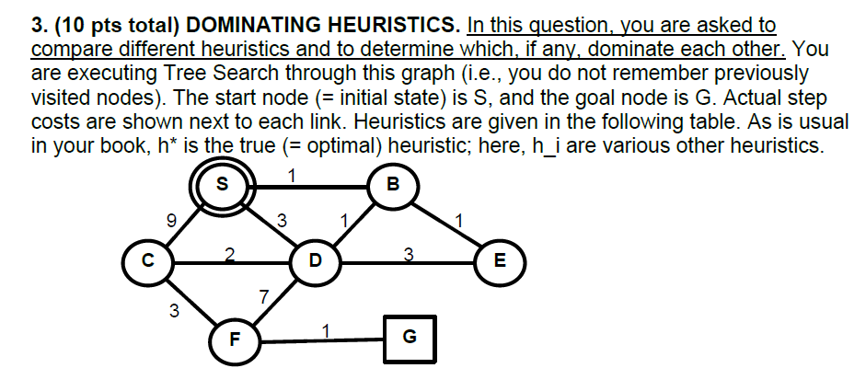
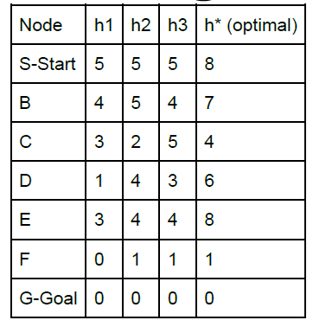
h1
Admissible but inconsistent
h(B) < h(D) + W(B,D) ?
4 < 1 + 1? No
h2
Consistent (implies admissible)
H3
Inadmissible (implies inconsistent)
-h(3) = 5 > 4

Slide 32
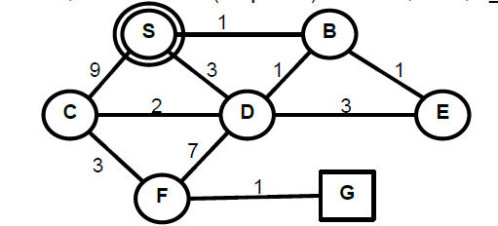
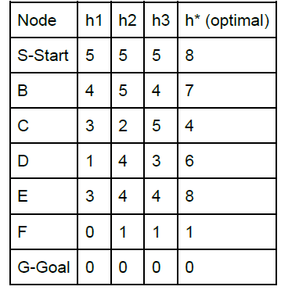
A* Tree Search Example h1
Frontier
S
Select
Expand

Slide 33
A* Tree Search Example h1
Frontier
Select
S
Expand
C→S (9+3)
D→S (1+3)
B→S (4+1)

Slide 34
A* Tree Search Example h1
Frontier
D→S (4), B→S (5), C→S(12)
Select
S
Expand
C→S (9+3)
D→S (1+3)
B→S (4+1)

Slide 35
A* Tree Search Example h1
Frontier
B→S (5), C→S(12)
Select
D→S (4)
Expand

Slide 36
A* Tree Search Example h1
Frontier
B→S (5), C→S(12)
Select
D→S (4)
Expand
S→D→S (6+5)
C→D→S (5+3)
B→D→S (4+4)
F→D→S (10+0)
E→D→S (6+3)

Slide 37
A* Tree Search Example h1
Frontier
B→S (5)
C→D→S (8)
B→D→S (8)
E→D→S (9)
F→D→S (10)
S→D→S (11)
C→S(12)
Select
D→S (4)
Expand
S→D→S (6+5)
C→D→S (5+3)
B→D→S (4+4)
F→D→S (10+0)
E→D→S (6+3)

Slide 38
A* Tree Search Example h1
Frontier
C→D→S (8)
B→D→S (8)
E→D→S (9)
F→D→S (10)
S→D→S (11)
C→S(12)
Select
B→S (5)
Expand

Slide 39
A* Tree Search Example h1
Frontier
C→D→S (8)
B→D→S (8)
E→D→S (9)
F→D→S (10)
S→D→S (11)
C→S(12)
Select
B→S (5)
Expand
S→B→S (2+5)
D→B→S (2+5)
E→B→S (2+5)

Slide 40
A* Tree Search Example h1
Frontier
S→B→S (7)
D→B→S (7)
E→B→S (7)
C→D→S (8)
B→D→S (8)
E→D→S (9)
F→D→S (10)
S→D→S (11)
C→S(12)
Select
B→S (5)
Expand
S→B→S (2+5)
D→B→S (2+5)
E→B→S (2+5)

Slide 41
A* Tree Search Example h1
Frontier
D→B→S (7)
E→B→S (7)
C→D→S (8)
B→D→S (8)
E→D→S (9)
F→D→S (10)
S→D→S (11)
C→S(12)
Select
S→B→S (7)
Expand

Slide 42
A* Tree Search Example h1
Frontier
D→B→S (7)
E→B→S (7)
C→D→S (8)
B→D→S (8)
E→D→S (9)
F→D→S (10)
S→D→S (11)
C→S(12)
Select
S→B→S (7)
Expand
C→ S→B→S (11+3)
D→ S→B→S (5 +1)
B→ S→B→S (3 + 4)

Slide 43
A* Tree Search Example h1
Frontier
D→ S→B→S (6)
D→B→S (7)
E→B→S (7)
B→ S→B→S (7)
C→D→S (8)
B→D→S (8)
E→D→S (9)
F→D→S (10)
S→D→S (11)
C→S(12)
C→ S→B→S (14)
Select
S→B→S (7)
Expand
C→ S→B→S (11+3)
D→ S→B→S (5 +1)
B→ S→B→S (3 + 4)

Slide 44
A* Tree Search Example h1
Frontier
D→B→S (7)
E→B→S (7)
B→ S→B→S (7)
C→D→S (8)
B→D→S (8)
E→D→S (9)
F→D→S (10)
S→D→S (11)
C→S(12)
C→ S→B→S (14)
Select
D→ S→B→S (6)
Expand

Slide 45
A* Tree Search Example h1
Frontier
D→B→S (7)
E→B→S (7)
B→ S→B→S (7)
C→D→S (8)
B→D→S (8)
E→D→S (9)
F→D→S (10)
S→D→S (11)
C→S(12)
C→ S→B→S (14)
Select
D→ S→B→S (6)
Expand

Slide 46
A* Graph Example

Slide 47
http://www.ics.uci.edu/~kkask/Fall-2015%20CS271/slides/03-InformedHeuristicSearch.pdf

Slide 48
Properties
Complete? Yes
Optimality?
If admissible, Yes
Tree search: no explored set
Graph search: need additional book-keeping
If consistent, f=g+h never decreases while expanding nodes (nodes in explored set do not move to frontier)

Slide 49
Local Search
Completeness
Soundness

Slide 50
Local Search
Hill-Climbing
Simulated Annealing
Local Beam
Genetic Algorithms
…
Local Search for CSP (min conflict)
Random Restart
Tabu Search

