Slide 1
CS 171: Intro to AI Discussion Week 2
Jan 15th 2016

Slide 2
Agenda
Project Information (15 min)
Team Formation by Today 23:59pm
Project Problem Generator by Sun., 24 Jan., 11:59pm
Monster Sudoku Example
Generator Specification
CSP Mini Sudoku Example (30 min)
Search : Backtracking
Heuristic : Variable (MRV/DH) Value (LCV)
Forward Checking
Arc Consistency
Quiz 1 (5 min)

Slide 3
Project Information
Team Formation
http://goo.gl/forms/YLixJ7ep5j
Monster Sudoku Example
Generator Specification

Slide 4
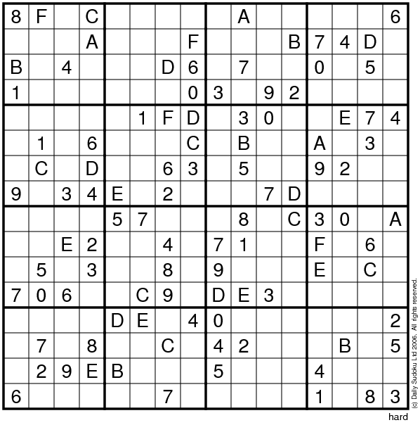
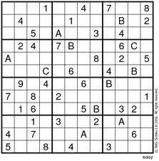
Examples
N x N grid
cell
token
block
P=3
q
p = 3, q = 4, N = 3x4 = 12
p = 4, q = 4, N = 4x4 = 16

Slide 5
Parameters
N
Number of tokens
Length of the N x N grid
Number of cells in each block
N = P * Q
P
Number of blocks fit horizontally
Number of rows in each block
Q
Number of blocks fit vertically
Number of columns in each block
M
Number of cells initially filled
Tokens
1,2,…,8,9,A,B,C,…,Z up to 35 tokens (35 X 35 grid)
0 is reserved for representing BLANK cell

Slide 6
Generator Specification
N, P, Q, M
Monster Sudoku Problem
Generator
(Initially N x N grid filled with 0)
Check if N = P*Q, M <= N*N (Don’t miss checking input params)
Randomly choose M cells
Replace 0 with Randomly chosen tokens in [1..N]
such that the generated problem is consistent, i.e., initial assignments should not be in conflict positions
It is okay to generate a problem with unique, multiple, no solution.
How to generate consistent problems?
Pickup a cell randomly
Assign a random token to it
Check constraints and if it doesn’t violate them pickup next cell
If the random token was in conflict to other cells, try other tokens until success
If there is no possible choice, then discard everything and start from the beginning!

Slide 7
Generator Specification
Input file
Generator
Output file
$ <executable_team_name> <input file name> <output file name>
you will submit single executable (and other stuffs..)
test it at openlab.ics.uci.edu with the test script before submission
Input file
Output file
M N P Q
6 2 3\n
5 0 0 3 0 0\n
0 0 2 0 0 4\n
…
0 2 0 0 1 5\n
N+1 lines,
First line: N P Q
Next N lines
Show each line in the grid
1 line, 4 numbers are separated by space
e.g. 14 6 2 3
14 <= 6*6 and 6 = 2*3

Slide 8
Submission
EEE Drop box
One of your team member should Submit “zipped” file
LastName_yourUCI_ID#_yourTeamName.zip
LEE_12345678_MyTeamName.zip
If your partner has deposited your submission, please deposit a text file
LastName_yourUCI_ID#_yourTeamName.txt
LEE_87654321_MyTeamName.txt
Lastname_UCI#ID_teamName
src: source files & other necessary files for producing the executable
bin: executable (recommend static link)
doc: report
Finally, you will analyze its performance and write up a report according to a report template

Slide 9
Mini Sudoku Example
M = 20
N = 6
P = 2
Q = 3
P=2

Slide 10
1 |  | 3 |  | 5 | 6
4 |  | 6
 | 1 |  |  | 3 | 2
6 |  | 2 | 5 |  | 4
 |  | 5 | 3 | 4
3 | 4 |  | 2 |  | 5

Slide 11
Backtracking search (Figure 6.5)
function BACKTRACKING-SEARCH(csp) return a solution or failure
return RECURSIVE-BACKTRACKING({} , csp)
function RECURSIVE-BACKTRACKING(assignment, csp) return a solution or failure
if assignment is complete then return assignment
var ← SELECT-UNASSIGNED-VARIABLE(VARIABLES[csp],assignment,csp)
for each value in ORDER-DOMAIN-VALUES(var, assignment, csp) do
if value is consistent with assignment according to CONSTRAINTS[csp] then
add {var=value} to assignment
result ← RECURSIVE-BACTRACKING(assignment, csp)
if result ≠ failure then return result
remove {var=value} from assignment
return failure

Slide 12
Search Heuristic
Variable Selection
Minimum Remaining Value
Select Variable with smallest domain size
Degree heuristic
Select Variable that involves in the largest number of constraints on unassigned variables
Value Selection
For each value, count number of removed values in other variables that are removed by current assignment
Select Value with the smallest count

Slide 13
Inference
Forward Checking
While Search (after assigning value to Xi)
Enforce Arc Consistency on { (Xj, Xi) } neighbors
Arc Consistency
Before Search
Global Arc Consistency → No need to do FC
While Search (after assigning value to Xi)
Maintaining Arc Consistency { (Xj, Xi) } propagate!

Slide 14
1 | x1 | 3 | X2 | 5 | 6
4 | x3 | 6 | x4 | x5 | X6
x7 | 1 | x8 | x9 | 3 | 2
6 | Z1 | 2 | 5 | Z2 | 4
Z3 | Z4 | 5 | 3 | 4 | Z5
3 | 4 | z6 | 2 | Z7 | 5
Variables X1~X9, Z1 ~ Z7
Domains {1,2,3,4,5,6}
Let assigned cells represent variables that are allowed to have only 1 value
Let’s call them
B1=1, B2=3, B3=4, B4=6
Y1=5, Y2=6
R1=1, R2=6, R3=2
P1=3,P2=2, P3=5, P4-4
G1=5,G2=3, G3=4
O1=3, O2=4, O3=2 O4=5
Constraints
AllDiff per Block 6 Blocks
AllDiff per Row 6 Rows
AllDiff per Column 6 Columns
For example, Row1
AllDiff (B1, X1, B2, X2, Y1, Y2) is a set of constraints
B1 != X1 B1 != B2 B1 != X2 B1 != Y1 B1 != Y2
X1 != B2 X1 != X2 X1 != Y1 X1 != Y2
B2 != X2 B2 != Y1 B2 != Y2
X2 != Y1 X2 != Y2
Y1 != Y2
We converted 1 AllDiff constraint into 15 binary constarints !
The Alldifferent Constraint: A Survey∗
http://www.math.unipd.it/~frossi/alldiff.pdf

Slide 15
1 | x1 | 3 | X2 | 5 | 6
4 | x3 | 6 | x4 | x5 | X6
x7 | 1 | x8 | x9 | 3 | 2
6 | Y1 | 2 | 5 | Y2 | 4
y3 | y4 | 5 | 3 | 4 | y5
3 | 4 | y6 | 2 | y7 | 5
Start
Select Variable
MRV?
Assigned cells can take ONLY ONE value
There are 20 such variables.
DH?
Same for all 20 variables
Pick up B1 = 1 (upper left)
Select Value, Only 1
Forward Checking Reduce domains
X1 = {2,3,4,5,6}
X2 = {2,3,4,5,6}
X3 = {2,3,4,5,6}
Check all constraints → Okay
If we convert all AllDiff constraints as
Binary constraints,
We have (3*6) * 15 = 270 constraints

Slide 16
1 | x1 | 3 | X2 | 5 | 6
4 | x3 | 6 | x4 | x5 | X6
x7 | 1 | x8 | x9 | 3 | 2
6 | Y1 | 2 | 5 | Y2 | 4
y3 | y4 | 5 | 3 | 4 | y5
3 | 4 | y6 | 2 | y7 | 5
B1 = 1
Select Variable
There are 19 pre-assigned cells
DH?
Any pre-assigned variable that are not related to B1 like R1
Select Value? Only 1
Forward Checking
X7 = {2,3,4,5,6}
X8 = {2,3,4,5,6}
X9 = {2,3,4,5,6}
Y4 = {2,3,4,5,6}
X1 = {2,3,4,5,6}
X2 = {2,3,4,5,6}
X3 = {2,3,4,5,6}

Slide 17
1 | x1 | 3 | X2 | 5 | 6
4 | x3 | 6 | x4 | x5 | X6
x7 | 1 | x8 | x9 | 3 | 2
6 | Y1 | 2 | 5 | Y2 | 4
y3 | y4 | 5 | 3 | 4 | y5
3 | 4 | y6 | 2 | y7 | 5
B1 = 1
R1 =1
Select Variable
There are 18 pre-assigned cells
DH?
Any pre-assigned variable that are not in blue/ red block and away from previously selected rows/columns like O1
Select Value? Only 3
Forward Checking
Y3 = {1,2,4,5,6}
Y4 = {2,4,5,6}
Y5 = {1,2,4,5,6}
Y7 = {1,2,4,5,6}
X9 = {2,4,5,6}
X4 = {1,2,4,5,6}
X2 = {2,4,5,6}
X1 = {2,3,4,5,6}
X2 = {2,3,4,5,6}
X3 = {2,3,4,5,6}
X7 = {2,3,4,5,6}
X8 = {2,3,4,5,6}
X9 = {2,3,4,5,6}
Y4 = {2,3,4,5,6}

Slide 18
1 | x1 | 3 | X2 | 5 | 6
4 | x3 | 6 | x4 | x5 | X6
x7 | 1 | x8 | x9 | 3 | 2
6 | Y1 | 2 | 5 | Y2 | 4
y3 | y4 | 5 | 3 | 4 | y5
3 | 4 | y6 | 2 | y7 | 5
B1 = 1, R1 =1, O1 = 3
Select Variable
By MRV we will select all pre-assigned cells
At each iteration, we apply Forward Checking
Then, domains for not-assigned variables become
X1 = {2}
X2 = {4}
X3 = {2,5}
X4 = {1}
X5= {1,2}
X6= {1,3}
X7 = {5}
X8 = {4}
X9 = {6}
Y1 = {3}
Y2 = {1}
Y3 = {2}
Y4 = {2,6}
Y5 = {1}
Y6 = {1}
Y7 = {1,6}

Slide 19
1 | x1 | 3 | X2 | 5 | 6
4 | x3 | 6 | x4 | x5 | X6
x7 | 1 | x8 | x9 | 3 | 2
6 | Y1 | 2 | 5 | Y2 | 4
y3 | y4 | 5 | 3 | 4 | y5
3 | 4 | y6 | 2 | y7 | 5
Select Variable
MRV?
X1, X2, X4, X7, X8, X9, Y1, Y2, Y3, Y5, Y6
Take only 1 value
DH? (w.r.t. unassigned variable?)
X1 = x3, x2, y1, y4
X2 = x1, x4, x5, x6, x9
X4 = x2, x5, x6, x3, x9
X7 = y1, x8, y3, x9
X8 = x7, x9, y6
X9 = x7, x8, y2, x2, x4
Y1 = x7, x8, x1, x3, y4
Y2 = x9, x5, y7, y1
Y3 = y4, y6, x7, y5
Y5 = x6, y3, y4, y7
Y6 = y3, y4, y7, x8
Y7 = y5, y6, y2, x5
X2, X4, X9, Y1 tie!
Select one of them like Y1 = 3
X1 = {2}
X2 = {4}
X3 = {2,5}
X4 = {1}
X5= {1,2}
X6= {1,3}
X7 = {5}
X8 = {4}
X9 = {6}
Y1 = {3}
Y2 = {1}
Y3 = {2}
Y4 = {2,6}
Y5 = {1}
Y6 = {1}
Y7 = {1,6}

Slide 20
1 | x1 | 3 | X2 | 5 | 6
4 | x3 | 6 | x4 | x5 | X6
x7 | 1 | x8 | x9 | 3 | 2
6 | Y1=3 | 2 | 5 | Y2 | 4
y3 | y4 | 5 | 3 | 4 | y5
3 | 4 | y6 | 2 | y7 | 5
Y1 =3
After assignment, let’s apply
Maintaining Arc Consistency Algorithm
Put binary constraints
(X1, Y1) (X3, Y1) (X7, Y1) (X8, Y1) (Y4, Y1)
Into Queue
All 5 binary constraints are consistent
No Change
X1 = {2}
X2 = {4}
X3 = {2,5}
X4 = {1}
X5= {1,2}
X6= {1,3}
X7 = {5}
X8 = {4}
X9 = {6}
Y1 = {3}
Y2 = {1}
Y3 = {2}
Y4 = {2,6}
Y5 = {1}
Y6 = {1}
Y7 = {1,6}

Slide 21
1 | x1 | 3 | X2 | 5 | 6
4 | x3 | 6 | x4 | x5 | X6
x7 | 1 | x8 | x9 | 3 | 2
6 | Y1=3 | 2 | 5 | Y2 | 4
y3 | y4 | 5 | 3 | 4 | y5
3 | 4 | y6 | 2 | y7 | 5
Y1 =3
After assignment, let’s apply
If we applied AC algorithm
Put all binary constraints
X1-X2 X2-X1
X1-X3, X3-X1
X1-Y4, Y4-X1
X7-X8, X8-X7
X7-X9, X9-X7
X7-Y3, Y3-X7
X8-X9, X9-X8
X8-Y6, Y6-X8
…
Into Queue
As a result,
We solve the problem
X1 = {2}
X2 = {4}
X3 = {2,5}
X4 = {1}
X5= {1,2}
X6= {1,3}
X7 = {5}
X8 = {4}
X9 = {6}
Y1 = {3}
Y2 = {1}
Y3 = {2}
Y4 = {2,6}
Y5 = {1}
Y6 = {1}
Y7 = {1,6}

Slide 22
1 | x1 | 3 | X2 | 5 | 6
4 | x3 | 6 | x4 | x5 | X6
x7 | 1 | x8 | x9 | 3 | 2
6 | Y1=3 | 2 | 5 | Y2 | 4
y3 | y4 | 5 | 3 | 4 | y5
3 | 4 | y6 | 2 | y7 | 5
Y1 =3
Select Variable?
MRV?
All except X3, X5, X6, Y4, Y7
DH?
X1=3
X2=5
X4=5
X7=3
X8=3
X9=5
Y2=3
Y3=4
Y5=3
Y6=4
Select X4 or X9
Select X9
What Value? X9 = 6
X1 = {2}
X2 = {4}
X3 = {2,5}
X4 = {1}
X5= {1,2}
X6= {1,3}
X7 = {5}
X8 = {4}
X9 = {6}
Y1 = {3}
Y2 = {1}
Y3 = {2}
Y4 = {2,6}
Y5 = {1}
Y6 = {1}
Y7 = {1,6}

Slide 23
1 | x1 | 3 | X2 | 5 | 6
4 | x3 | 6 | x4 | x5 | X6
x7 | 1 | x8 | X9=6 | 3 | 2
6 | Y1=3 | 2 | 5 | Y2 | 4
y3 | y4 | 5 | 3 | 4 | y5
3 | 4 | y6 | 2 | y7 | 5
Y1 =3, X9=6
MRV/ DH will Select
X1, X2, X4, X7, X8, Y2, Y3, Y5, Y6
Let’s not apply FC
X1 = {2}
X2 = {4}
X3 = {2,5}
X4 = {1}
X5= {1,2}
X6= {1,3}
X7 = {5}
X8 = {4}
X9 = {6}
Y1 = {3}
Y2 = {1}
Y3 = {2}
Y4 = {2,6}
Y5 = {1}
Y6 = {1}
Y7 = {1,6}

Slide 24
1 | X1=2 | 3 | X2=4 | 5 | 6
4 | X3=5 | 6 | X4=1 | x5 | X6=3
X7=5 | 1 | X8=4 | X9=6 | 3 | 2
6 | Y1=3 | 2 | 5 | Y2=1 | 4
Y3=2 | y4 | 5 | 3 | 4 | Y5=1
3 | 4 | Y6=1 | 2 | Y7 | 5
What Variable?
MRV X3, X5, X6, Y4, Y7
DH?
X3 = 3
X5 = 3
X6 = 2
Y4 = 1
Y7 = 1
Choose X3 or X5
If we choose X3,
What Value to choose?
LCV?
2: inconsistent
5: Only possible value
X3= 5
X3 = {2,5}
X5= {1,2}
X6= {1,3}
Y4 = {2,6}
Y7 = {1,6}

Slide 25
1 | 2 | 3 | 4 | 5 | 6
4 | 5 | 6 | 1 | 2 | 3
5 | 1 | 4 | 6 | 3 | 2
6 | 3 | 2 | 5 | 1 | 4
2 | 6 | 5 | 3 | 4 | 1
3 | 4 | 1 | 2 | 6 | 5

Slide 26
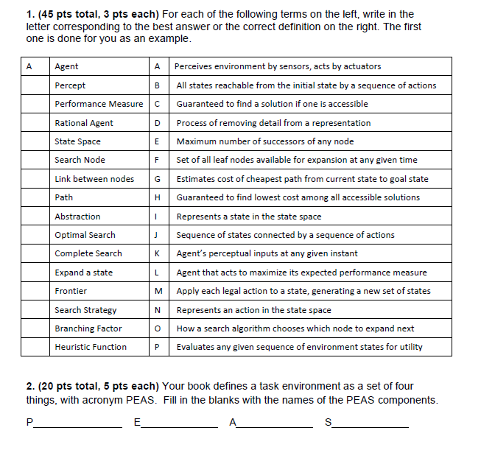
Quiz 1

Slide 27
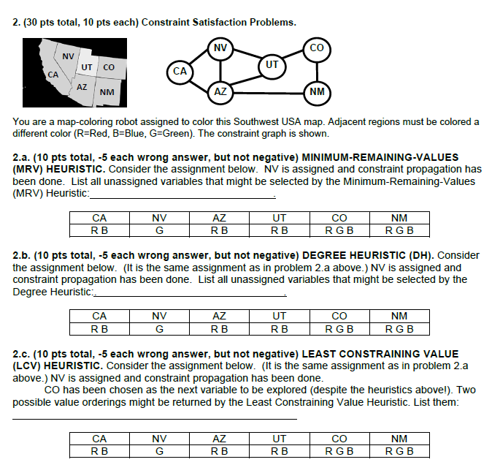

Slide 28
