Slide 1
Review Machine Learning Classifiers
Chapters 18.5-18.12; 20.2.2
Decision Regions and Decision Boundaries
Classifiers:
  Decision trees
  K-nearest neighbors
  Perceptrons
  Support vector Machines (SVMs), Neural Networks
  Naïve Bayes

Slide 2
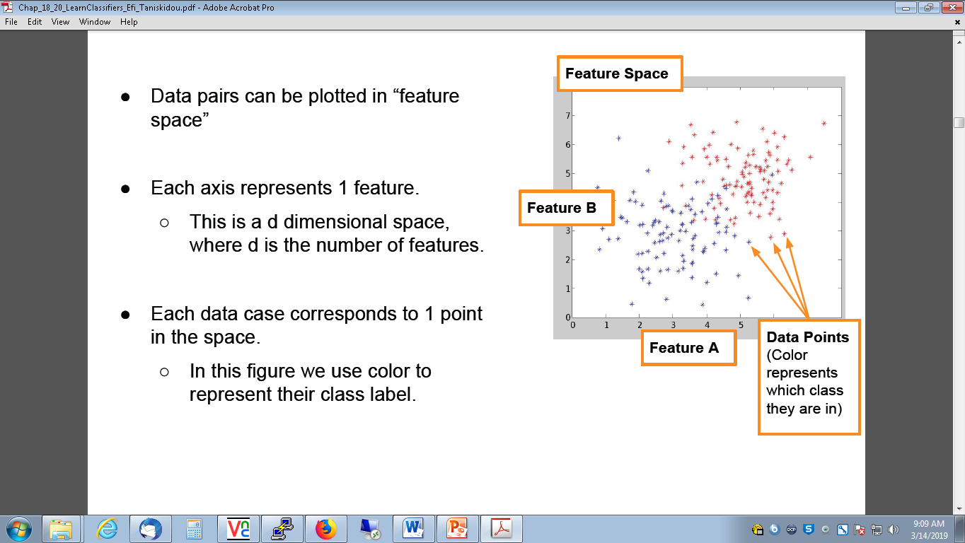
A Different View on Data Representation
Data pairs can be plotted in “feature space”
Each axis represents one feature.
  This is a d dimensional space, where d is the number of features.
Each data case corresponds to one point in the space.
  In this figure we use color to represent their class label.

Slide 3
Decision Boundaries
Can we find a boundary that separates the two classes?
Decision
Boundary
Decision
Region 1
Decision
Region 2

Slide 4
Classification in Euclidean Space
A classifier is a partition of the feature space into disjoint decision regions
  Each region has a label attached
  Regions with the same label need not be contiguous
  For a new test point, find what decision region it is in, and predict the corresponding label
Decision boundaries = boundaries between decision regions
  The “dual representation” of decision regions
We can characterize a classifier by the equations for its decision boundaries
Learning a classifier ⬄ searching for the decision boundaries that optimize our objective function

Slide 5
Decision Tree Example
Debt
Income > t1
t2
Debt > t2
t3
t1
Income
Income > t3
Note: tree boundaries are
linear and axis-parallel

Slide 6
A Simple Classifier: Minimum Distance Classifier
Training
  Separate training vectors by class
  Compute the mean for each class, μ_{k}, k = 1,… m
Prediction
  Compute the closest mean to a test vector x’ (using Euclidean distance)
  Predict the corresponding class
In the 2-class case, the decision boundary is defined by the locus of the hyperplane that is halfway between the 2 means and is orthogonal to the line connecting them
This is a very simple-minded classifier – easy to think of cases where it will not work very well

Slide 7
Minimum Distance Classifier

Slide 8
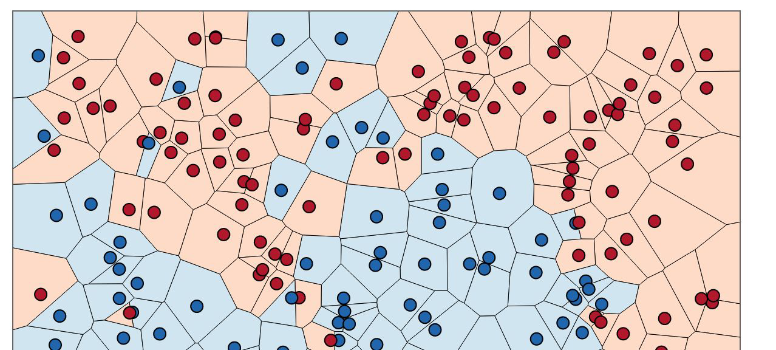
Another Example: Nearest Neighbor Classifier
The nearest-neighbor classifier
  Given a test point x’, compute the distance between x’ and each input data point
  Find the closest neighbor in the training data
  Assign x’ the class label of this neighbor
  (sort of generalizes minimum distance classifier to exemplars)
The nearest neighbor classifier results in piecewise linear decision boundaries
Image Courtesy: http://scott.fortmann-roe.com/docs/BiasVariance.html

Slide 9
Overall Boundary = Piecewise Linear
Decision Region
for Class 1
Decision Region
for Class 2
1
2
Feature 2
1
2
?
2
1
Feature 1

Slide 12
Larger K ⟹ Smoother boundary

Slide 13
Linear Classifiers
Linear classifiers classification decision based on the value of a linear combination of the attributes.
  Linear decision boundary (single bofor 2-class case)
We can represent a linear decision boundary by a linear equation:
w₁ x₁ + w₂ x₂ + … + w_{d} x_{d} = Σ w_{j} x_{j} = w^{t} x = 0
In d dimensions, this defines a (d-1) dimensional hyperplane
  d=3, we get a plane; d=2, we get a line
For prediction we simply see if Σ w_{j} x_{j} > 0
The w_{i} are the weights (parameters)
  Learning consists of searching in the d-dimensional weight space for the set of weights (the linear boundary) that minimizes an error measure
  A threshold can be introduced by a “dummy” feature that is always one; it weight corresponds to (the negative of) the threshold
Note that a minimum distance classifier is a special (restricted) case of a linear classifier

Slide 14
Linear Classifiers
Linear classifiers classification decision based on the value of a linear combination of the characteristics.
  Linear decision boundary (single boundary for 2-class case)
We can always represent a linear decision boundary by a linear equation:
The w_{i} are weights; the x_{i} are feature values

Slide 15
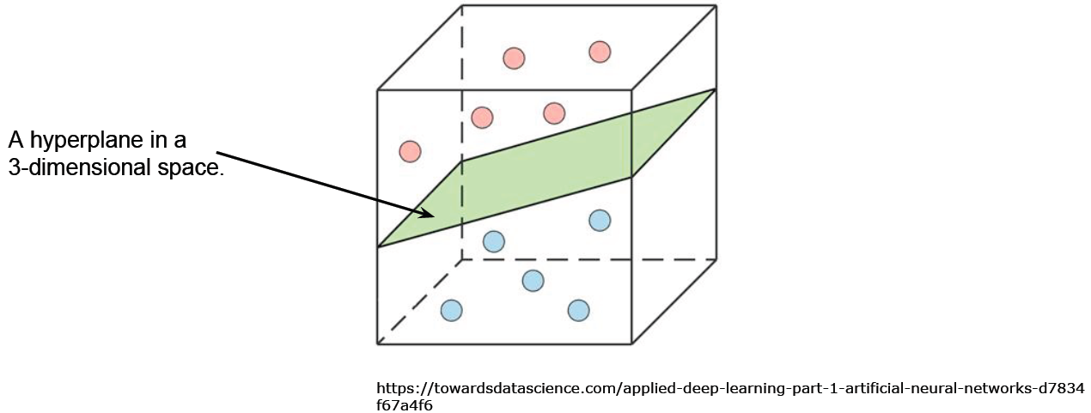
Linear Classifiers
This equation defines a hyperplane in d dimensions
  A hyperplane is a subspace whose dimension is one less than that of its ambient space.
  If a space is 3-dimensional, its hyperplanes are the 2-dimensional planes;
  if a space is 2-dimensional, its hyperplanes are the 1-dimensional lines.

Slide 16

Linear Classifiers
For prediction we simply see if
for new data x.
  If so, predict x to be positive
  If not, predict x to be negative
Learning consists of searching in the d-dimensional weight space for the set of weights (the linear boundary) that minimizes an error measure
A threshold can be introduced by a “dummy” feature
  The feature value is always 1.0
  Its weight corresponds to (the negative of) the threshold
Note that a minimum distance classifier is a special case of a linear classifier

Slide 18
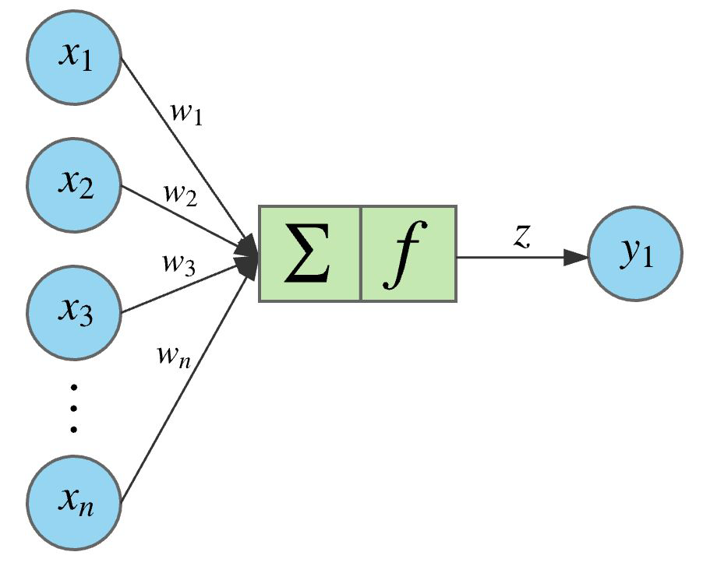
The Perceptron Classifier
(pages 729-731 in text)
Output
Θ
Transfer Function
Bias or Threshold
Input
Attributes
(Features)
Weights For Input
Attributes
https://towardsdatascience.com/applied-deep-learning-part-1-artificial-neural-networks-d7834f67a4f6

Slide 19
Two different types of perceptron output
x-axis below is f(x) = f = weighted sum of inputs
y-axis is the perceptron output
Thresholded output,
takes values +1 or -1
o(f)
f
σ(f)
Sigmoid output, takes
real values between -1 and +1
The sigmoid is in effect an approximation
to the threshold function above, but
has a gradient that we can use for learning
f
Sigmoid function is defined as
σ[ f ] = [ 2 / ( 1 + exp[- f ] ) ] - 1

Slide 20
Pseudo-code for Perceptron Training
Initialize each w_{j} (e.g.,randomly)
While (termination condition not satisfied)
  for i = 1: N % loop over data points (an iteration)
    for j= 1 : d % loop over weights
      deltawj = η ( y(i) – σ[f(i)] ) ∂σ[f(i)] x_{j}(i)
      w_{j} = w_{j} + deltawj
    end
  calculate termination condition
  end
Inputs: N features, N targets (class labels), learning rate η
Outputs: a set of learned weights

Slide 21
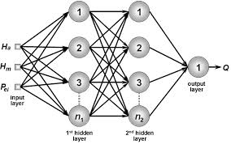
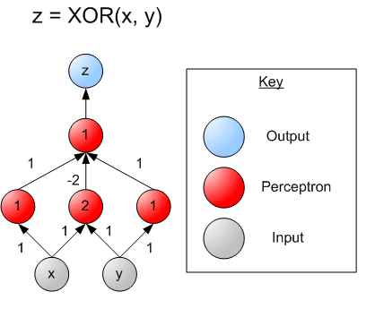
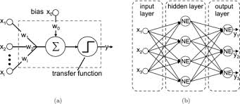
Multi-Layer Perceptrons (Artificial Neural Networks) (sections 18.7.3-18.7.4 in textbook)

Slide 22
Multi-Layer Perceptrons (Artificial Neural Networks) (sections 18.7.3-18.7.4 in textbook)
What if we took K perceptrons and trained them in parallel and then took a weighted sum of their sigmoidal outputs?
  This is a multi-layer neural network with a single “hidden” layer (the outputs of the first set of perceptrons)
  If we train them jointly in parallel, then intuitively different perceptrons could learn different parts of the solution
    They define different local decision boundaries in the input space
What if we hooked them up into a general Directed Acyclic Graph?
  Can create simple “neural circuits” (but no feedback; not fully general)
  Often called neural networks with hidden units
How would we train such a model?
  Backpropagation algorithm = clever way to do gradient descent
  Bad news: many local minima and many parameters
    training is hard and slow
  Good news: can learn general non-linear decision boundaries
  Generated much excitement in AI in the late 1980’s and 1990’s
  New current excitement with very large “deep learning” networks

Slide 23
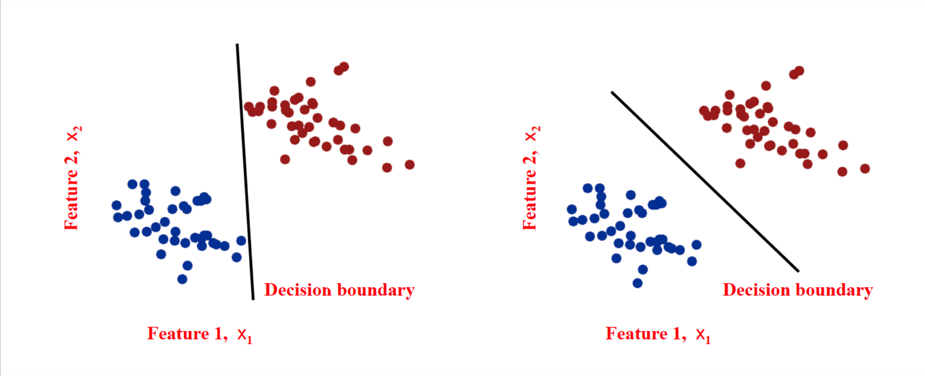
Which decision boundary is “better”?
Both have zero training error (perfect training accuracy).
But one seems intuitively better, more robust to error

Slide 24
Support Vector Machines (SVM): “Modern perceptrons”
(section 18.9, R&N)
A modern linear separator classifier
  Essentially, a perceptron with a few extra wrinkles
Constructs a “maximum margin separator”
  A linear decision boundary with the largest possible distance from the decision boundary to the example points it separates
  “Margin” = Distance from decision boundary to closest example
  The “maximum margin” helps SVMs to generalize well
Can embed the data in a non-linear higher dimension space
  Constructs a linear separating hyperplane in that space
    This can be a non-linear boundary in the original space
  Algorithmic advantages and simplicity of linear classifiers
  Representational advantages of non-linear decision boundaries
Currently most popular “off-the shelf” supervised classifier.

Slide 25
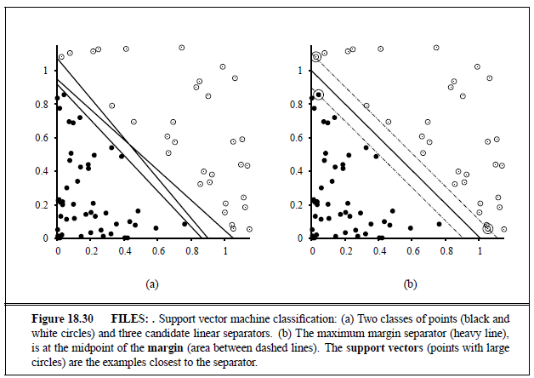
Constructs a “maximum margin separator”

Slide 26
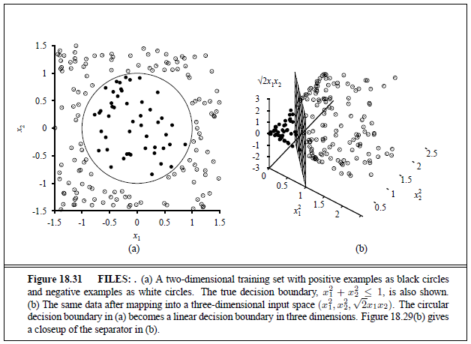
Can embed the data in a non-linear higher dimension space

Slide 27
Naïve Bayes Model (section 20.2.2 R&N 3rd ed.)
X₁
X₂
X₃
X_{n}
C
Basic Idea: We want to estimate P(C | X₁,…X_{n}), but it’s hard to think about computing the probability of a class from input attributes of an example.
Solution: Use Bayes’ Rule to turn P(C | X₁,…X_{n}) into a proportionally equivalent expression that involves only P(C) and P(X₁,…X_{n} | C).
Then assume that feature values are conditionally independent given class, which allows us to turn P(X₁,…X_{n} | C) into Π_{i} P(X_{i} | C).
P(C | X₁,…X_{n}) = P(C) P(X₁,…X_{n} | C) / P(X₁,…X_{n)} ∝ P(C) Π_{i} P(X_{i} | C)
We estimate P(C) easily from the frequency with which each class appears within our training data, and we estimate P(X_{i} | C) easily from the frequency with which each X_{i} appears in each class C within our training data.

Slide 28
Naïve Bayes Model (section 20.2.2 R&N 3rd ed.)
X₁
X₂
X₃
X_{n}
C
By Bayes Rule: P(C | X₁,…X_{n}) is proportional to P (C) Π_{i} P(X_{i} | C)
[note: denominator P(X₁,…X_{n}) is constant for all classes, may be ignored.]
Features Xi are conditionally independent given the class variable C
  choose the class value c_{i} with the highest P(c_{i} | x₁,…, x_{n})
  simple to implement, often works very well
  e.g., spam email classification: X’s = counts of words in emails
Conditional probabilities P(X_{i} | C) can easily be estimated from labeled date
  Problem: Need to avoid zeroes, e.g., from limited training data
  Solutions: Pseudo-counts, beta[a,b] distribution, etc.

Slide 29
Naïve Bayes Model (2)
P(C | X₁,…X_{n}) = α Π P(X_{i} | C) P (C)
Probabilities P(C) and P(Xi | C) can easily be estimated from labeled data
P(C = cj) ≈ #(Examples with class label cj) / #(Examples)
P(Xi = xik | C = cj)
≈ #(Examples with Xi value xik and class label cj)
/ #(Examples with class label cj)
Usually easiest to work with logs
log [ P(C | X₁,…X_{n}) ]
= log α + Σ [ log P(X_{i} | C) + log P (C) ]
DANGER: Suppose ZERO examples with Xi value xik and class label cj ?
An unseen example with Xi value xik will NEVER predict class label cj !
Practical solutions: Pseudocounts, e.g., add 1 to every #() , etc.
Theoretical solutions: Bayesian inference, beta distribution, etc.

Slide 30
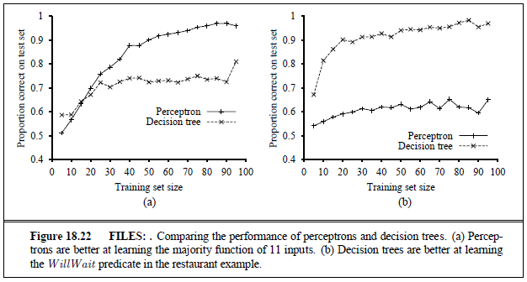
Classifier Bias — Decision Tree or Linear Perceptron?

Slide 31
Classifier Bias — Decision Tree or Linear Perceptron?

Slide 32
Classifier Bias — Decision Tree or Linear Perceptron?

Slide 33
Classifier Bias — Decision Tree or Linear Perceptron?

Slide 34
Classifier Bias — Decision Tree or Linear Perceptron?

