Slide 1
Intro to Artificial Intelligence CS 171
Reasoning Under Uncertainty
Chapter 13 and 14.1-14.2
Andrew Gelfand 3/1/2011

Slide 2
Today…
Representing uncertainty is useful in knowledge bases
Probability provides a coherent framework for uncertainty
Review basic concepts in probability
Emphasis on conditional probability and conditional independence
Full joint distributions are difficult to work with
Conditional independence assumptions allow us to model real-world phenomena with much simpler models
Bayesian networks are a systematic way to build structured distributions
Reading: Chapter 13; beginning of Chapter 14

Slide 3
History of Probability in AI
Early AI (1950’s and 1960’s)
Attempts to solve AI problems using probability met with mixed success
Logical AI (1970’s, 80’s)
Recognized that working with full probability models is intractable
Abandoned probabilistic approaches
Focused on logic-based representations
Probabilistic AI (1990’s-present)
Judea Pearl invents Bayesian networks in 1988
Realization that working w/ approximate probability models is tractable and useful
Development of machine learning techniques to learn such models from data
Probabilistic techniques now widely used in vision, speech recognition, robotics, language modeling, game-playing, etc

Slide 4
Uncertainty
Let action A_{t} = leave for airport t minutes before flight
Will A_{t} get me there on time?
Problems:
partial observability (road state, other drivers' plans, etc.)
noisy sensors (traffic reports)
uncertainty in action outcomes (flat tire, etc.)
immense complexity of modeling and predicting traffic
Hence a purely logical approach either
risks falsehood: “A₂₅ will get me there on time”, or
leads to conclusions that are too weak for decision making:
“A₂₅ will get me there on time if there's no accident on the bridge and it doesn't rain and my tires remain intact etc etc.”
(A₁₄₄₀ might reasonably be said to get me there on time but I'd have to stay overnight in the airport …)

Slide 5
Handling uncertainty
Default or nonmonotonic logic:
Assume my car does not have a flat tire
Assume A₂₅ works unless contradicted by evidence
Issues: What assumptions are reasonable? How to handle contradiction?
Rules with fudge factors:
A₂₅ |→_{0.3} get there on time
Sprinkler |→ _{0.99} WetGrass
WetGrass |→ _{0.7} Rain
Issues: Problems with combination, e.g., Sprinkler causes Rain??
Probability
Model agent's degree of belief
Given the available evidence,
A₂₅ will get me there on time with probability 0.04

Slide 6
Probability
Probabilistic assertions summarize effects of
laziness: failure to enumerate exceptions, qualifications, etc.
ignorance: lack of relevant facts, initial conditions, etc.
Subjective probability:
Probabilities relate propositions to agent's own state of knowledge
e.g., P(A₂₅ | no reported accidents) = 0.06
These are not assertions about the world
Probabilities of propositions change with new evidence:
e.g., P(A₂₅ | no reported accidents, 5 a.m.) = 0.15

Slide 7
Making decisions under uncertainty
Suppose I believe the following:
P(A₂₅ gets me there on time | …) = 0.04
P(A₉₀ gets me there on time | …) = 0.70
P(A₁₂₀ gets me there on time | …) = 0.95
P(A₁₄₄₀ gets me there on time | …) = 0.9999
Which action to choose?
Depends on my preferences for missing flight vs. time spent waiting, etc.
Utility theory is used to represent and infer preferences
Decision theory = probability theory + utility theory

Slide 8
Syntax
Basic element: random variable
Similar to propositional logic: possible worlds (aka sample space) defined by assignment of values to random variables.
Boolean random variables
e.g., Cavity (do I have a cavity?)
Discrete random variables
e.g., Weather is one of <sunny,rainy,cloudy,snow>
Domain values must be exhaustive and mutually exclusive
Elementary proposition constructed by assignment of a value to a random variable:
e.g., Weather = sunny, Cavity = false (abbreviated as ¬cavity)
Complex propositions formed from elementary propositions and standard logical connectives e.g., Weather = sunny ∨ Cavity = false

Slide 9
Syntax
Atomic event: A complete specification of the state of the world about which the agent is uncertain
e.g. Imagine flipping two coins
The set of all possible worlds is:
S={(H,H),(H,T),(T,H),(T,T)}
Meaning there are 4 distinct atomic events in this world
Atomic events are mutually exclusive and exhaustive
2 atomic events A and B are mutually exclusive if A ∧ B = Ø when A ≠ B

Slide 10
Axioms of probability
Given a set of possible worlds S
P(A) ≥ 0 for all atomic events A
P(S) = 1
If A and B are mutually exclusive (ME), then
P(A ∨ B) = P(A) + P(B)
Refer to P(A) as probability of event A
e.g. if coins are fair P({H,H}) = ¼

Slide 11
Probability and Logic
Probability can be viewed as a generalization of propositional logic
P(a):
a is any sentence in propositional logic
Belief of agent in a is no longer restricted to true, false, unknown
P(a) can range from 0 to 1
P(a) = 0, and P(a) = 1 are special cases
So logic can be viewed as a special case of probability

Slide 12
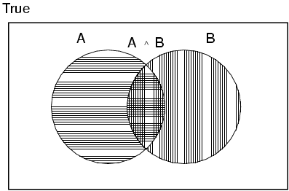
Basic Probability Theory
If A and B are not ME
P(A ∨ B) = P(A) + P(B) – P(A ∧ B)
e.g. imagine I flip two coins
4 possible worlds S={(H,H),(H,T),(T,H),(T,T)}
and all are equally likely
Consider event E that the 1st coin is heads: E={(H,H),(H,T)}
And event F that the 2nd coin is heads: F={(H,H),(T,H)}
P(E ∨ F) = P(E) + P(F) – P(E ∧ F) = ½ + ½ - ¼

Slide 13
Conditional Probability
The 2 dice problem
Suppose I roll two fair dice and 1st dice is a 4
What is probability that sum of the two dice is 6?
6 possible events, given 1st dice is 4
(4,1),(4,2),(4,3),(4,4),(4,5),(4,6)
Since all events (originally) had same probability, these 6 events should have equal probability
Probability that sum is 6, given 1st dice is 4 is 1/6

Slide 14
Conditional Probability
Let A denote event that sum of dice is 6
Let B denote event that 1st dice is 4
Conditional Probability denoted as: P(A|B)
Probability of event A given event B
General formula given by:
Probability of A ∧ B relative to probability of B
Conditional probabilities follow same rules as unconditional or prior probabilities
e.g. P(A|B) + P(⌐A|B) = 1

Slide 15
Random Variables
Often interested in some function of event, rather than event itself
e.g. we care that sum of two dice is 4, not whether the event was (1,3), (2,2) or (3,1)
Random variable is a real-valued function on space of all possible worlds
e.g. Let Y = Number of heads in 2 coin flips
P(Y=0) = P({T,T}) = ¼
P(Y=1) = P({H,T} ∨ {T,H}) = ½

Slide 16
Prior (Unconditional) Probability
Probability distribution gives values for all possible assignments:
Joint probability distribution for a set of random variables gives the probability of every atomic event on those random variables
P(A,B) is shorthand for P(A ∧ B)
Joint distributions are normalized: Σ_{a} Σ_{b} P(A=a, B=b) = 1
For a set of k binary variables, joint distribution represented as table with 2^{k} entries!
Desire a more compact representation…
 | Sunny | Rainy | Cloudy | Snowy
P(Weather) | 0.7 | 0.1 | 0.19 | 0.01
P(Weather,Cavity) | Sunny | Rainy | Cloudy | Snowy
Cavity | 0.144 | 0.02 | 0.016 | 0.006
⌐Cavity | 0.556 | 0.08 | 0.174 | 0.004

Slide 17
Computing Probabilities
Say we are given following joint distribution
What is P(cavity)?
Law of Total Probability (aka marginalization)
P(a) = Σ_{b} P(a, b)
= Σ_{b} P(a | b) P(b)

Slide 18
Computing Probabilities
What is P(cavity|toothache)?
Can compute any conditional probability given joint distribution
P(c | b) = Σ_{a} Σ_{d} P(a, c, d | b)
= Σ_{a} Σ_{d} P(a, c, d, b) / P(b)

Slide 19
Computing Probabilities: The Chain Rule
We can always write
P(a, b, c, … z) = P(a | b, c, …. z) P(b, c, … z)
(by definition of joint probability)
Repeatedly applying this idea, we can write
P(a, b, c, … z) = P(a | b, c, …. z) P(b | c,.. z) P(c| .. z)..P(z)
This factorization holds for any ordering of the variables
This is the chain rule for probabilities

Slide 20
Independence
A and B are independent iff
P(A|B) = P(A) or P(B|A) = P(B) or P(A, B) = P(A) P(B)
e.g. for n independent biased coins, O(2^{n}) →O(n)
Absolute independence is powerful but rare
e.g. Consider field of dentistry. Many variables, none of which are independent. What should we do?

Slide 21
Conditional independence
P(Toothache, Cavity, Catch) has 2³ – 1 = 7 independent entries
If I have a cavity, the probability that the probe catches doesn't depend on whether I have a toothache:
(1) P(catch | toothache, cavity) = P(catch | cavity)
The same independence holds if I haven't got a cavity:
(2) P(catch | toothache,¬cavity) = P(catch | ¬cavity)
Catch is conditionally independent of Toothache given Cavity:
P(Catch | Toothache,Cavity) = P(Catch | Cavity)
Equivalent statements:
P(Toothache | Catch, Cavity) = P(Toothache | Cavity)
P(Toothache, Catch | Cavity) = P(Toothache | Cavity) P(Catch | Cavity)

Slide 22
Conditional independence...
Write out full joint distribution using chain rule:
P(Toothache, Catch, Cavity)
= P(Toothache | Catch, Cavity) P(Catch, Cavity)
= P(Toothache | Catch, Cavity) P(Catch | Cavity) P(Cavity)
= P(Toothache | Cavity) P(Catch | Cavity) P(Cavity)
Requires only 2 + 2 + 1 = 5 independent numbers
In most cases, the use of conditional independence reduces the size of the representation of the joint distribution from exponential in n to linear in n.
Conditional independence is our most basic and robust form of knowledge about uncertain environments.

Slide 23
Conditional Independence vs Independence
Conditional independence does not imply independence
Example:
A = height
B = reading ability
C = age
P(reading ability | age, height) = P(reading ability | age)
P(height | reading ability, age) = P(height | age)
Note:
Height and reading ability are dependent (not independent) but are conditionally independent given age

Slide 24
Bayes’ Rule
Two urns problem
Urn 1 contains: 2 white balls & 7 black balls
Urn 2 contains: 5 white balls & 6 black balls
Flip a fair coin and draw a ball from Urn 1 if heads; Urn 2 if tails
What is probability that coin was heads, given a white ball was selected?
Want to compute P(H|W)
Have P(H) = ½ , P(W|H) = 2/9 and P(W|⌐H) = 5/11

Slide 25
Bayes' Rule…
Derived from product rule: P(a ∧ b) = P(a|b) P(b) = P(b|a) P(a)
⇒ P(a | b) = P(b | a) P(a) / P(b)
or in distribution form
P(Y|X) = P(X|Y) P(Y) / P(X) = αP(X|Y) P(Y)
P(a | b, c) = ??
= P(b, c | a) P(a) / P(b,c)
P(a, b | c, d) = ??
= P(c, d | a, b) P(a, b) / P(c, d)
Both are examples of basic pattern p(x|y) = p(y|x)p(x)/p(y)
(it helps to group variables together, e.g., y = (a,b), x = (c, d))

Slide 26
Bayes' Rule and conditional independence
P(Cavity | toothache ∧ catch)
= α P(toothache ∧ catch | Cavity) P(Cavity)
= α P(toothache | Cavity) P(catch | Cavity) P(Cavity)
This is an example of a naïve Bayes model:
P(Cause,Effect₁, … ,Effect_{n}) = P(Cause) π_{i}P(Effect_{i}|Cause)
Total number of parameters is linear in n

Slide 27
What does all this have to do with AI?
Logic-based knowledge representation
Set of sentences in KB
Agent’s belief in any sentence is: true, false, or unknown
In real-world problems there is uncertainty
P(snow in New York on January 1) is not 0 or 1 or unknown
P(vehicle speed > 50 | sensor reading)
P(Dow Jones will go down tomorrow | data so far)
P(pit in square 2,2 | evidence so far)
Not acknowledging this uncertainty can lead to brittle systems and inefficient use of information
Uncertainty is due to:
Things we did not measure (which is always the case)
E.g., in economic forecasting
Imperfect knowledge
P(symptom | disease) -> we are not 100% sure
Noisy measurements
P(speed > 50 | sensor reading > 50) is not 1

Slide 28
Agents, Probabilities & Degrees of Belief
What we were taught in school (“frequentist” view)
P(a) represents the frequency that event a will happen in repeated trials -> “relative frequency” interpretation
Degree of belief
P(a) represents an agent’s degree of belief that event a is true
This is a more general view of probability
Agent’s probability is based on what information they have
E.g., based on data or based on a theory
Examples:
a = “life exists on another planet”
What is P(a)? We will all assign different probabilities
a = “Mitt Romney will be the next US president”
What is P(a)?
In each case the probabilities can vary from agent to agent depending on their models of the world and how much data they have

Slide 29
More on Degrees of Belief
Our interpretation of P(a | e) is that it is an agent’s degree of belief in the proposition a, given evidence e
Note that proposition a is true or false in the real-world
P(a|e) reflects the agent’s uncertainty or ignorance
The degree of belief interpretation does not mean that we need new or different rules for working with probabilities
The same rules (Bayes rule, law of total probability, probabilities sum to 1) still apply – our interpretation is different
If Agent 1 has inconsistent sets of probabilities (violate axioms of probability theory) then there exists a betting strategy that allows Agent 2 to always win in bets against Agent 1
See de Finetti’s argument in the text

Slide 30
Decision Theory – why probabilities are useful
Consider 2 possible actions that can be recommended by a medical decision-making system:
a = operate
b = don’t operate
2 possible states of the world
c = patient has cancer, and also not(c)
Given evidence so far, agent’s degree of belief in c is p(c|e)
Costs (to agent) associated with various outcomes:
Take action a and patient has cancer: cost = $30k
Take action a and patient has no cancer: cost = -$50k
Take action b and patient has cancer: cost = -$100k
Take action b and patient has no cancer: cost = 0.

Slide 31
Maximizing expected utility
What action should the agent take?
A rational agent should maximize expected utility, or equivalently minimize expected cost
Expected cost of actions:
E[ cost(a) ] = 30 p(c) – 50 [1 – p(c) ]
E[ cost(b) ] = -100 p(c)
Break even point? 30p – 50 + 50p = -100p
100p + 30p + 50p = 50
=> p(c) = 50/180 ~ 0.28
If p(c) > 0.28, the optimal decision is to operate
Original theory from economics, cognitive science (1950’s)
- But widely used in modern AI, e.g., in robotics, vision, game-playing
Can only make optimal decisions if know the probabilities

Slide 32
Constructing a Propositional Probabilistic Knowledge Base
Define all variables of interest: A, B, C, … Z
Define a joint probability table for P(A, B, C, … Z)
We have seen earlier how this will allow us to compute the answer to any query, p(query | evidence),
where query and evidence = any propositional sentence
2 major problems:
Computation time:
P(a|b) requires summing out over all other variables in the model, e.g., O(m^{K-1}) with K variables
Model specification
Joint table has O(m^{K}) entries – where will all the numbers come from?
These 2 problems effectively halted the use of probability in AI research from the 1960’s up until about 1990

Slide 33
Bayesian Networks

Slide 34
A Whodunit
You return home from a long day to find that your house guest has been murdered.
There are two culprits:
1) The Butler; and 2) The Cook
There are three possible weapons:
1) A knife; 2) A gun; and 3) A candlestick
Lets use probabilistic reasoning to find out whodunit?

Slide 35
Representing the problem
There are 2 uncertain quantities
Culprit = {Butler, Cook}
Weapon = {Knife, Pistol, Candlestick}
What distributions should we use?
Butler is an upstanding guy
Cook has a checkered past
Butler keeps a pistol from his army days
Cook has access to many kitchen knives
The Butler is much older than the cook

Slide 36
Representing the problem…
What distributions should we use?
Butler is an upstanding guy
Cook has a checkered past
Butler keeps a pistol from his army days
Cook has access to many kitchen knives
The Butler is much older than the cook
 | Butler | Cook
P(Culprit) | 0.3 | 0.7
 | Pistol | Knife | Candlestick
P(weapon|culprit=Butler) | 0.7 | 0.15 | 0.15
 | Pistol | Knife | Candlestick
P(weapon|culprit=Cook) | 0.1 | 0.6 | 0.3

Slide 37
Solving the Crime
If observe that murder weapon was a pistol, who is the most likely culprit?
The Butler!

Slide 38
Graphical Representation
Each node represents a random variable
Arrows indicate cause-effect relationship
Shaded nodes represent observed variables
Whodunit model in “words”:
Culprit chooses a weapon;
You observe the weapon and infer the culprit
Culprit
Weapon

Slide 39
Bayesian Networks
Represent dependence/independence via a directed graph
Nodes = random variables
Edges = direct dependence
Structure of the graph ⬄ Conditional independence relations
Recall the chain rule of repeated conditioning:
P(a, b, c, … z) = P(a | b, c, …. z) P(b | c,.. z) P(c| .. z)..P(z)
Requires that graph is acyclic (no directed cycles)
2 components to a Bayesian network
The graph structure (conditional independence assumptions)
The numerical probabilities (for each variable given its parents)
p(X₁, X₂,....X_{N}) = Π p(X_{i} | parents(X_{i} ) )
The full joint distribution
The graph-structured approximation

Slide 40
Example of a simple Bayesian network
A
B
p(A,B,C) = p(C|A,B)p(A)p(B)
C
Probability model has simple factored form
Directed edges => direct dependence
Absence of an edge => conditional independence
Also known as belief networks, graphical models, causal networks
Other formulations, e.g., undirected graphical models

Slide 41
Examples of 3-way Bayesian Networks
A
B
C
Marginal Independence:
p(A,B,C) = p(A) p(B) p(C)

Slide 42
Examples of 3-way Bayesian Networks
Conditionally independent effects:
p(A,B,C) = p(B|A)p(C|A)p(A)
B and C are conditionally independent
Given A
e.g., A is a disease, and we model
B and C as conditionally independent
symptoms given A
e.g. A is culprit, B is murder weapon
and C is fingerprints on door to the
guest’s room
A
B
C

Slide 43
Examples of 3-way Bayesian Networks
A
B
Independent Causes:
p(A,B,C) = p(C|A,B)p(A)p(B)
“Explaining away” effect:
Given C, observing A makes B less likely
e.g., earthquake/burglary/alarm example
A and B are (marginally) independent
but become dependent once C is known
C

Slide 44
Examples of 3-way Bayesian Networks
A
B
C
Markov chain dependence:
p(A,B,C) = p(C|B) p(B|A)p(A)
e.g. A is culprit, B is fingerprints
and C is murder weapon

Slide 45
Example
Consider the following 5 binary variables:
B = a burglary occurs at your house
E = an earthquake occurs at your house
A = the alarm goes off
J = John calls to report the alarm
M = Mary calls to report the alarm
What is P(B | M, J) ? (for example)
Using full joint distribution to answer this question requires
2⁵ = 32 probabilities
Can we use prior domain knowledge to come up with a Bayesian network that requires fewer probabilities?

Slide 46
Constructing a Bayesian Network (1)
Order the variables in terms of causality (may be a partial order)
e.g., {E, B} -> {A} -> {J, M}
P(J, M, A, E, B) = P(J, M | A, E, B) P(A| E, B) P(E, B)
≈ P(J, M | A) P(A| E, B) P(E) P(B)
≈ P(J | A) P(M | A) P(A| E, B) P(E) P(B)
These CI assumptions are reflected in the graph structure of the Bayesian network

Slide 47
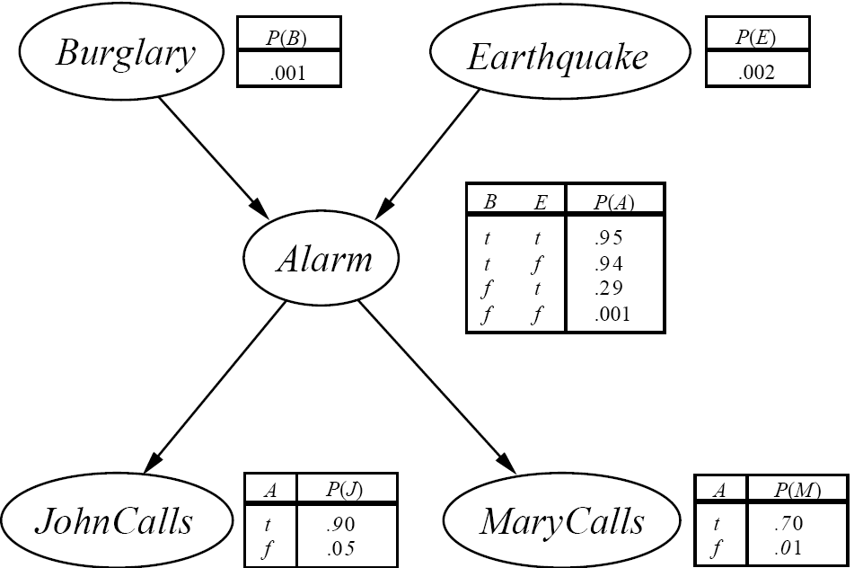
The Resulting Bayesian Network

Slide 48
Constructing this Bayesian Network (2)
P(J, M, A, E, B) =
P(J | A) P(M | A) P(A | E, B) P(E) P(B)
There are 3 conditional probability
tables (CPDs) to be determined:
P(J | A), P(M | A), P(A | E, B)
Requires 2 + 2 + 4 = 8 probabilities
And 2 marginal probabilities P(E), P(B) -> 2 more probabilities
Where do these probabilities come from?
Expert knowledge
From data (relative frequency estimates)
Or a combination of both - see discussion in Section 20.1 and 20.2 (optional)

Slide 49
The Bayesian network

Slide 50
Number of Probabilities in Bayes Nets
Consider n binary variables
Unconstrained joint distribution requires O(2^{n}) probabilities
If we have a Bayesian network, with a maximum of k parents for any node, then we need O(n 2^{k}) probabilities
Example
Full unconstrained joint distribution
n = 30: need 10⁹ probabilities for full joint distribution
Bayesian network
n = 30, k = 4: need 480 probabilities

Slide 51
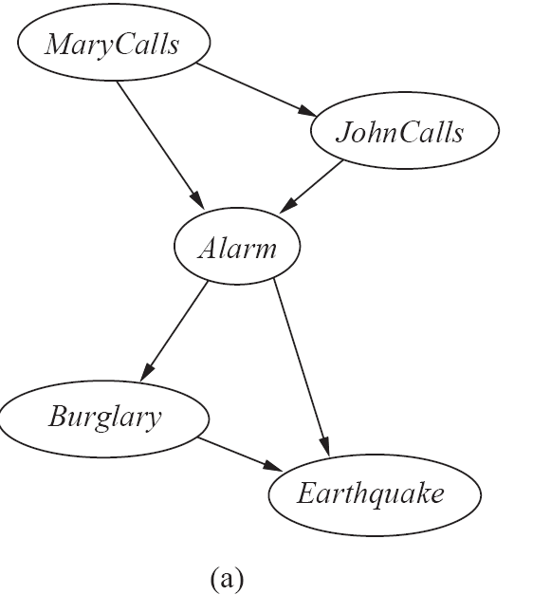
The Bayesian Network from a different Variable Ordering

Slide 52
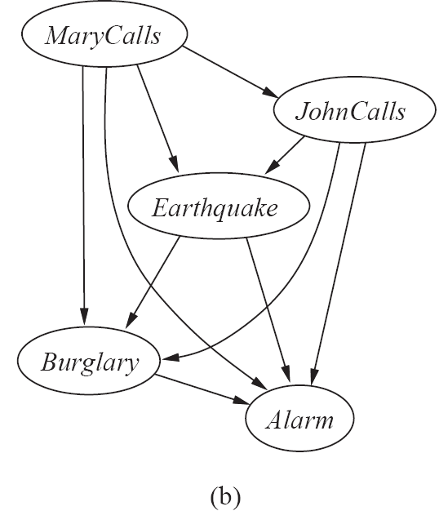
The Bayesian Network from a different Variable Ordering

Slide 53
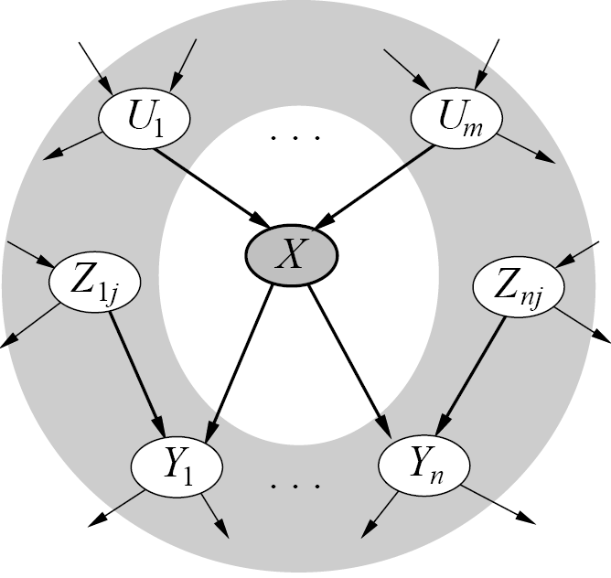
Given a graph, can we “read off” conditional independencies?
A node is conditionally independent
of all other nodes in the network
given its Markov blanket (in gray)

Slide 54
Inference (Reasoning) in Bayes Nets
Consider answering a query in a Bayesian Network
Q = set of query variables
e = evidence (set of instantiated variable-value pairs)
Inference = computation of conditional distribution P(Q | e)
Examples
P(burglary | alarm)
P(earthquake | JCalls, MCalls)
P(JCalls, MCalls | burglary, earthquake)
Can we use the structure of the Bayesian Network to answer queries efficiently? Answer = yes
Generally speaking, complexity is inversely proportional to sparsity of graph

Slide 55
General Strategy for inference
Want to compute P(q | e)
Step 1:
P(q | e) = P(q,e)/P(e) = α P(q,e) since P(e) is constant wrt Q
Step 2:
P(q,e) = Σ_{a..z} P(q, e, a, b, …. z), by the law of total probability
Step 3:
Σ_{a..z} P(q, e, a, b, …. z) = Σ_{a..z} Π_{i} P(variable i | parents i)
(i.e. use Bayesian network factoring)
Step 4:
Distribute summations across product terms for efficient computation

Slide 56
Complexity of Bayes Net inference
Assume the network is a polytree
Only a single directed path between any 2 nodes
Complexity scales as O(n m^{K+1})
n = number of variables
m = arity of variables
K = maximum number of parents for any node
Compare to O(m^{n-1}) for brute-force method
Network is not a polytree?
Can cluster variables so that ‘new’ graph is a tree
Complexity is then O(n m^{W+1}), where W = # variables in largest cluster
D
B
E
A
C

Slide 57
Naïve Bayes Model
C
X₁
X₂
X₃
X_{n}
P(C | X₁,…X_{n}) = α Π P(X_{i} | C) P (C)
Features X are conditionally independent given the class variable C
Widely used in machine learning
e.g., spam email classification: X’s = counts of words in emails
Probabilities P(C) and P(Xi | C) can easily be estimated from labeled data

Slide 58
Hidden Markov Model (HMM)
Observed
Y₁
Y₂
Y₃
Y_{n}
- - - - - - - - - - - - - - - - - - - - - - - - - - - - - - - - - - - - - - - - - - - - - - - - - - - -
S₃
S_{n}
Hidden
S₁
S₂
Two key assumptions:
1. hidden state sequence is Markov
2. observation Y_{t} is CI of all other variables given S_{t}
Widely used in speech recognition, protein sequence models
Since this is a Bayesian network polytree, inference is linear in n

Slide 59
Summary
Bayesian networks represent joint distributions using a graph
The graph encodes a set of conditional independence assumptions
Answering queries (i.e. inference) in a Bayesian network amounts to efficient computation of appropriate conditional probabilities
Probabilistic inference is intractable in the general case
Can be done in linear time for certain classes of Bayesian networks

