Slide 1
Shape Classification Using Zernike Moments
By:
Michael Vorobyov

Slide 2
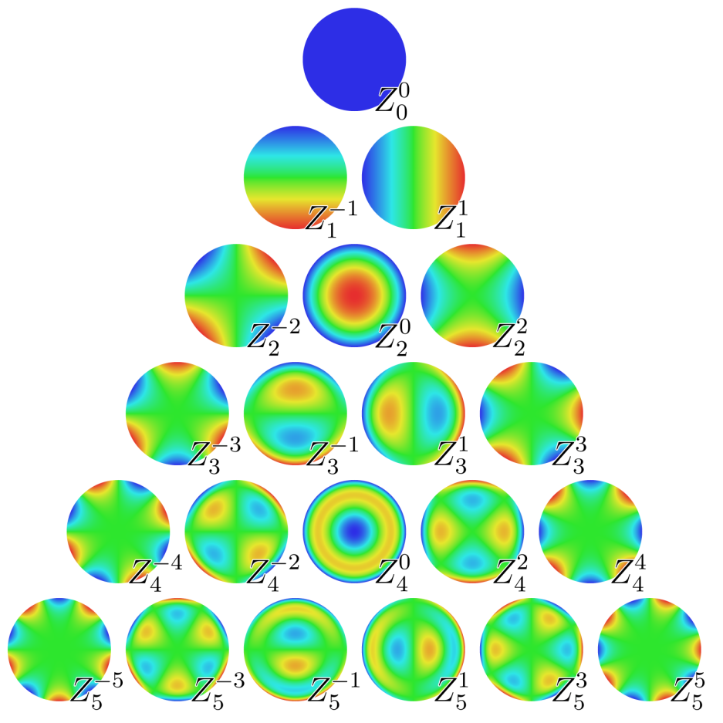
Moments
In general, moments are quantitative values that describe a distribution by raising the components to different powers

Slide 3
Regular (Cartesian) Moments
A regular moment has the form of projection of onto the monomial

Slide 4
Problems of Regular Moments
The basis set is not orthogonal → The moments contain redundant information.
As increases rapidly as order increases, high computational precision is needed.
Image reconstruction is very difficult.

Slide 5
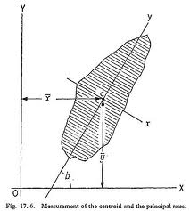
Benefits of Regular Moments
Simple translational and scale invariant properties
By preprocessing an image using the regular moments we can get an image to be translational and scale invariant before running Zernike moments

Slide 6
Orthogonal Functions
A set of polynomials orthogonal with respect to integration are also orthogonal with respect to summation.

Slide 7
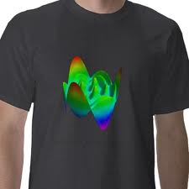
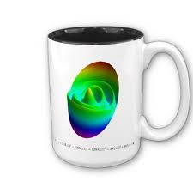
Orthogonal Moments
Moments produced using orthogonal basis sets.
Require lower computational precision to represent images to the same accuracy as regular moments.

Slide 8
Zernike Polynomials
Set of orthogonal polynomials defined on the unit disk.

Slide 9
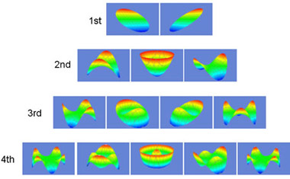
Zernike Moments
Simply the projection of the image function onto these orthogonal basis functions.

Slide 10
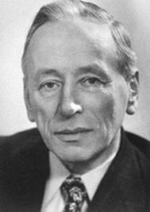
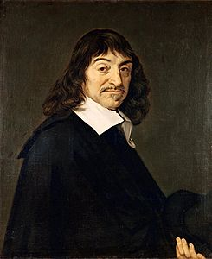
Advantages of Zernike Moments
Simple rotation invariance
Higher accuracy for detailed shapes
Orthogonal
Less information redundancy
Much better at image reconstruction (vs. cartesian moments)
VS.

Slide 11
Scale and Translational Invariance
Scale: Multiply by the scale factor raised to a certain power
Translational: Shift image’s origin to centroid (computed from normal first order moments)

Slide 12
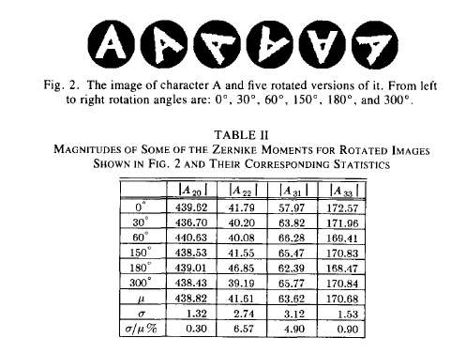
Rotational Invariance
The magnitude of each Zernike moment is invariant under rotation.

Slide 13
Image Reconstruction
Orthogonality enables us to determine the individual contribution of each order moment.
Simple addition of these individual contributions reconstructs the image.

Slide 14
Can you guess the reconstruction?

Slide 15
Order: 5
Ball?
Face?
Pizza?

Slide 16
Order: 15
Squirrel?
Mitten?
Cowboy Hat?

Slide 17
Order: 25
Dinosaur?
Bird?
Flower?

Slide 18
Order: 35
Bird?
Plane?
Superman?

Slide 19
Order: 45
Pterodactyl?
Crane?
Goose?

Slide 20
Crane!

Slide 21
Image Reconstruction
Reconstruction of a crane shape via Zernike moments up to order 10k-5,
k = {1,2,3,4,5}.
(a)
(b)
(c)
(d)
(e)
(f)

Slide 22
Determining Min. Order
After reconstructing image up to moment
Calculate the Hamming distance,
which is the number of pixels that are
different between and
Since, in general, decreases as
increases, finding the first for which
will determine the minimum order to reach a predetermined accuracy.

Slide 23
Experimentation & Results
We used a leaf database of 62 images of 19 different leaf types which were reduced to a 128 by 128 pixel image from 2592 by 1728 pixel image
Made to be scale and translational by resizing to a common area of 1450 pixels and putting the origin at the centroid
Clustering was done by using the Hierarchical clustering method

Slide 24
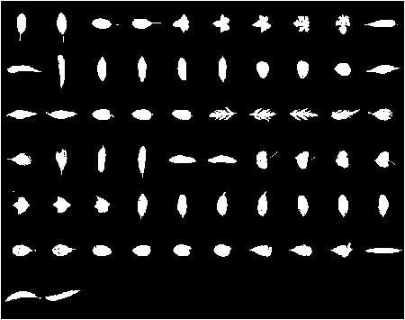
Image Database

Slide 25
Original Clusters
Type 1
Type 5
Type 2
Type 6
Type 3
Type 7
Type 4

Slide 26
The Zernike Clusters
Type 1
Type 5
Type 2
Type 6
Type 3
Type 7
Type 4

Slide 27
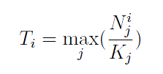
How to Evaluate Clusters
Cue validity is a measure of how valid is the clustering with respect to the cue or object type.
Category validity is the measure of how valid is the clustering with respect to other inter-cluster objects.
Combination

Slide 28
Cue/Category Validity
Cue: max(4/6, 1/7, 1/6) = 4/6
Cat: max(4/6, 1/6, 1/6) = 4/6
Q = 4/6 * 4/6 = 4/9
Cue: max(2/6, 1/7, 5/6) = 5/6
Cat: max(2/8, 1/8, 5/8) = 5/8
Q = 5/6 * 5/8 = 25/48
Cue: max(0/6, 5/7, 0/6) = 5/7
Cat: max(0/5, 5/5, 0/5) = 5/5
Q = 5/7 * 5/5 = 5/7

Slide 29
Clustering Results for Different Orders

Slide 30
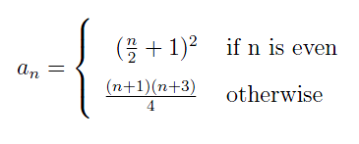
How To Improve Results?
High order Zernike Moments are computed to really high powers they capture a lot of noise
Propose 4 weight functions
Polynomial:
Exponential:
Order Amount: where
Hamming Distance: where

Slide 31
Weight Functions

Slide 32
Results

Slide 33
Results Cont.

Slide 34
Conclusion
The ideal number of moments to use in a clustering problem depends on the data at hand and for shapes, nearly all the information is found in the boundary.
For our dataset, we found that by utilizing a high number of moments becomes redundant
For our data ZM's seem to reach an optimal accuracy at around the order 15 and afterwards seems to drop and almost flatten out at a certain limit

Slide 35
Conclusion Cont. – Weight Functions
When a weight function is applied the clustering results reach a peak and then flatten out without ever increasing no matter how many orders are added
The wider the range of orders that give accurate results during classification, the less chance one has of making an error when picking the threshold for the Hamming distance.

Slide 36
Future Research
Apply Zernike’s to supervised classification problem
Make hybrid descriptor which combines Zernike’s and contour curvature to capture shape and boundary information
Use machine learning techniques to learn the weight of Zernike Moments
Weight function using variance of moments
Run against other shape descriptors to match performance

