Slide 1
ICS FACULTY PANEL ON IMPROVING YOUR GRADUATE SCHOOL APPLICATION Tuesday, 1 Nov., 2016, noon-1:50pm, in DBH-6011 **** Pizza, soft drinks, and refreshments will be served. ****
Wondering what to do to improve your graduate school application?
Wondering how the process "really works," and what they look for?
Come to this ICS FACULTY PANEL to hear advice from the ICS faculty.
The very people who admit students into the ICS graduate programs
will give advice and answer questions about graduate school applications.
Next, a panel of current ICS graduate students will discuss their
experiences in successfully navigating graduate school admission.
Sophomores, Juniors, and Masters students are especially encouraged
to attend so that they can begin planning for graduate school now.
For students unable to attend the event, a video of the discussion
subsequently will be posted on the ICS SAO web page.

Slide 2
ICS FACULTY PANEL ON IMPROVING YOUR GRADUATE SCHOOL APPLICATION Tuesday, 1 Nov., 2016, noon-1:50pm, in DBH-6011 **** Pizza, soft drinks, and refreshments will be served. ****
Wondering what to do to improve your graduate school application?
Come to this ICS FACULTY PANEL to hear advice from the ICS faculty.
Daniel Fabrega, Special Guest
* Manager, Graduate Preparation and Recruitment, UCI Graduate Division
Yunan Chen, Professor and Vice-Chair for Undergraduate Affairs, Informatics
* Human Computer Interaction, Medical Informatics
Rina Dechter, Professor and Vice Chair Computing Division, Computer Science
* Artificial Intelligence and Machine Learning
Dan Gillen, Professor and Chair, Statistics
* Statistics and Statistical Theory
Ian Harris, Professor and Vice Chair of Undergraduate Studies, Computer Science
* Computer Architecture and Design, Embedded Systems
Gillian R Hayes, Robert A. and Barbara L. Kleist Professor and Vice Chair of Graduate Affairs, Informatics
* Computer-Supported Cooperative Work, Human Computer Interaction, Medical Informatics, Social Informatics,
Ubiquitous Computing
Alexandru Nicolau, Professor and Chair, Computer Science
* Computer Architecture and Design, Embedded Systems, Programming Languages and Systems
Hal Stern, Professor and Ted and Janice Smith Family Foundation Dean, Statistics
* Statistics and Statistical Theory, Artificial Intelligence and Machine Learning
André van der Hoek, Professor and Chair, Informatics
* Software Engineering
Zhaoxia Yu, Professor and Vice Chair of Undergraduate Affairs, Statistics
* Statistics and Statistical Theory
Following the faculty, a panel of current ICS graduate students will discuss their experiences in how they successfully navigated graduate school admission.

Slide 3
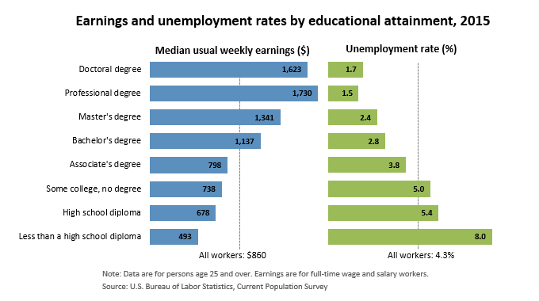
Source: US Bureau of Labor Statistics
“Career Outlook, March 2016 / Data on display: Education matters”
http://www.bls.gov/careeroutlook/2016/data-on-display/education-matters.htm
Professional degrees include MD, DDS, DVM, LLB, JD.
(Physicians, dentists, veterinarians, lawyers; the US has not offered the LLB since 1971.)

