Slide 1
A Welcome and Orientation
to UCI
and Donald Bren School of ICS
For International Students
Summer 2015

Slide 2
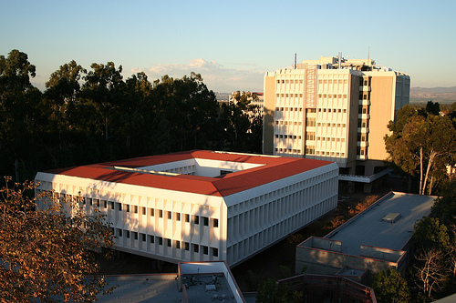
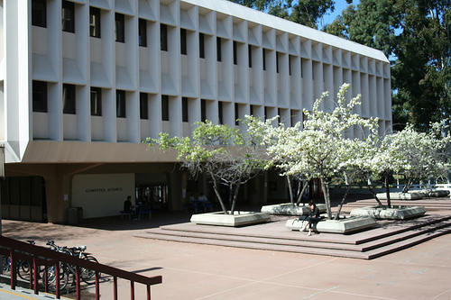
Bren School Student Affairs Office
  364 Computer Science I
  Telephone: (949) 824-5156
  E-mail: ucounsel@uci.edu
  Web: www.ics.uci.edu
  Monday – Friday: 9 a.m. – 12 p.m. & 1-4 p.m.

Slide 3


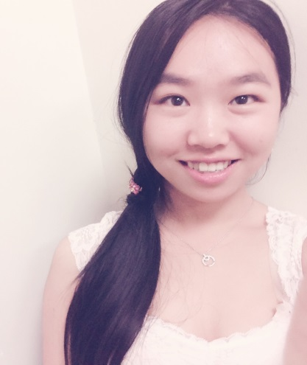
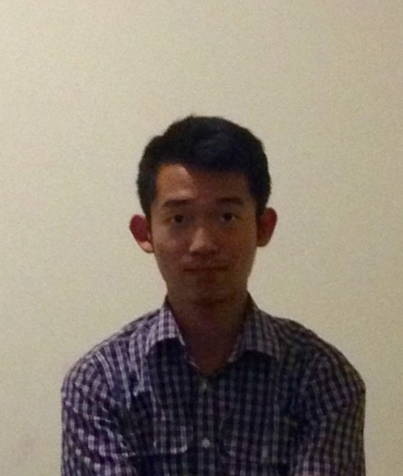
ICS Peer Advisors
  Walk-in advising
  Can help you with:
    -Academic planning
    -Scheduling issues
    -Campus resources
    -Changing/Adding Majors
    -Minors
    -Academic progress check
    -Graduation Check
    -Non-academic issues
      Stress management
      Time management
      Success strategies
  ucounsel@uci.edu
  949-824-8010

Slide 4
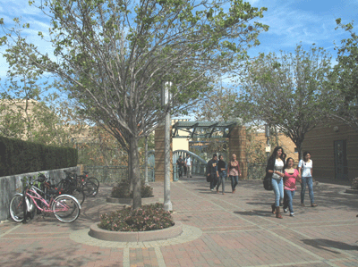
Your UCI Catalogue Rights
2015-16 is your catalogue year
You are held to the policies and requirements in this catalogue (or the year in which you started community college)
Can find answers to almost all of general student Qs here
The 2015-16 catalog will be available online in July: http://www.editor.uci.edu/catalogue/

Slide 5
3 Components of your UCI Degree
UC Requirements
General Education Requirements
UC Entry Level Writing
American History & Institutions
Unit Requirement
Residency Requirement
Grade Requirement
General Education
Writing (3)
Science & Technology (3)
Social & Behavioral Sciences (3)
Arts & Humanities (3)
Quantitative, Symbolic & Computational Reasoning (3)
Language other than English (1-3)
Multicultural Studies (1)
International / Global Issues (1)
Major Requirements
Individual requirements depending on your major

Slide 6
Donald Bren School of
Information
& Computer Sciences
#1-5 UC Requirements
Summer 2015

Slide 7

#1. UC Entry Level Writing
International students will enroll in WR 39A after Academic English courses:
WR 39A Introduction to Writing and Rhetoric
  Write essays, learn principles of rhetoric, paragraph development, sentence structure

Slide 8

#2. American History & Institutions
International students will enroll in:
  -History 40ABC; or
  -One course from History 40ABC and Political Science 21A (2 courses total)

Slide 9

#3, 4 & 5. Unit, Residency & Grade Requirements
You must graduate with a minimum of 180 units.
At least 36 of the last 45 units must be completed at UCI.
Grade Requirement: 2.0 GPA
  -In all UC courses
  -In all courses required for your major
  -In all UD courses required for your major

Slide 10
Donald Bren School of
Information
& Computer Sciences
#6 General Education Requirements
Summer 2015

Slide 11
Academic English
Enrollment in Academic English is based on the AE placement exam
AE courses help students whose first language is not English succeed in their studies at UCI by providing tools to strengthen their reading and writing skills
AE courses help prepare students for the Writing 39 series

Slide 12
Category I: Lower Division Writing
International students will take these courses after Academic English courses:
WR 39A Introduction to Writing and Rhetoric
  Write essays, learn principles of rhetoric, paragraph development, sentence structure
WR 39B Critical Reading and Rhetoric
  Learn how to read critically, analyze literary, academic, journalistic and fictional writings
WR 39C Argument and Research
  Practice argumentation, logic and inquiry, and learn how to do research
Must complete WR 39C within 6 quarters after completing AE

Slide 13





Category I: Upper Division Writing
Upper division writing 1) must be completed with a grade of “C” or better and 2) must be taken at UCI.
CS, SE Majors - ICS 139W
In4matx (OIT) Majors - INF 162W
CSE Majors - CSE 181CW
BIM, CGS, In4matx (HCI) Majors - Any upper division course w/ a “W” suffix (ex: ICS 139W, Soc Sci 185W, Eng 190W, etc.)

Slide 14





Category II: Science & Technology
BIM Majors - Completed via ICS 21-22 / ICS 31-33
CGS & SE Majors - Completed via ICS 21-22 / ICS 31-33
CS Majors - Completed via ICS 21-22 / ICS 31-33. 2 additional GE category II except those offered by CSE, Economics, ICS, or Math.
CSE Majors - Completed via 18 units of basic science courses including Physics 7C, 7LC; Physics 7D/LD, and the remainder from the approved Science Elective list.
In4matx Majors - Completed via ICS 21-22 / ICS 31-33.

Slide 15



Category III: Social & Behavioral Sciences
Must complete 3 quarter (or 2 semester) courses for category III
Topics include Anthropology, Economics, Geography, Linguistics, Psychology, and Sociology
Can overlap with category VII and VIII of the UCI General Education requirements.
BIM majors will receive credit for 2 courses via their degree requirement of Econ 20AB

Slide 16
Category IV: Arts & Humanities
Must complete 3 quarter (or 2 semester) courses for category IV
Topics include Art History, Dance, Drama, Fine Arts, History, Philosophy, Comparative Literature, Language, Women Studies
Can overlap with category VII and VIII of the UCI General Education requirements
CGS majors will receive credit for 1 course via their degree requirement of Film & Media Studies 85A or 85C

Slide 17





Category V: Quantitative, Symbolic & Computational Reasoning
All Bren School majors will satisfy this category via their degree requirements ☺

Slide 18
Category VI: Foreign Language
Must demonstrate language competency other than English via:
  -3 years of high school language w/ “C” or higher in both semesters
  -3 or higher on AP language exam
  -570 or higher on SAT II language exam; 500 or higher on SAT II Modern Hebrew language exam
Completion of an approved course via EAP
Exemption by examination www.testingcenter.uci.edu
Completion of 1C level at UCI or equivalent at another institution

Slide 19
Category VI: Foreign Language
For international students-
  Satisfactory completion, with C average or higher, of one year of formal schooling at the sixth grade level or higher where language of instruction was not English
  Come to ICS Student Affairs at the end of winter quarter to have this applied to your DegreeWorks

Slide 20



Category VII: Multicultural Studies
Must complete 1 course for category VII
Can overlap with category III and IV of the UCI General Education requirements

Slide 21






Category VIII: International / Global Issues
Must complete 1 course from category VIII
Can overlap with category III and IV of the UCI General Education requirements
May be approved via:
-Completion of an approved course via EAP
  -4 years of high school language w/ “C” or higher in both semesters
  -4 or 5 on AP language exam
  -620 or higher on SAT II language exam; 540 or higher on SAT II Modern Hebrew language exam
  -Exemption by examination www.testingcenter.uci.edu

Slide 22
Category VIII: International / Global Issues
For international students-
  Satisfactory completion, with C average or higher, of two years of formal schooling at the sixth grade level or higher where language of instruction was not English
  Come to ICS Student Affairs at the end of winter quarter to have this applied to your DegreeWorks

Slide 23

Taking Courses Outside UCI
Courses may be completed outside of UCI to satisfy general education and elective courses
Must take all major courses at UCI
Students may petition to take up to four approved UC-transferable lower-division classes, except for writing classes, at a community college or other university.
Use http://www.assist.org/ to make sure community college courses will transfer!

Slide 24
Donald Bren School of
Information
& Computer Sciences
Major Requirements
Summer 2015

Slide 25





Business Information Management
Interdisciplinary degree designed to understand and apply theories and concepts of computing, informatics, business fundamentals and analytical decision making
BIM students go to ICS for academic counseling
Lower-division Informatics/ICS, Econ, and Mgmt courses (9)
Lower-division mathematics courses (5)
Upper-division Informatics, Math, Mgmt and elective
courses (20)
34 required courses

Slide 26






Computer Game Science
Computer Science with a focus on designing, building, and understanding computer games and interactive media
Lower-division Bren School courses (10)
Lower-division mathematics courses (6)
Upper-division Bren School courses (16)
Physics and Film and Media (2)
34 required courses

Slide 27
Computer Science
Provides a foundation in low-level architecture and systems, middle-level infrastructure, algorithms, and mathematical foundations
Lower-division Bren School courses (9)
Lower-division mathematics courses (6)
Science courses (2)
Upper-division Bren School courses (15)
32 required courses
Choice of 9 specializations: Algorithms, Architecture & Embedded Systems, Bioinformatics, General Computing, Information, Intelligent Systems, Networked Systems, Systems & Software, Visual Computing

Slide 28




Computer Science and Engineering
Provides the fundamentals of computer science and the application of engineering concepts for hardware and software design
Lower-division CSE/INF courses (11)
Lower-division mathematics courses (8)
18 units of basic science (5)
Approved science electives (2)
Upper-division CSE courses (17)
33 required courses

Slide 29


Data Science
Intersection of computer science and statistics to understand and manage complex data sets
Lower-division Bren School courses (7)
Lower-division mathematics courses (6)
Lower-division statistics courses (3)
Upper-division statistics courses (9)
Upper-division Bren School courses (5)
Required courses (33)

Slide 30
Informatics
Study of the design, application, use and impact of information technology on social, cultural, and organizational settings
Lower-division Informatics & ICS courses (6)
Lower-division mathematics courses (2)
Upper-division Informatics & CS courses (18-19)
26-27 required courses
Choice of 2 tracks
    -Human Computer Interaction (HCI)
    -Organizations and Information Technology (OIT)

Slide 31
Software Engineering
Provides a solid foundation of computer science with knowledge of how to engineer software systems, and how to function within teams
Lower-division Informatics & ICS courses (8)
Lower-division mathematics courses (6)
Upper-division Informatics & CS courses (20)
34 required courses

Slide 32
Sample 4 Year Plans
Go to catalogue.uci.edu
Click on Donald Bren School of Information and Computer Sciences
Click on Majors
Select your major
Scroll to the bottom
Note: The sample plan is exactly that—a sample plan! The plan should be used for guiding purposes only.

Slide 33
AP Exams
Exam Score Class Credit for
Computer Science:
A Exam 3, 4 or 5 ICS/CSE 21 (must take ICS 31)
AB Exam 3 ICS/CSE 21 (must take ICS 31)
4 or 5 ICS/CSE 21 and 22 (skip ICS 31-33)
Mathematics:
AB Exam 4 or 5 Math 2A
BC Exam 3 Math 2A
4 or 5 Math 2A and 2B
Physics:
Exam C, Part I or II 4 or 5 Physics 2
Exam C, Part I 5 Physics 3A
Exam C, Part II 5 Physics 3B
Chemistry:
AP Chemistry Exam 4 or 5 Chemistry 1A + 4 elective units
Statistics:
AP Statistics 3, 4, or 5 Statistics 7
Economics
Macroeconomics 4 or 5 Economics 20B
Microeconomics 4 or 5 Economics 20A

Slide 34
Fall Sample Schedule
BIM CGS CS CSE
Econ 20A (4) ICS 31 (4) ICS 31 (4) CSE 41 (4)
Math 2A (4) Math 2A (4) Math 2A (4) Math 2A (4)
WR 39A (4) ICS 60 (4) WR 39A (4) WR 39A or Physics 2 (4)
ICS 90 (1)
DS ICS-UD IN4MATX SE
ICS 31 (4) ICS 31 (4) ICS 31 (4) ICS 31 (4)
Math 2A (4) Math 2A (4) Stats 7 (4) Math 2A (4)
WR 39A (4) WR 39A (4) WR 39A (4) WR 39A (4)
ICS 90 (1) ICS 90 (1)
*** If writing courses are full or if you have not taken the ELW exam yet, please substitute with a GE III or GE IV course.

Slide 35



ICS Degree/Major Requirements
All courses taken to satisfy major requirements MUST be taken for a letter grade!
These include Math, Writing, Science, Economics, Film & Media, Physics, etc. where applicable

Slide 36

ICS 90: First Year Seminar
To help new students transition to UCI and learn about technical areas within ICS via faculty talks
1 unit, P/NP
Mandatory for CS and In4matx majors
Offered Fall quarter only!

Slide 37
English Conversation Program (ECP)
ECP is mandatory for all ICS international students
10 week course for international students
1.3 Pass/No Pass units
No exams! ☺
Opportunity for international students to practice their oral, conversational English with English-speaking facilitators
To sign up, go to the International Center website at http://www.ic.uci.edu/Programs/ecp.php

Slide 38
I-STEPS International Students Transitioning to Educational and Personal Success
10 week course for new, first year international students
HIGHLY RECOMMENDED!!!
1.3 Pass/No Pass units
No exams! ☺
Learn about American culture and tips about how to be academically and socially successful at UCI
Make new friends and meet faculty and staff
Explore campus resources and services
To sign up, go to the International Center website at http://www.ic.uci.edu/Programs/isteps.php

Slide 39
Donald Bren School of
Information
& Computer Sciences
Academic Honesty Policy
Summer 2015

Slide 40
Academic Honesty Policy
Please visit http://www.ics.uci.edu/ugrad/policies/Academic_Integrity
The following examples are considered academic dishonesty:
-Copying during an exam or quiz
-Copying a person’s homework
-Sharing code during a lab assignment
-Sharing notes and problem solutions
-Any joint effort when individual effort is required.
*WHEN INTELLECTUAL CONTRIBUTION IS NOT SOLELY YOUR OWN!
Do not assume anything, ask questions.

Slide 41





Consequences of Academic Dishonesty
Automatic F in the assignment, quiz, or exam, OR
Automatic F in the course, OR
2 quarter suspension, OR
Expulsion from the University
A report will be placed in your student file within the school and University for 2+ years

Slide 42
Donald Bren School of
Information
& Computer Sciences
Important Policies & Deadlines
Summer 2015

Slide 43

University Privacy Policy
By law, UCI officials may not release ANY information about you to ANY ONE without your explicit consent (registration, grades, academic status, etc.
Includes parents, family members, employers, etc.

Slide 44
International Student Center
International Center website
www.ic.uci.edu
Important information for new international students http://www.ic.uci.edu/Students/New/NewStudents.php
Whenever you have questions that are related to your international student status, please go to the International Student Center!

Slide 45


Official Transcripts
All transcripts (high school, community college, university) are due to Admissions by July 1st
Admissions will place a hold on your admissions offer on July 15th if transcripts are late.
Do not miss this deadline! Admissions could rescind your admissions offer! ☹
Office of Admissions and Relations with Schools
-260 Aldrich Hall, Irvine CA 92697-1075

Slide 46




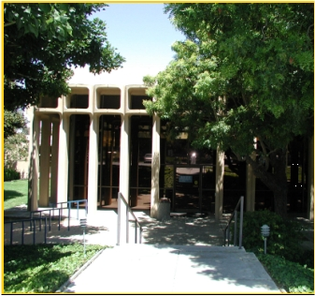
Student Health Insurance
ALL students are required to carry adequate health insurance
USHIP automatically assessed in student fees
Can be waived if student’s personal health insurance is deemed equal or superior to UCI health insurance
Deadline to submit online waiver form: Sept 11th
Go to www.shs.uci.edu for more information

Slide 47





Fee Payment
Fees are due by 4pm on Sept 15th
Failure to pay by deadline will result in classes being dropped
Late fees will be applied if fees paid after deadline
Zotbill
-your responsibility to periodically check for deadlines and inaccuracies
-https://zotaccount.uci.edu

Slide 48
UCI Email Account
You should have already activated your UCInetID through your MyAdmission homepage
Your UCInetID is also your UCI email
Peter Anteater
-Email panteater@uci.edu
-UCInetID panteater
UCI staff will only respond to email sent by a UCI email account
Problems? Contact Office of Information Technology (OIT) at www.oit.uci.edu
Please ensure that you have properly set up your UCI Gmail account

Slide 49
ICS Email Account
This is in addition to your UCI email account
Required to use the ICS computing facilities
To activate ICS account, go to ICS lab in Computer Science I, 364
UCI student ID is required
Your ICSnetID is also your ICS email
Peter Anteater
-Email panteater@ics.uci.edu
-ICSnetID panteater

Slide 50



Add/Drop/Change Policy
Deadline to make ANY changes to your schedule is Friday of Week 2
Exceptions will only be considered under documented extenuating circumstances
Approvals are required by the Dean of the School that is offering the course AND the Dean of the School of your major

Slide 51
Donald Bren School of
Information
& Computer Sciences
Enrolling in Courses
Summer 2015

Slide 52

Necessary Items for Enrollment
8-digit student ID number
UCInetIC and password
-If you have forgotten your password, go to www.oit.uci.edu to reset it
-To activate your UCInetID, go to www.activate.uci.edu

Slide 53
Enrolling in Courses
Enroll in Fall quarter courses based on the recommended plan that was given to you today
After this presentation, you will enroll in classes at the ICS labs
Enroll in classes via WebReg
    -WebReg is UCI’s registration system
    -Allows you to register from anywhere using your UCInetID and password
    -Go to http://www.reg.uci.edu
Once your enrollment window opens, you have 48 hours of access to WebReg. After 48 hours, you are restricted to WebReg between 7p.m. to 7 a.m.

Slide 54

About WebReg
Add or drop a course
Change grade option
Modify units
Check your eligibility to enroll
Confirm your class schedule
Identify any holds on your account
Accessible 7 days per week, except 4-6 a.m. (scheduled maintenance)
Issues with WebReg? Call the Registrar’s office at 949-824-6124

Slide 55
Searchable Schedule of Classes (WebSoc)
WebSoc will identify updated info on class times, locations, enrollment numbers, restrictions, etc.
Enroll in courses via the 5-digit course code
Must enroll in corresponding lab or discussion if one is listed with the lecture
If you are not a CSE major, do not enroll in CSE courses!

Slide 56
What do you need to enroll?
You must know your 8 digit student ID number
You must know your UCInetID and password to enroll in classes today
  If you have forgotten your password, you will have to go to www.oit.uci.edu to reset it.
  If you did not activate your UCInetID, go to www.activate.uci.edu to activate it.

Slide 57
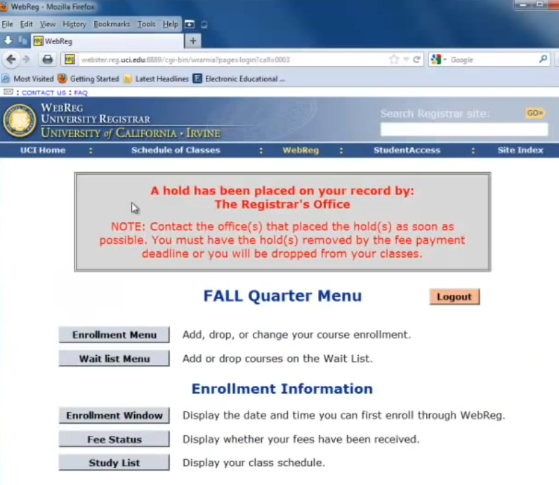
WEBREG - http://reg.uci.edu

Slide 58
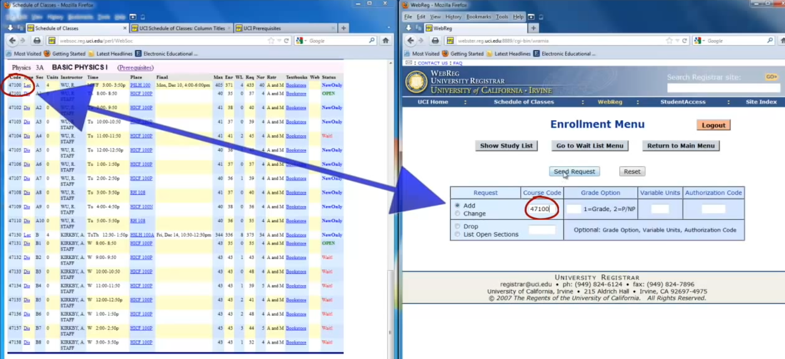
1. SCHEDULE OF CLASSES
2. WEBREG

Slide 59
Common WebReg Error Messages
Why did my course(s) get dropped?
  Make sure you enroll in the accompanying lab and/or discussion
Why can’t I add the class(es) I want?
  Time conflicts are not allowed
  Allowed maximum 18 units (waitlisted courses are counted)
  Some courses have school/major restrictions
What does “prerequisite not met” mean?
  WebReg does not recognize that you have the prerequisite course(s). Contact the Student Affairs Office for that course.

Slide 60

Other Enrollment Items
Financial aid—Must be enrolled in 6 units for aid to be disbursed
First day of instruction is always the first day of lecture EXCEPT for Humanities Core and Professor Pattis’ courses in which case discussion / lab is your first day of instruction.
Unauthorized repeat / credit—May not take/ repeat a course for which you have already earned credit via AP exam, articulation review, grade of Pass or C and better

Slide 61
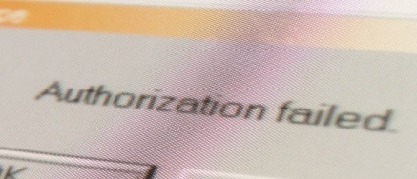



Prerequisite Clearing Requests
WebReg does not recognize prerequisite credit via AP exam, non-UCI course, syllabus review, petition and / or exception to policy
Go to https://ugradforms.ics.uci.edu
Open 24/ 7. Do not wait until the last minute to submit your prerequisite clearing (PC) requests!
DO NOT submit requests for courses you do not need clearance for!
Note: If you need to be cleared for a non-ICS course, you must go to the academic counseling unit of the dept that offers the course

Slide 62
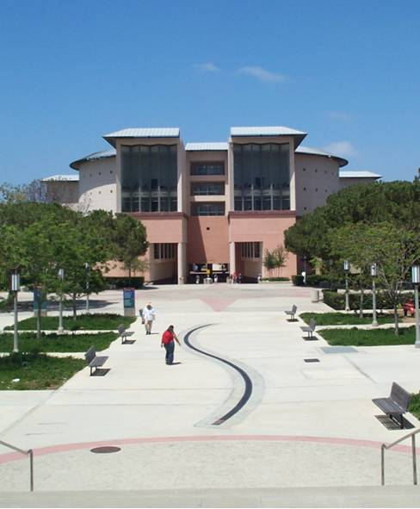
Important Events
Welcome Week
  Monday, Sept 21 to Wednesday Sept 23
New Student Convocation
  Monday, Sept 21, 9:15-10:15 a.m.
Dean’s Welcome
  Monday, Sept 21, Time to be determined
Anteater Club Fair
  Monday, Sept 21: Afternoon
ICS Academic Planning Workshop
  Wednesday, Sept 23, Time to be determined
Note: All Welcome Week events are FREE! ☺

Slide 63
Don’t Forget
CLASSES BEGIN
ON
THURSDAY, SEPTEMBER 24TH!

