Slide 1
Orientation to
UC Irvine and
Donald Bren School of ICS
for International Freshmen
Fall 2019

Slide 2
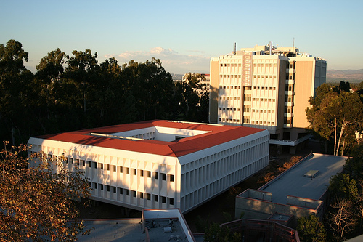



ICS Student Affairs Office
    - Academic planning
  (949) 824-5156
    - Scheduling issues
    - Campus resources
  ucounsel@uci.edu
    - Changing/Adding Majors
  www.ics.uci.edu/ugrad
    - Minors
    - Graduation Check
    - Academic Advising Workshops

Slide 3
Your Responsibilities
Fall 2019

Slide 4
UCI Catalogue
Catalogue.uci.edu
2019-2020 is your catalogue year
Detailed list of degree requirements
Course Descriptions & Prerequisites
Policies governing what you can and cannot do as a UCI student

Slide 5
3 Components of your UCI Degree
General Education
Requirements
UC Requirements
UC Entry Level Writing
American Hist. & Inst.
Minimum units
Minimum GPA
Residency
Writing
Science & Tech
Social and Behavioral Sci.
Arts and Humanties
Quantitative, Symbolic, Computational Reasoning
Foreign Language
Multicultural Studies
International/Global Issues
Major Requirements
Vary per major (lower division & upper division courses)
2.0 GPA
Specialization/Tracks
Normal progress to graduation

Slide 6

Graduation Requirements
Minimum of 180 units
General Education requirements
Major requirements
UC requirements
Grade Requirement: 2.0 GPA
    - UC courses
    - Major courses
    Upper-division major courses
Residency requirement: 36 of the last 45 units need to be completed at UCI.

Slide 7



ICS Degree/Major Requirements
All courses taken to satisfy major requirements MUST be taken for a letter grade!
These include Math, Writing, Science, Economics, Film & Media, Physics, etc. where applicable
Notes:
Combine with grad policies slide, etc.

Slide 8
Academic Honesty Policy
The following examples are considered academic dishonesty:
  Copying a person’s exam or homework
  Sharing code or notes during a lab assignment
  Any joint effort when individual effort is required.
  Posting homework online
  Using information from GitHub
  WHEN INTELLECTUAL CONTRIBUTION IS NOT SOLELY YOUR OWN!
Never assume, ASK QUESTIONS!
Pay close attention to instructor rules!

Slide 9





Consequences of Academic Dishonesty
Automatic F in the assignment, quiz, or exam
Automatic F in the course
2 quarter suspension
Expulsion from the University
An incident report and all letters/reports will be placed in a campus database for SEVEN years

Slide 10
University Privacy Policy
Per campus policy, UCI officials may not release ANY information about you to ANYONE without your explicit consent

Slide 11



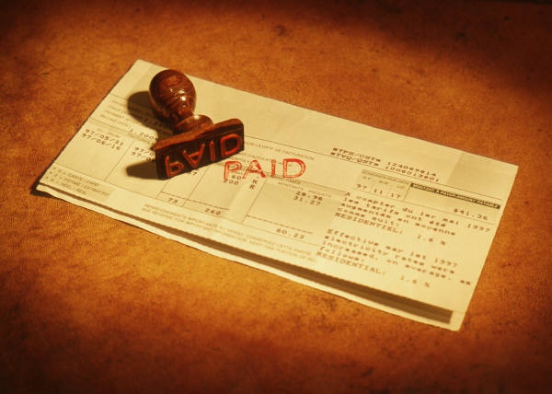

Fee Payment
Fees are due by 4 p.m. on Sept 16
Failure to pay by deadline will result in classes being dropped
Late fees will be applied if fees paid after deadline
Zotbill
  It is your responsibility to periodically check for deadlines and inaccuracies
  https://zotaccount.uci.edu

Slide 12
UCI Email Account
UCI staff will respond only to email sent by a UCI email account
When sending an email:
      Include your full name and student ID#
Your UCInetID is also your UCI email
-Email: panteater@uci.edu
-UCInetID: panteater
Problems? Contact Office of Information Technology (OIT) at www.oit.uci.edu
It is your responsibility to read your UCI e-mail and not miss important information!
Notes:
Removing email, focusing on UCI Net ID and password- to be used in Lab for Reg.

Slide 13






ICS Account
This is in addition to your UCI email account
Required to use the ICS computing facilities
To activate ICS account:
  go to ICS lab in 364 ICS Building
  UCI student ID and photo ID are required
Notes:
Prep for lab time- will use temp password and then create their own ICS.

Slide 14



Add/Drop/Change Policy
Deadline to make ANY changes to your schedule is Friday of Week 2
Exceptions will only be considered under documented extenuating circumstances
Approvals are required by the Dean of the School that is offering the course AND the Dean of the School of your major (that means the Student Affairs Office as agent of the Dean)

Slide 15
ACADEMIC PLANNING
Your academic plan is
YOUR
responsibility
Notes:
Show REG video

Slide 16
Will I Graduate On Time?
What does “on time” mean to you?
Create your personalized academic plan to know when your estimated graduation quarter will be
Use your summers wisely!
Be flexible, know your priorities
Make sure you have a “cushion” in your plan for unforeseen circumstances

Slide 17

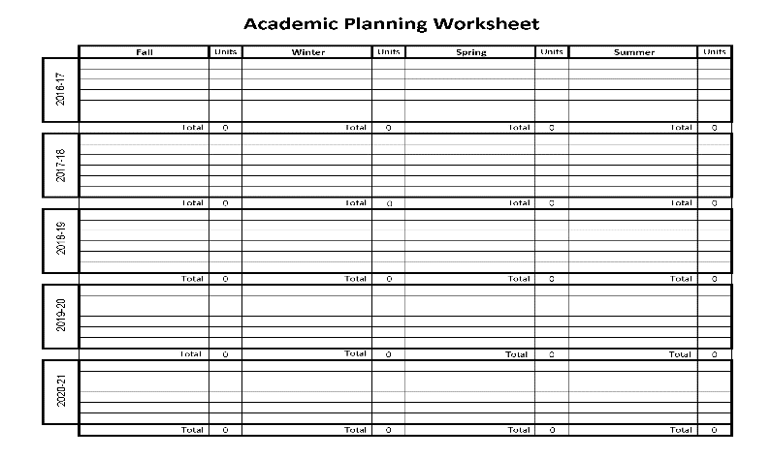
YOUR ACADEMIC PLANNING TOOLS
1) Degreeworks reg.uci.edu
Degreeworks
Graduation requirements
Check degree requirements
Check prerequisites
Check when courses are offered
Use the current schedule to map out courses
Make your personalized academic plan
2) Catalogue catalogue.uci.edu
3) Academic Year Plan www.ics.uci.edu
4) Academic Planning Worksheet www.ics.uci.edu
Notes:
Open Links so they can navigate with you

Slide 18
CS Sample Plan

Slide 19
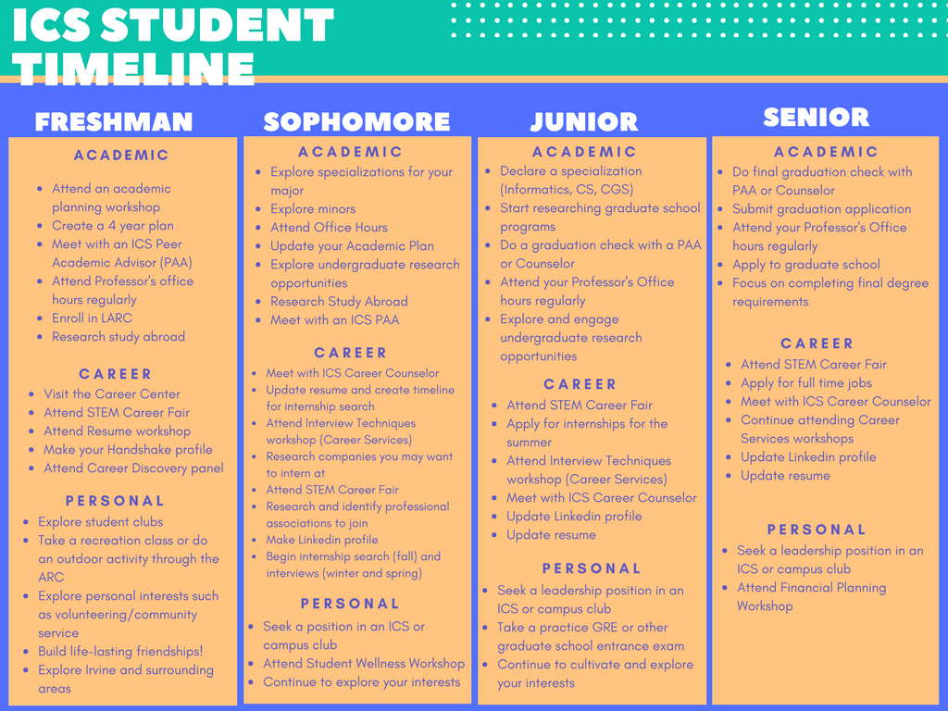

Slide 20
AP Exams
Exam Score Class Credit for
Mathematics:
AB Exam 4 or 5 Math 2A
BC Exam 3 Math 2A
4 or 5 Math 2A and 2B
Physics:
Exam C, Part I or II 4 or 5 Physics 2
Exam C, Part I 5 Physics 3A
Exam C, Part II 5 Physics 3B
Chemistry:
AP Chemistry Exam 4 or 5 Chemistry 1A + 4 elective units
Statistics:
AP Statistics 3, 4, or 5 Statistics 7
Economics
Macroeconomics 4 or 5 Economics 20B
Microeconomics 4 or 5 Economics 20A
Notes:
How to read pretty reports, etc.

Slide 21
Recommended Fall Plan without AP credit
BIM CGS CS CSE
I&CSCI 31(4) I&CSCI 31 (4) I&CSCI 31 (4) I&CSCI 31(4)
Math 2A (4) Math 2A (4) Math 2A (4) Math 2A (4)
GE (4) I&CSCI 60 (4) GE (4) GE or Physics 2 (4)
I&CSCI 90 (1)
DS ICS-UD IN4MATX SE
I&CSCI 31 (4) I&CSCI 31 (4) I&CSCI 31 (4) I&CSCI 31 (4)
Math 2A (4) Math 2A (4) Stats 7 (4) Math 2A (4)
GE (4) GE (4) GE (4) GE (4)
I&CSCI 90 (1) I&CSCI 90 (1)
GE: ELWR or Categories 1, 3, 4, 7, or 8.

Slide 22
Recommended Fall Plan with AP credit
BIM CGS CS CSE
I&CSCI 31(4) I&CSCI 31 (4) I&CSCI 31 (4) I&CSCI 31(4)
Math 2B Math 2B Math 2B Math 2B, 2D,
or I&CSCI 6B (4) or I&CSCI 6B (4) or I&CSCI 6B (4) or I&CSCI 6B (4)
GE (4) I&CSCI 60 (4) GE (4) GE (4)
I&CSCI 90 (1)
DS ICS-UD IN4MATX SE
I&CSCI 31 (4) I&CSCI 31 (4) I&CSCI 31 (4) I&CSCI 31 (4)
Math 2B Math 2B I&CSCI 6B (4) Math 2B
or I&CSCI 6B (4) or I&CSCI 6B (4) GE (4) or I&CSCI 6B (4)
GE (4) GE (4) I&CSCI 90 (1) GE (4)
I&CSCI 90 (1)
GE: ELWR or Categories 1, 3, 4, 7, or 8.

Slide 23
ICS 32A
Accelerated course
  Combines ICS 31 and ICS 32 in one quarter
  Python
  Same instructor as ICS 32
Criteria for admission
  3, 4, or 5 on AP CS A Exam
  AP CS Principles Exam does not qualify- must take ICS 31
  One semester of computer programming with grade of B or better
Please note: students who enroll in ICS 32A and do not earn a passing grade, MUST retake ICS 32A in order to be eligible for grade replacement.
  If you opt-out of retaking ICS 32A, and instead enroll in ICS 31, you will not be eligible for grade replacement / grade forgiveness (no exceptions).

Slide 24
Placement Exams
Should have already taken exams. If not, do so immediately!
Report based on placement exam results and AP credit
Refer to Testing Center to determine what exams you need to do
testingcenter.uci.edu

Slide 25
Donald Bren School of
Information
& Computer Sciences
Recommendations for
International Students
Notes:
Show REG video

Slide 26

Academic English
Enrollment in Academic English (AE) is based on the AE placement exam
AE courses help students whose first language is not English succeed in their studies at UCI by providing tools to strengthen their reading and writing skills
AE courses help prepare students for the Writing 39 series
Notes:
When are intl students notified if they need to take this? And how soon will have their results? Or do they take at ISO?

Slide 27
GE VI: Foreign Language
For International Students:
  Satisfactory completion, with a C average or higher, of formal schooling at the high school level where language of instruction was NOT English.
  Email Ucounsel@uci.edu to have this applied to your Degreeworks at the END of winter quarter.

Slide 28
GE VIII: International / Global Issues
For International Students:
  Satisfactory completion, with a C average or higher, of one year of formal schooling at the 6th grade level or higher where language of instruction was NOT English.
  Email ucounsel@uci.edu to have this applied to your Degreeworks at the END of winter quarter.

Slide 29

English Conversation Program (ECP)
ECP is mandatory for all ICS international students
10 week course for international students
1.3 Pass/No Pass units
No exams! ☺
Opportunity for international students to practice their oral, conversational English with English-speaking facilitators.
To sign up, go to the International Center website at:
  http://ic.uci.edu/Programs/ecp.php
Notes:
This is a mandatory thing? Do we track and follow up with our students who don’t enroll?

Slide 30

International Student Center
International Center Website
  https://ic.uci.edu/
Important information for new international students
  https://ic.uci.edu/students/newStudents.php
When you have questions that are related to your international student status, make sure to go to the International Student Center!

Slide 31

I-STEPS International Students Transitioning to
Educational & Personal Success
10 week course for new, first year international students
HIGHLY RECOMMENDED!
1.3 Pass/No Pass units
No exams! ☺
Learn about American culture and tips on how to be academically & socially successful at UCI
Make new friends and meet faculty and staff
Explore campus resources & services
To sign up, go to the International Center website:
  http://ic.uci.edu/Programs/isteps.php

Slide 32
Donald Bren School of
Information
& Computer Sciences
Enrolling in Courses

Slide 33

Necessary Items for Enrollment
8-digit student ID number
Photo ID card
UCInetID and password
  If you have forgotten your password, go to www.oit.uci.edu to reset it
  To activate your UCInetID, go to www.activate.uci.edu

Slide 34





About WebReg
Add or drop a course
Change grade option
Check your eligibility to enroll
Confirm your class schedule
Identify any holds on your account
Accessible 7 days per week, except 4-6 a.m. (scheduled maintenance)
Issues with WebReg?
  Call the Registrar’s office at 949-824-6124

Slide 35
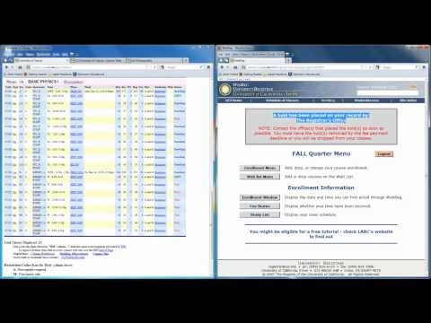
Web Reg Tutorial
Go www.reg.uci.edu
Click on Schedule of Classes
Look up courses in Schedule of Classes and map out a schedule that works best for you
Don’t think that you can avoid 8 a.m. times and have classes 3 days only
Pay attention to course restriction codes! Many non-ICS courses are blocked to other majors
Once you have everything mapped out, go to WebReg and log in to register

Slide 36
Go to www.reg.uci.edu
Click on WebReg in yellow toolbar
Login with UCInetID and password.
Reset password if you forgot it, or will be locked out for 1 hour.
WebReg sessions only stay open for 10 minutes.
Do not have multiple WebReg windows or stay logged in longer than 10 minutes, or you will get locked out.
Do not enter anything in the “Grade” section.

Slide 37
Schedule of Classes
SOC will identify updated info on class times, locations, enrollment numbers, restrictions, etc.
Enroll in courses via the 5-digit course code
Must enroll in corresponding lab or discussion if one is listed with the lecture
http://reg.uci.edu

Slide 38
Common WebReg Error Messages
Why did my course(s) get dropped?
  Make sure you enroll in the accompanying lab and/or discussion
Why can’t I add the class(es) I want?
  Time conflicts are not allowed
  Allowed maximum 18 units (waitlisted courses are counted)
  Some courses have school/major restrictions
What does “prerequisite not met” mean?
  WebReg does not recognize that you have the prerequisite course(s). Contact the Student Affairs Office for that course.

Slide 39
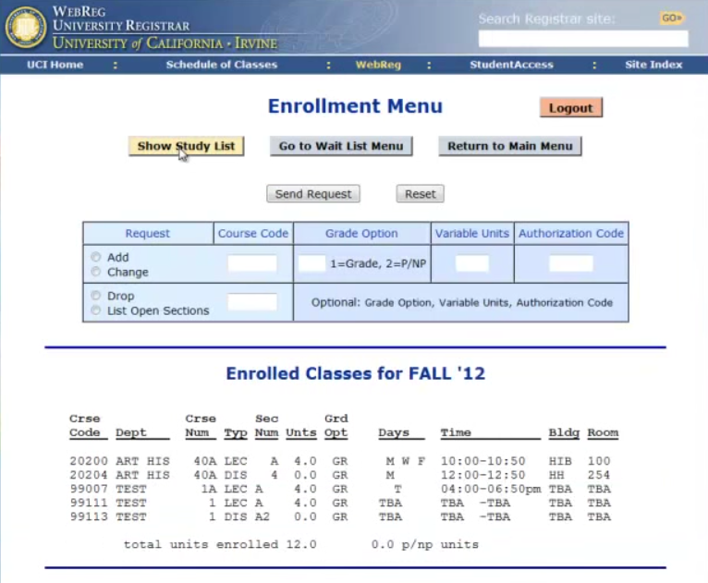
3. Verify enrollment by checking your WebReg Study List

Slide 40

3. Verify enrollment by checking your Study List

Slide 41
4. Verify enrollment in your StudentAccess
Logout

Slide 42
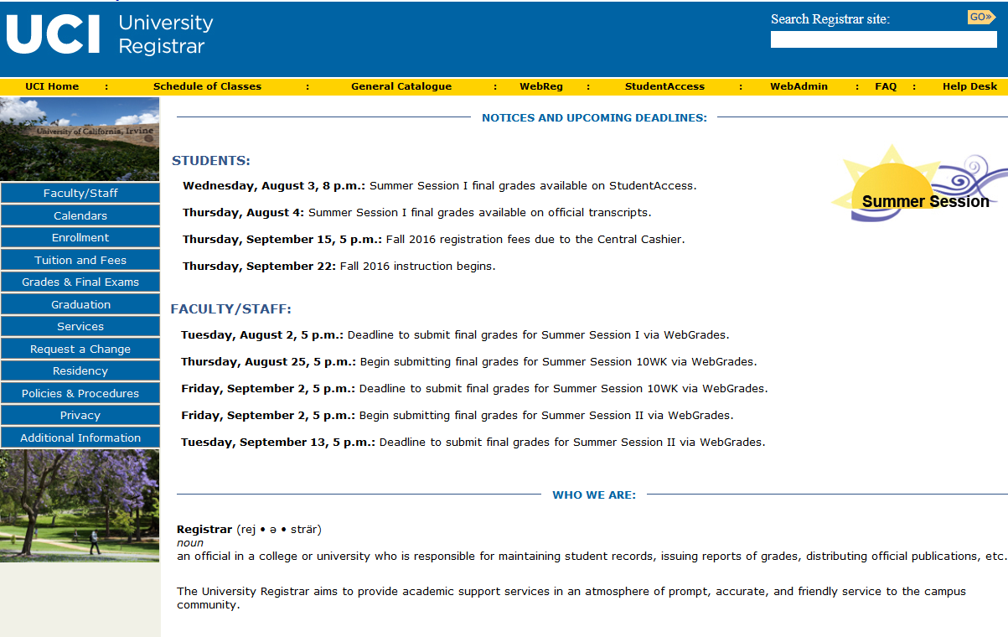
4. Verify enrollment in your StudentAccess
Logout
Click and Login to StudentAccess

Slide 43
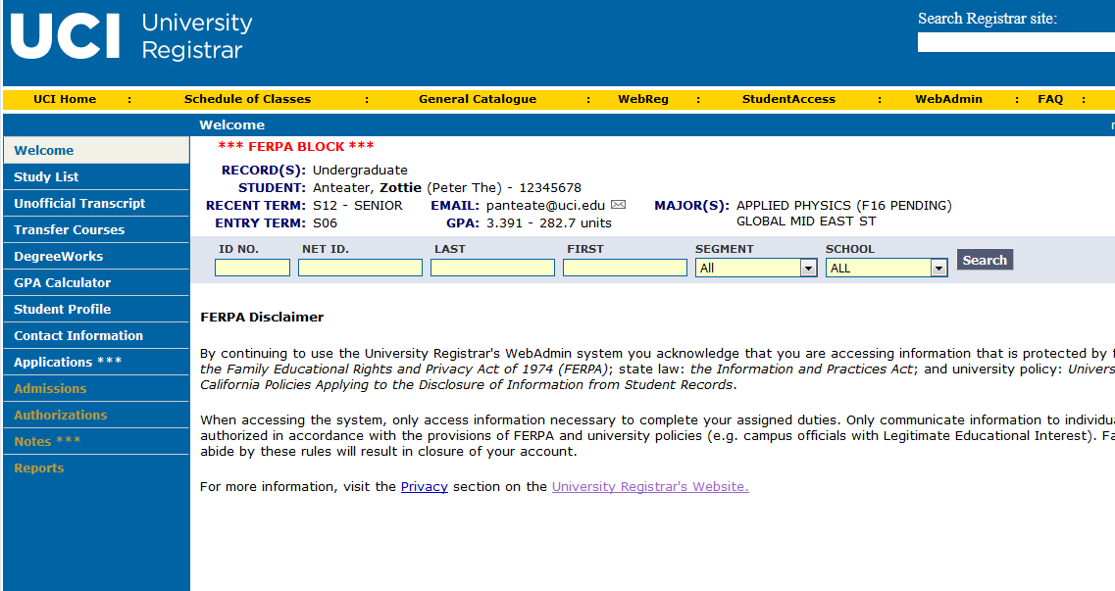
4. Verify enrollment in your StudentAccess
Logout
Click and Login to StudentAccess
Click on Study List

Slide 44
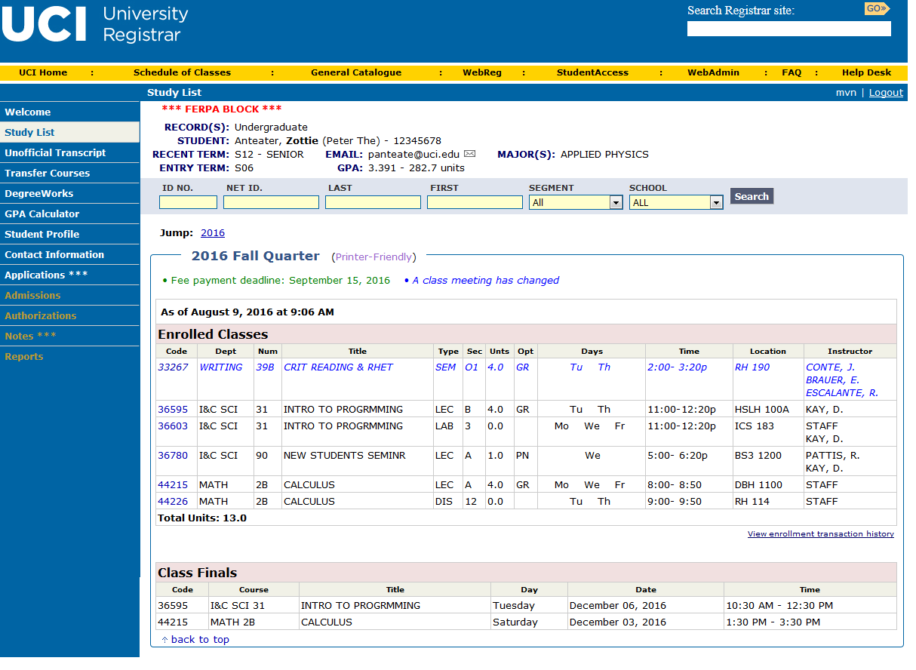
4. Verify enrollment in your StudentAccess
Logout
Click and Login to StudentAccess
Click on Study List
Make sure to review your final exam schedule at the bottom of your study list.

Slide 45
Prerequisite Clearing Requests
WebReg does not recognize prerequisite credit via AP exam, non-UCI course, syllabus review, petition and/or exception to policy
Go to https://ugradforms.ics.uci.edu
Open 24/7. Do not wait until the last minute to submit your prerequisite clearing (PC) requests.
Do not submit requests for courses you do not need clearance for.
Do not expect staff to clear your PC requests in a short time frame or ask us to put you ahead of the queue.
Note: If you need to be cleared for a non-ICS course, you must go to the academic counseling unit of the dept that offers the course

Slide 46
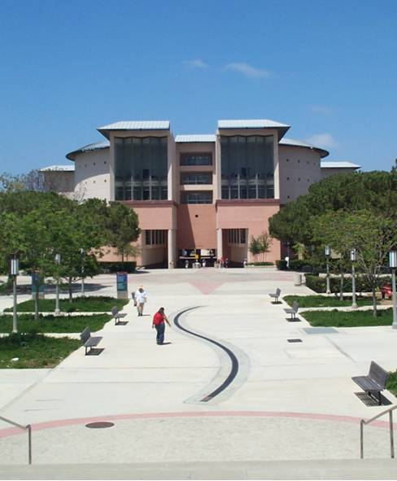
Important Events
International Student Parent Orientation Program (ISPOP)
  September 17-19
Welcome Week
  Monday, Sept 23 - Wednesday Sept 25
New Student Convocation
  Monday, Sept 23
Dean’s Welcome
  Monday, Sept 23
Anteater Club Fair
  Monday, Sept 23
First Day of Instruction
  September 26
Note: All Welcome Week events are FREE! ☺

Slide 47
Don’t Forget
CLASSES BEGIN
THURSDAY, SEPTEMBER 26!

