Slide 1

CS152: Computer Systems Architecture
Processor Microarchitecture
Sang-Woo Jun
Winter 2019
Large amount of material adapted from MIT 6.004, “Computation Structures”,
Morgan Kaufmann “Computer Organization and Design: The Hardware/Software Interface: RISC-V Edition”,
and CS 152 Slides by Isaac Scherson

Slide 2
Course outline
Part 1: The Hardware-Software Interface
  What makes a ‘good’ processor?
  Assembly programming and conventions
Part 2: Recap of digital design
  Combinational and sequential circuits
  How their restrictions influence processor design
Part 3: Computer Architecture
  Simple and pipelined processors
  Computer Arithmetic
  Caches and the memory hierarchy
Part 4: Computer Systems
  Operating systems, Virtual memory

Slide 3
How to build a computing machine?
Pretend the computers we know and love have never existed
We want to build an automatic computing machine to solve mathematical problems
Starting from (almost) scratch, where you have transistors and integrated circuits but no existing microarchitecture
  No PC, no register files, no ALU
How would you do it? Would it look similar to what we have now?

Slide 4
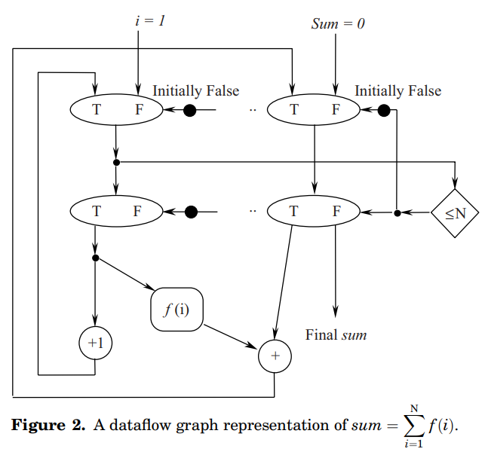
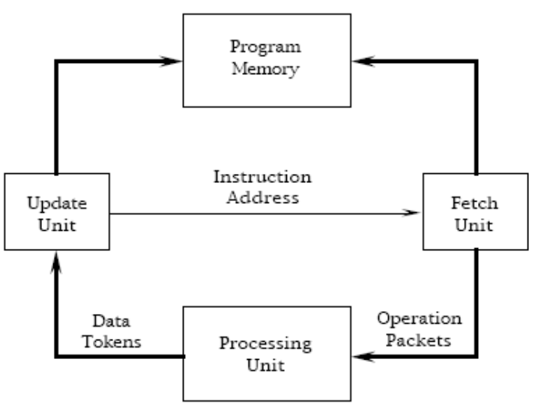
Aside: Dataflow architecture
Instead of a PC traversing over instructions to execute, all instructions are independent, and are each executed whenever operands are ready
  Programs are represented as graphs
  (with dependency information)
Did not achieve market success, (why?)
but the ideas are now everywhere
e.g., Out-of-Order microarchitecture
A “static” dataflow architecture

Slide 5
The von Neumann Model
Almost all modern computers are based on the von Neumann model
  John von Neumann, 1945
Components
  Main memory, where both data and programs are held
  Processing unit, which has a program counter and ALU
  Storage and I/O to communicate with the outside world
Key idea!
Main Memory
Central
Processing
Unit
Storage
and I/O

Slide 6
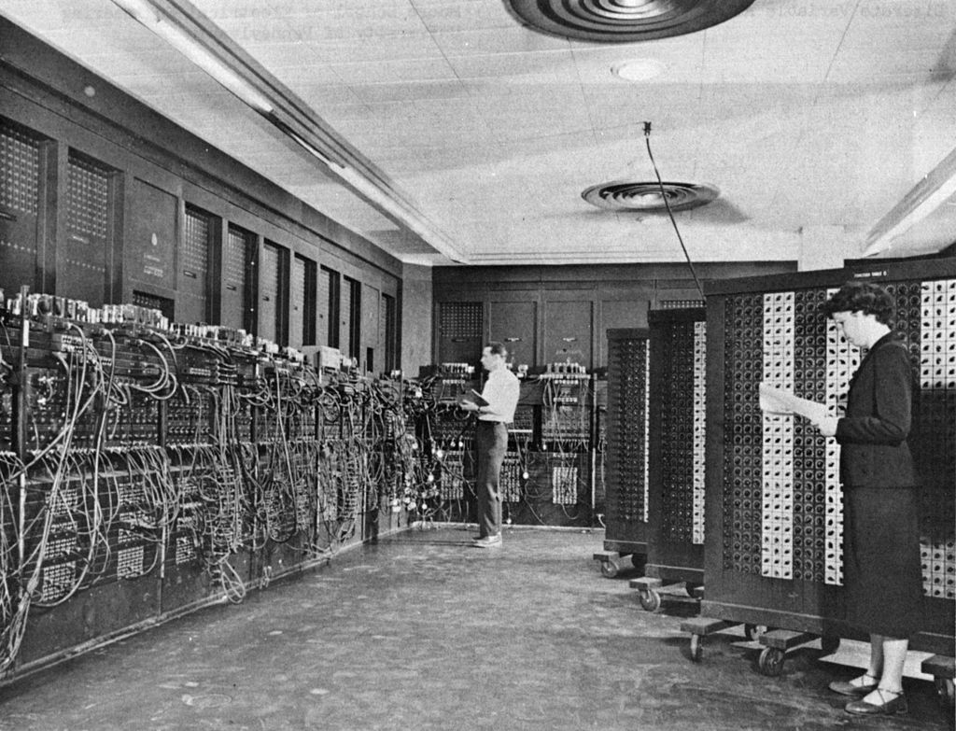
Key Idea: Stored-Program Computer
Very early computers were programmed by manually adjusting switches and knobs of the individual programming elements
  (e.g., ENIAC, 1945)
von Neumann Machines instead had a
general-purpose CPU, which loaded its
instructions also from memory
  Express a program as a sequence of coded
  instructions, which the CPU fetches, interprets,
  and executes
  “Treating programs as data”
Similar in concept to a universal Turing machine (1936)
ENIAC, Source: US Army photo

Slide 7
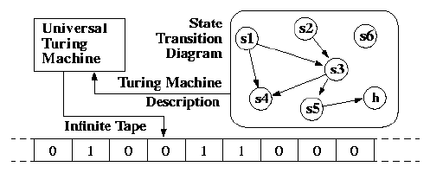
von Neumann and Turing machine
Turing machine is a mathematical model of computing machines
  Proven to be able to compute any mechanically computable functions
  Anything an algorithm can compute, it can compute
Components include
  An infinite tape (like memory) and a header which can read/write a location
  A state transition diagram (like program) and a current location (like pc)
    State transition done according to current value in tape
Only natural that computer designs
gravitate towards provably universal models
Source: Manolis Kamvysselis

Slide 8
Stored program computer, now what?
Once we decide on the stored program computer paradigm
  With program counter (PC) pointing to encoded programs in memory
Then it becomes an issue of deciding the programming abstraction
  Instruction set architecture, which we talked about
Then, it becomes an issue of executing it quickly and efficiently
  Microarchitecture! – Improving performance/efficiency/etc while maintaining ISA abstraction
  Which is the core of this class, starting now

Slide 9
A high-level view of computer architecture
CPU
Instruction
cache
Data
cache
Low latency
(~1 cycle)
Shared cache
DRAM
High latency
(100s~1000s of cycles)
Will deal with caches in detail later!

Slide 10
Remember:
Super simplified processor operation
inst = mem[PC]
next_PC = PC + 4
if ( inst.type == STORE ) mem[rf[inst.arg1]] = rf[inst.arg2]
if ( inst.type == LOAD ) rf[inst.arg1] = mem[rf[inst.arg2]]
if ( inst.type == ALU ) rf[inst.arg1] = alu(inst.op, rf[inst.arg2], rf[inst.arg3])
if ( inst.type == COND ) next_PC = rf[inst.arg1]
PC = next_PC

Slide 11
The classic RISC pipeline
Many early RISC processors had very similar structure
  MIPS, SPARC, etc…
  Major criticism of MIPS is that it is too optimized for this 5-stage pipeline
RISC-V is also typically taught using this structure as well
Fetch
Decode
Execute
Memory
Write
Back
Why these 5 stages? Why not 4 or 6?

Slide 12
The classic RISC pipeline
Fetch: Request instruction fetch from memory
Decode: Instruction decode & register read
Execute: Execute operation or calculate address
Memory: Request memory read or write
Writeback: Write result (either from execute or memory) back to register

Slide 13
Designing a microprocessor
Many, many constraints processors are optimize for, but for now:
Constraint 1: Circuit timing
  Processors are complex! How do we organize the pipeline to process instructions as fast as possible?
Constraint 2: Memory access latency
  Register files can be accessed as a combinational circuit, but it is small
  All other memory have high latency, and must be accessed in separate request/response
    Memory can have high throughput, but also high latency
Memory will be covered in detail later!

Slide 14
The most basic microarchitecture
Because memory is not combinational, our RISC ISA requires at least three disjoint stages to handle
  Instruction fetch
  Instruction receive, decode, execute (ALU), register file access, memory request
  If mem read, write read to register file
Three stages can be implemented as a
Finite State Machine (FSM)
Register
File
Instruction
Decoder
PC
ALU
Will this processor be fast?
Why or why not?
①
②
③
Memory Interface

Slide 15
Limitations of our simple microarchitecture
Stage two is disproportionately long
  Very long critical path, which limits the clock speed of the whole processor
  Stages are “not balanced”
Note: we have not pipelined things yet!
*Critical path depends on
the latency of each component
Register
File
Instruction
Decoder
PC
ALU
①
②
③
Memory Interface

Slide 16
Limitations of our simple microarchitecture
Let’s call our stages Fetch(“F”), Execute(“E”), and Writeback (“W”)
Speed of our simple microarchitecture, assuming:
  Clock-synchronous circuits, single-cycle memory
Lots of time not spent doing useful work!
  Can pipelining help with performance?
time
instr. 1
F
E
W
F
E
W
instr. 2
Clock cycle due to critical path of Execute

Slide 17
Pipelined processor introduction
Attempt to pipeline our processor using pipeline registers/FIFOs
Much better latency and throughput!
  Average CPI reduced from 3 to 1!
  Still lots of time spent not doing work. Can we do better?
Fetch
Execute
Writeback
* We will see soon why pipelining
a processor isn’t this simple
time
F
F
E
E
W
instr. 1
W
F
E
W
F
E
W
instr. 2
Note we need a memory interface with two concurrent interfaces now! (For fetch and execute)
Remember instruction and data caches!

Slide 18
Building a balanced pipeline
Must reduce the critical path of Execute
Writing ALU results to register file can be moved to “Writeback”
  Most circuitry already exists in writeback stage
  No instruction uses memory load and ALU at the same time
    RISC!
Register
File
Instruction
Decoder
PC
ALU
Memory Interface

Slide 19
Building a balanced pipeline
Divide execute into multiple stages
  “Decode”
    Extract bit-encoded values from instruction word
    Read register file
  “Execute”
    Perform ALU operations
  “Memory”
    Request memory read/write
No single critical path which reads and writes to register file in one cycle
Fetch
Execute
Writeback
Decode
Execute
Memory
Results in a small number of stage with relatively good balance!

Slide 20
Ideally balanced pipeline performance
Clock cycle: 1/5 of total latency
Circuits in all stages are always busy with useful work
time
instr. 1
Fetch
Decode
Execute
Memory
Writeback
instr. 2
Fetch
Decode
Execute
Memory
Writeback
instr. 3
Fetch
Decode
Execute
Memory
Writeback

Slide 21
Aside: Real-world processors have wide range of pipeline stages
Name | Stages
AVR/PIC microcontrollers | 2
ARM Cortex-M0 | 3
Apple A9 (Based on ARMv8) | 16
Original Intel Pentium | 5
Intel Pentium 4 | 30+
Intel Core (i3,i5,i7,…) | 14+
RISC-V Rocket | 6
Designs change based on requirements!

Slide 22
Achieving correct pipelining

Slide 23
Will our pipeline operate correctly?
Register
File
Fetch
Decode
Execute
Memory
Writeback
Memory Interface

Slide 24
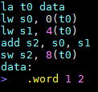
A problematic example
What should be stored in data+8? 3, right?
Assuming zero-initialized register file, our pipeline will write zero
Why? “Hazards”

Slide 25
Hazard #1:
Read-After-Write (RAW) Data hazard
When an instruction depends on a register updated by a previous instruction’s execution results
  e.g.,
i1: add s0, s1, s2
i2: add s3, s0, s4
Register
File
Fetch
Decode
Execute
Memory
Writeback
Cycle 1
Cycle 2
i1 reads s1, s2
Cycle 3
i2 reads s0, s4
i1 calculates s0

Slide 26
Hazard #1:
Read-After Write (RAW) Hazard
i1: addi s0, zero, 1
i2: addi s1, s0, 0
s0 should be 1, s1 should be 1
Fetch
Decode
Execute
Memory
Writeback
Cycle 1
s0 = 0
Cycle 2
i2 reads s0, but s0 is still zero!
s0 = 0
Cycle 3
s0 = 0
Cycle 4
s0 = 0
Cycle 5
s0 = 0
Cycle 6
s0 = 1

Slide 27
Solution #1: Stalling
The processor can choose to stall decoding when RAW hazard detected
Sacrifices too much performance!
i1: add s0, s1, s2
Register
File
i2: add s3, s0, s4
Fetch
Decode
Execute
Memory
Writeback
Cycle 1
Cycle 2
i1 reads s1, s2
…
Pipeline “bubbles”
Cycle 5
i2 not decoded
i1 writing s0
Cycle 6
i1 retired
i2 reads s0

Slide 28
Solution #1: Stalling
i1: addi s0, zero, 1
i2: addi s1, s0, 0
Fetch
Decode
Execute
Memory
Writeback
Cycle 1
s0 = 0
Cycle 2
i2 stalled until s0 is applied
s0 = 0
Cycle 3
“Pipeline bubble” – Wasted cycles
s0 = 0
Cycle 4
s0 = 0
Cycle 5
s0 = 0
Cycle 6
s0 = 1
Cycle 7
i2 reads correct s0
s0 = 1
Sacrifices too much performance!

Slide 29
Solution #2: Forwarding (aka Bypassing)
Forward execution results to input of decode stage
  New values are used if write index and a read index is the same
i1: add s0, s1, s2
Register
File
i2: add s3, s0, s4
Fetch
Decode
Execute
Memory
Writeback
Cycle 1
Cycle 2
i1 reads s1, s2
Cycle 3
i2 reads s0, s4
i1 calculates s0
But! Uses new s0 forwarded from execute
No pipeline stalls!

Slide 30
Solution #2: Forwarding details
May still require stalls for a deeper pipeline microarchitecture
  If execute took many cycles?
Adds combinational path from execute to decode
  But does not imbalance pipeline very much!
Register
File
Fetch
Decode
Execute
Memory
Writeback
Instruction bit decode
Register file access
Execute
Question: How does hardware detect hazards?
Combinational path only to end of decode stage!

Slide 31
Solution #2:Forwarding
i1: addi s0, zero, 1
i2: addi s1, s0, 0
results forwarded to decode within same cycle
Fetch
Decode
Execute
Memory
Writeback
Cycle 1
s0 = 0
Cycle 2
s0 is still zero, but i1 results forwarded to i2
s0 = 0
Cycle 3
s0 = 0
Cycle 4
s0 = 0
Cycle 5
s0 = 0
Cycle 6
s0 = 1
Forwarding is possible in this situation
because the answer (s0 = 1) exists somewhere in the processor!

Slide 32
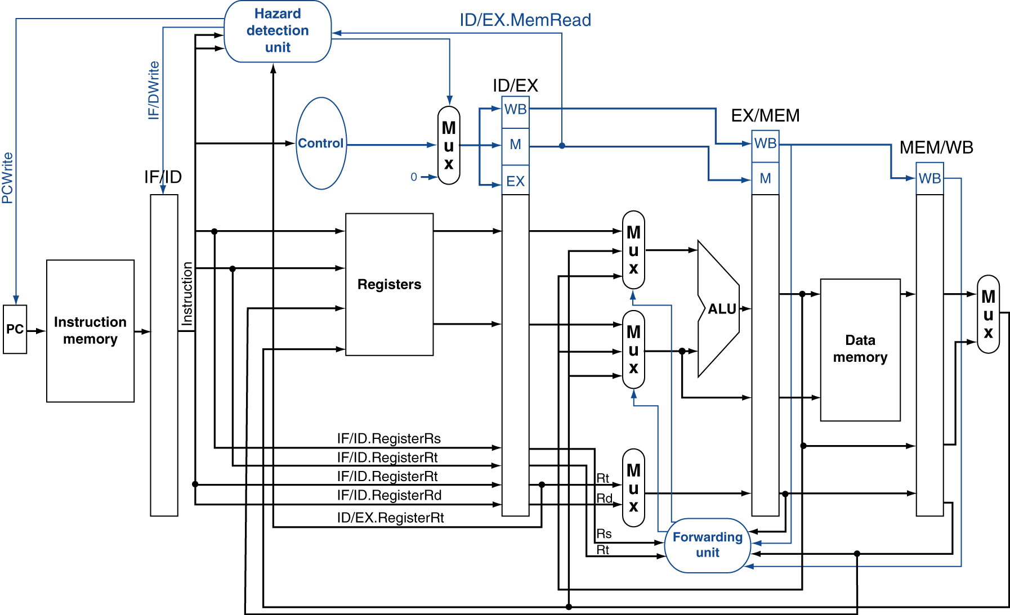
Datapath with Hazard Detection
Not very intuitive… We will revisit with code later

Slide 33
Hazard #2:
Load-Use Data Hazard
When an instruction depends on a register updated by a previous instruction
  e.g.,
Forwarding doesn’t work here, as loads only materialize at writeback
  Only architectural choice is to stall
i1: lw s0, 0(s2)
i2: addi s1, s0, 1
Register
File
Fetch
Decode
Execute
Memory
Writeback

Slide 34
Hazard #2: Load-Use Data Hazard
i1: lw s0, 0(s2)
i2: addi s1, s0, 1
Fetch
Decode
Execute
Memory
Writeback
Cycle 1
s0 = 0
Cycle 2
i2 stalled until s0 is updated
s0 = 0
Cycle 3
s0 = 0
Cycle 4
s0 = 0
Cycle 5
s0 = 0
Cycle 6
s0 = 1
Cycle 7
i2 reads correct s0
s0 = 1
Forwarding is not useful because the answer (s0 = 1) exists outside the chip (memory)

Slide 35
A non-architectural solution:
Code scheduling by compiler
Reorder code to avoid use of load result in the next instruction
e.g., a = b + e; c = b + f;
lw x1, 0(x0)
lw x2, 8(x0)
add x3, x1, x2
sw x3, 24(x0)
lw x4, 16(x0)
add x5, x1, x4
sw x5, 32(x0)
lw x1, 0(x0)
lw x2, 8(x0)
lw x4, 16(x0)
add x3, x1, x2
sw x3, 24(x0)
add x5, x1, x4
sw x5, 32(x0)
stall
stall
20 cycles
14 cycles
Compiler does best, but not always possible!

Slide 36
Review: A problematic example
← RAW hazard
← RAW hazard
← RAW hazard
← Load-Use hazard
← RAW hazard
Note: “la” is not an actual RISC-V instruction
  Pseudo-instruction expanded to one or more instructions by assembler
  e.g., auipc x5,0x1
  addi x5,x5,-4 # ← RAW hazard!

Slide 37
Other potential data hazards
Read-After-Write (RAW) Hazard
  Obviously dangerous! -- Writeback stage comes after decode stage
  (Later instructions’ reads can come before earlier instructions’ write)
Write-After-Write (WAW) Hazard
  No hazard for in-order processors
Write-After-Read (WAR) Hazard
  No hazard for in-order processors -- Writeback stage comes after decode stage
  (Later instructions’ reads cannot come before earlier instructions’ write)
Read-After-Read (RAR) Hazard?
  No hazard within processor
read rf
3 cycle difference
write rf
Fetch
Decode
Execute
Memory
Writeback

Slide 38
Hazard #3:
Control hazard
Branch determines flow of control
  Fetching next instruction depends on branch outcome
  Pipeline can’t always fetch correct instruction
    e.g., Still working on decode stage of branch
i1: beq s0, zero, elsewhere
i2: addi s1, s0, 1
PC
Fetch
Decode
Execute
Memory
Writeback
Cycle 1
Cycle 2
Should I load this or not?

Slide 39
Control hazard (partial) solutions
Branch target address can be forwarded to the fetch stage
  Without first being written to PC
  Still may introduce (one less, but still) bubbles
Decode stage can be augmented with logic to calculate branch target
  May imbalance pipeline, reducing performance
  Doesn’t help if instruction memory takes long (cache miss, for example)
PC
Fetch
Decode
Execute
Memory
Writeback

Slide 40
Aside: An awkward solution:
Branch delay slot
In a 5-stage pipeline with forwarding, one branch hazard bubble is injected in best scenario
Original MIPS and SPARC processors included “branch delay slots”
  One instruction after branch instruction was executed regardless of branch results
  Compiler will do its best to find something to put there (if not, “nop”)
Goal: Always fill pipeline with useful work
Reality:
  Difficult to always fill slot
  Deeper pipelines meant one measly slot didn’t add much (Modern MIPS has 5+ cycles branch penalty!)
But once it’s added, it’s forever in the ISA…
One of the biggest criticisms of MIPS

Slide 41








Eight great ideas
Design for Moore’s Law
Use abstraction to simplify design
Make the common case fast
Performance via parallelism
Performance via pipelining
Performance via prediction
Hierarchy of memories
Dependability via redundancy

Slide 42
Control hazard and pipelining
Solving control hazards is a fundamental requirement for pipelining
  Fetch stage needs to keep fetching instructions without feedback from later stages
  Must keep pipeline full somehow!
  … Can’t know what to fetch
Fetch
Decode
Execute
Memory
Writeback
Cycle 1
Fetch PC = 0
Cycle 2
Fetch PC = …?
Decode PC = 0

Slide 43
Control hazard (partial) solution
Branch prediction
We will try to predict whether branch is taken or not
  If prediction is correct, great!
  If not, we somehow do not apply the effects of mis-predicted instructions
    (Effectively same performance penalty as stalling in this case)
  Very important to have mispredict detection before any state change!
    Difficult to revert things like register writes, memory I/O
Simplest branch predictor: Predict not taken
  Fetch stage will keep fetching pc <= pc + 4 until someone tells it not to

Slide 44
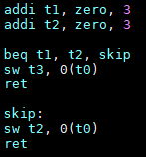
Predict not taken example
Fetch
Decode
Execute
Memory
Writeback
addi
addi
addi
Mispredict detected!
beq
addi
addi
sw t3
beq
addi
addi
ret
sw t3
beq
addi
addi
sw t2
beq
addi
Pipeline bubbles
Fetch correct branch
No state update before Execute stage can detect misprediction
(Fetch and Decode stages don’t write to register)

Slide 45
How to handle mis-predictions?
Implementations vary, each with pros and cons
  Sometimes, execute sends a combinational signal to all previous stages,
  turning all instructions into a “nop”
A simple method is “epoch-based”
  All fetched instructions belong to an “epoch”, represented with a number
  Instructions are tagged with their epoch as they move through the pipeline
  In the case of mis-predict detection, epoch is increased,
  and future instructions from previous epochs are ignored

Slide 46
Predict not taken example with epochs
epoch = 0
epoch = 1
Fetch
Decode
Execute
Memory
Writeback
addi (0)
addi (0)
addi (0)
Mispredict detected!
beq (0)
addi (0)
addi (0)
sw t3 (0)
beq (0)
addi (0)
addi (0)
ret (0)
sw t3 (0)
beq (0)
addi (0)
addi (0)
sw t2 (1)
ret (0)
sw t3 (0)
beq (0)
addi (0)
ret (1)
sw t2 (1)
ret (0)
beq (0)
Ignored
Fetch correct branch
ret (1)
sw t2 (1)
Ignored

Slide 47
Some classes of branch predictors
Static branch prediction
  Based on typical branch behavior
  Example: loop and if-statement branches
    Predict backward branches taken
    Predict forward branches not taken
Dynamic branch prediction
  Hardware measures actual branch behavior
    e.g., record recent history (1-bit “taken” or “not taken”) of each branch
    in a fixed size “branch history table”
  Assume future behavior will continue the trend
    When wrong, stall while re-fetching, and update history
Many many different methods, Lots of research, some even using neural networks!

Slide 48
Branch prediction and performance
Effectiveness of branch predictors is crucial for performance
  Spoilers: On SPEC benchmarks, modern predictors routinely have 98+% accuracy
  Of course, less-optimized code may have much worse behavior
Branch-heavy software performance depends on good match between software pattern and branch prediction
  Some high-performance software optimized for branch predictors in target hardware
  Or, avoid branches altogether! (Branchless code)

Slide 49
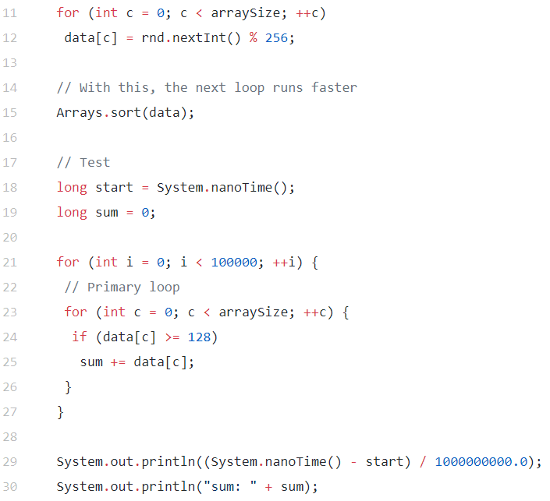
Aside:
Impact of branches
“[This code] takes ~12 seconds to run. But on commenting line 15, not touching the rest, the same code takes ~33 seconds to run.”
“(running time may wary on different machines, but the proportion will stay the same).”
Source: Harshal Parekh, “Branch Prediction — Everything you need to know.”

Slide 50
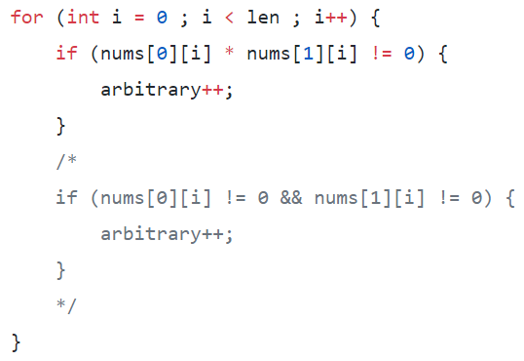
Aside:
Impact of branches
Slower because it involves two branches
Source: Harshal Parekh, “Branch Prediction — Everything you need to know.”

Slide 51
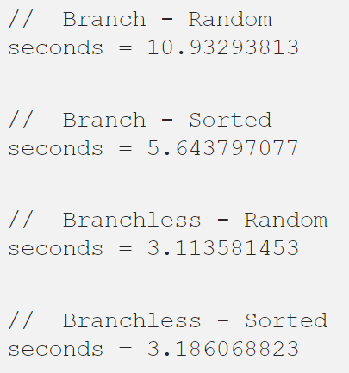

Aside: Branchless programming
Source: Harshal Parekh, “Branch Prediction — Everything you need to know.”

Slide 52
Into details of pipelining!

Slide 53
Try for yourself!
Up-to-date code in openlab
  /home/swjun/cs152/processor
  Copy to your own directory!
Vim syntax files for Bluespec
  /home/swjun/cs152/vim-bsv
Environment variables for Bluespec, etc
  /home/swjun/cs152/setup.sh
  Either run “source /home/swjun/cs152/setup.sh” or add to .bashrc
  Before you can run any bluespec binaries!

Slide 54
Try for yourself!
Compiling and running the simulation
  “make”
  “./obj/bsim” – Stands for “bluesim”
  New login may require recompiling
    “make clean; make”
    Library differences between openlab instances
Example execution:
Cycle
PC
$ ./obj/bsim
Answer for addr 1024 is 3
[0x00000000:0x0000] Fetching instruction count 0x0000
[0x00000001:0x0004] Fetching instruction count 0x0001
[0x00000001:0x0000] Decoding 0x40000293
[0x00000002:0x0008] Fetching instruction count 0x0002
[0x00000002:0x0004] Decoding 0x00300313
rf writing 00000400 to 5
[0x00000002:0x0000] Executing
[0x00000003:0x000c] Fetching instruction count 0x0003
[0x00000003:0x0008] Decoding 0x00300393
rf writing 00000003 to 6
[0x00000003:0x0004] Executing
[0x00000003:0x0000] Writeback writing 00000400 to 5
[0x00000004:0x0010] Fetching instruction count 0x0004
…

Slide 55
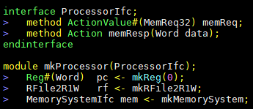
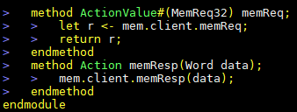
Basic microarchitecture in Bluespec:
The interface
ProcessorIfc proc <- mkProcessor;
src/processors/Processor.bsv
…
proc
memReq
memResp
Outside environment polls this method for memory requests
Memory responses

Slide 56
Basic microarchitecture in Bluespec:
The stages
A 4-stage pipeline is provided
  Execute and memory merged into Execute for simplicity
  Expressed via four rules
    doFetch
    doDecode
    doExecute
    doWriteback
A MemorySystem in which caching may be implemented
  Exposes two interfaces to processor (instruction and data cache)
  Exposes one interface to the outside world (to main memory/MMIO/etc)

Slide 57
Basic microarchitecture in Bluespec:
The memory system
Exposes two interfaces to processor (iMem, dMem),
one to outside world (client)
…
proc
Fetch
Decode
Execute
Writeback
iMem
dMem
Caching…?
mem
client
memReq
memResp

Slide 58
Basic microarchitecture in Bluespec:
The non-pipelined architecture
Let’s look at code!
  The finite-state-machine implementation
  src/processor/ProcessorFSM.bsv
Notice: Only one stage executes at any cycle
  No instructions overlap
  Each instruction takes 3 cycles (4 if memory read) to finish

Slide 59
Basic microarchitecture in Bluespec:
The non-pipelined architecture
…
…
…
…
…
…

Slide 60
Basic microarchitecture in Bluespec:
The stages
No pipelining yet!
nextpcQ
Always enqueued by execute:
Either PC+4 or branch target
nextpcQ
rf
f2d
d2e
e2m
Fetch
Decode
Execute
Writeback
mem.iMem
mem.dMem

Slide 61
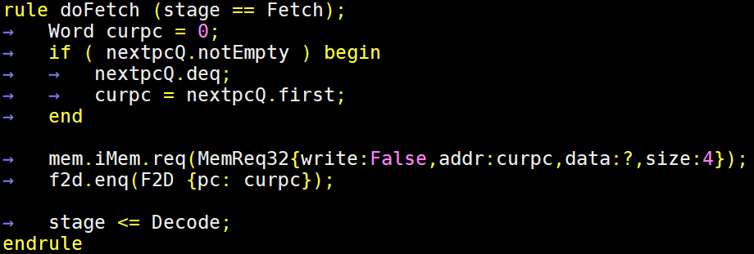
Basic microarchitecture in Bluespec:
Non-pipeline fetch
Checking nextpcQ.notEmpty because it is empty initially

Slide 62
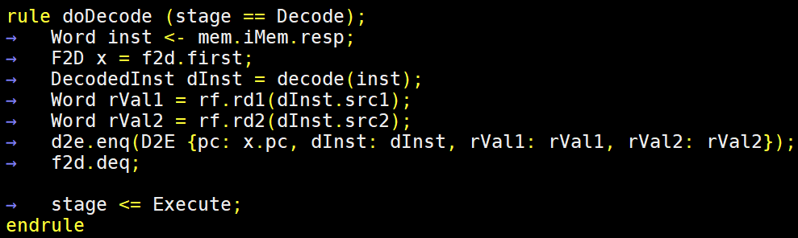
Basic microarchitecture in Bluespec:
Non-pipeline decode
“decode” function defined in src/Decode.bsv
  Extracts bit-encoded information and expands it into an easy-to-use structure
Let’s look at code! (Decode.bsv)
Bluespec functions are simple data transformation (No state changes)
Intermediate values (like immU) calculated once and used in all case statements!
to encourage combinational circuit re-use

Slide 63
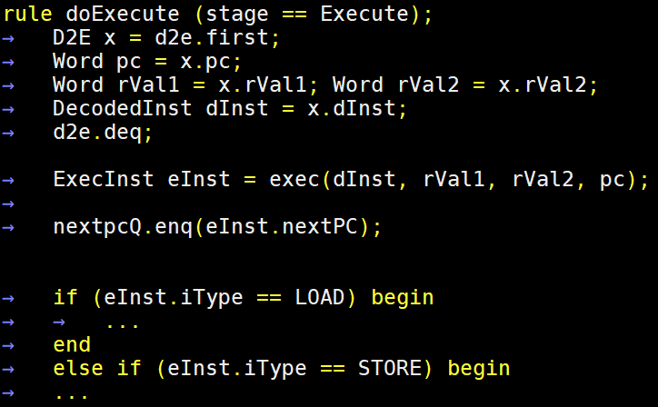
Basic microarchitecture in Bluespec:
Non-pipeline execute
“exec” implements ALU operations (in src/Execute.bsv)
Bluespec functions are simple data transformation (No state changes)
non-pipelined version always enqueues
nextpcQ for Fetch

Slide 64
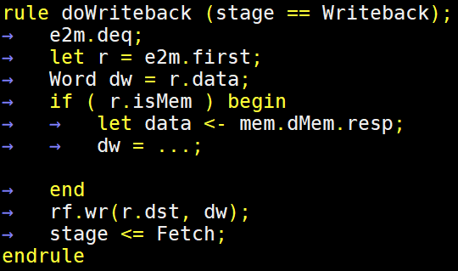
Basic microarchitecture in Bluespec:
Non-pipeline writeback
Straightforward enough!
  Let’s look at code! And notice handling of signed/unsigned numbers

Slide 65
Let’s start pipelining
Start with handling branch hazards
  Data hazards produce wrong results,
  but without handling branch hazards we cannot pipeline things at all
    Which address should Fetch read?
Things to solve:
  Branch hazard
  Load-Use hazard
  Read-After-Write hazard

Slide 66
Basic microarchitecture in Bluespec:
Pipelining step 1: Branch hazards
Add epochs to fetch and execute
nextpcQ
Enqueued by execute only when branch mispredict
(Update epochs when it does!)
epochFetch
nextpcQ
epochExecute
PC
f2d
d2e
e2m
Fetch
Decode
Execute
Writeback
“epoch” and “pc_predicted”
added to inter-stage data
Ignore unless
instruction.epoch == epochExecute

Slide 67
Modifying fetch for branch prediction
Keep track of epochFetch
Augmented F2D with two new elements
  epoch of each fetched instruction (For execute to check)
  pc_predicted, which is the predicted next instruction after this one
  (For execute to compare against branch instruction results)
nextpcQ is now only enqueued when mispredicts happen
  Update epochFetch, change current PC

Slide 68
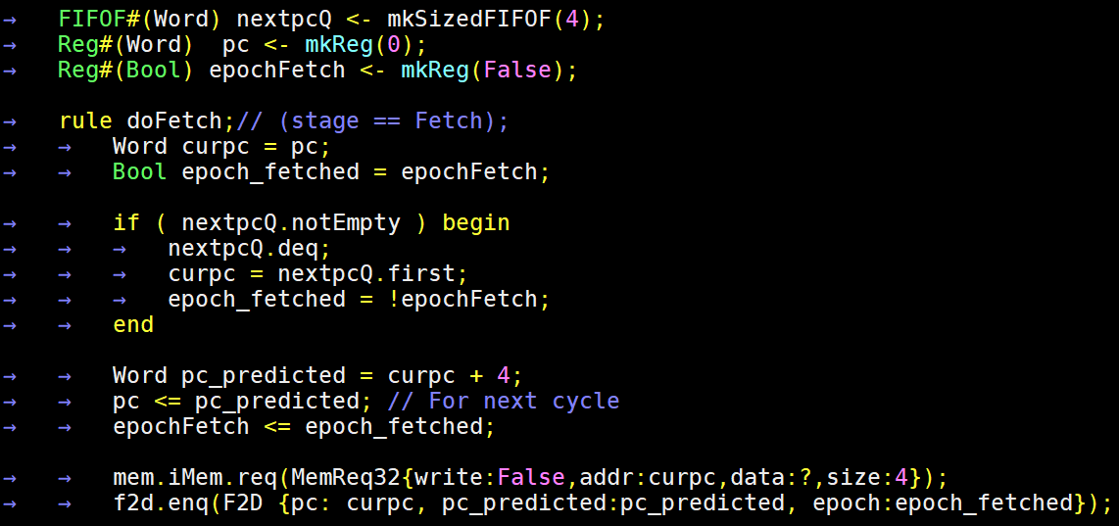
Modifying fetch for branch prediction
Is a Boolean epoch enough?
Temporary variables curpc and epoch_fetched
Take new PC and
Increment epoch
New prediction = pc + 4
Can change this for better prediction

Slide 69
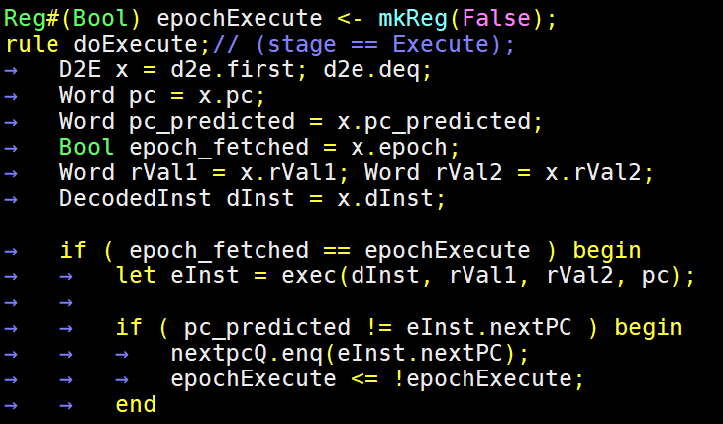
Modifying execute for branch prediction
…
Epoch of the instruction is compared against epochExecute
  Ignored if wrong epoch!
nextpcQ only enqueued
if misprediction
Is a Boolean epoch enough?
Yes! Because epochs can only change within
if (epoch_fetched == epochExecute) block

Slide 70
Basic microarchitecture in Bluespec:
Pipelining step 1: Branch hazards
Let’s look at code!
  The finite-state-machine implementation
  src/processor/Processor.bsv
Notice: Now all stages fire at (almost) every cycle
  Branches are handled correctly
  Mis-predicts have performance overhead!
  Data hazards not handled yet

Slide 71
Let’s run some software
The simulation environment defined in mmap.txt
  # Load sw/obj/branch1.bin to address 0, and MMIO to check if data written to 1024 is “3”
  +0 sw/obj/branch1.bin
  ?1024 3
Let’s try running branch1.bin, pipeunsafe2.bin

Slide 72
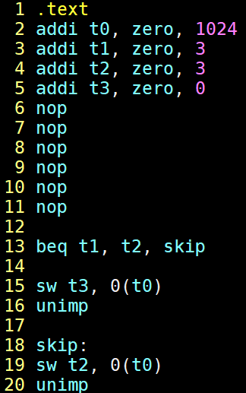
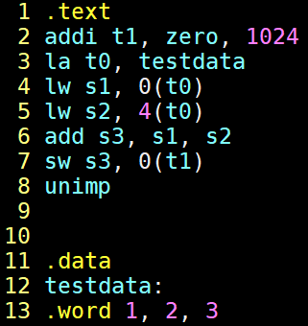
Let’s run some software
branch1.s
Branch1.s has a lot of “nop”s to remove
data hazards via code
  Some mis-predict overhead, but runs correctly!
pipeunsafe2.s on the
other hand…
  Hazards even within “la”!
  As expected
pipeunsafe2.s
#far enough
#far enough
#t0,s1,s2,d3
#not far enough
Let’s run the code and look at the results

Slide 73
Branch1.s: Points to focus on
Cycle
PC
…
[0x0000000a:0x0028] Fetching instruction count 0x000a
[0x0000000b:0x002c] Fetching instruction count 0x000b
[0x0000000b:0x0028] Decoding 0x00730663
[0x0000000c:0x0030] Fetching instruction count 0x000c
[0x0000000c:0x002c] Decoding 0x01c2a023
[0x0000000c:0x0028] detected misprediction, jumping to 0x00000034
[0x0000000c:0x0028] Executing
[0x0000000d:0x0034] Fetching instruction count 0x000d
[0x0000000d:0x0030] Decoding 0xc0001073
[0x0000000d:0x002c] ignoring mispredicted instruction
[0x0000000e:0x0034] Decoding 0x0072a023
[0x0000000e:0x0030] ignoring mispredicted instruction
[0x0000000f:0x0034] Mem write 0x00000003 to 0x00000400
[0x0000000f:0x0034] Executing
28: 00730663 beq x6,x7,34 <skip>
2c: 01c2a023 sw x28,0(x5)
30: c0001073 unimp
<skip>:
34: 0072a023 sw x7,0(x5)
mispredict discovered at cycle 0xc, execute stage of pc=0x28
mispredicted sw and unimp ignored at execute stage (cycle=0xd and 0xe)

Slide 74
Pipeunsafe2.s: Points to focus on
4: 00001297 auipc x5,0x1
8: ffc28293 addi x5,x5,-4 # 1000 <testdata>
Assembler’s attempt to load 0x1000 to x5
Add pc+(1<<12) to x5, and subtract 4
[0x00000001:0x0004] Fetching instruction count 0x0001
[0x00000002:0x0008] Fetching instruction count 0x0002
[0x00000002:0x0004] Decoding 0x00001297
[0x00000003:0x0008] Decoding 0xffc28293
[0x00000003:0x0004] rf writing 00001004 to 5
[0x00000003:0x0004] Executing
[0x00000004:0x0008] rf writing fffffffc to 5
[0x00000004:0x0008] Executing
[0x00000004:0x0004] Writeback writing 00001004 to 5
[0x00000005:0x0008] Writeback writing fffffffc to 5
addi reads 0 from x5 (RAW hazard)
And writes back -4 to x5

Slide 75
Things to solve
Branch hazard – Done!
Load-Use hazard – Stalling
Read-After-Write hazard – Stalling, Forwarding

Slide 76
Solving data hazards!
Step 1: Stalling
  How to detect data hazards?
  The decode stage must know whether a previous instruction incurs data hazard
    Previous instruction in flight will write to a register I need to read from?
  Restriction: Detection must happen combinationally, within the decode cycle
    Otherwise, we will slow down the pipeline
Step 2: Forwarding
  To be continued

Slide 77
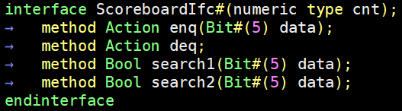
Detecting data hazards: Scoreboard
Module which keeps track of destination registers
  Decode inserts the destination register number (if any)
  Writeback removes oldest target
  Decode checks if any source registers exist in scoreboard, stall if so
Interface of scoreboard:
Insert destination register number
Remove oldest target
Two search methods for checking
maximum of two input operands
Why do we need two separate methods?
Both searches need to happen in same cycle!

Slide 78
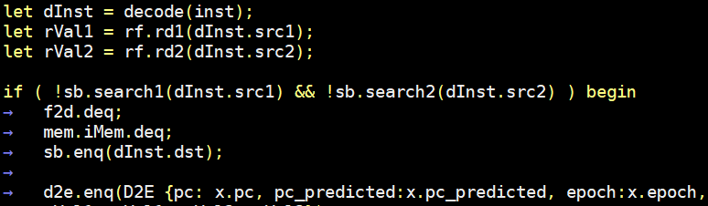
Decode stage for correct stalling
Stall unless both input operands are not found in scoreboard
  if ( !sb.search1(dInst.src1) && !sb.search2(dInst.src2) ) begin
  f2d.deq and mem.iMem.deq should only be done when not stalling
When not stalling, insert destination register into scoreboard
  sb.enq(dInst.dst)

Slide 79
Writeback stage for correct stalling
Writeback should remove the current instruction’s dst from scoreboard
  All instructions are in-order, so simply removing the oldest works
  call “sb.deq”
Scoreboard
enq
search1,search2
deq
Fetch
Decode
Execute
Writeback

Slide 80
Let’s run some benchmarks
4: 00001297 auipc x5,0x1
8: ffc28293 addi x5,x5,-4 # 1000 <testdata>
Assembler’s attempt to load 0x1000 to x5
Add pc+(1<<12) to x5, and subtract 4
Without stalling
With stalling
[0x00000001:0x0004] Fetching instruction count 0x0001
[0x00000002:0x0008] Fetching instruction count 0x0002
[0x00000002:0x0004] Decoding 0x00001297
[0x00000003:0x0008] Decoding 0xffc28293
[0x00000003:0x0004] rf writing 00001004 to 5
[0x00000003:0x0004] Executing
[0x00000004:0x0008] rf writing fffffffc to 5
[0x00000004:0x0008] Executing
[0x00000004:0x0004] Writeback writing 00001004 to 5
[0x00000005:0x0008] Writeback writing fffffffc to 5
[0x00000001:0x0004] Fetching instruction count 0x0001
[0x00000002:0x0008] Fetching instruction count 0x0002
[0x00000002:0x0004] Decoding 0x00001297
[0x00000003:0x0008] Decode stalled -- 5 0
[0x00000003:0x0004] rf writing 00001004 to 5
[0x00000003:0x0004] Executing
[0x00000004:0x0008] Decode stalled -- 5 0
[0x00000004:0x0004] Writeback writing 00001004 to 5
[0x00000005:0x0008] Decoding 0xffc28293
[0x00000006:0x0008] rf writing 00001000 to 5
[0x00000006:0x0008] Executing
[0x00000007:0x0008] Writeback writing 00001000 to 5

Slide 81
Two ways of implementing scoreboards
Bit mask
FIFO-based

Slide 82
Things to solve
Branch hazard – Done!
Load-Use hazard – Stalling
Read-After-Write hazard – Stalling, Forwarding
  Pipeline is correct already, but now to improve performance!

Slide 83
Implementing forwarding
Add a combinational forwarding path from execute to decode
  If the current cycle’s execute results can be used as one of inputs of decode, use that value
Regardless of whether scoreboard.search1/2 returns true or false,
If forward path has a source operand, we can use that value and not stall
Register
File
Fetch
Decode
Execute
Writeback

Slide 84

Aside: Inter-rule combinational communication in Bluespec
So far, communication between rules have been via state
  Registers, FIFOs
  State updates only become visible at the next cycle!
  How do we make doExecute send bypass information to doDecode combinationally?
Solution: “Wires”
  Used just like Bluespec Registers, except data is available in the same clock cycle
  Data is not stored across clock cycles
Declaration
In Decode
…omitted…
In Execute

Slide 85
Let’s run some benchmarks
pipeunsafe2.s
0: 40000313 addi x6,x0,1024
4: 00001297 auipc x5,0x1
8: ffc28293 addi x5,x5,-4 # 1000 <testdata>
c: 0002a483 lw x9,0(x5)
10: 0042a903 lw x18,4(x5)
14: 012489b3 add x19,x9,x18
18: 01332023 sw x19,0(x6)
1c: c0001073 unimp
With stalling
** SYSTEM: Memory write request at cycle 16
** Results CORRECT! Writing 3 to address 400
[0x00000010:0x0018] Mem write 0x00000003 to 0x00000400
With forwarding
** SYSTEM: Memory write request at cycle 11
** Results CORRECT! Writing 3 to address 400
[0x0000000b:0x0018] Mem write 0x00000003 to 0x00000400
Why 11? Why not 8?
(Instruction no. 7
2 pipeline stages to execute)

Slide 86
Some more details of current forwarding implementation
pipeunsafe2.s
Why did this stall?
…
[0x00000005:0x0010] Decode stalled -- 5 0
[0x00000005:0x0008] Writeback writing 00001000 to 5
[0x00000006:0x0010] Decoding 0x0042a903
[0x00000006:0x000c] Writeback writing 00000001 to 9
[0x00000007:0x0018] Fetching instruction count 0x0006
[0x00000007:0x0010] Mem read from 0x00001004
[0x00000007:0x0010] Executing
[0x00000007:0x0014] Decode stalled -- 9 18
[0x00000008:0x0014] Decode stalled -- 9 18
…
0: 40000313 addi x6,x0,1024
4: 00001297 auipc x5,0x1
8: ffc28293 addi x5,x5,-4
c: 0002a483 lw x9,0(x5)
10: 0042a903 lw x18,4(x5)
14: 012489b3 add x19,x9,x18
18: 01332023 sw x19,0(x6)
1c: c0001073 unimp
Load-use hazard must stall
Register
File
The three stalls increased cycle count from ideal 8 to 11. Why did instruction 0x10 stall?
Fetch
Decode
Execute
Writeback

Slide 87
A more complete forwarding solution
Writeback needs a forwarding path too!
x5 is available from register file after Writeback of addi
  An instruction dependent (lw) on x5 which is in decode while addi is in Writeback must stall
If we add a second forwarding path, we can reduce cycle count to 10
  Worth it? Maybe!
  (In real world, profile critical path, etc)
pipeunsafe2.s
0: 40000313 addi x6,x0,1024
4: 00001297 auipc x5,0x1
8: ffc28293 addi x5,x5,-4
c: 0002a483 lw x9,0(x5)
10: 0042a903 lw x18,4(x5)
14: 012489b3 add x19,x9,x18
18: 01332023 sw x19,0(x6)
1c: c0001073 unimp
2-cycle gap
Register
File
Fetch
Decode
Execute
Writeback

Slide 88
Some more topics
Branch predictors
Microprogramming
Superscalar
SMT
OoO…?

